Slide 1
Welcome Freshmen!
Vincent Dinh & Arvidas Anderson
05.02.2024

Slide 3
Members of the new board 2024

Slide 4
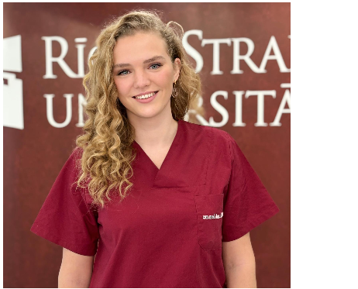
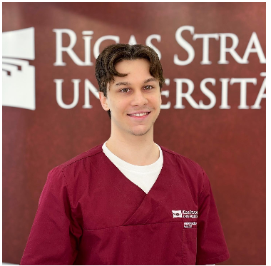
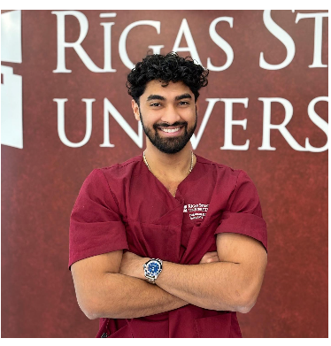
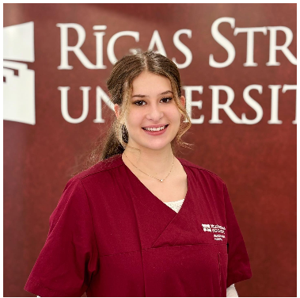
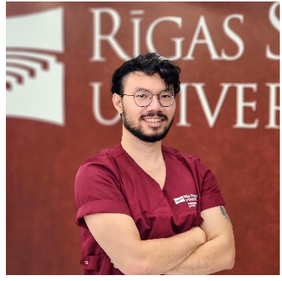
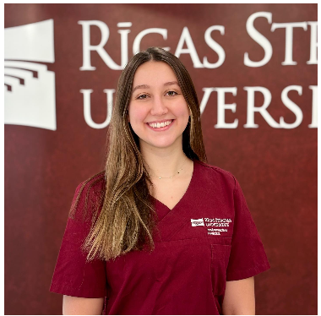
Amelie Ute Louisa Möller
President
Arvidas Anderson
Vice President
Shashwat Anirudh
Social and Integration Officer
Jaroscha Graf
Public Relations Officer
Vincent Myllykallio Dinh
Ambassador
Vera Limbach
Head of Academics

Slide 5
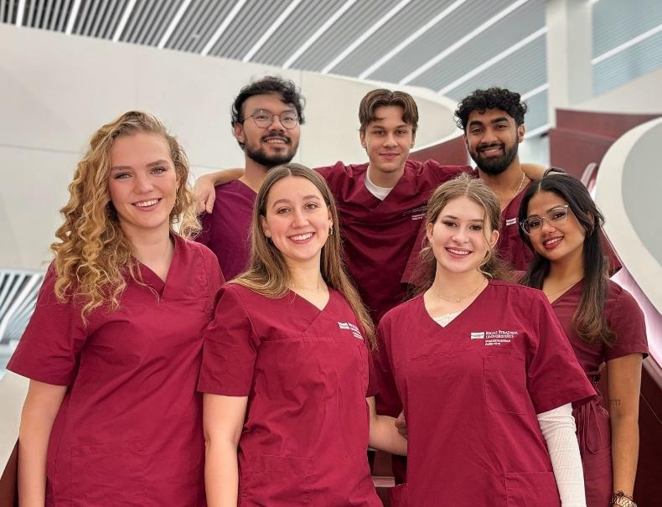
Dental Student Association
DSA’s Aims
Improve our daily university life
Better communication between students and university
Integrate dentistry students
Organize events and educational workshops to form connections between semester
Create mobility opportunity for dental students within Europe and worldwide

Slide 6
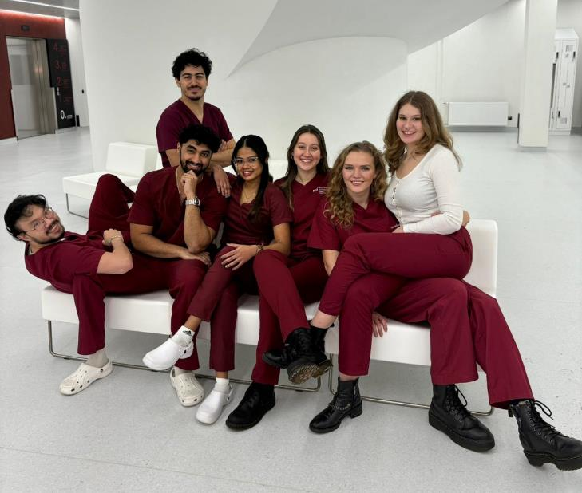
Who does what?
President & Vice-President – Recruitment & Coach, represent, make final decisions, have general overview of everything
Head of Academic Affairs – deal with University and study related problems
Public Relations Officer – social media
Social and Integration Officer – events
Ambassador - representing DSA in meetings & keep track of their events (ISA, LDSA, etc).

Slide 7
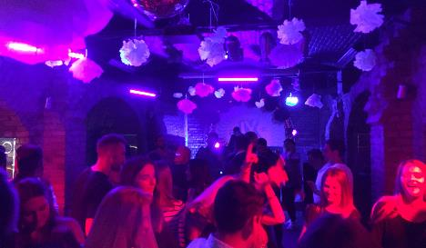
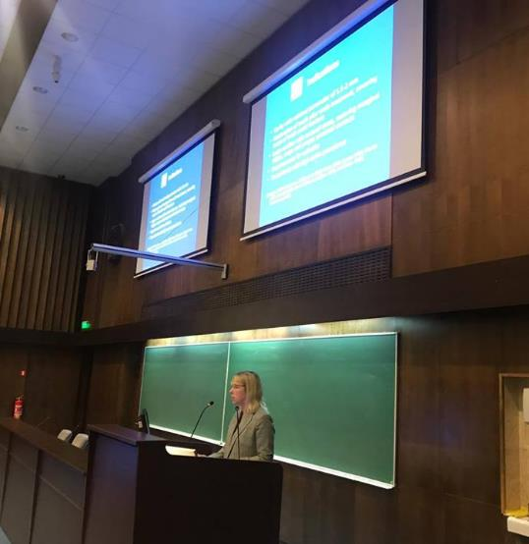
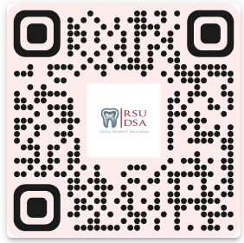
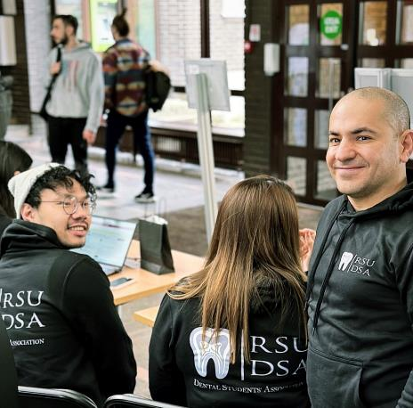
By students for students

Slide 8
Upcoming events
08.02. 5 pm Anatomy Museum
12.02. 12 pm Info Fair
16/17.02. DSA Pub Crawl
Loupes Seminars (TBA)
Monthly open board meeting
Teddy bear hospital with dentists (TBA)
Speed Friending (TBA)
Sport tourmanent (TBA)

Slide 9
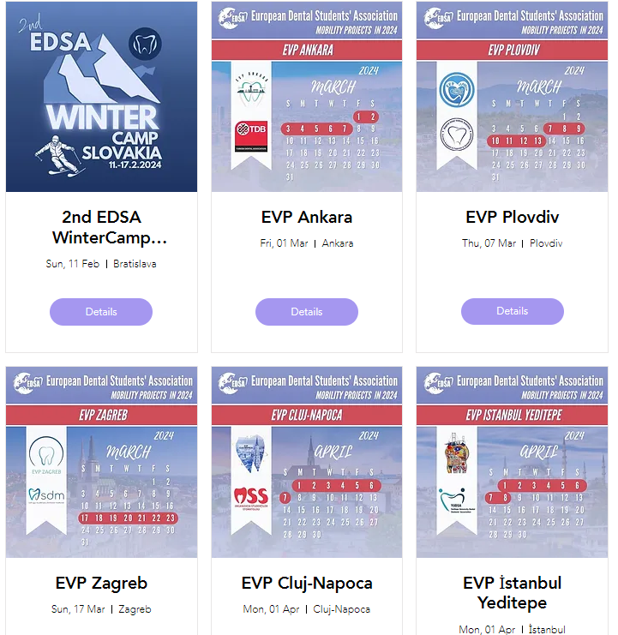
EDSA European Dental Students' Association
Founded in 1988
Represents the voice of over 70,000 dental students in 34 countries in the WHO European Region.
Inform students about the E.U. organization and politics in relation to dental medicine, while defending the interests of dental students
MOBILITY PROJECTS: provide opportunities for European dental students to visit dental schools in European countries with an educational purpose

Slide 10
IADS International Association of Dental Students
Founded in 1951 in Copenhagen
Serve the educational needs of dental students throughout the world.
Representing the interests of more than 200,000 dental students in around 60 countries worldwide and
Having its central office at the FDI World Dental Federation headquarters in Geneva

Slide 11
White coat is obligatory in all on-site practical classes
Especially in Anatomicum!

Slide 12
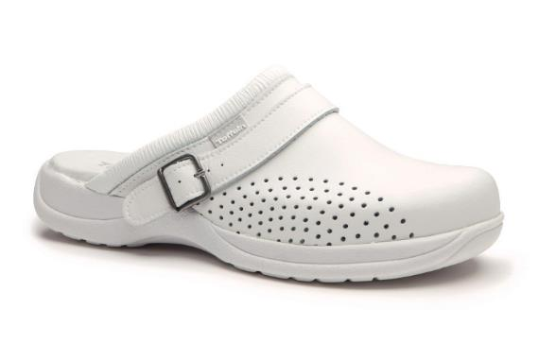
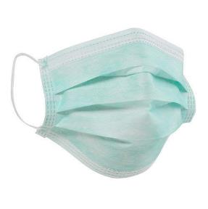
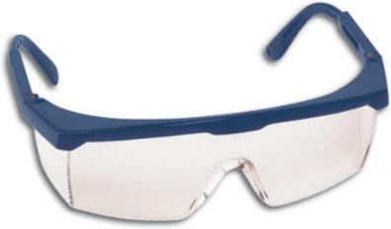
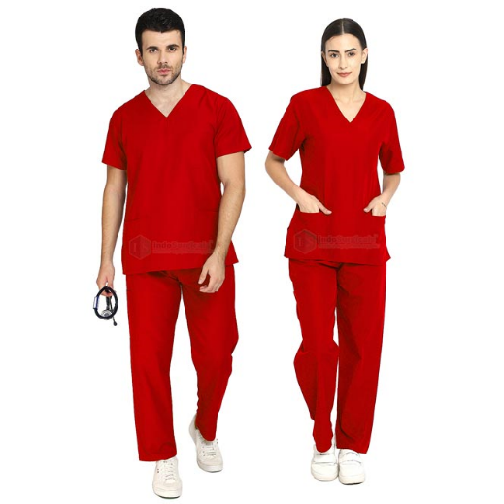
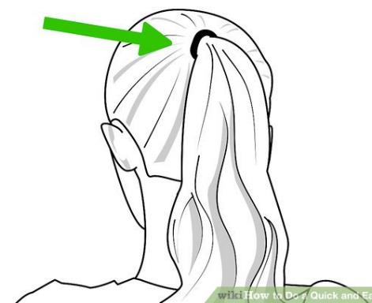
Dress code for preclinical and clinical classes

Slide 13
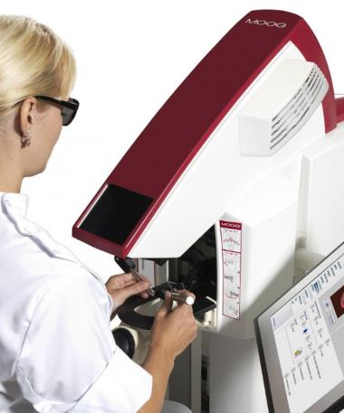
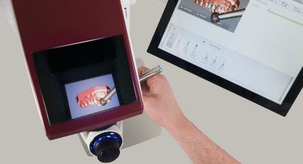
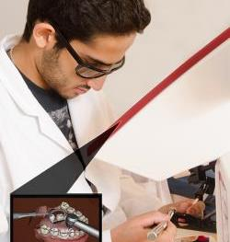
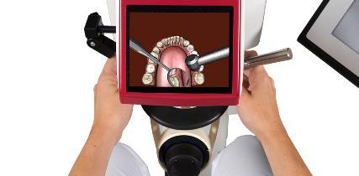
MOOG Simodont® Dental Trainer
advanced dental simulation
improvement of hand-skills → early introduction to clinical dentistry
made especially for dental schools
realistic virtual reality training of manual drilling skills
working in a 3D environment
teachers can follow progress
students receive immediate feedback

Slide 14
A sneak peak to Dentistry Program
Preclinics
Clinics
3rd year
5th semester and 6th semester
Preclinical prosthetics
Cariology (patients)
Oral Surgery (patients)
Preclinical and clinical Endodontics
Preclinical and clinical Periodontology
Radiology
Oral pathologies
4th year
7th semester and 8th semester
Clinical Prosthetics
Therapeutics (Cario, perio, endo)
Maxillofacial surgery
Orthodontics
Paediatric Dentistry
5th year
9th semester – thesis
10th semester – 6 weeks practical placement (in Latvia or home country), State exam
1st year
1st semester
General studies
2nd semester
Dental Anatomy
Preoperative Dentistry
2nd year
3rd semester
Operative Dentistry (drilling plastic teeth)
Preclinical Prosthetics
Cariology
4th semester
Operative Dentistry
Preclinical Prosthetics
Oral and Maxillofacial surgical Anatomy

Slide 15
1st semester courses – Questions?
Human Anatomy
Histology
Human Molecular Biology
Latvian Language in Dentistry
Medical Physics
General Medical Chemistry
Civil and Environmental Protection, First Aid
Philosophical Anthropology
”Anatomy and histology are two courses where you don’t do much during the course in form of assignments or tests but you have colloquiums that are very important, so don’t procrastinate until the colloquium date, do little everyday. Don’t get too caught up on other courses just because there will be a lot of weekly assignments and tests, it sounds more overwhelming than it is.”
Loujain, previous 1st Semester Leader

Slide 16
Remote studies – thoughts from previous 1st Semester Leader
Try and make a routine, it can be hard in the beginning to adjust to studying online and also handling the stress
Don’t procrastinate, stick to your routine
Try to study at the same times everyday so it becomes natural to the brain to do that task at that certain time – you don’t have to prepare mentally all the time before you start studying, so you save time.
It might take a while to find out what works for you, so relax and let it take its time.
Ask for help if you struggle, it might feel scary, but students are willing to help!
zoom study sessions with your group mates can help

Slide 17
Take home -message:
Dentistry studies are hard, but you can make it
Take care of yourself and your group mates – teamwork is important
Never hesitate to ask for help from peers and seniors
Follow DSA on our social media accounts
Instagram : @rsu.dsa
Facebook: RSU DSA - Rīga Stradiņš University, Dental Students' Association
Good luck for your studies! Thank you for listening!

