Slide 1
Costing of Interventions against Cervical Cancer in Cambodia – A Disease Dynamics Model
Steffen Flessa, PhD
Professor of Health Care Management,
Ernst-Moritz-Arndt-University of Greifswald

Slide 2
Overview
Introduction
Cervix uteri carcinoma
Model
Results
Discussion

Slide 3
1. Introduction
WHO 2008

Slide 4
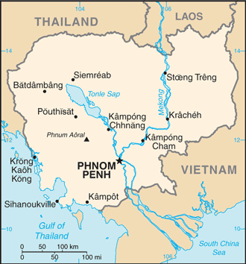
Cambodia

Slide 5
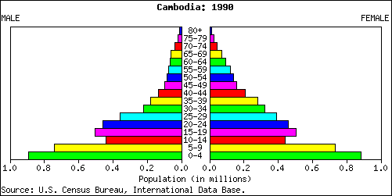

Slide 6
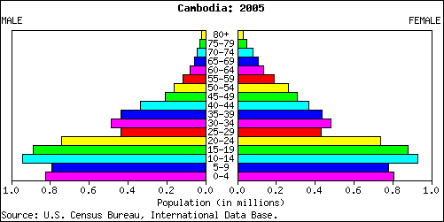

Slide 7
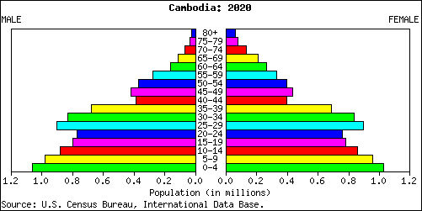

Slide 8
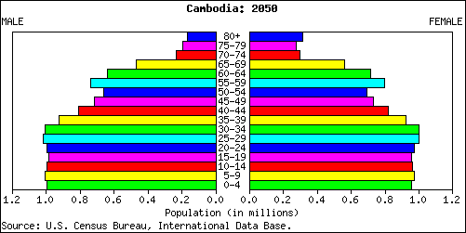

Slide 9
Mortality 2010

Slide 10
Cancer in Cambodia
 | Male | Female | Both sexes
Population (thousands) | 7117 | 7444 | 14561
Number of new cancer cases (thousands) | 5.9 | 7.0 | 12.9
Age-standardised rate | 152.9 | 123.0 | 133.1
Risk of getting cancer before age 75 (%) | 16.5 | 13.1 | 14.3
Number of cancer deaths (thousands) | 4.6 | 4.3 | 8.9
Age-standardised rate | 127.5 | 80.1 | 98.2
Risk of dying from cancer before age 75 (%) | 13.6 | 8.9 | 10.8

Slide 11
2. Cervix uteri carcinoma
Cause:
human papilloma virus (HPV)
Sexually transmitted disease
Epidemiology:
second most common cancer in women worldwide
500,000 new cases p.a.
270,000 death cases p.a.
80 % in developing countries

Slide 12
Cervical Cancer Incidence (p. 100,000 women in 2012)
http://globocan.iarc.fr/old/FactSheets/cancers/cervix-new.asp

Slide 13
Cervix uteri carcinoma
Cambodia:
Neither prevention nor treatment element of basic package
Two central hospitals allow treatment
Death cases: 800 p.a.
Pre-malignant lesions: 3% of women > 15

Slide 14
Interventions
Primary prevention: HPV-vaccination
Secondary prevention:
Screening: visual inspection with acetic acid (VIA)
Cryotherapy or Cold Coagulation
Treatment
radiation
surgery

Slide 15
Research Question
How many cases do we expect in Cambodia?
What is a cost-effective intervention package?
What is the budget-impact of interventions against cervical cancer?

Slide 16
3. Model

Slide 17
Variables
P_{t,s,a,h} Population in time t of sex s in
age a in health status h
$$h=\left\{\begin{matrix}1 & not infected \\ 2 & infected, healthy \\ 3 & infected, lesion \\ 4 & cancer\end{matrix}\right.$$

Slide 18
Demography
Fertility
General Mortality
Aging
Transition
Progression from “infected and healthy” to “infected with lesion”
Clearance from “Infect and healthy” to “healthy”
Invasion: “Infected with lesion” to “cancer”
Cancer to death

Slide 19
Stable partnership infections
$${I_P}_{t,s,a}=$$
$\sum_{u=1}^{2}{\sum_{v=14}^{99}{\left[\begin{aligned}\begin{aligned}\frac{P_{t,s,a,1}}{P_{t,s,a,1}+P_{t,s,a,2}+P_{t,s,a,3}}∙\frac{P_{t,u,v,2}+P_{t,u,v,3}}{P_{t,u,v,1}+P_{t,u,v,2}+P_{t,u,v,3}}∙ \\ \\ \frac{1}{d_{p}}∙\left\{1−{\left(1−q_{t,s,a}\right)}^{d_{p}∙Min\left({k_{p}}_{s,a};{k_{p}}_{u,v}\right)}\right\}∙\left(1−{vi}_{t,s,a}\right)∙ \\ \end{aligned} \\ MIN\left\{\begin{aligned}{s_p}_{s,a,u,v}∙\left(P_{t,s,a,1}+P_{t,s,a,2}+P_{t,s,a,3}\right); \\ {s_p}_{u,v,s,a}∙\left(P_{t,u,v,1}+P_{t,u,v,2}+P_{t,u,v,3}\right) \end{aligned}\right\}\end{aligned}\right]}}$
for s=1..2 and a=14..99.

Slide 20
Infection during short-term relationship
${I_S}_{t,s,a}=\sum_{u=1}^{2}{\sum_{v=14}^{99}{\left[\begin{aligned}\frac{P_{t,s,a,1}}{P_{t,s,a,1}+P_{t,s,a,2}+P_{t,s,a,3}}∙\frac{P_{t,u,v,2}+P_{t,u,v,3}}{P_{t,u,v,1}+P_{t,u,v,2}+P_{t,u,v,3}} \\ \\ ∙q_{t,s,a}∙\left(1−{vi}_{t,s,a}\right)∙ \\ \\ MIN\left\{\begin{aligned}{s_i}_{s,a,u,v}∙\left(P_{t,s,a,1}+P_{t,s,a,2}+P_{t,s,a,3}\right); \\ {s_i}_{u,v,s,a}∙\left(P_{t,u,v,1}+P_{t,u,v,2}+P_{t,u,v,3}\right) \end{aligned}\right\}\end{aligned}\right]}}$
for s=1..2 and a=14..99

Slide 21
4. Results

Slide 22
Combined Intervention

Slide 23
Combined Intervention

Slide 24
Sensitivity

Slide 26
Robustness
Basic (no treatment, no screening)
Treatment
Standard_Treat (25 % effectiveness)
Eff=50% (50 % effectiveness)
l= (25 % effectiveness, double survival time)
Screening
Standard_Screen (30-49 yrs, every 3 yrs, compliance=50%, sensitivity=100%, specifity=100%)
Long (30-60 yrs)
Once (once in lifetime)
VIA20 (30 % compliance)
VIA80 (80 % compliance)
Sens90 (sensitivity = 90 %)
Sens80 (sensitivity = 80 %)
Spec95 (specifivity = 95%)
Spec90 (specifivity = 90%)

Slide 27
Robustness
Vaccination
Standard_vacc (effectiveness = 63%, compliance = 75 %, life-long)
E100C100 (effectiveness = 100%, compliance = 100 %)
E90C75 (effectiveness = 90%, compliance = 75 %)
E63C100 (effectiveness = 63%, compliance = 100 %)
Short (20 yrs.)
Structural
Standard (sexual inclination triangular)
SC_Screen (Screening and sexual inclination rectangular)
SC_Treat (Treatment and sexual inclination rectangular)
SC_Vacc (Vaccination and sexual inclination rectangular)
SC_Screen+Treat (Screen and Treat and sexual inclination rectangular)
SC_Screen+Treat+Vacc (Screen and Treat and vaccinate and sexual inclination rectangular)

Slide 28
Robustness of Results

Slide 29
5. Results
Health Policy Cambodia
Include „See-and-Treat“ in basic package
Vaccination: GAVI?
Treatment facilities in central hospitals
Uncertainty
Structural
Data
Social

Slide 30
CUC Policy
A long-term disease:
Vaccination: age < 15 years
Infection: Ø 25 years
Lesion: Ø 41 years
Invasive Cancer: Ø 49 years
Death: Ø 51 years
Any intervention must be long-term
Cost-effectiveness depends on the time-horizon

Slide 31
Economics of Cancer
Prediction of health care demand
Design of cost-effective basic health care package
Prediction of budget-impact
Health care production (quantity, quality, location)

Slide 32
Economics of Cancer
Health Care Needs Disease Dynamics Modelling!
Prediction of health care demand
Design of cost-effective basic health care package
Prediction of budget-impact
Health care production (quantity, quality, location)

