Slide 1
Overview of SHARE data
02.10.2019
Andrejs Ivanovs

Slide 2
Waves of SHARE
The 1st wave of SHARE was conducted in 2004 as a representative survey in 11 European countries.
Since 2004 survey has been repeated every 2 years;
Within those 6 waves new countries took participation in SHARE project.
Wave 7 was realised in 2017 in 28 European countries + Israel.
Wave 8
  Pretest and Field Rehearsal was realised in 2019.
  Main field work would be realized 2020 in 28 European countries + Israel.

Slide 3
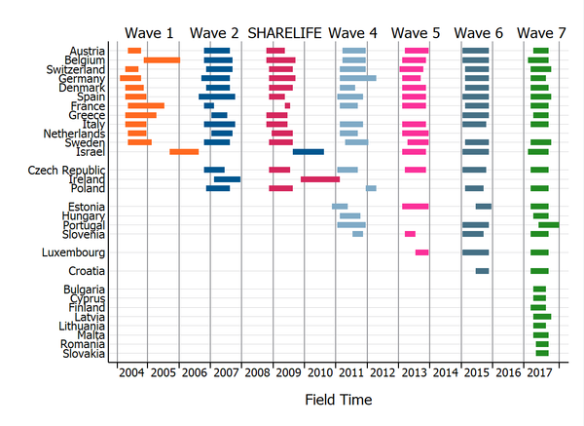
2002 – 2017

Slide 4
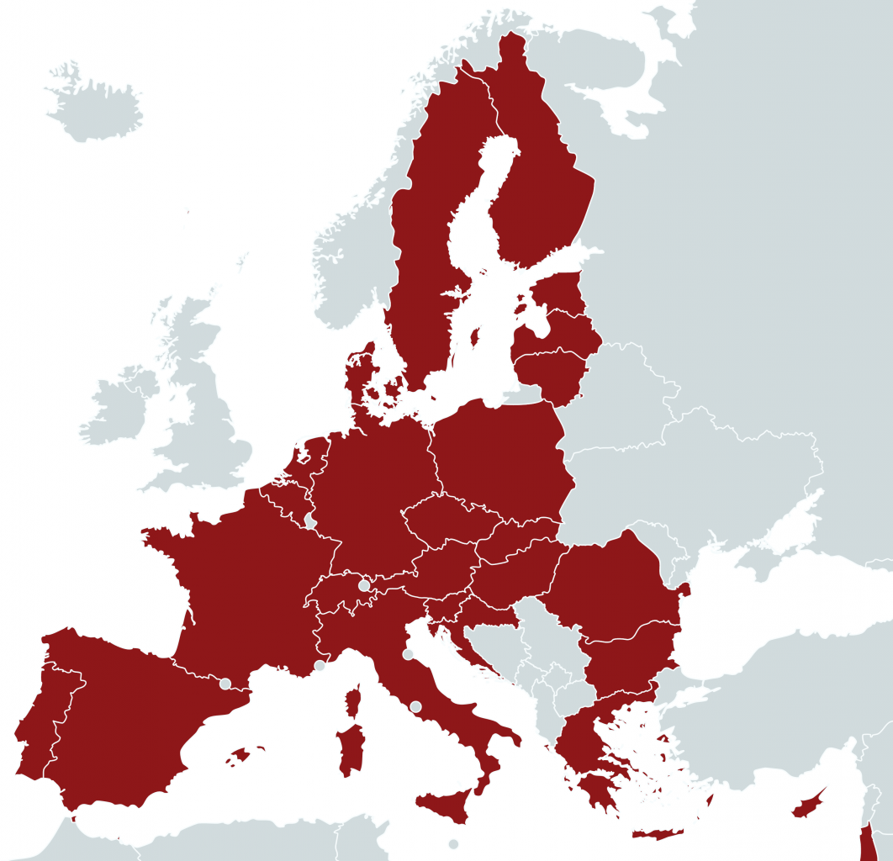
Wave 7, 2017

Slide 5
SHARE’s data advantages
Multidisciplinarity;
Longitudinal design;
Comparability.

Slide 6
1. Multidisciplinarity
Investigates the population ageing process of relations between economics, social and medical variables.
Brings together many scientific disciplines:
  Demography;
  Economics;
  Epidemiology;
  Psychology;
  Sociology;
  Medicine;
  Biology;
  Statistics.

Slide 7
2. Longitudinal design
The panel design show the dynamic character of the ageing process.
SHARE data contains information about respondents’ entire life – early childhood until now.
Notes:
we want to ask the same people every 2 years
collecting retrospective life histories on conditions in childhood, family background, employment histories and health - (life-course perspective)

Slide 8
3. Comparability
Cross-national design allows to compare different country situations.
Data is harmonized with:
  U.S. Health and Retirement Study (HRS);
  English Longitudinal Study of Ageing (ELSA).
Has become a role model for several ageing surveys worldwide.
Notes:
All countries use the same questions
All countries use same software
All countries on same schedule
Wave 7 in up to 28 countries

Slide 9
Methodology of SHARE in Latvia
Sample –
  Cluster random sample;
  Data from Address Register;
    By The Office of Citizenship and Migration Affairs (PLMP ☺)
  Addresses of households with at least one person aged 50 years and older.
Sample size –
  Individual interviews: 1755;
  Households with complete interview: 1304.
Face-to-face interviews;
Individual response rate: 58.3 %;
Data was weight on accordingly the general population structure in Latvia.

Slide 10
Questions included in the SHARE questionnaire

Slide 11
19 Question modules
Demographics;
Children;
Physical Health;
Behavioral Risks*;
Cognitive Function;
Grip Strength;
Mental Health*;
Health Care;
Employment and Pensions;
IT / Computer Use*;
Social Support*;
Financial Transfers*;
Assets*;
Housing*;
Household Income;
Consumption;
Activities;
Expectations*;
SHARELIFE.
* Was not included in LV, these modules will be asked to the respondents in Wave 8.

Slide 12
Demographics and Networks
Year of birth;
Gender;
Education;
Birth country;
Citizenship;
Marital status;
Number of children;
Occupation;
Age of parents;
Contact intensity with parents;
Age of death of parents.

Slide 13
Children
Number of children;
Demographics of children;
  Gender;
  Age;
  Employment;
  Education;
  Marital status.
Contact intensity;
Number of grandchildren.

Slide 14
Physical Health
Health in general;
Long-term illnesses;
Drug usage;
Height;
Weight;
Difficulties;
Usage of aids.

Slide 15
Behavioral Risks*
Smoking habits;
Sports or activities that are vigorous;
Eating habits:
  Dairy;
  Eggs;
  Meat;
  Fruits and vegetables.
Consumption of alcohol.
* Module was not included in LV in Wave 7, will be asked to respondents in Wave 8.

Slide 16
Cognitive Function & Strength
Memory training –
  Remember 10 words;
  Reading and writing skills;
  Verbal fluency;
  Numeracy;
Grip strength.

Slide 17
Mental Health*
Depression;
Suicidal feelings;
Trouble sleeping;
Appetite;
Isolation from others.
* Module was not included in LV in Wave 7, will be asked to respondents in Wave 8.

Slide 18
Health care
Doctor and hospital visit frequency;
Opportunity to visit doctors;
Opportunity to buy drugs:
  High costs;
  Too long.

Slide 19
Employment and Pensions
Employment stages:
  Start;
  Characteristics;
  Industry;
  Load;
  Salary;
  Taxes;
  Duration;
  Satisfaction.
Retirement;
Amount of pension

Slide 20
IT / Computer Use*
Computer use:
  Usage in workplace;
  Computer skills;
  Usage of internet.
* Module was not included in LV in Wave 7, will be asked to respondents in Wave 8.

Slide 21
Social Support*
Received support from others:
  Help provider;
  Frequency.
Providing help:
  Help receiver;
  Frequency.
* Module was not included in LV in Wave 7, will be asked to respondents in Wave 8.

Slide 22
Financial Transfers* and Assets*
Financial Transfers:
Transfers given:
  Amount;
  Receiver.
Transfers received;
  Amount;
  Giver.
Assets:
Amount and value;
Types;
Debts;
Insurances;
Cars.
* Modules were not included in LV in Wave 7, will be asked to respondents in Wave 8.

Slide 23
Housing*
Housing:
Characteristics:
  Inc. children's home, prisons, camps, hospital, etc.
Ownership;
Location;
  Region.
Duration;
Current housing situation
Mortgages or property loans.
Living conditions:
Number of rooms;
Living amenities;
Household composition;
Household economic status;
  Objective;
  Subjective.
* Module was not included in LV in Wave 7, will be asked to respondents in Wave 8.

Slide 24
Household Income
Total income;
Additional income;
Income from other sources;
Contributors to household income.

Slide 25
Consumption
Food:
  Expenses;
  Home produced food.
Minimum amount needed for month;
Borrowing money;
Being able to make ends meet.

Slide 26
Activities and Expectations*
  Activities:
Satisfaction with life;
Activities done in last
12 months:
  Reading books;
  Educational training;
  Games;
  Sports.
Expectations and future*:
Life expectancy;
Saving money;
Political views;
Frequency of praying.
* Module was not included in LV in Wave 7, will be asked to respondents in Wave 8.

Slide 27
SHARELIFE sections
Retrospective Children;
Retrospective Partner History;
Retrospective Accommodation;
Childhood Conditions (age 10);
Retrospective Employment;
Work quality;
Disability;
Health History;
Health Care History;
General Life and Persecution History;
Financial Investment History

Slide 28
Modules in Wave 8
Demographics
Social Networks*
Children
Physical Health
Behavioral risks
Cognitive Function
Mental Health
Health Care
Employment and Pensions
Financial Transfers
Housing
Household Income
Consumption
Assets
Grip Strength
IT module
Activities
Expectations
End-of-Life Interview*
Social Support
* New modules

Slide 29
Thanks, any questions?

