Slide 1
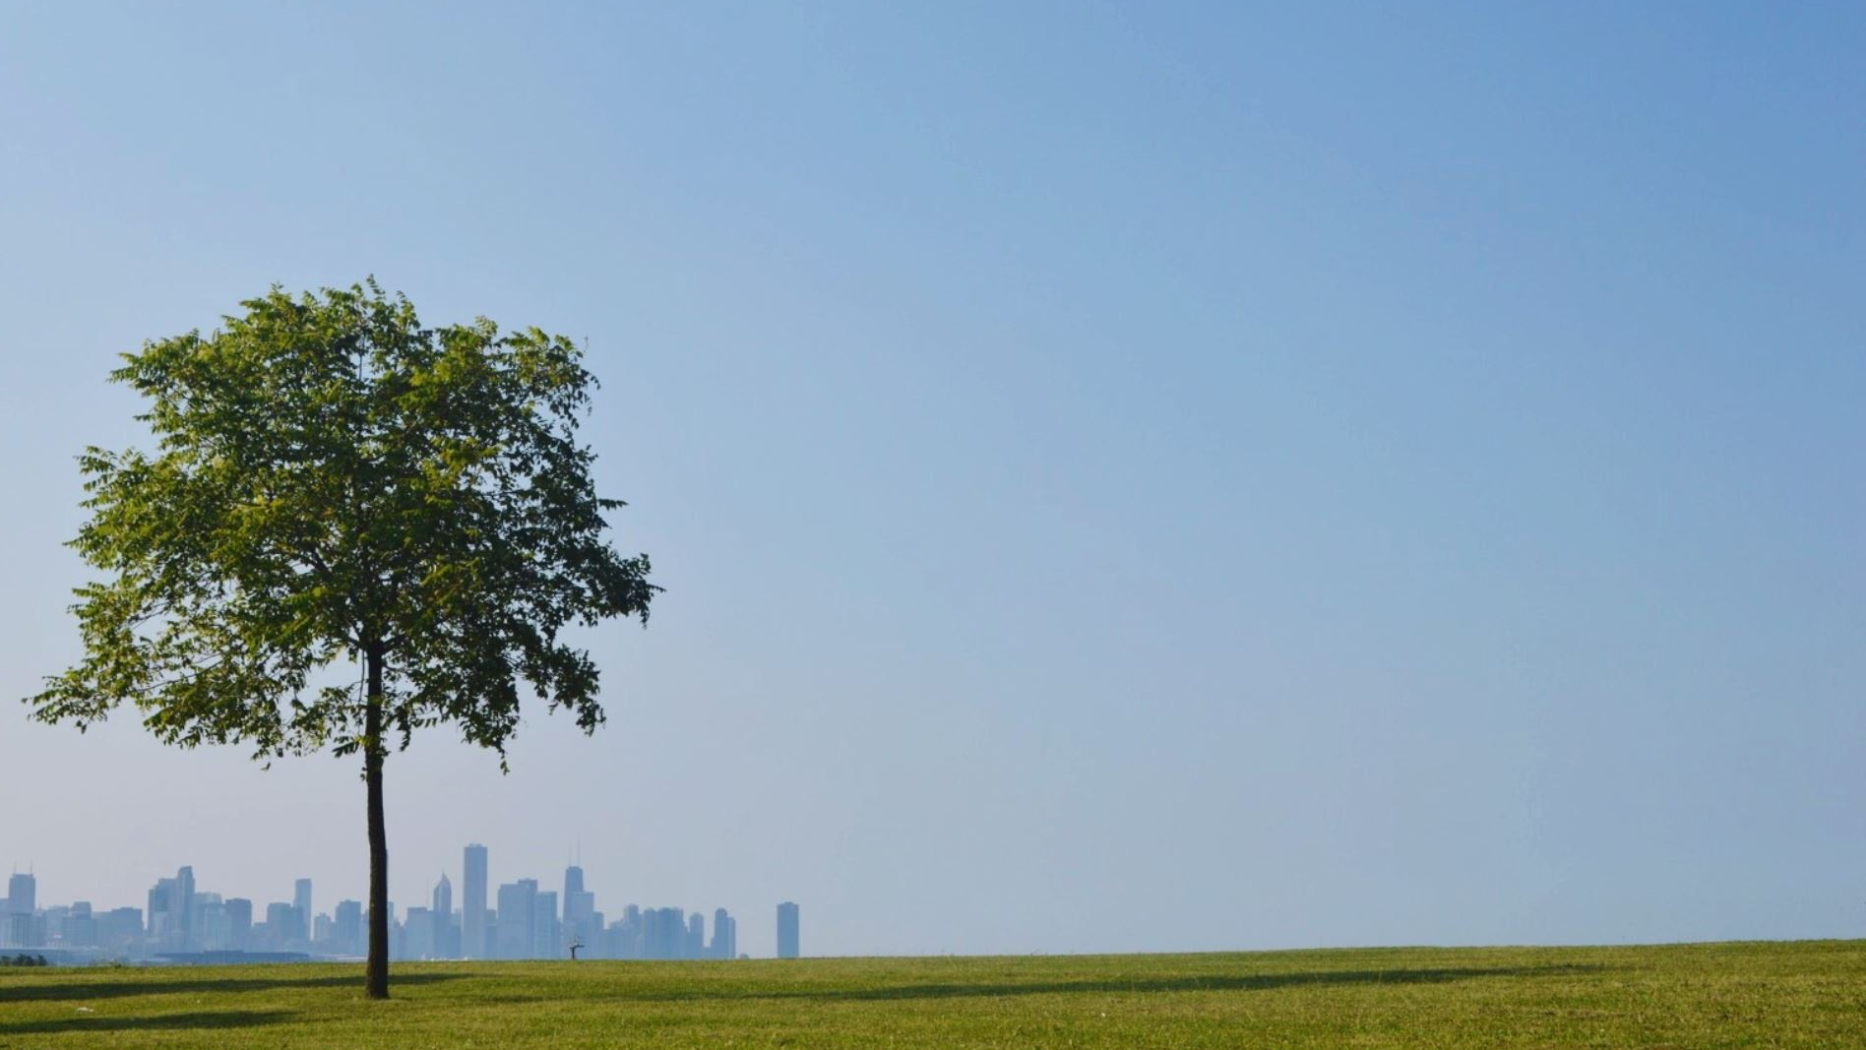
Entrepreneurship and Innovation in the Green Economy at Riga Stradiņš University (WP 5)
3 LoE Rome 18-21 October 2022

Slide 2
The Concept of the Programme
First, understanding
  the architecture and essentials of approaches to Green economy
  innovation by international institutions and governments, experts, and educators which made up the green entrepreneurship orientation and needs for educational policies and programmes reflecting new trends in labour markets and business environment, development of new knowledge and skills
Second, information on some of issues faced in Latvia related to practices and policies addressed in education. As the realm of education policy is very broad,
we focused on five areas:
  socio-economic situation and labour market needs
  green entrepreneurship and innovation
  job -related training in EU and Latvia
  development of a bachelor’s degree programme/subprogramme and cooperation with business
  promotion of the programme
  further projects on joint programmes with international partners

Slide 3
Background

Slide 4
The Concept of Green Innovation
Entrepreneurship has an important role in delivering more radical green innovations that challenge existing firms and business models
Green Social Performance
Green Economic Performance
Green Environmental Performance
Green Innovation
Green Entrepreneurship

Slide 5
HEIs.
Importance and promotion of green economy and innovation in the context of EU and Latvia
European Skills Agenda
Sustainable development and European Green Deal
The Next GenerationEU Recovery plan
RePower Europe plan

Slide 6
EU and International examples/experiences
Germany- Hamburg Educational Institutions
Finland
Satakuna University
Belgium- Vlerick Business School
France- Lyon Business School Foundation

Slide 7
Latvia’ s Position in Sustainable Development (SD)
A well-developed and comprehensive framework for sustainable development-
it is defined by law and adopts the principle of vertical (hierarchical) and horizontal co-ordination of planning documents
The SD Strategy of Latvia until 2030 includes long-term priorities, goals, action lines, is consistent with the SDGs- it is based on a capital approach to SD with focuses on ecological limits, with an emphasis on the correlation between environmental and economic systems and wealth

Slide 8
Latvia’ s Position in Sustainable Development (SD)
Several areas for action have been identifies:
increasing productivity of the economy, including through more efficient use of resources and larger investment in R&D and R&N
improving labour market performance
improving the health care and social welfare systems
improving service provision to low-density areas, including road infrastructure, public transport and housing
adapting to climate change, reducing GHG (greenhouse gases) emissions and promoting wider use of renewable energy sources

Slide 9
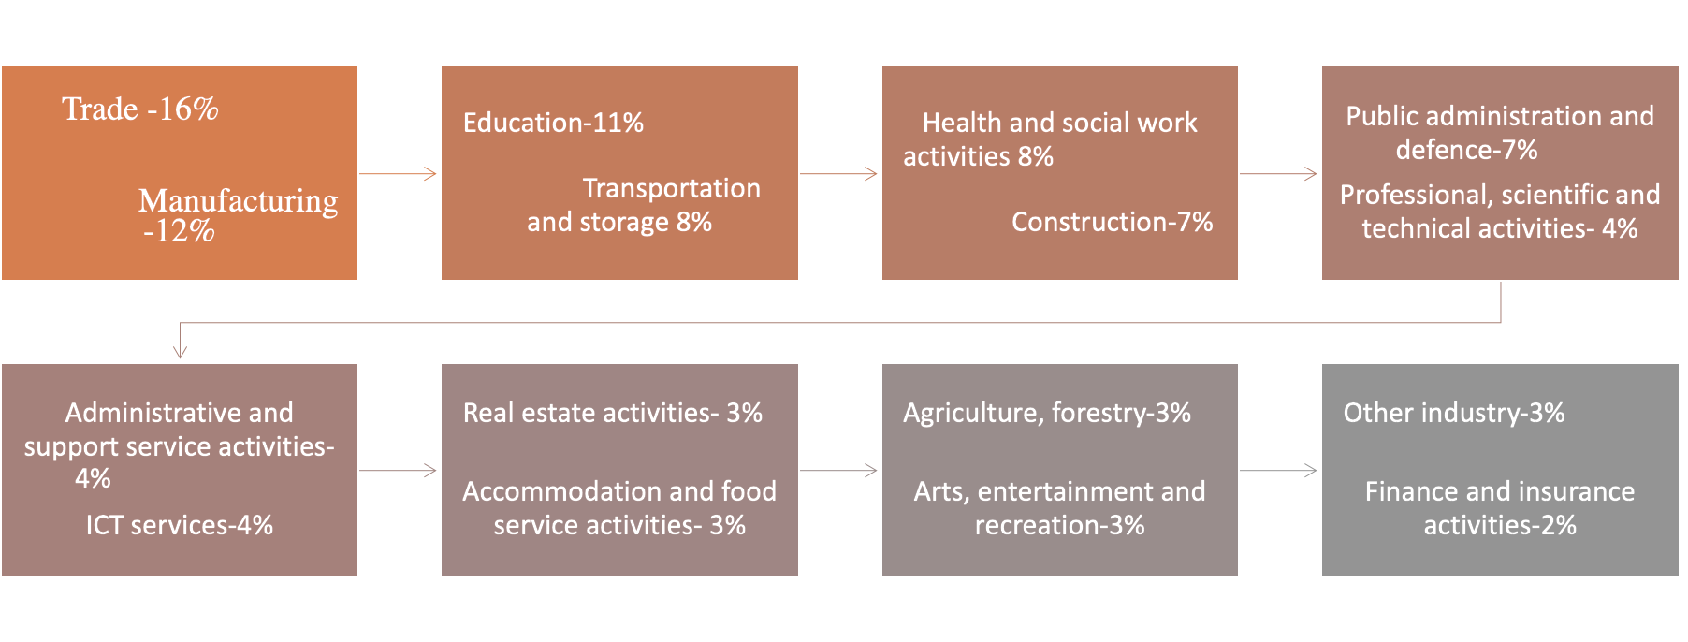
Economic Structure

Slide 10
Demography
the population is decreasing more rapidly - by 0.76%in 2020 compared to 0.64% 2019, including a decrease of 0.59% due to negative natural growth and 0.17% due to migration
In 2020 the lowest birth rate in the last hundred years was registered- 17.6 thousand children were born in Latvia
The HE system has to adjust to two forthcoming changes arising from demographic changes – a decrease in total enrolment volume and a change in the age structure
Conclusion
Opening up new types and models in education could be part of the solution- a trend of vocational education and professional educational programmes at HE institutions

Slide 11

As a result,….

Slide 12
The objectives of the programme development concept
Interrelations
between
Economy
Labour market
Exchange of practical experiences in Latvia and other partner countries in 3LoE
The importance of green entrepreneur orientation and innovation in education
Demography
Education- the needs for updates
(OECD, WEF)

Slide 13
Knowledge
Knowledge | Explanation
K-1 | Able to demonstrate specialized knowledge in international business and entrepreneurship and innovation in the green economy and management
K-2 | Able demonstrate a critical and current understanding of concepts and regularities in the economy and management of entrepreneurship and innovation in the green economy
K-3 | Able to demonstrate in-depth theoretical and practical knowledge of the theory, methods of analysis and tools in the economic analysis of international business, entrepreneurship and innovation in the green economy and management
K-4 | Recognizes the development of necessary knowledge and skills, including social digital skills, and the need for self-growth in the global environment of international business, entrepreneurship and innovation in the green economy and management

Slide 14
Skills
Skills | Explanation
S-5 | Able to identify trends and find creative solutions using a scientific approach to the changing issues of international business, entrepreneurship and innovation in the green economy and management
S-6 | Able to gather information independently and analytically from various sources, critically evaluate it and present it correctly
S-7 | Able to formulate information in a structured analytical and concise manner in writing, to express himself precisely and to discuss arguments in general and specialized aspects of international business, entrepreneurship and innovation in the green economy and management
S-8 | Able to use appropriate practical and theoretical knowledge and skills in professional business management and research (scientific) work, being aware of the impact of their activities on the environment and society

Slide 15
Competences
Competences | Explanation
C-9 | Able to plan business processes and resources, including time, work, personnel, talent, finance, infrastructure
C-10 | Able to participate in the development of international business and start-ups in a global environment, offering innovative solutions to industry problems
C-11 | Able to demonstrate an understanding of and application of professional ethics and culture, including intercultural understanding and respect

Slide 16
Structure of the programme in years and ECTS
Duration
6 semesters
1.semester – 20 KP (24 ECTS)- general courses
2.semester – 20 KP (24 ECTS)- general and specific courses
3.semester – 20 KP (24 ECTS)- studies at work – specific courses
4.semester – 20 KP (24 ECTS)- studies at work- specific courses
5.semester – 20 KP (24 ECTS)- studies at work specific courses
6.semester – 20 KP (24 ECTS)- Bachelor Thesis+ methodological seminar
7 semesters or 3,5 academic years- in case of distance learning ( after 3 years completed – graduates can apply for additional courses
The result- a Certificate to the Diploma – Bachelor in Social Silences

Slide 17
Examples of Courses
General
Applied Microeconomics and Mathematics in Business
Applied Macroeconomics and Statistics
Basics of Accounting and Finances
International Business and Marketing
Specialised
Sustainable Social Entrepreneurship
Social Innovation. Design and Impact Assessment
Process Management for Sustainable Business Development
Green Start-ups and Scale-ups
Green Entrepreneurship and Green Innovation for SEMs
The Business of Society-Implications of Digital Transformation
Essentials and Advances in Digital Innovation and Entrepreneurship

Slide 18
In conclusion…

Slide 19
Progress
Fruitful discussions on the programme ideology with potential teachers and the university administration
Mapping of the programme’s content
Understanding of steps and duration of the drafting and licencing of the programme/subprogramme

Slide 20
Challenges
Educational system in Latvia- no dual programmes
Cooperation with employers- to wider the existing network
Languages for studies: LV; EN
International cooperation
Human resources

Slide 21

Thank you!
RSU Team
PP11/3LoE

