Slide 1
Human papillomavirus genome associated correlates of disease progression and treatment response for cervical neoplasms and cancer
LZP-2021/1-0484
Maria Issagouliantis (Isaguliants)

Slide 2
Partner RSU
Maria Issagouliantis, leading researcher
Androniks Mitildzans, MD
Arta Spridzane, MD
Ilvija Uzulina, medical nurse
Juris Jansons , researcher
Liba Sokolovska, researcher, PhD student
Alesja Dudorova (internship, completed)
Karina Biserova (internship)
Partner Paul Stradins University Hospital
Jurijs Nazarovs, Specialist in Pathology, MD, PhD
Austra Breiksa, MD (2022-2023)
Daira Krisande, MD (2023-2024)
Svetlana Gebrila, laboratory assistant

Slide 3
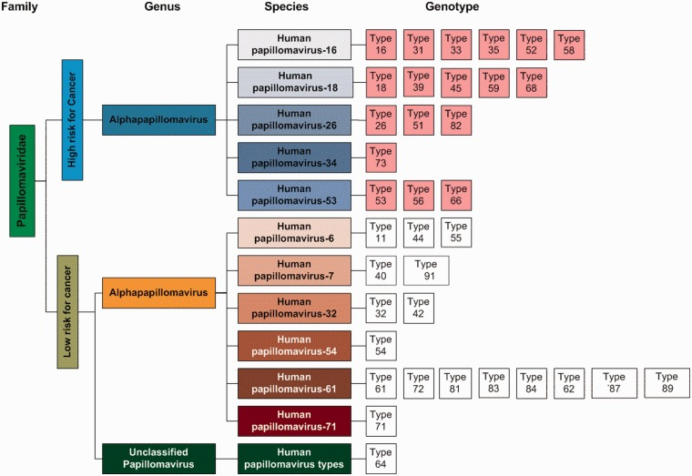
Circulating genotypes of human papilloma viruses
Alpha-9:
HPV 16, 31, 33, 35, 52, and 58
Alpha-7:
HPV 18, 39, 45, 51, 59, and 68
Alpha-5, 6:
HPV 53, 56, 66, and 69
Notes:
Asian Pac J Cancer Prev
. 2015;16(17):7633-40.
doi: 10.7314/apjcp.2015.16.17.7633.
Diagnostic Performance of HPV E6/E7 mRNA and HPV DNA Assays for the Detection and Screening of Oncogenic Human Papillomavirus Infection among Woman with Cervical Lesions in China
Hye-young Wang ¹, Dongsup Lee, Sunyoung Park, Geehyuk Kim, Sunghyun Kim, Lin Han, Ren Yubo, Yingxue Li, Kwang Hwa Park, Hyeyoung Lee
Affiliations expand
PMID: 26625774
DOI: 10.7314/apjcp.2015.16.17.7633
Free article
Abstract
Background: Human papillomavirus (HPV) is the most common sexually transmitted infection worldwide and it is responsible for most cases of cervical uterine cancer. Although HPV infections of the cervix do not always progress to cancer, 90% of cervical cancer cases have been found to be associated with high risk HPV (HR- HPV) infection. HPV DNA testing is widely used, along with Papanicolaou (Pap) testing, to screen for cervical abnormalities. However, there are no data on the prevalence of genotype-specific HPV infections assessed by measuring HPV E6/E7 mRNA in women representative of the Chinese population across a broad age range.
Materials and methods: In the present study, we compared the results with the CervicGen HPV RT-qDx assay, which detects 16 HR-HPV genotypes (Alpha-9: HPV 16, 31, 33, 35, 52, and 58; Alpha-7: HPV 18, 39, 45, 51, 59, and 68; and Alpha-5, 6: HPV 53, 56, 66, and 69), and the REBA HPV-ID assay, which detects 32 HPV genotypes based on the reverse blot hybridization assay (REBA) for the detection of oncogenic HPV infection according to cytological diagnosis. We also investigated the prevalence and genotype distribution of HPV infection with a total of 324 liquid-based cytology samples collected in western Shandong province, East China.
Results: The overall HPV prevalences determined by HPV DNA and HPV E6/E7 mRNA assays in this study were 79.9% (259/324) and 55.6% (180/324), respectively. Although the positivity of HPV E6/E7 mRNA expression was significantly lower than HPV DNA positivity, the HPV E6/E7 mRNA assay showed greater specificity than the HPV DNA assay (88.6% vs. 48.1%) in normal cytology samples. The prevalence of Alpha-9 (HPV 16, 31, 33, 35, 52, and 58) HPV infection among these women accounted for up to 80.3% and 76.1% of the high-grade lesions detected in the HPV mRNA and DNA tests, respectively. The HR-HPV genotype distribution, based on HPV DNA and E6/E7 mRNA expression by age group in patients with cytologically confirmed lesions, was highest in women aged 40 to 49 years (35.9% for cytologically confirmed cases, Pearson correlation r value=0.993, p<0.001) for high-grade lesions. Among the oncogenic HR-HPV genotypes for all age groups, there was little difference in the distribution of HPV genotypes between the HPV DNA (HPV -16, 53, 18, 58, and 33) and HPV E6/E7 mRNA (HPV -16, 53, 33, 58, and 18) assays. HPV 16 was the most common HPV genotype among women with high- grade lesions.
Conclusions: Our results suggest that the HPV E6/E7 mRNA assay can be a sensitive and specific tool for the screening and investigation of cervical cancer. Furthermore, it may provide useful information regarding the necessity for early cervical cancer screenings and the development of additional effective HPV vaccines, such as one for HPV 53 and 58. Additionally, gaining knowledge of HPV distribution may also inform us about ecological changes in HPV after the vaccination.

Slide 4
PROJECT AIMS
Genotype HR HPVs in healthy and diseased cervix and determine prevalent genotypes;
Indentify eventual genotype drift;
Characterize evolution of dominant strains (epitopic drift);
Assess degree of DNA damage due to HPV integration.

Slide 5
Study includes women with squamous intraepithelial lesions and carcinomas and matching controls (40 each).
Women with squamous intraepithelial lesions and carcinomas (n=40)
Squamous intraepithelial lesions HSIL (n=20)
- n=10-15, Jurijs N., from Paul Stradins University Hospital dated before 2015
n=10-15 from clinical follow up, Androns M dated from 2021 on.
Sample collection and sreenings 1-4(5) – smears, bipsies, materials from conization
Squamous cell carcinomas (n=20, Jurijs N. from Paul Stradins University Hospital collection)
dated before 2015 (n=10)
dated after 2016 (n=10)
Newly collected (n=100)
Screenings 1-4(5) Every 6 month after primary investigation – semars, bipsoies, excised tumor materials.
Follow up after surgery - month 3, month 9, month 15, month 21-22 (year left before project completion, one more screening is possible
Matching conditionally healthy controls (n=40)
from clinical follow up, Androns M dated from 2021 (n=40 for start)
Every 8-10 month after primary investigation
Cervical smear collection and screenings 1-3(4)
Month 3, month 12, month 22, (year left before project completion, one more screening is possible - month 30-32).
Notes:
Shall we try pt quests? I can give an example.
Ethical permit.

Slide 6
Cervical smears (on-going)
80 primary + 40*3=120 conditionally healthy follow up + 40*3=120 HSIL & CSSC follow up, totally 350 samples during 24 month.
Collection - cervical brush, conservation of material, transfer for PCR analysis in sets of 20-30 samples at a time (10-12 runs in total). Samples would be kept in preservation material in the freege for >month )
Liquid cytometry – Subcontracts with Centrala Laboratorija and Gulbja Laboratoria. Diagnosis confirmation
DNA extraction + HR HPV specific PCR (kits) Subcontracts with Centrala Laboratorija and Gulbja Laboratoria.

Slide 7
Cervical biopsies and resected material of tumors (done)
40 from collection,
unknown number from the prospective study – expected to be approx 20
Collection - formalin fixation 1-2 days 4% formalin, transfer to PBS, paraffinization
Immunohistochemistry of biopsies and sections from conization materials and resected tumors for p21, p53– Paul Stradins University Hospital
DNA extraction Sectioning FFPE blocks, DNA extraction QUIGEN kits. Aliqoting, deep freezing of the aliqotes.
HR HPV specific PCR of extracted DNA (Q PCR for 15 HR HPVs)

Slide 8
Genotype HR HPVs in healthy and diseased cervix - 2023 (done)
Determine prevalent genotypes on newly collected samples
– after each screening – 20* 5=100 HSIL samples
In biobank HSIL and SCCC samples from earlier years – before 2015, after 2016 – max 40 SCCC samples
In total, 140 samples
Conditionally healthy – 40 pts * 2-4 visits
HR HPV PCR in totally 300 samples during two years.
Define two dominant HR HPVs – HPV16 and ?? (HPV 56, or 58, or 52??)
Now we know that it is HPV31 in conditionally healthy, and HPV33 in cancer

Slide 9
Characterize evolution of dominant strains (started)
L1 as most variable capsid, E6 and E7 as oncoproteins defining chronic infection & malignization – attempt Sanger sequening in all 1st and last samples from the dominant strains.
HPV 16 – 100% in cancer, 10-15% in general population.
Other HR HPV – 10% max, of total 80 – 10 early and 10 late samples. 20 sequencing runs.
Subcontract arranged for the whole RSU, experiments to be done in 2024.
Will receive approx 40 sequences of E6 and E7 of HR HPV 16 and one more HR HPV.
In sequential samples, and in newly collected vs biobanked samples:
Genotype drift
Epitopic drift in L1, E6, E7
Notes:
MGI Latvian sequencing, LBMC, Genera – sequencing options.

Slide 10
HPV whole genomic sequencing (WGS) - 2024
Quality of DNA in stored samples, HPV WGS where amount of HR HPV DNA permits (independently of HR HPV genotype)
HPV genomic sequencing in samples with sufficiently good DNA quality and amount of HPV DNA (approx n=10)
Search for human-HPV DNA chimeras and insertions of full lenght oncogenes E6 and E7 (have preliminary data to publish; findings here will be in support)
HPV-human DNA chimeras resulting from HPV integration will be quantified and their quantitiy and localization compared in patient with
Different course/outcome of HPV infection
Patients with different HR HPV genotypes
Depending on epitopic drift

Slide 11
In vitro experiments will assess the effect of typical HPV DNA inserts on tumorigenic & metastatic portential of expressing epithelial cells
E6E7 expressing murine adenocarcinoma cells already established
Metabolism (mitochondrial respiration & glycolysis)
Motility (wound healing assay)
Doubling time, colony formation on soft agar
Tumorigenicity and metastatic activity in vivo in syngenic mice
Assessment of the effects of E6E7 expression on tumor cells.
Effects of longitudinal E6E7 expression on genonic stability by WGS of E6E7 expressing adenocarcinoma cells after short (10 passages) and long passaging (>40).
E6/E7 based DNA vaccines against HR HPVs (optional)

Slide 12
Outcomes
Identification of early markers predisposing to malignization to personalize treatment and prevent development of cervical cancer:
Epitopic drift
Degree of DNA damage
Rates of HR HPV clearance and reinfection
Evaluation of the direct tumorigenic effects of E6 and E7 expression on the epithelial cells in the absence of interference of p53 (4T1luc2 cells are p53(-)).

Slide 13
Thank you for your attention!

