Slide 1
Disease Dynamics Modelling
Prof. Dr. Steffen Flessa
Department of Health Care Management
University of Greifswald

Slide 2

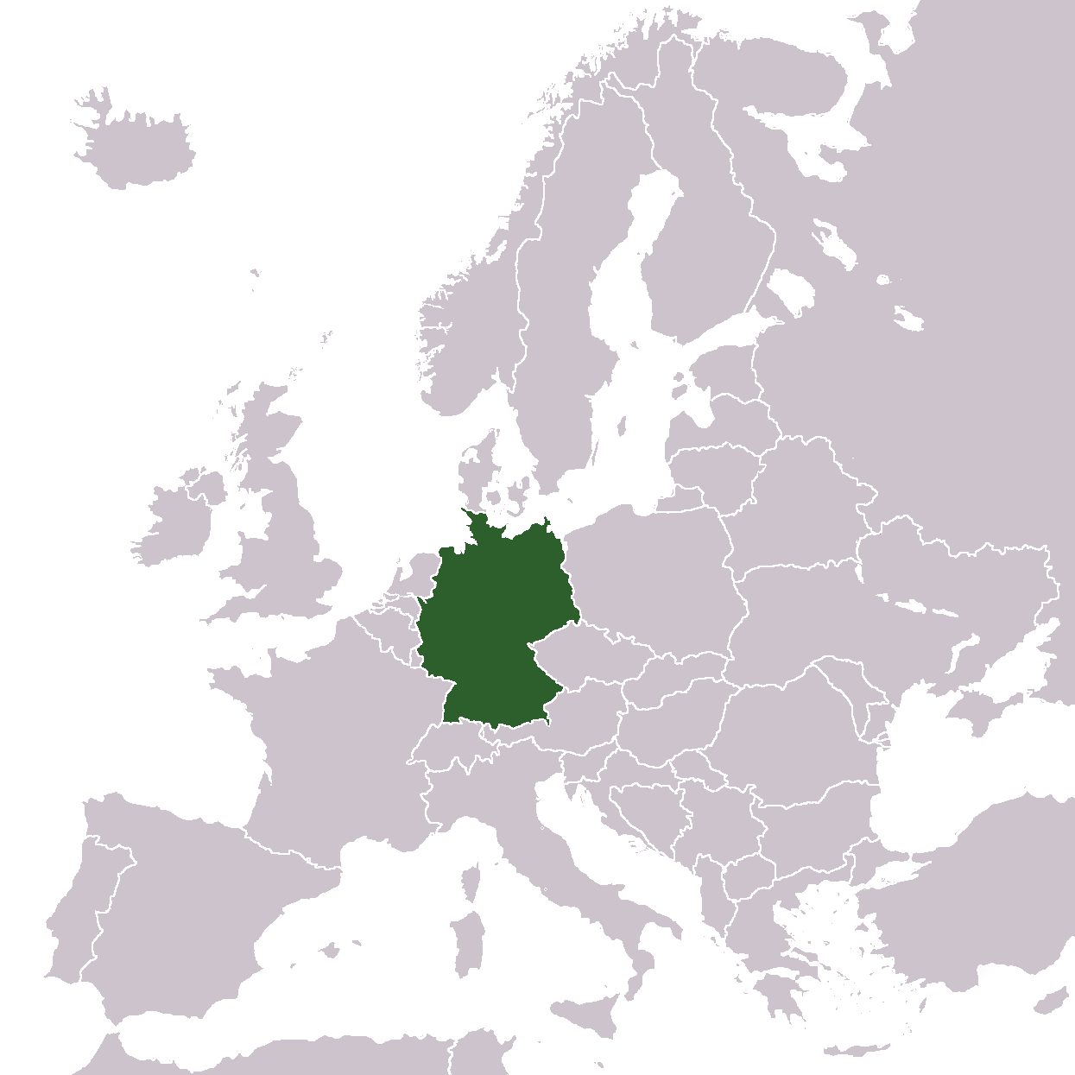
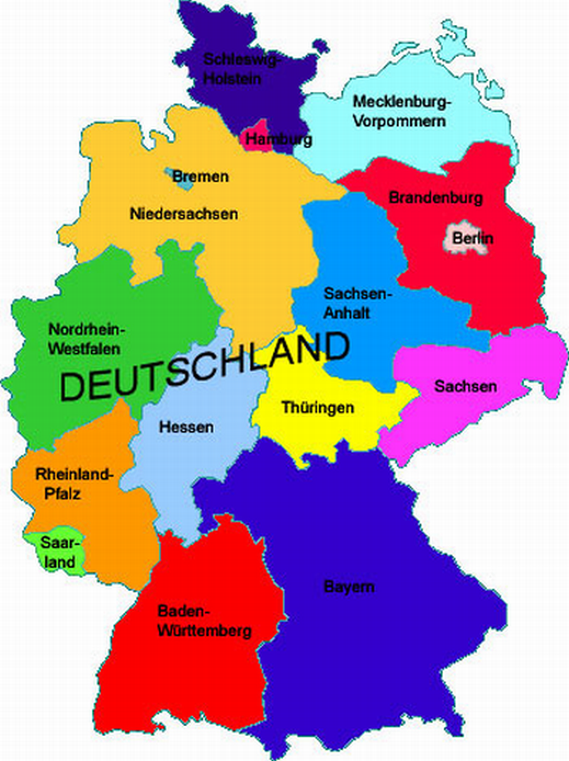
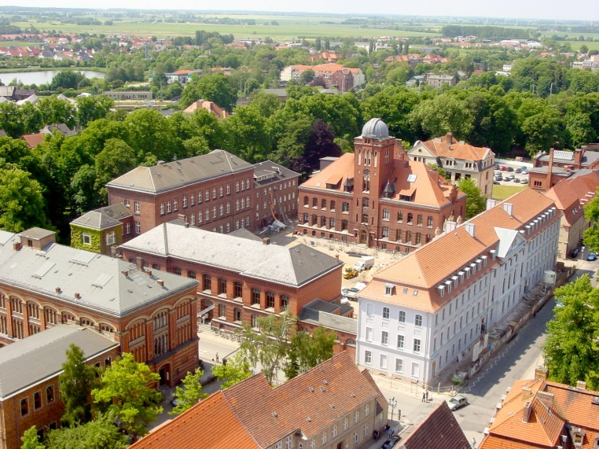
Population: 82,000,000

Slide 3
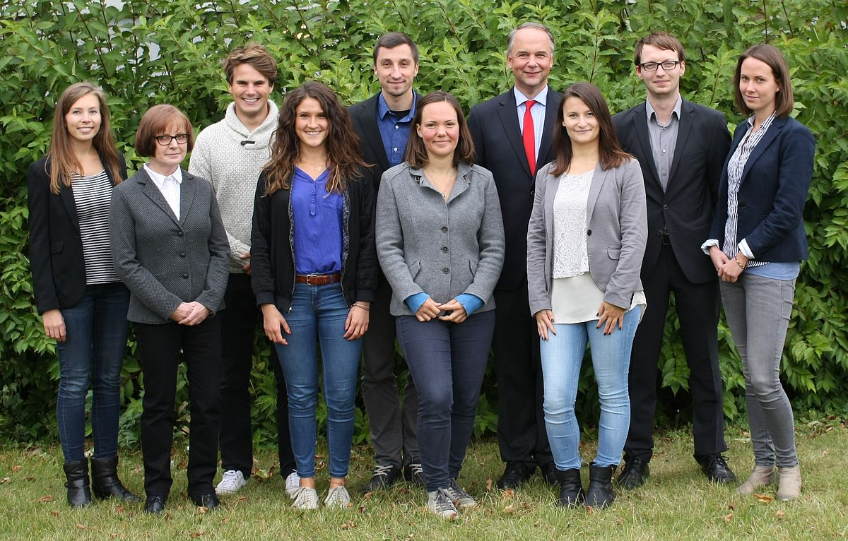
Prof. Dr. Steffen Fleßa
1966
Married, 2 children
BA, MBA, PhD, Habilitation Uni Erlangen-Nürnberg
Lecturer for hospital management, Masoka Management Training Institute, Tanzania
Professor for Nursing Administration, University of Applied Sciences, Nürnberg
Professor for International Health Economics, University of Heidelberg
Since 2004 director of the department of health care management, University of Greifswald
Since 2016 Vice President, University of Greifswald
Research interests: : Quantitative Techniques in Health Care, Nonprofit Organizations, International Health Care Management

Slide 4
Agenda
Lecture: Disease Dynamics Models
Case Study I: Anopheles
Lecture: Cervical Cancer in Cambodia
Case Study II: HIV

Slide 5
Contents
Introduction
Prognosis
Example I: Aids
Example II: Malaria
Conclusions

Slide 6
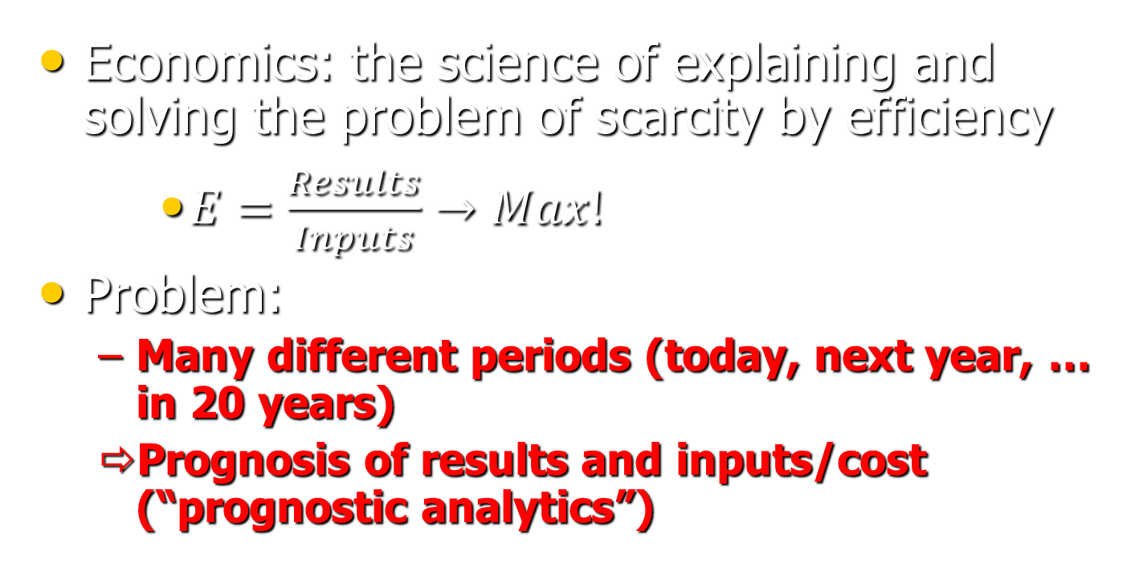
1. Introduction
Economics: the science of explaining and solving the problem of scarcity by efficiency
    $E=\frac{Results}{Inputs}→Max!$
Problem:
  Many different periods (today, next year, … in 20 years)
  Prognosis of results and inputs/cost (“prognostic analytics”)

Slide 7
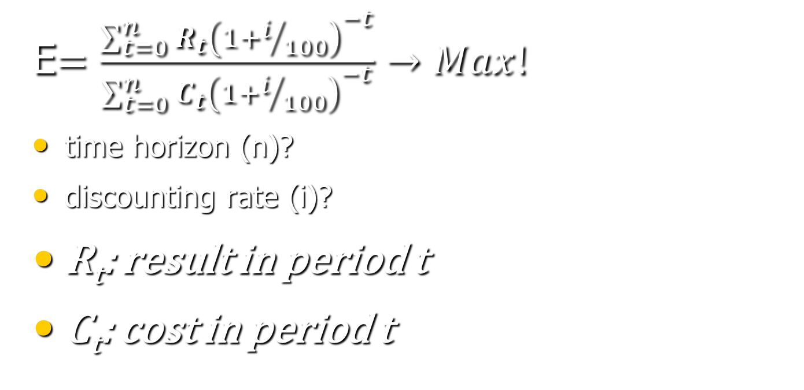
Efficiency
E$=\frac{\sum_{t=0}^{n}{R_{t}{\left(1+i/{100}\right)}^{−t}}}{\sum_{t=0}^{n}{C_{t}{\left(1+i/{100}\right)}^{−t}}}→Max!$
time horizon (n)?
discounting rate (i)?
R_{t}: result in period t
C_{t}: cost in period t

Slide 8
2. Prognosis
Dimensions
  Prognosis of results (e.g. incidence, prevalence, mortality)
  Prognosis of costs (e.g. resources for treatment, prevention)
Types of models
    Biomathematical models
    Biometric / Econometric models
    Markov Models
    System Dynamics Models
    Discrete Event Simulation (DES), Agent Based Simulation, …

Slide 9
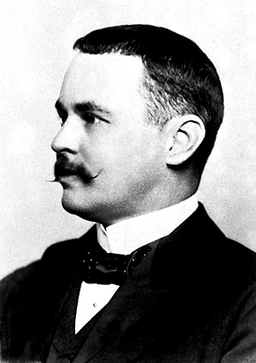
Biomathematical Models (e.g. Ross-McDonald-Modell)
R₀
m
a
b₁
b₂
r
μ
basic reproductive rate
number of mosquitos
number of bites
infection risk of humans
infection risk of mosquito
recovery rate of humans
mortality of mosquito
Ronald Ross,
Nobel Price 1902

Slide 10
Biometrics / Econometrics

Slide 11
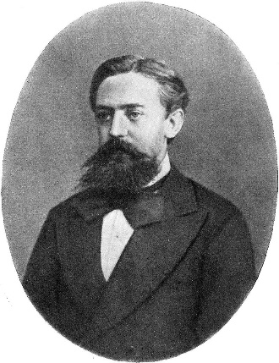
Markov-Model
w_{j}: Population in state j
a_{ij}: Transition probability from state i to state j
Andrei A. Markov
a
12
w₂
a
24
a
21
a
42
w₁
a
14
w₄
a
41
a
32
a
23
a
31
a
34
a
13
w₃
a₄₃

Slide 12
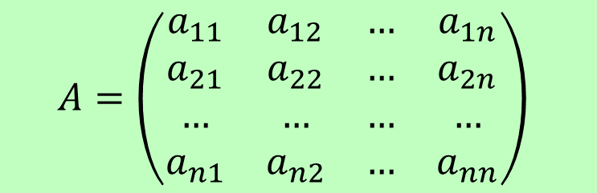
Markov-Model
$$A=\left(\begin{matrix}a_{11} & a_{12} & … & a_{1n} \\ a_{21} & a_{22} & … & a_{2n} \\ … & … & … & … \\ a_{n1} & a_{n2} & … & a_{nn}\end{matrix}\right)$$

Slide 13
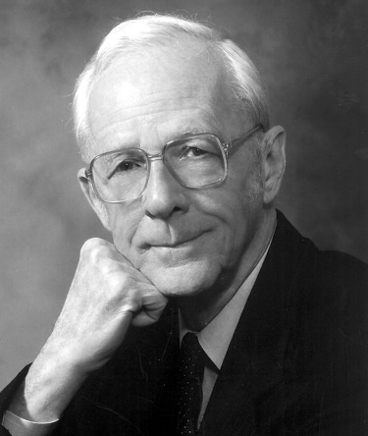
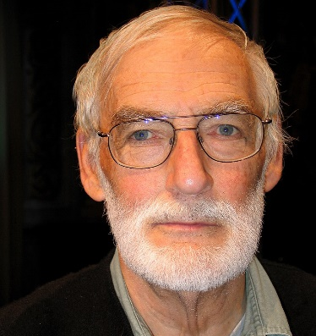



System Dynamics Model
Definition: System dynamics (SD) is an approach to understanding the nonlinear behaviour of complex systems over time using stocks, flows, internal feedback loops, and time delays (MIT)
Industrial Dynamics
  Forrester (1961)
Urban Dynamics
  Forrester (1969)
World Dynamics
  Limits to Growth (1972)
  Dennis Meadows, Club of Rome
Business Dynamics
  Sterman (2000)
Jay Wright Forrester
Dennis Meadows
John Sterman

Slide 14
System Dynamics Model

Slide 15
System Dynamics Model

Slide 16
System Dynamics Model
Flow
Loop
Stock

Slide 17
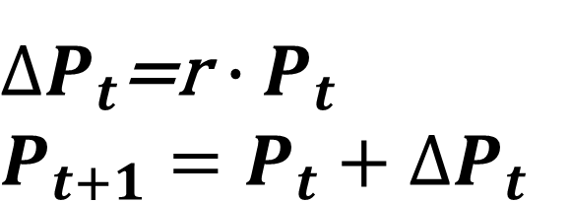
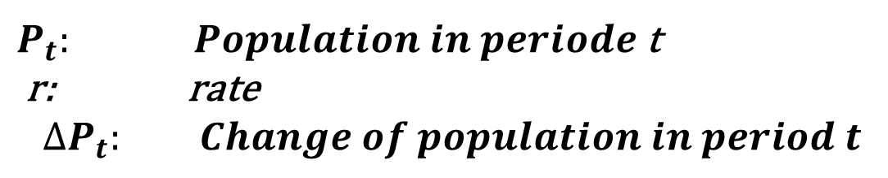
System Dynamics of a Population
$P_{t}: Population in periode$t
r: rate
$$∆P_{t}: Change of population in period t$$
$∆P_{t}$=r $∙P_{t}$
$$P_{t+1}=P_{t}+∆P_{t}$$

Slide 18
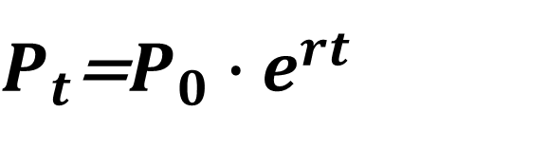
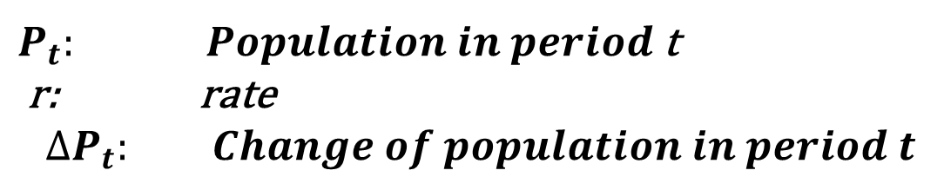
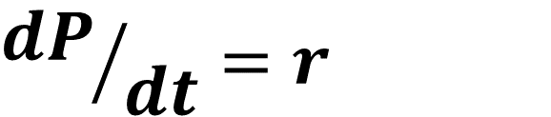
System Dynamics of a Population
$P_{t}: Population in period$t
r: rate
$$∆P_{t}: Change of population in period t$$
Differential Equation
$${dP}/{dt}=r$$
$∆P_{t}$=r $∙P_{t}$
$$P_{t+1}=P_{t}+∆P_{t}$$
$P_{t}$=$P_{0}∙e^{rt}$
Difference Equation
Exponential Equation

Slide 19
System Dynamics of a Population
P₀ = 100,000
r=0.05
t: years
t | P (difference) | P (differential)
0 | 100,000 | 100,000
1 | 105,000 | 105,127
2 | 110,250 | 110,517
3 | 115,763 | 116,183
4 | 121,551 | 122,140
5 | 127,628 | 128,403
6 | 134,010 | 134,986
7 | 140,710 | 141,907
8 | 147,746 | 149,182
9 | 155,133 | 156,831
10 | 162,889 | 164,872

Slide 21
System Dynamics of Anopheles

Slide 22
System Dynamics of Anopheles

Slide 23
System Dynamics of Anopheles

Slide 24
System Dynamics of Anopheles
Flow
Loop
Delay
Stock

Slide 25
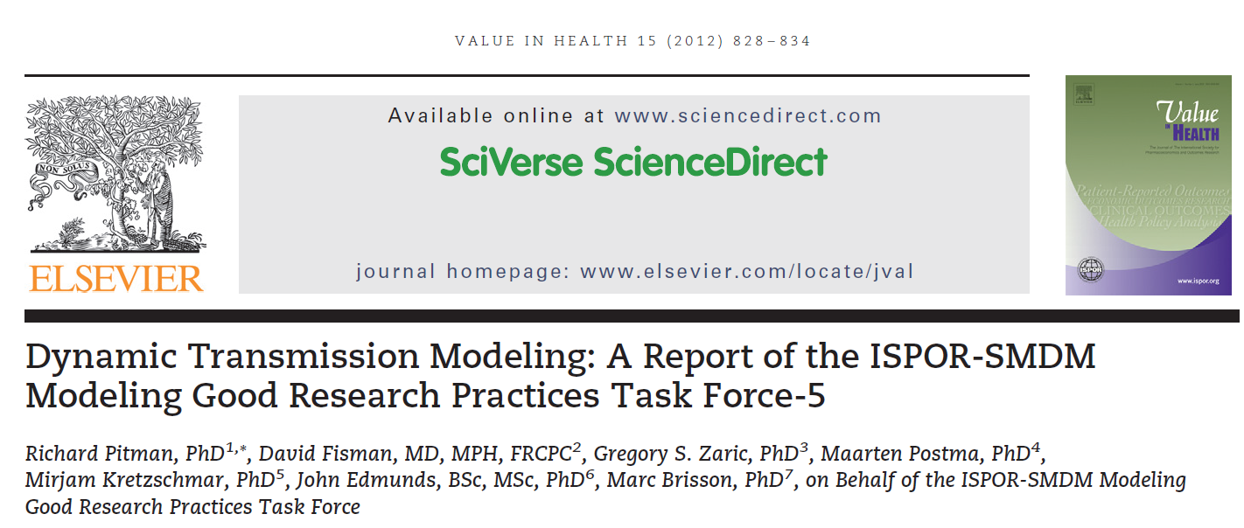
System Dynamics of Anopheles

Slide 26
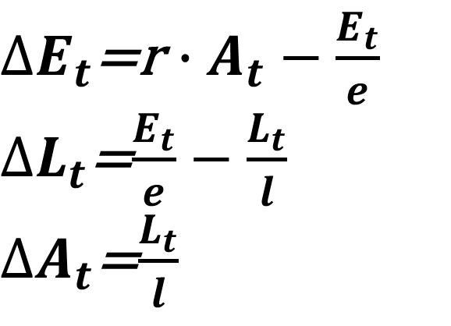
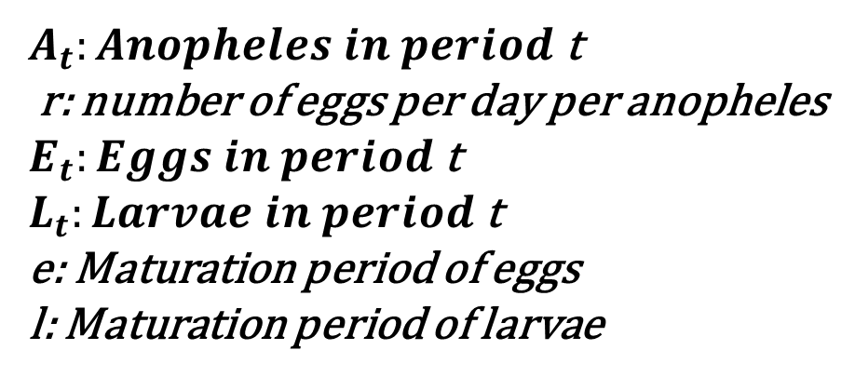
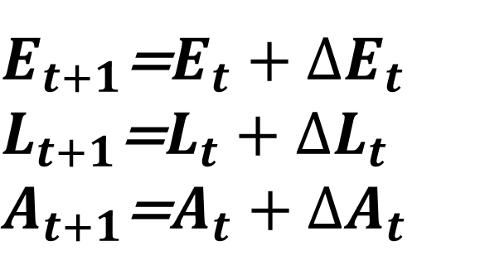
System Dynamics of Anopheles
$A_{t}:Anopheles in period$t
r: number of eggs per day per anopheles
$E_{t}:Eggs in period$t
$L_{t}:Larvae in period$t
e: Maturation period of eggs
l: Maturation period of larvae
$∆E_{t}$=r $∙A_{t}−\frac{E_{t}}{e}$
$∆L_{t}$=$\frac{E_{t}}{e}−\frac{L_{t}}{l}$
$∆A_{t}$=$\frac{L_{t}}{l}$
$E_{t+1}$=$E_{t}+{∆E}_{t}$
$L_{t+1}$=$L_{t}+{∆L}_{t}$
$A_{t+1}$=$A_{t}+{∆A}_{t}$

Slide 27
Discrete Event Simulation (DES)
Simulation of specific agents where individual characteristics are required
Example: Mother-To-Child-Transmission of HIV
  One child – attached to a specific mother
  Characteristic: HIV+, type of delivery, breast-feeding etc.

Slide 28
Decision on Prognosis Model
Purpose of economic analysis
  Epidemiological, Budget-Impact, Interventions
Resources
  DES > System Dynamics > Markov > Econom. > Biomath.
Complexity of ecological system
  Infectious or degenerative diseases
  vector biology
  Rainfall, altitude, …
Time horizon: 1-5-10-50-100 years?
Discounting: does a future value have the same value as present?
“Modelling for insights, not for numbers”

Slide 29
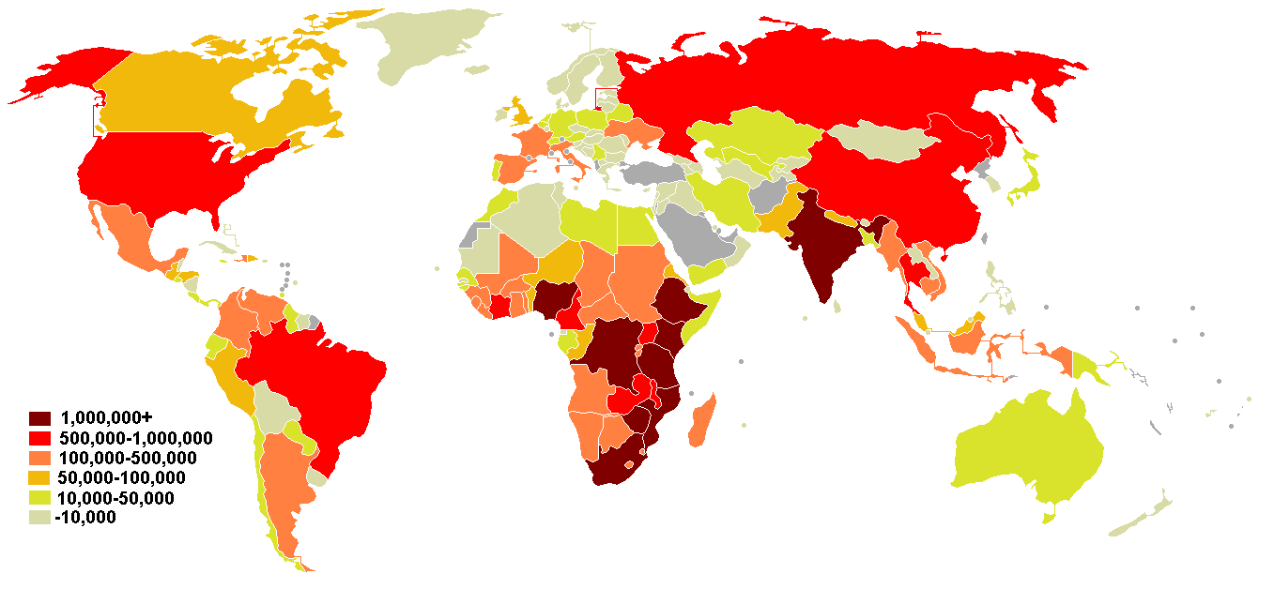
3. Example I: Aids
  Pandemic: >20 Millionen casulaties
  Cases per country:
http://www.mapsharing.org/MS-maps/map-pages-worldmap/7-world-map-aids.html

Slide 30
Economic Consequences
Treatment
  Anti-Retroviral Therapy
  Opportunistic infections
  Palliative Care
Prevention
  „Aids-Control-Programs“
Orphans

Slide 31
Anti-Retroviral Therapy
Short-term: tremendous impact on patients!
Long-term risks:
  Resistence
  Compliance
  Sexual behavior change
  Opportunity cost

Slide 32
Intended, short-term impact of HAART
effectiveness of HAART
Cost-effectiveness
Long-term???

Slide 34
Example: Aids in Tanzania

Slide 35
Annual direct cost

Slide 36
Vaccination Scenarios

Slide 37
Prediction of Aids
A disease with an incubation period of 10 years calls for dynamic models.
Any intervention must be long-term.
Cost-effectiveness depends on the time-horizon.

Slide 38
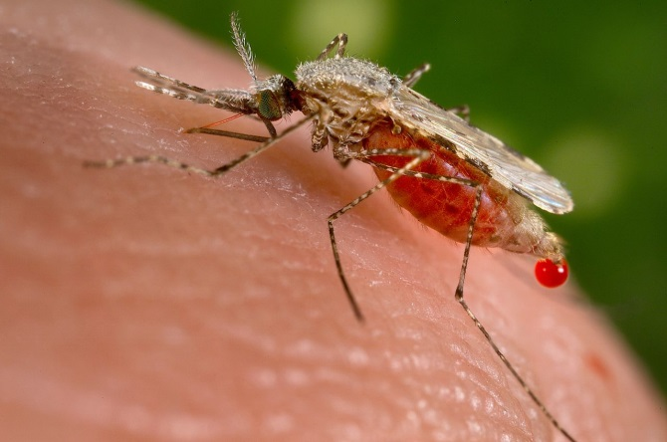
4. Example II: Malaria

Slide 39
Economic relevance
Treatment (example: Kenya)
  Simple malaria: 5 US$ p. case
  Complicated malaria: 20-40 US$ p. case
Indirect cost: loss of 10 man-days per case
Prevention:
  Malaria Eradication Programme
  Roll-Back-Malaria (WHO)
Seasonality and excess capacity

Slide 40
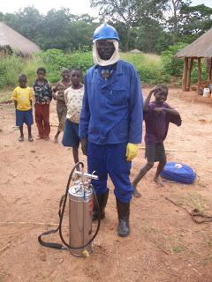
In-door spraying
Infections
1,2E+07
8,0E+06
4,0E+06
0
0
5
10
15
20
25
Time [yrs.]
Standard
B=500
B=1000

Slide 41
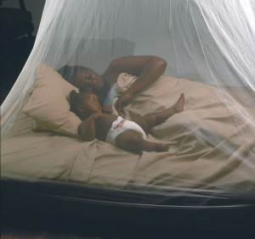
Bed-net programs
Infections
1,2E+07
8,0E+06
4,0E+06
0
0
5
10
15
20
25
Time [yrs.]
Standard
B=500
B=1000

Slide 42

Migration

Slide 43

Malaria
Roll-Back Malaria:
  we need sustainable interventions
  We need long-term financing
Economic development:
  Planners have to consider long-term effects of agricultural, social, economic programs
⇨we have to predict epidemiological and economic effects of interventions

Slide 44
5. Conclusions
Health care always entails an existential dimension:
  with the same money safe 1000 malaria children or 1 dialysis patient???
Ethics: “What is good or bad?” …
  … depends on time horizon and time preference (interest)!
  … cannot be answered easily!
  … needs reliable calculations!

Slide 45
5. Conclusions
  ⇨ Responsible decision-making requires reliable modelling!
Health care in resource-poor countries always entails an existential dimension:
  with the same money safe 1000 malaria children or 1 dialysis patient???
Ethics: “What is good or bad?” …
  … depends on time horizon and time preference (interest)!
  … cannot be answered easily!
  … needs reliable calculations!

