Slide 1
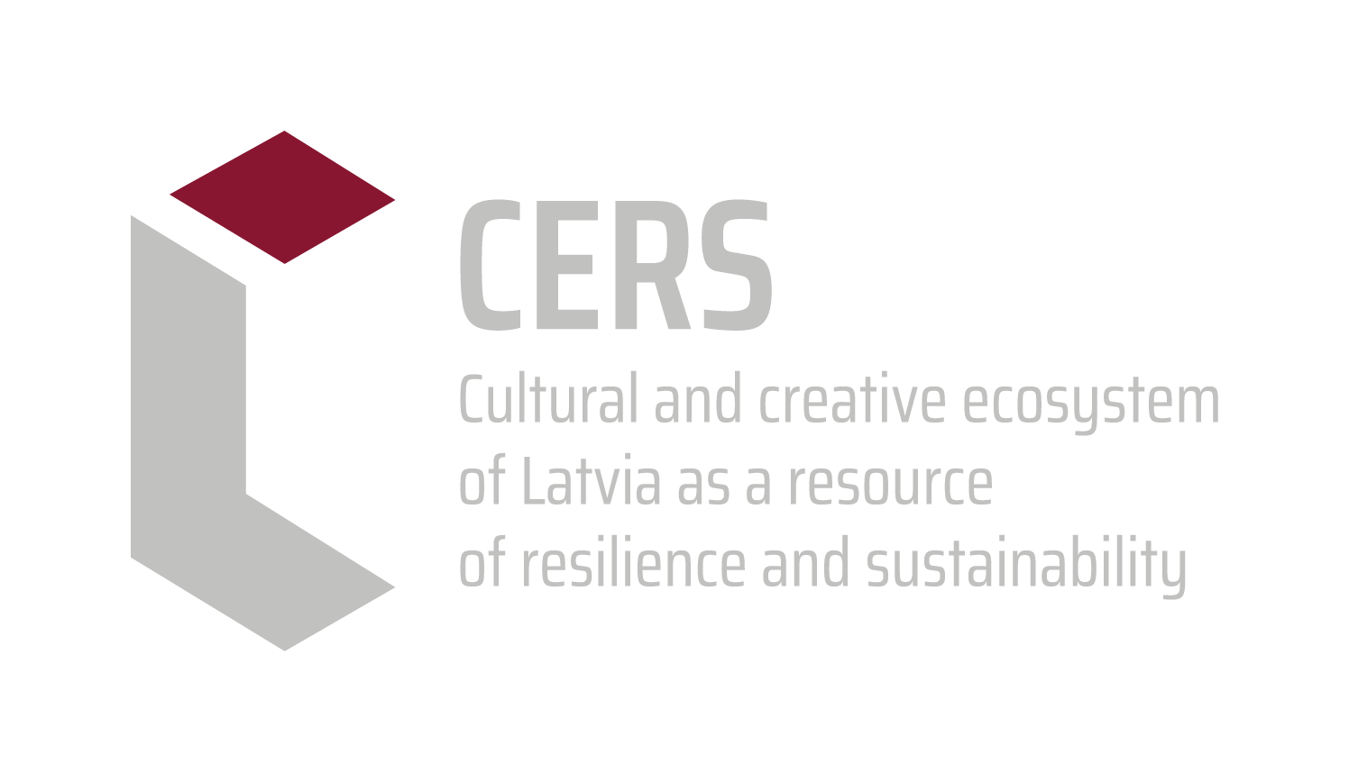
Learning from the unknown.
Curatorial education as source for the experiment
Antra Priede
Mag. art., Vice-rector for Academic Affairs
The Art Academy of Latvia
22.04.2026.

Slide 2
The defining categories of curatorial work — often underestimated by academic research — are space and the material presence of artifacts, as well as the non-linearity of presentation. This allows for establishing connections through analogy and opposition, through aesthetic and temporal properties, and through multi-media environments that incorporate visual, textual, and material items. A less hierarchical, associative
experience can open up subjective readings, or rather perceptions and perspectives.
Raul Gschrey, Curating as Research, 2016
https://www.on-culture.org/journal/perspectives/curating-as-research/

Slide 3
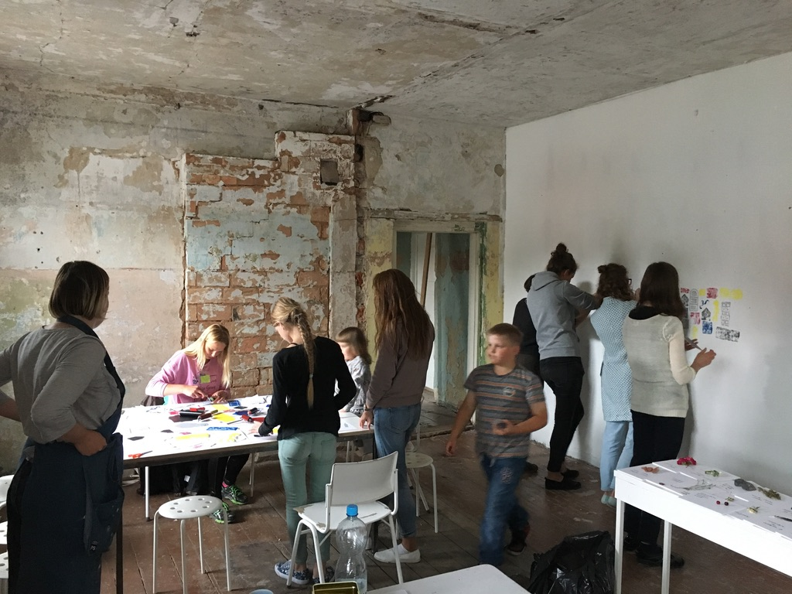
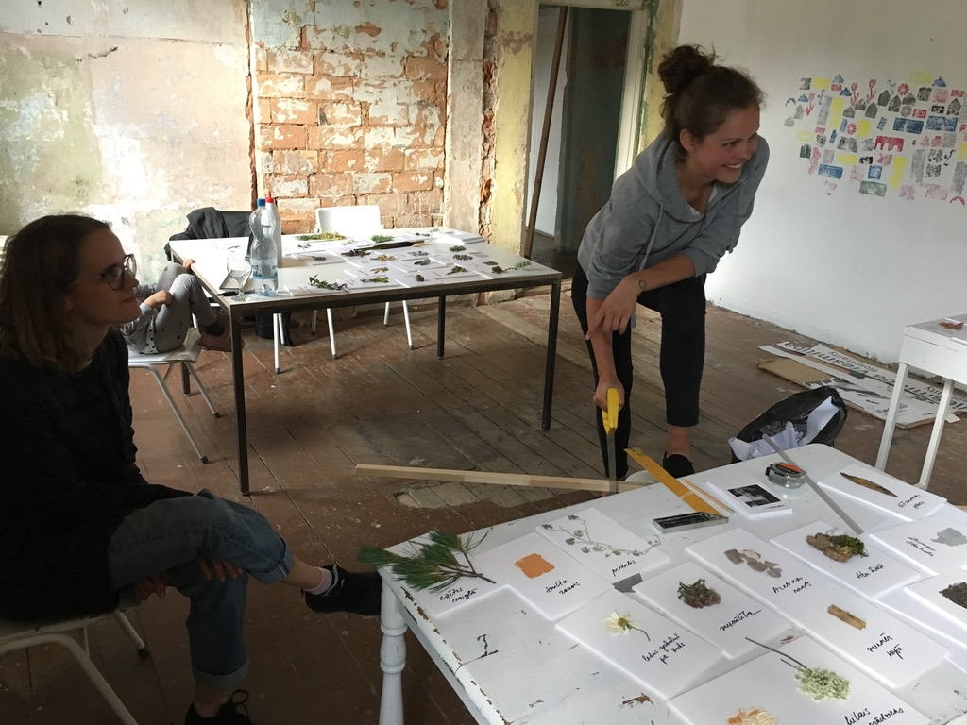
AAL Curatorial Course Summer practice in Kuldīga, 2019

Slide 4
My question is: how can we learn something that does not exist yet? It might sound paradoxical at first, because classically what is expected from educators is that they teach something that already exists; they transmit existing knowledge to someone else. But this is neither all that education nor research has been about. We could say research should be about learning what we don't know yet. In that way, if we relate research to learning something that didn't exist before we knew it, we also create it by knowing it.
Nora Sternfeld , Lecture at the Symposium "Show and try again", 18th of October 2019 at Academy of Fine Arts HGB Leipzig
https://www.youtube.com/watch?v=VsKj9L3uvqQ

Slide 5
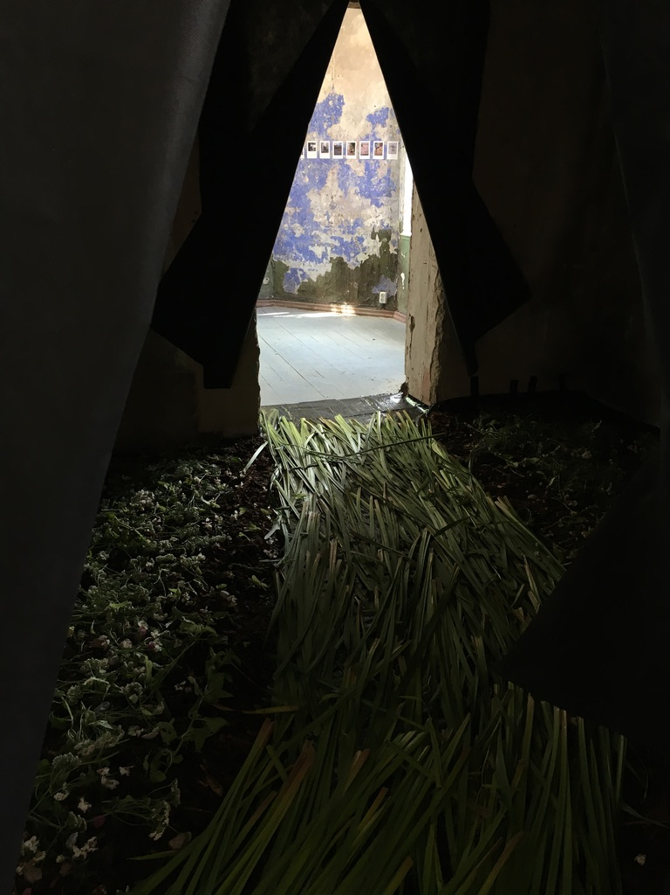
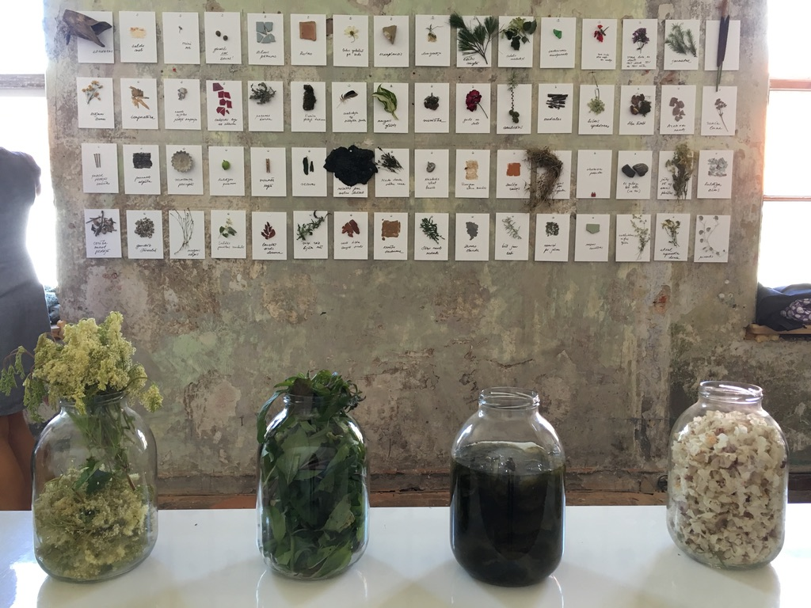
AAL Curatorial Course Summer practice in Kuldīga, 2019

Slide 6
Fail Again, Fail Better
Democracy of Experiences
It is important to realize that versatility, insecurity, openness, complexity, ambiguity are not a problem, but a necessity. The challenge is to face them and respond in such a way that the solution creates a meaning.
Artistic Research Methodology: Narrative, Power and the Public, 2014

Slide 7
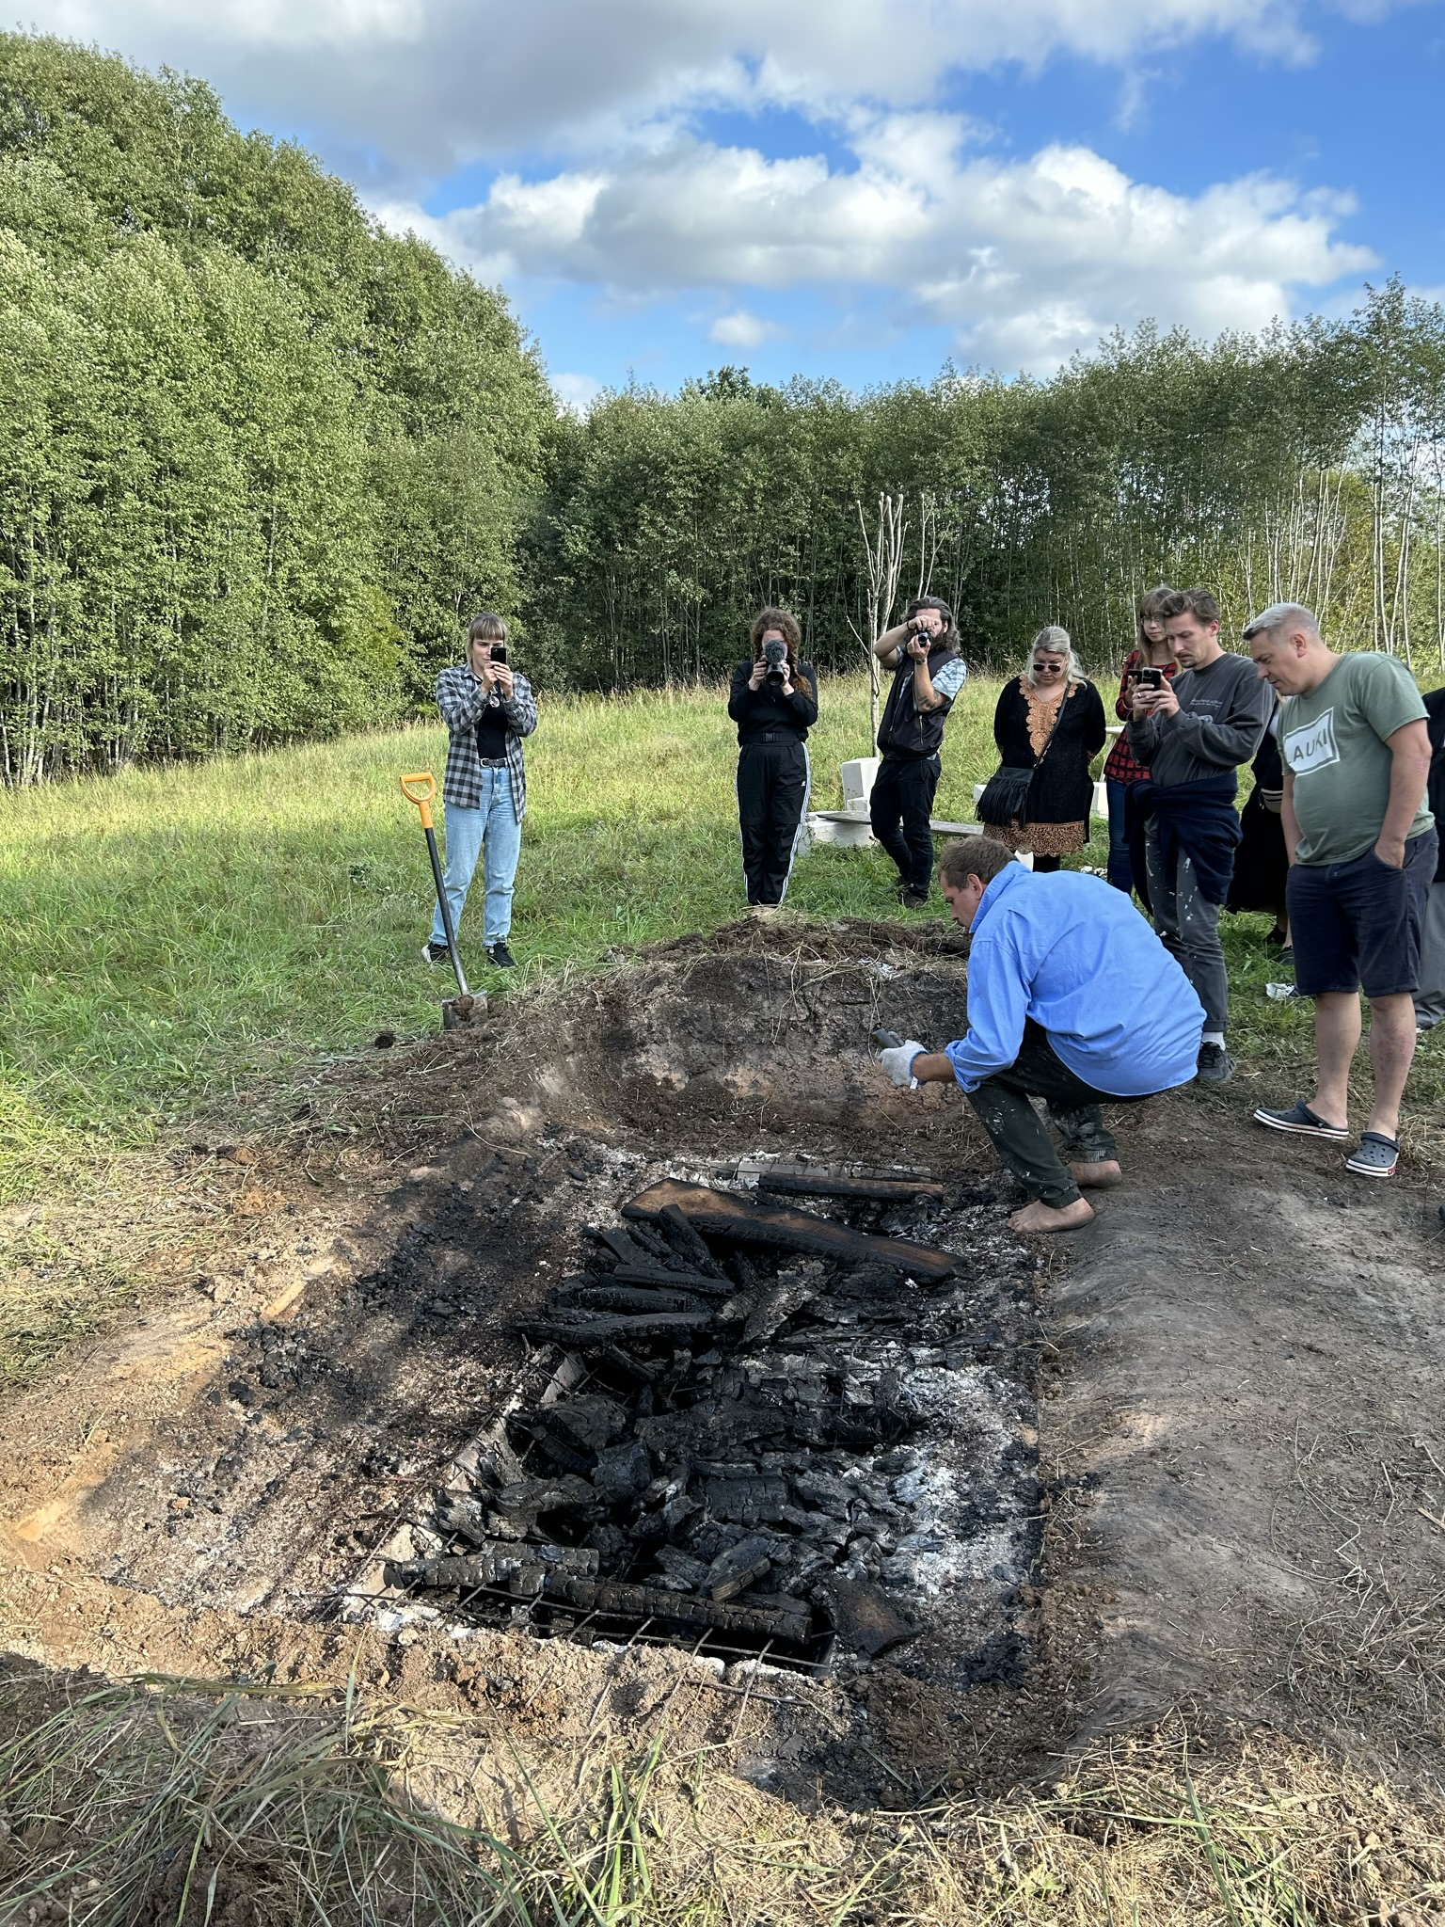
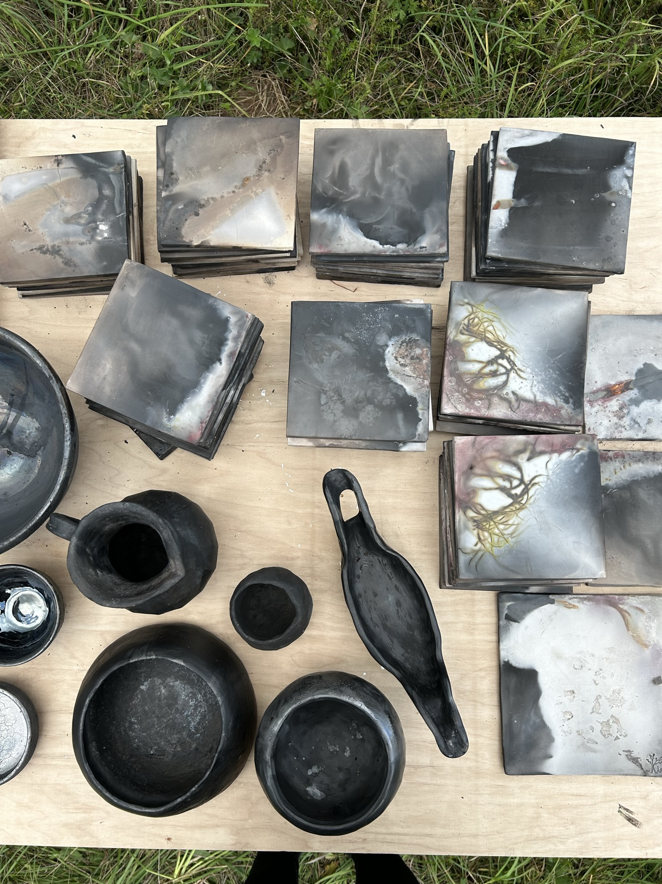
AAL Curatorial Course Summer practice in Savvaļa, 2023

Slide 8
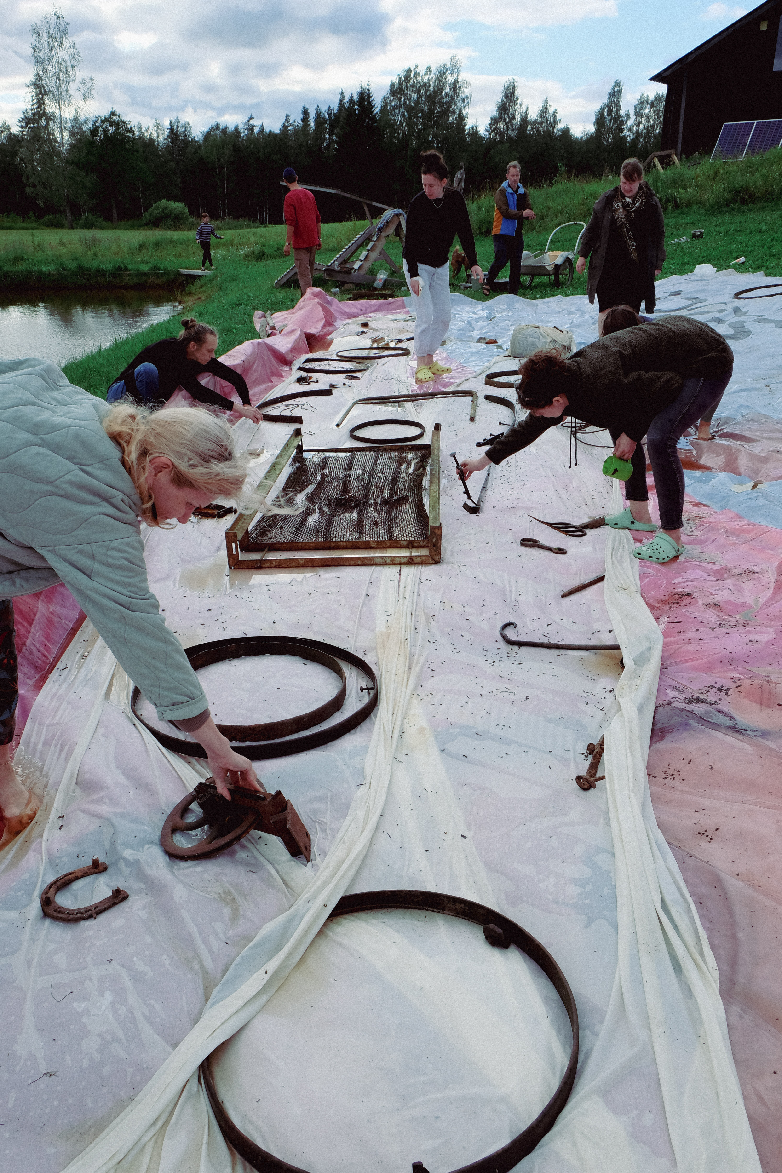
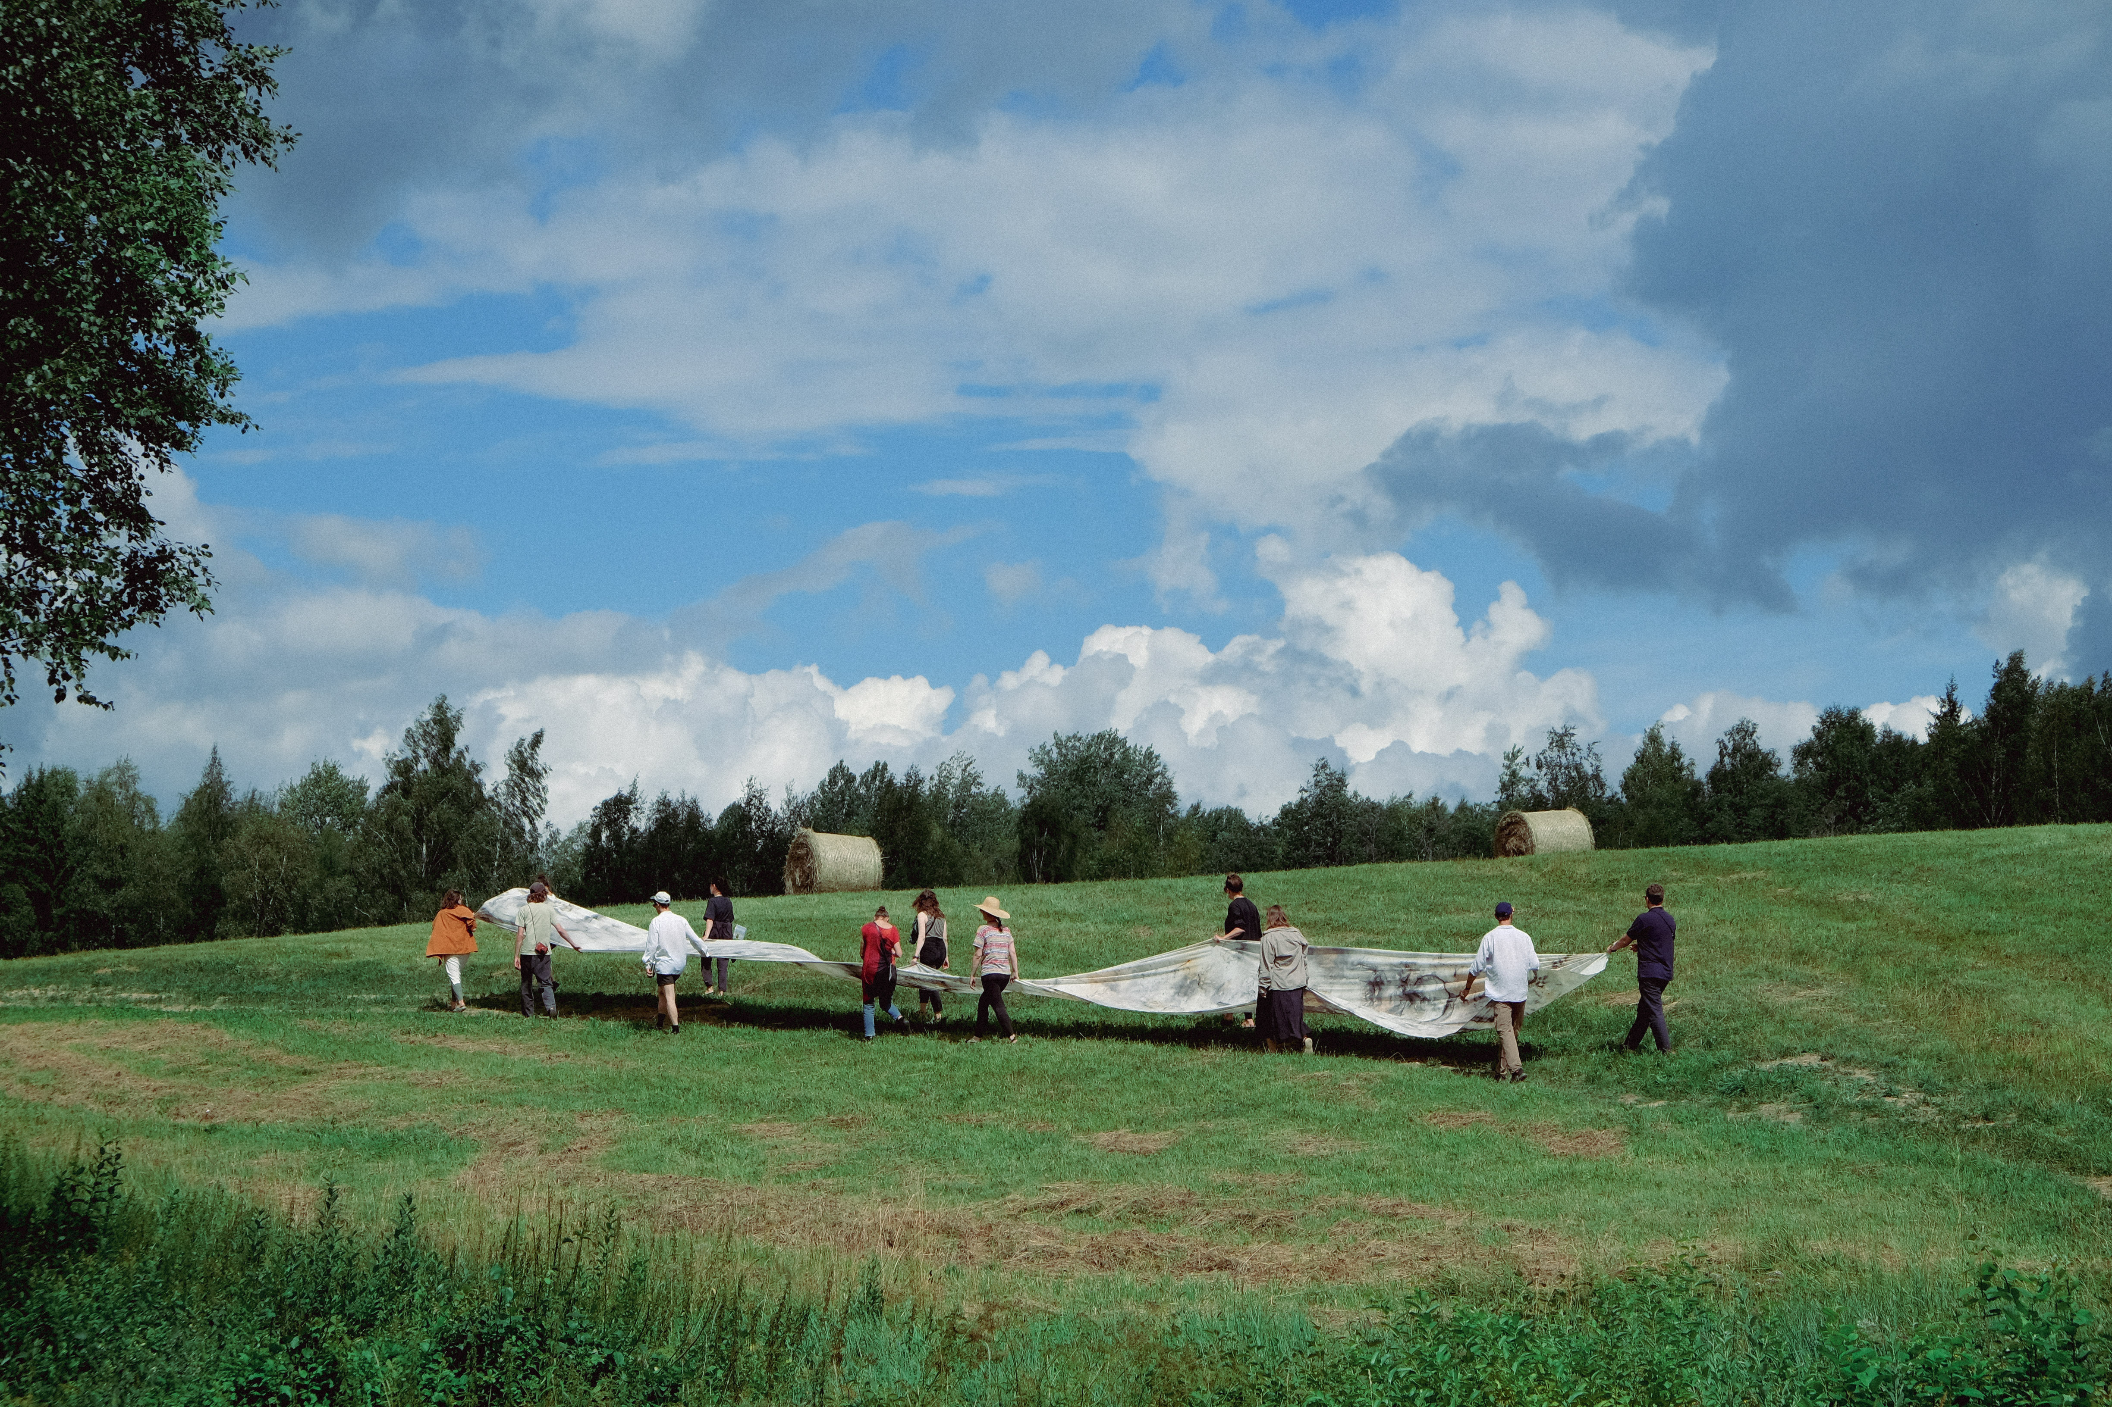
AAL Curatorial Course Summer practice in Savvaļa, 2024

Slide 9
From Black Mountain college (1933–1957) to :
https://instituteofradicalimagination.org
Institute of Radical Imagination (IRI) is a group of curators, artists, activists, scholars with a shared interest in co-producing knowledge as artistic and political research-interventions aimed at implementing post-capitalist forms of life in the Mediterranean and the Global South.
https://www.schoolofdisobedience.org
In this world of brutality and aggression, the School of Disobedience wants to be a peaceful island of radical tenderness, softness, and care.
https://shared-campus.com
The future belongs to professionals who communicate, exchange, debate, and critically reflect on ideas within a global framework.
Shared Campus is a cooperative platform for international education formats, research networks, and joint productions, established by leading international arts universities, schools, and colleges.

Slide 10
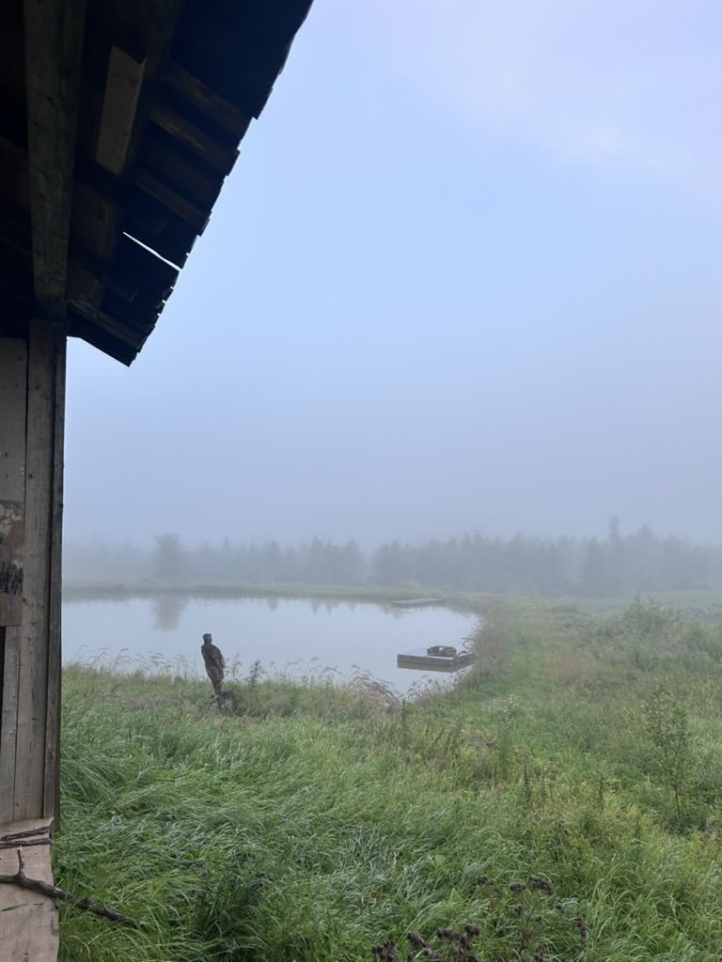
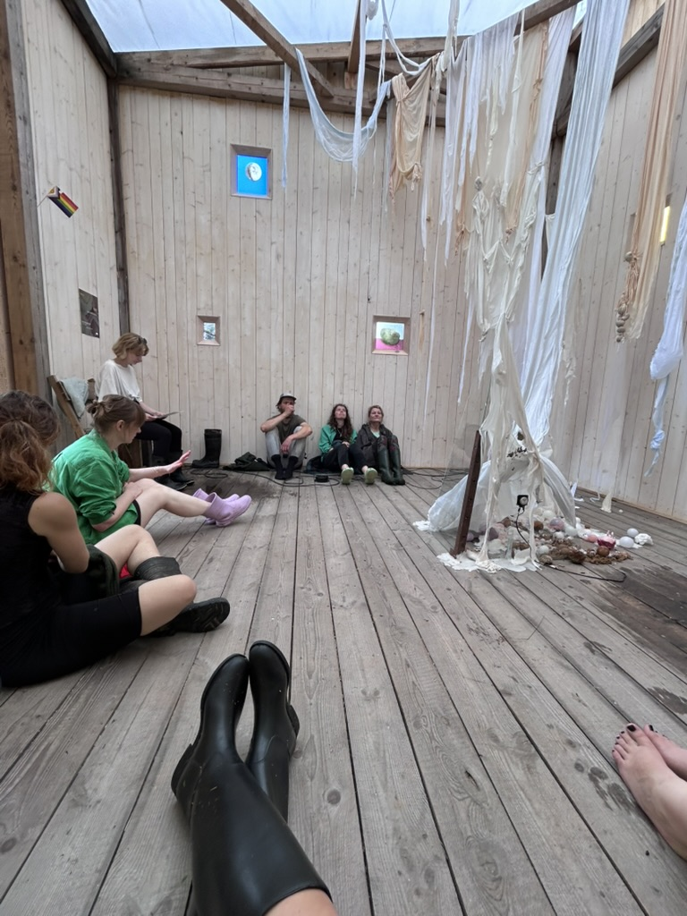
AAL Curatorial Course Summer practice in Savvaļa, 2025

Slide 11
(..) but we do need an earthwide network of connections, including the ability partially to translate knowledges among very different- and power- differentiated- communities. We need the power of modern critical theories of how meanings and bodies get made, not in order to deny meanings and bodies, but in order to build meanings and bodies that have a chance for life. Natural, social, and human sciences.
Donna Haraway, "Situated Knowledges: The Science Question in Feminism and the Privilege of Partial Perspective", Feminist Studies 14:3, Autumn 1988, pp 575-599.

Slide 12
Knowledge: Awareness of the world, the history and the context. Be able to speak as the soil, as trees and rocks, as the concrete building form the place you are coming from.
Competences: To care without the need to become overprotective an be deep as an ocean.
Skills: To transform into a bird and be able to listen and translate between different forms of knowing, explicit and tacit, claimed and unspoken. To be loud as a protester and quite as in forest.

