Slide 1
Cultural and creative sector as social infrastructure in an age of security-driven policy
Žanete Eglīte, Ph.D. cand.
Latvian Academy of Culture
Ministry of Culture of the Republic of Latvia

Slide 2
Introduction
The cultural and creative sector (CCS) operates within a policy landscape increasingly shaped by military, economic and energy security concerns. In this context, the CCS is required to demonstrate its relevance in relation to social resilience and stability.
The question: How can the cultural and creative sector be understood as infrastructure in an age of security-driven policy?

Slide 3

What counts as security, and what makes a society worth securing?
Notes:
In an age shaped by war, disinformation, energy insecurity and economic strain, public value is increasingly measured through defence, preparedness and strategic resilience. Yet this raises a harder question:

Slide 4
If security policy is about what allows a society to endure, where does culture belong?
Notes:
Yet this raises a harder question:
How can the cultural and creative sector be understood as social infrastructure in a policy environment increasingly shaped by security concerns?
Security has become the dominant public language, but culture is one of the conditions that makes resilience socially possible.

Slide 5
Culture refers to the collective beliefs, values, customs, and practices that characterize a particular group or society. It encompasses language, art, religion, and social norms, shaping how individuals interact with one another and perceive the world.
UNESCO

Slide 6
Culture in a security-shaped policy environment
Culture is increasingly important in a world shaped by geopolitical tensions, foreign information manipulation, anti-democratic movements, technological change, and the digital transition. Its strategic importance remains underestimated even though it has clear value in confronting these issues (European Commission, 2025)
Cultural and creative sectors (CCS) are intrinsically bound with communities in terms of the resilience, connectedness and well-being they provide.” (UNESCO, 2022)
Notes:
The recent European policy shift is important because it shows that this is beginning to change. The question is whether policy will recognise culture not only as something valuable, but as something structurally necessary.

Slide 7
Culture in a security-shaped policy environment
SECURITY
Defence spending
Military readiness
Energy independence
Cyber threats
Strategic reserves
Critical infrastructure
CULTURE
Shared values
Cultural policy
Social infrastructure
Resilience
Liveability
Cultural and media literacy
Cultural heritage protection
Notes:
Cultural policy
Social infrastructure (spaces, practices, institutions and relationships)
Social resilience (ability to preserve solidarity, agency, orientation and shared meaning under pressure)
Liveability, quality of life, wellbeing
Intermediaries
Cultural and media literacy
Cultural heritage protection

Slide 8
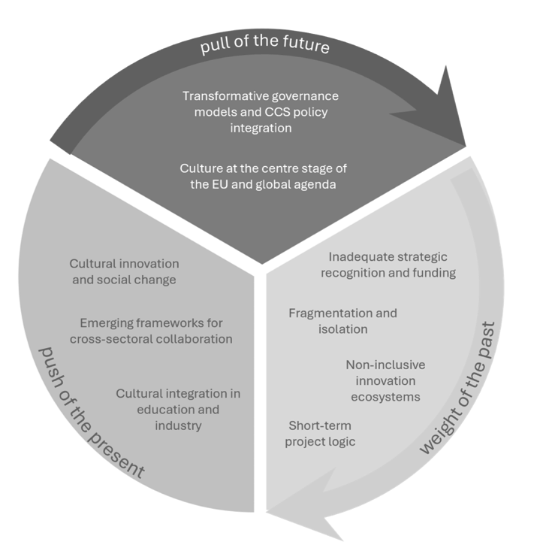
Shifts in international strategic agendas
EU strategic agenda 2024-2029 and the UN Sustainable Development Goals 2030, demonstrate the need for collaborative action to create better futures for societies. (IDEA Consult et.al., 2024)

Slide 9
Social and cultural infrastructure
Spaces, services and structures that bring people together, and that can strengthen the social and cultural fabric of our communities (Berkley et al., 2025)
SPACES
RELATIONSHIP
CONTENT
FUNCTIONS
ACCESS
PRACTICES
libraries
parks
community organisations
museums
religious spaces
cultural venues
events
rituals
trust
identity
belonging
social ties
shared meanings
memories
heritage
traditions
narratives
creative expressions
connection
participation
care
cohesion
learning
representation
resilience
availability
openness
proximity
affordability
inclusiveness
gathering
volunteering
celebrating
commemorating
creating
learning
participating
Notes:
Social and cultural infrastructure refers to the spaces, services and structures that bring people together, and that can strengthen the social and cultural fabric of our communities (Berkley et al., 2025)
This is a concept that encompasses both tangible and intangible elements, including physical spaces and the social networks that are created between people and within communities
It allows people not simply to coexist, but to recognise one another as part of a common world. Culture enters here very clearly. It creates repeated encounters, gives language and form to collective experience, and shapes how people understand themselves in relation to a place, to one another, and to the wider political community.

Slide 10
Why is it important?
Culture and cultural heritage have an impact on social and economic development; it serves as a source of identity and local pride and provides opportunities for social inclusion and collective action (Ozoliņa & Eglīte, 2022)
Culture is part of the foundations of national security, linking it to language, cultural space, identity and collective belonging (LSM, 2025)

Slide 11
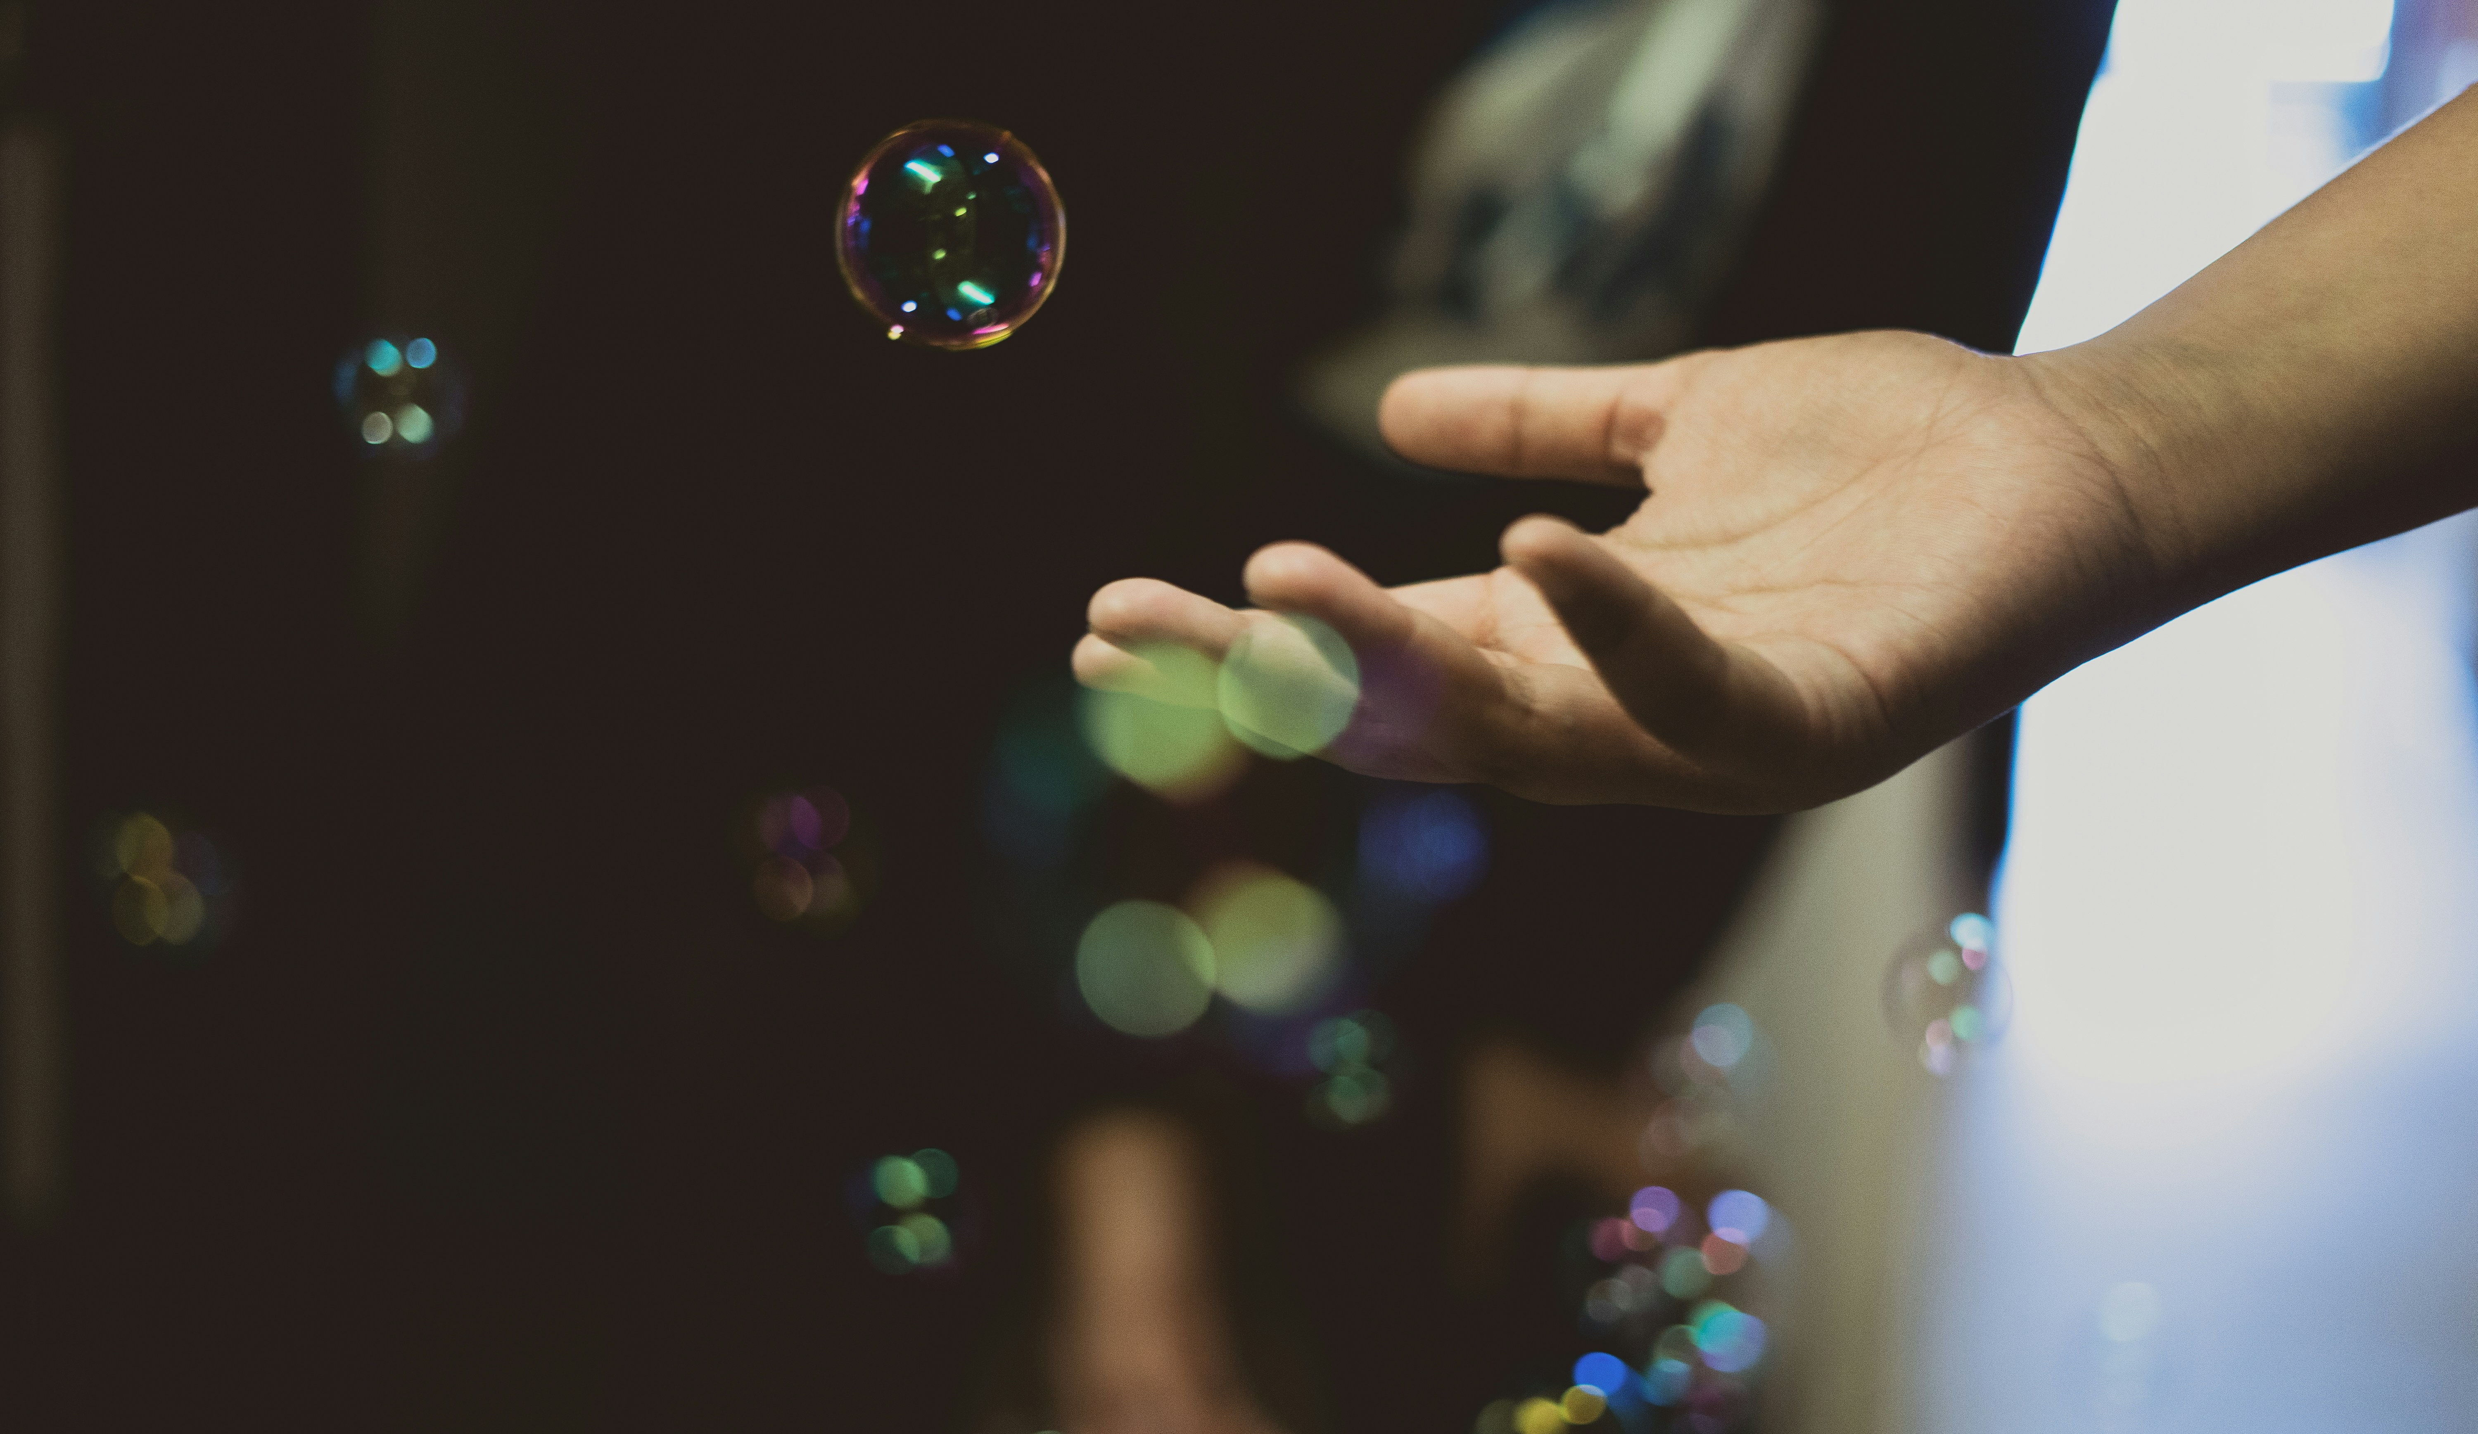
The cultural and creative sector can be understood as social and cultural infrastructure – it helps to produce the conditions under which communities remain participatory, interpretable and socially connected. (Eglīte, 2021; UNESCO, 2022; European Commission, 2025)

Slide 12
Why this matters now: security, resilience and policy change
Resilience – not only as the capacity to absorb shocks, but as the capacity of a society to preserve meaning, solidarity, participation and agency under conditions of stress (European Commission, 2025; UNESCO, 2022)
Culture as a public good, a contributor to democratic resilience, social cohesion, well-being and collective security.
Cultural and creative sector
Social and cultural infrastructure
Sustains trust, belonging, participation and civic capacity
Essential to societal resilience

Slide 13
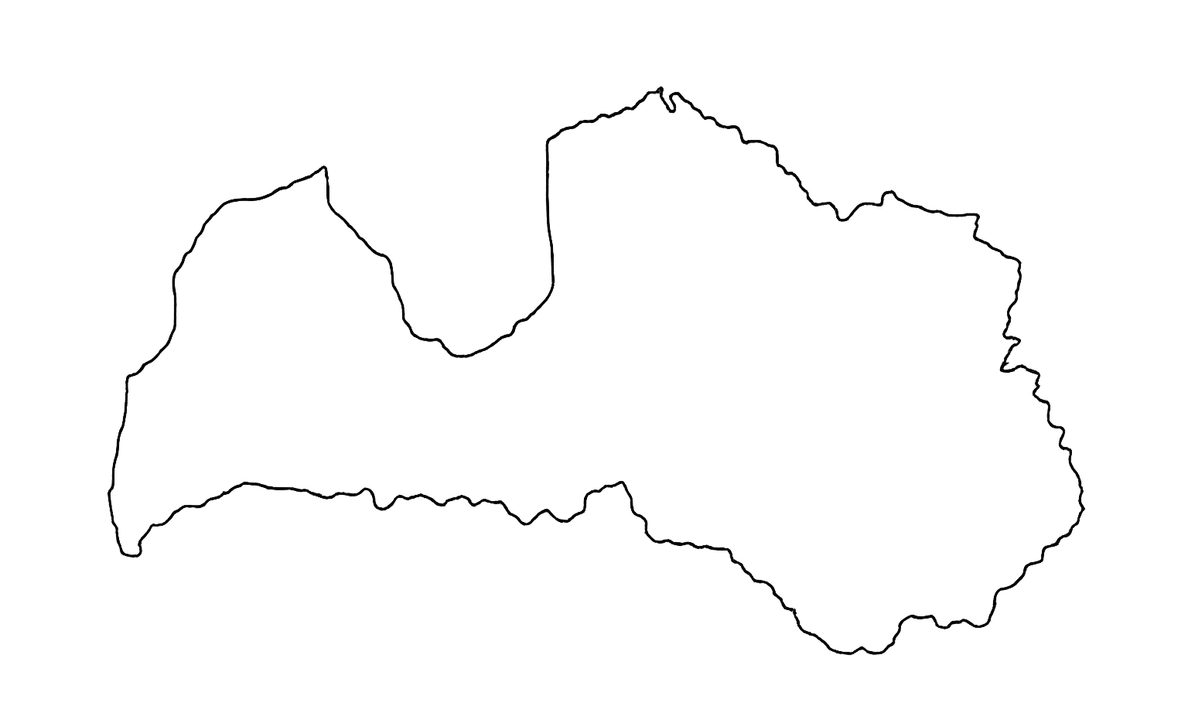
Small cities and rural areas as a place-based context
Demographic pressure, regional inequality, geopolitical proximity and uneven access to services make the social role of culture especially visible.
In small cities and rural areas, culture often remains one of the few systems that still actively produces community life, place attachment and local continuity.
Small-city cultural life is often sustained through formal and informal cooperation networks, shared resources and repeated interaction. In such contexts, culture is not only a sector; it is part of the social environment that makes cooperation possible (Zemīte, Eglīte, & Vinagre de Castro, 2025).

Slide 14
Media literacy as part of resilience
Media literacy should be treated as part of cultural resilience because it concerns how citizens interpret reality, assess trustworthiness and remain connected to democratic information systems in a fragmented and manipulative information environment (Civitta/NEPLP, 2024).
30% trust higher-ranked search results more
60% think government controls how news media portray events in democracies
45% of social media users do not know how to report a fake profile or hate speech
media literacy is therefore a democratic resilience issue
Notes:
Media literacy matters here because resilience is also interpretive. A society may be digitally connected and still remain vulnerable if people cannot distinguish credibility from visibility, do not understand how media independence works, or cannot respond to manipulation in online environments. Latvian data show exactly these weaknesses. That is why media literacy should be treated as part of a broader cultural resilience framework.

Slide 15
Heritage protection as resilience practice
Treating cultural heritage requires preparedness, coordination, risk awareness and response capacity in times of crisis. Latvia’s official plan explicitly frames crisis situations as including natural disasters, human-induced disasters and military conflict. (Ministry of Culture of Latvia, 2025)
The needs related to the digitalisation of cultural heritage have changed: whereas before Russia’s full-scale invasion of Ukraine the purpose of digitalisation was to make heritage more accessible to the wider public, its primary purpose is now preservation. (ibid.)
Already being organised through planning, training, coordination and risk response.

Slide 16
From cultural support to resilience policy
CCS functions as infrastructure – it sustains trust, belonging, interpretation and participation.
In Latvia’s small cities and rural areas, this role is especially visible –greater unevenness in access, institutional density and continuity than larger cities.
Culture helps maintain connection, place attachment and shared meaning under conditions of demographic and territorial pressure.
In a security-driven context, resilience depends not only on defence and systems, but also on social cohesion and democratic orientation across uneven territories.
Heritage protection and media literacy issues show that culture already operates within the wider field of resilience.
CCS should therefore be understood as part of Latvia’s societal resilience infrastructure.

Slide 17

If security policy is concerned with what allows a society to endure, then culture should be recognised as part of it, because it sustains the trust, belonging, literacy and shared meanings through which a society remains socially alive.

Slide 18
Thank you!
zanete.eglite@km.gov.lv / +37128338033

