Slide 1
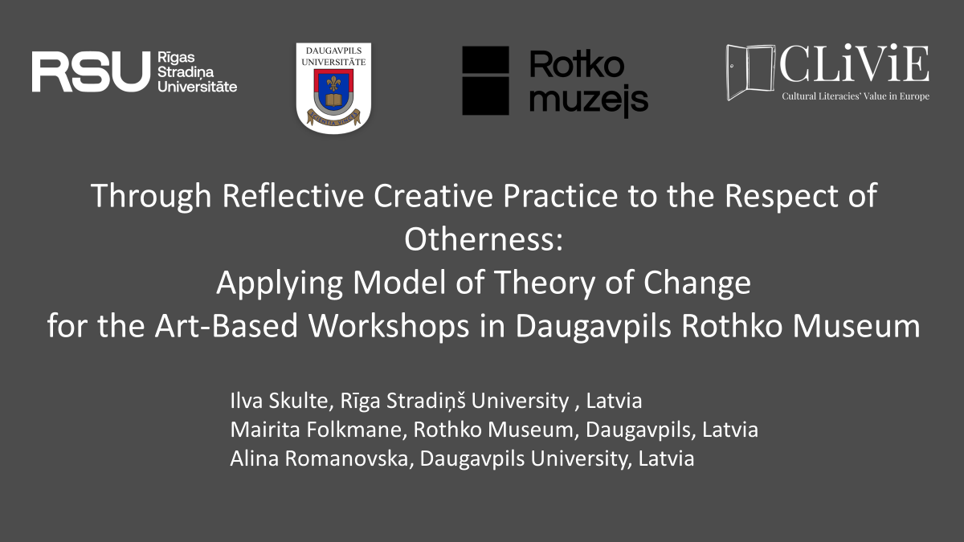

Slide 2
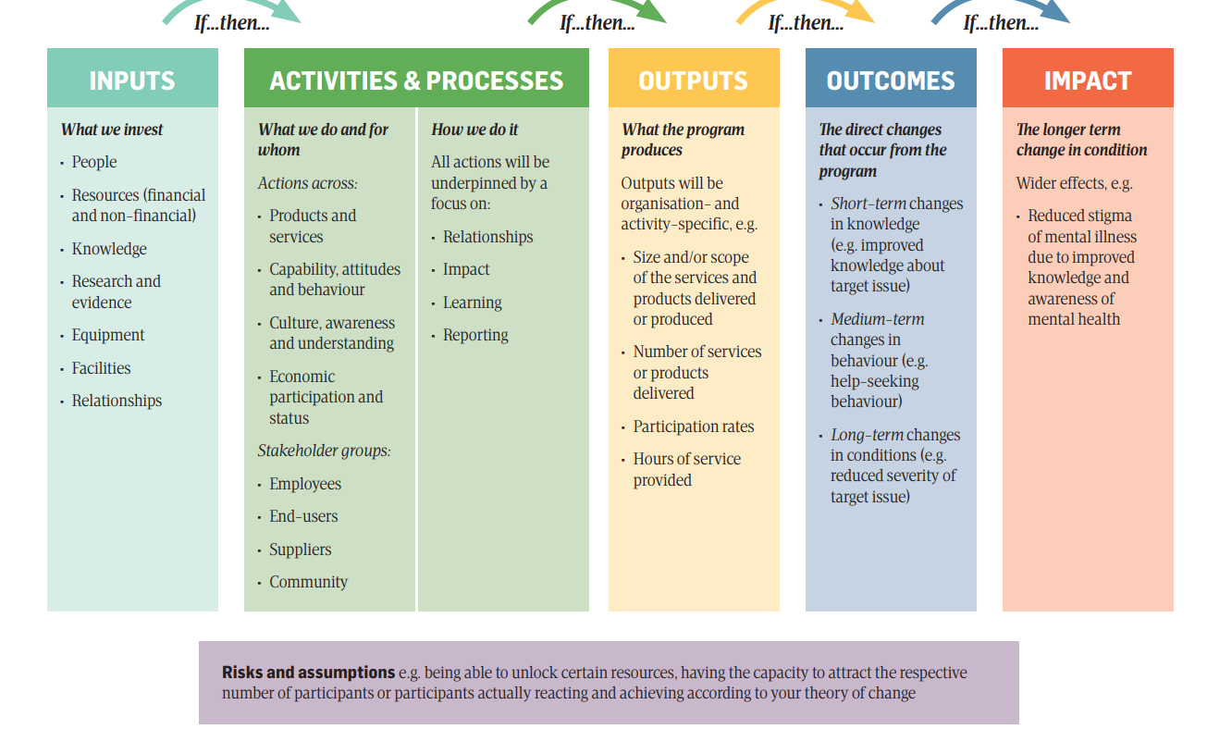
SOCIAL CHANGE >>>>> THEORY OF CHANGE
«Theoretical analysis of change should distinguisg between processes which maintain the equilibrum of a system and structural changes wherein a system moves from one state to another. Structural change occurs when disturbances in or around system are sufficient to overcome the forces of equilibrum. For social systems one source of disturbance is alteration in the relation of the system to its environment which produces the deficits in the input of goal attainment to acting units.»
(Source: Parsons, T. (1961). Some considerations on the theory of social change. Rural Sociology, 26(3), 219.)
Problem of theory based evaluation (Weiss, 1995, 1998)
Source: Ramia, I., Powell, A., Stratton, K., Stokes, C., Meltzer, A., Muir, K. (2021). Roadmap to outcomes measurement. Your step-by-step guide to planning, measuring and communicating social impact. Centre for Social Impact., p. 16.

Slide 3
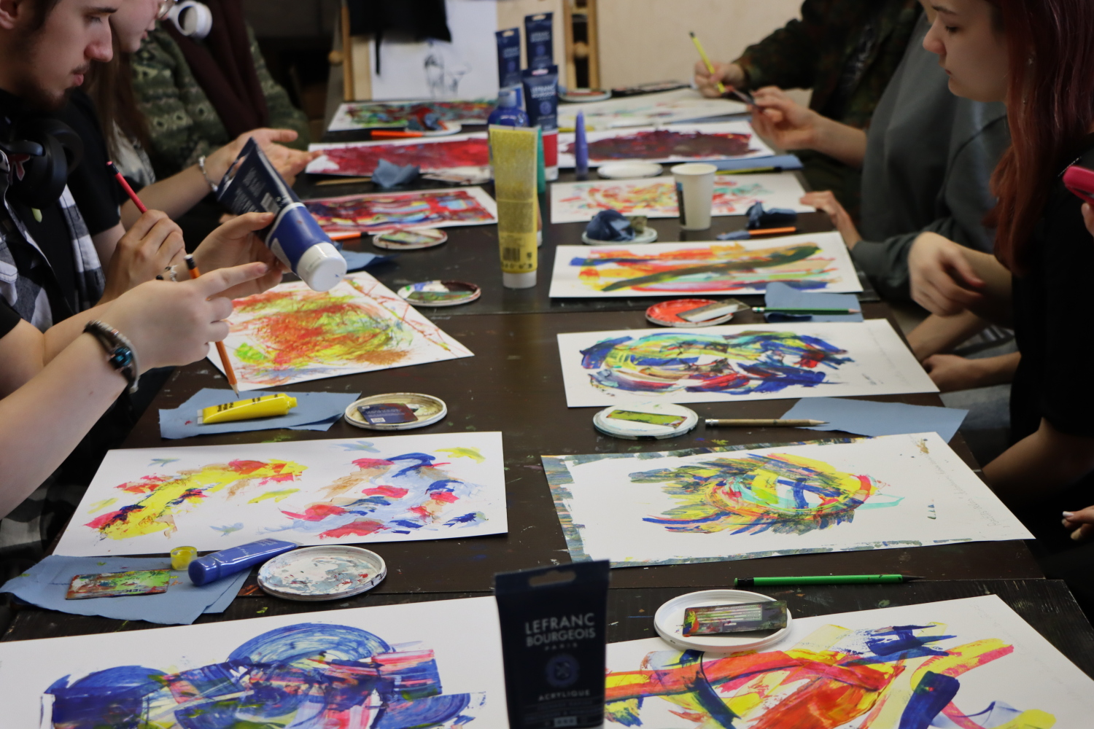
REFLECTION>>>>CREATIVITY>>>>PRACTICE
«The general formula [social contexts + personal concerns] attaches equal importance to both elements in accounting for the extensiveness of reflexivity and its dominant modality.»
Source: Archer, M. S. (2010). Routine, reflexivity, and realism. Sociological theory, 28(3), 272-303.

Slide 4
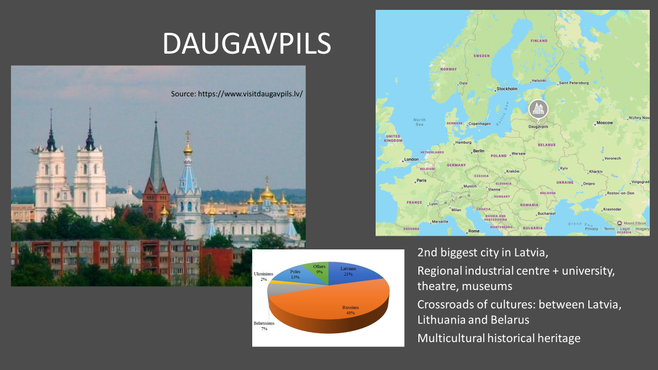

Slide 5
THE CONCEPT OF OTHERNESS/OTHER
«I think, therefore I think the other;
I think, therefore I need the other (to think);
I think, therefore the possibility of friendship lodges itself in
the movement of my thought insofar as it requires, calls,
desires the other, the necessity of the other, the cause of the other at the heart of the cogito.»
Derrida, J. (1993). Politics of friendship. American Imago, 50(3), 353-391.

Slide 6
CASE STUDY AS AN INTERVENTION
Exploration of art as a medium for fostering cultural understanding, collaboration, and social engagement among young people in Daugavpils and the Augšdaugava region.
artistic exploration,
participatory research methods,
cultural attitudes,
engagement,
tolerance
more inclusive and collaborative cultural environment.

Slide 7
WHAT WE WANTED TO ACHIEVE
Intended Impact
Develop and apply values, attitudes, and skills to manage and engage with diverse groups and perspectives
Intended Outcomes
Strengthened intercultural understanding and empathy through artistic collaboration
Enhanced engagement with and understanding of art and museum practice

Slide 8
STAKEHOLDERS
Key groups of stakeholders:
Teachers of culture and art subjects,
Students (16-18 years old),
Cultural workers directly or indirectly involved in the case study,
Leaders of cultural organizations (both state and non-state) and local cultural policymakers,
Researchers.
A meeting was held with representatives of all the identified stakeholder groups to discuss the concept of the case study and establish its priorities.

Slide 9
METHODOLOGY
Methods
Indicators
questionnaires,
semi-structured interviews with stakeholders
focus group discussions with the young participants,
observations,
field notes, photo and video documentation,
attendance records,
exhibition of the participants’ artworks.
[outputs, outcomes and/or impacts of this case study]
Improved participants' mental well-being;
Improved participants' skills development, which affects employment, productivity, and wages in future life;
Improved participation in cultural life;
Promoted social cohesion and improved civic participation.

Slide 10
RESOURCES
Monetary
The CliViE project funding,
Daugavpils municipality funding (e.g., teachers' salaries),
In-kind contributions – the Rothko Museum's financial resources and assets (space, salaries of involved cultural workers, exhibition visit costs).
Non monetary
cultural and educational space (the Rothko Museum).
Rothko Museum’s technical equipment and furniture.
young volunteers from the Rothko Museum
communication, administrative support, and access to institutional networks provided by the Rothko Museum.

Slide 11
INPUTS
Non-monetised inputs:
• Previous collaboration between Daugavpils University and the Rothko Museum
• Emotional engagement of young people
Monetised inputs:
• Contribution of the Rothko Museum's management
• Contribution of the Rothko Museum's cultural workers in leading activities
• Contribution of teachers
• Volunteer work
• Material resources for conducting the sessions

Slide 12
ACTIVITIES> PROCESSES >OUTPUTS
Collaboration with Rothko museum, art college «Saules skola» and local schools
• 5 workshops attended by 30 young people (aged 16-18);
• Pre-survey filled in by the young people
• 5 focus group discussions with the young people
• 3 interviews with stakeholders;
• Exhibition of youth works at the Museums Night 2025;
• Follow-up creative task on belonging to the place where the young people live.

Slide 13
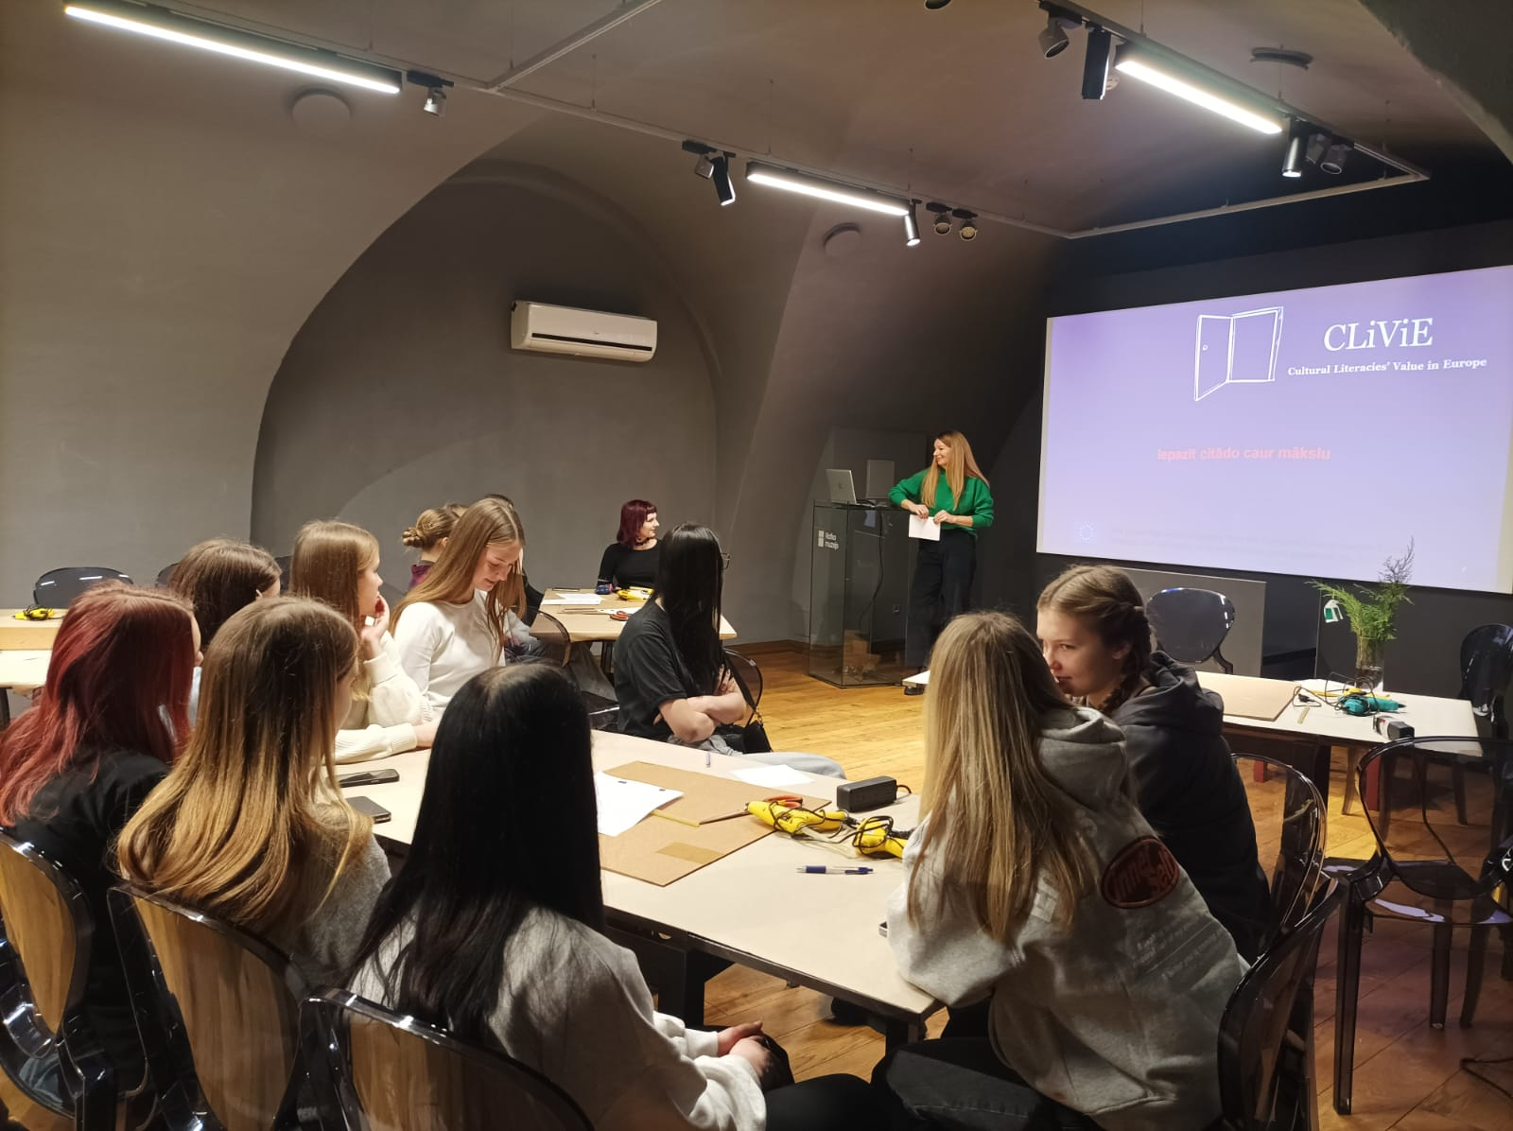
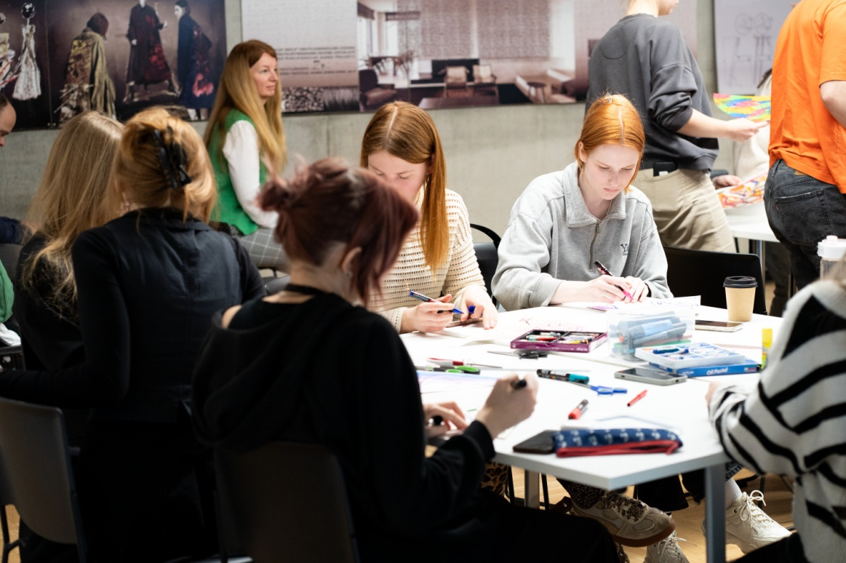
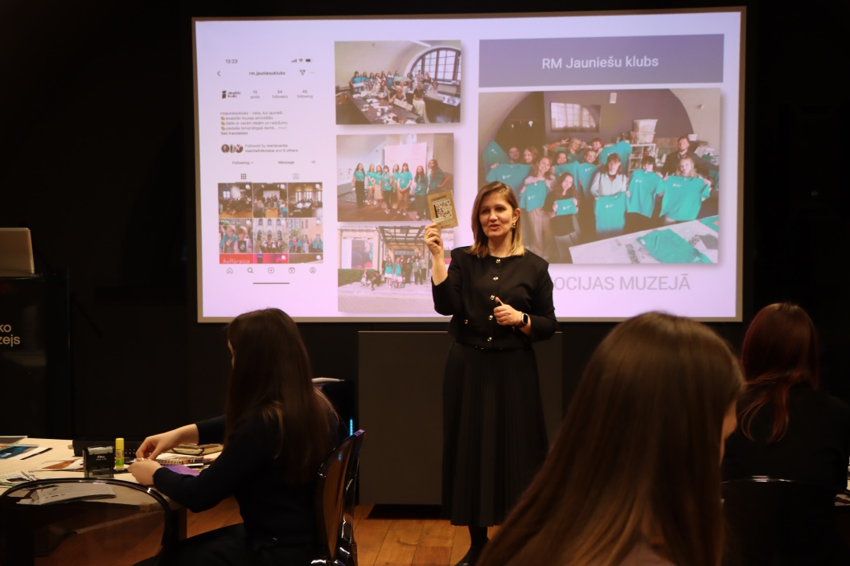
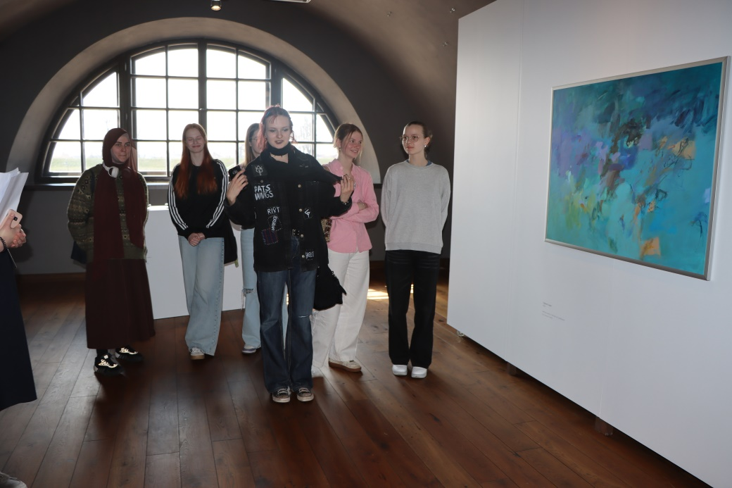

Slide 14
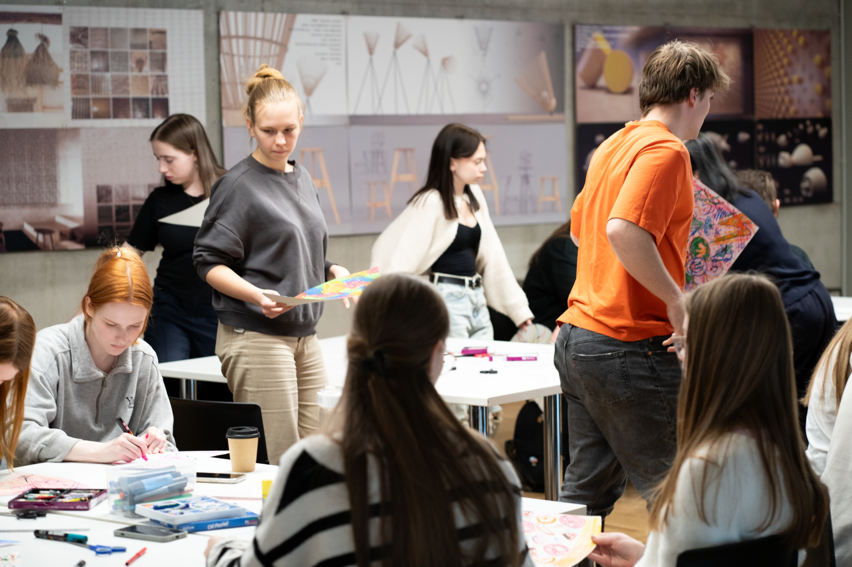
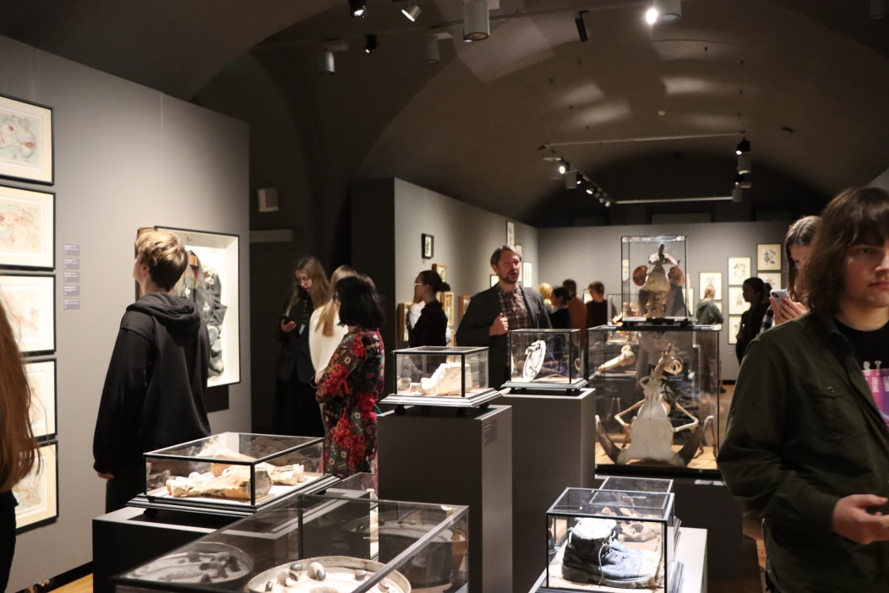
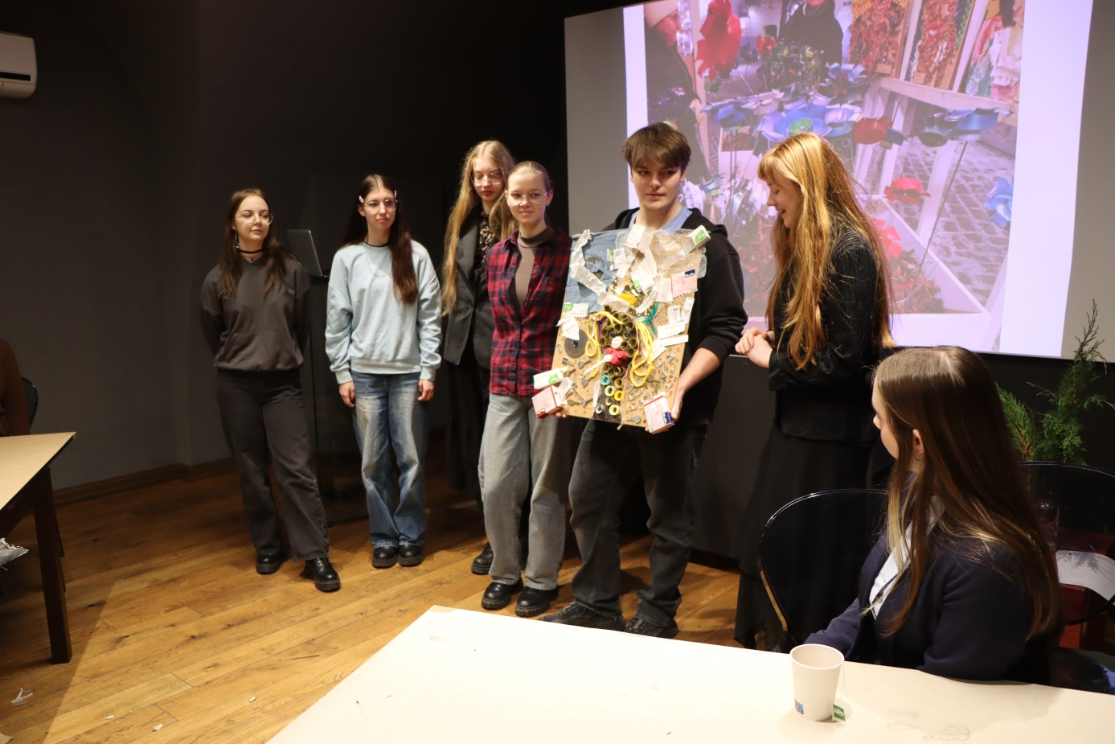
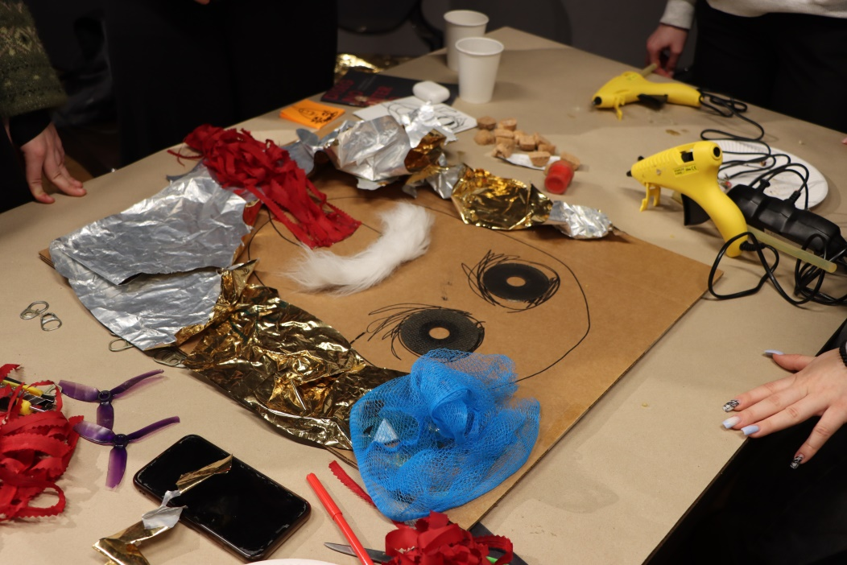

Slide 15
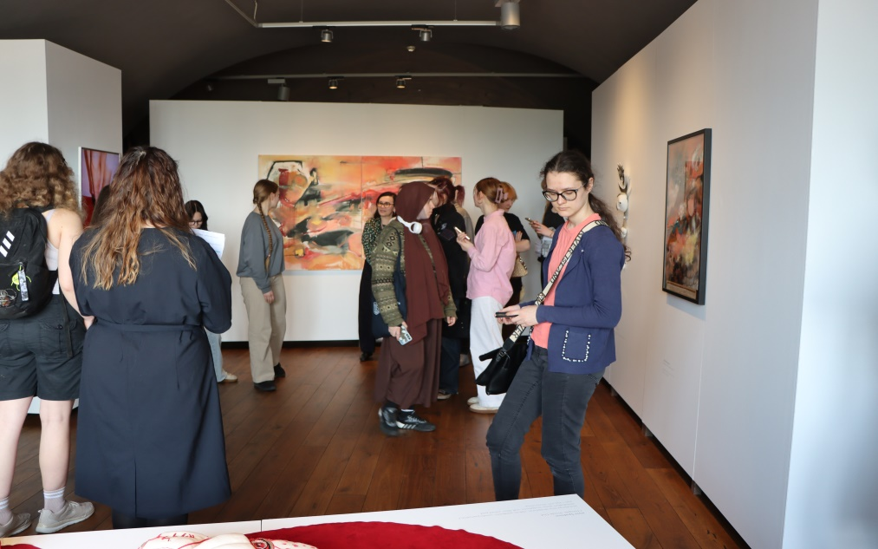

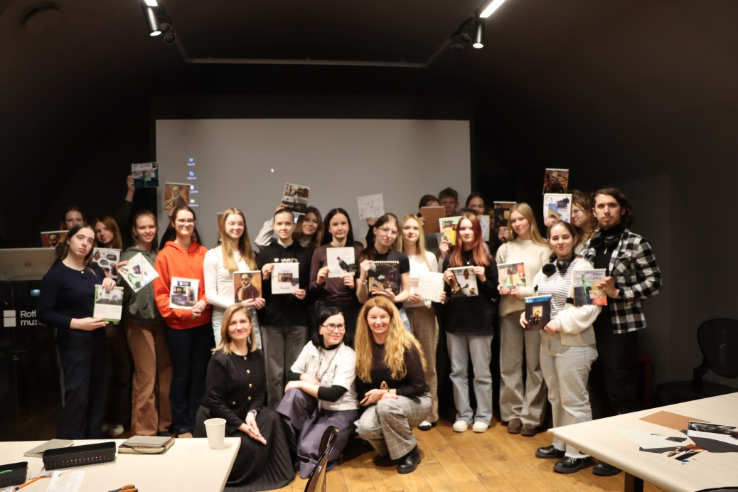

Slide 16
OUTCOMES
• Increased understanding of cultural diversity, identity, and the role of art in society (measured through focus group interviews).
• Greater confidence in engaging with museums and contemporary art practices measured through focus group interviews.
• Improved teamwork, collaboration, and communication skills demonstrated during group activities, measured through focus group interviews.
• Strengthened cooperation between participating schools and the Rothko Museum (measured through stakeholder feedback).
• Positive student perception of museums as relevant community spaces measured through focus group interviews.

Slide 17
IMPACT
• Increased sustained engagement of young people with art and cultural institutions (continued event attendance, enrolment in cultural education, further creative participation).
• Development of values and attitudes supporting empathy, openness to the Other, and intercultural understanding.
• Contribution to a more inclusive cultural environment in Daugavpils through youth participation and institutional collaboration.

Slide 18
CONCLUSIONS
Cultural education (formal and non-formal) field can be seen as having significant resources to be used for social integration of young people from different ethnical backgrounds in Daugavpils.
Theory of Change model is an appropriate tool to develop and evaluate artistic interventions encouraging social change, especially, in the field of social integration. The application of the model allows to identify resources precisely and to plan actions strategically.
‘
Creativity understood as practice with research elements contributes to a deeper understanding of problems and elaborated cognitive change regarding perception of otherness, differences between social groups and the (social) life of community living together in one place.
Critical (self)reflection, deliberation and discussion are important parts of the application of the ToC model regarding impacts of social change (social cohasion of youth in Daugavpils).
Methodology has limitations connected to a potencial subjectivity. To deminish limitations comparative research would be appropriate, and based on this, precision of the criteria and evaluation scales for indicators.

Slide 19

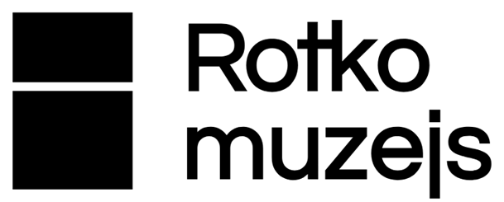


Thank You for Your attention
www.clivieproject.eu

