Slide 1


Promotion of social cohesion through non-formal cultural education: the case study in Daugavpils
Anita Stašulāne, Alīna Romanovska, Irina Presnakova,
Daugavpils University, LATVIA
This project has received funding from the European Union’s Horizon Europe Research and Innovation programme under grant agreement No. 101132285.

Slide 2
Site selection: Daugavpils
the unemployment level has reached 6.7% at the beginning of 2025 (Latgales plānošanas reģions, 2025)
ethnic diversity: 78,3000 residents of whom 46% are Russians, 21% Latvians, 13% Poles, and 20% other ethnicities, including Belarusians, Ukrainians, Lithuanians, and Roma people (Oficiālās statistikas portāls, 2024).
the attitude towards the Russian war in Ukraine in Daugavpils s is certainly ambiguous amongst residents of the city (Ardava-Āboliņa, 2023).
Latvians generally trust and use the media in Latvian, whereas the Russian-speaking inhabitants have preferred the TV channels controlled by the Russian government (Rožukalne, 2022).

Slide 3
Case Study
Activities: | The Other in Art and Life | Together We Rise
Age: | 16-18 (n=30) | 11-13 ( n=25)
Institutional setting: | Non-formal Marko Rothko Museum | Non-formal NGO «HVARAN» Latgale Taekwondo Centre “Jitae”
Art/Cultural form: | Visual Arts and Crafts | Sports and recreation

Slide 4
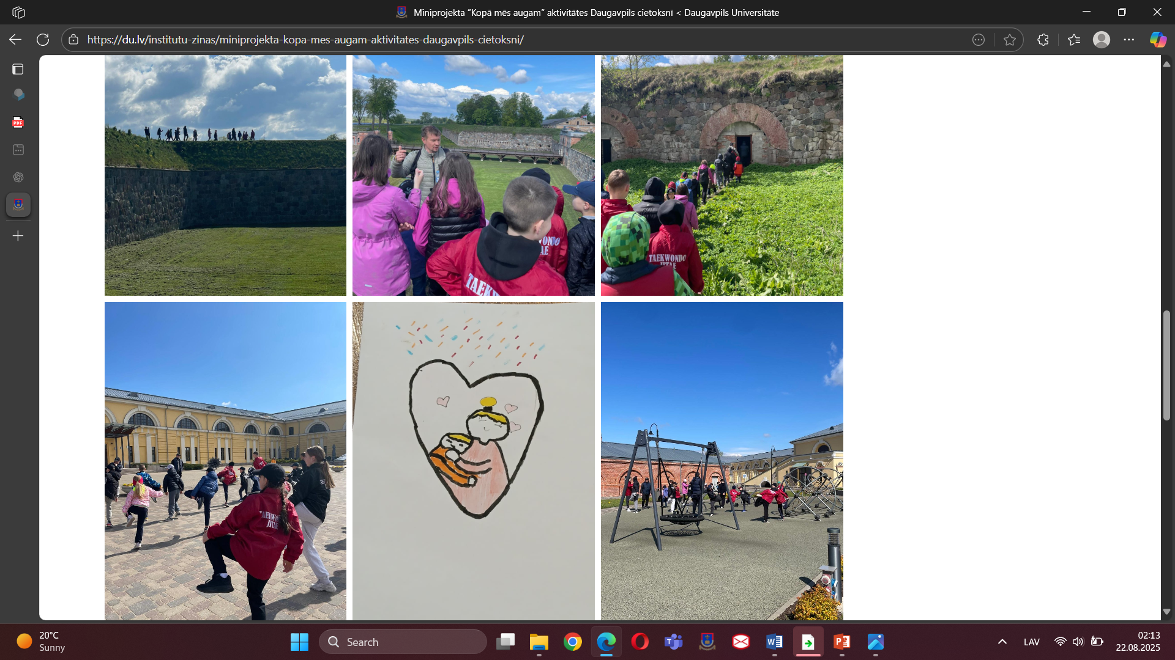
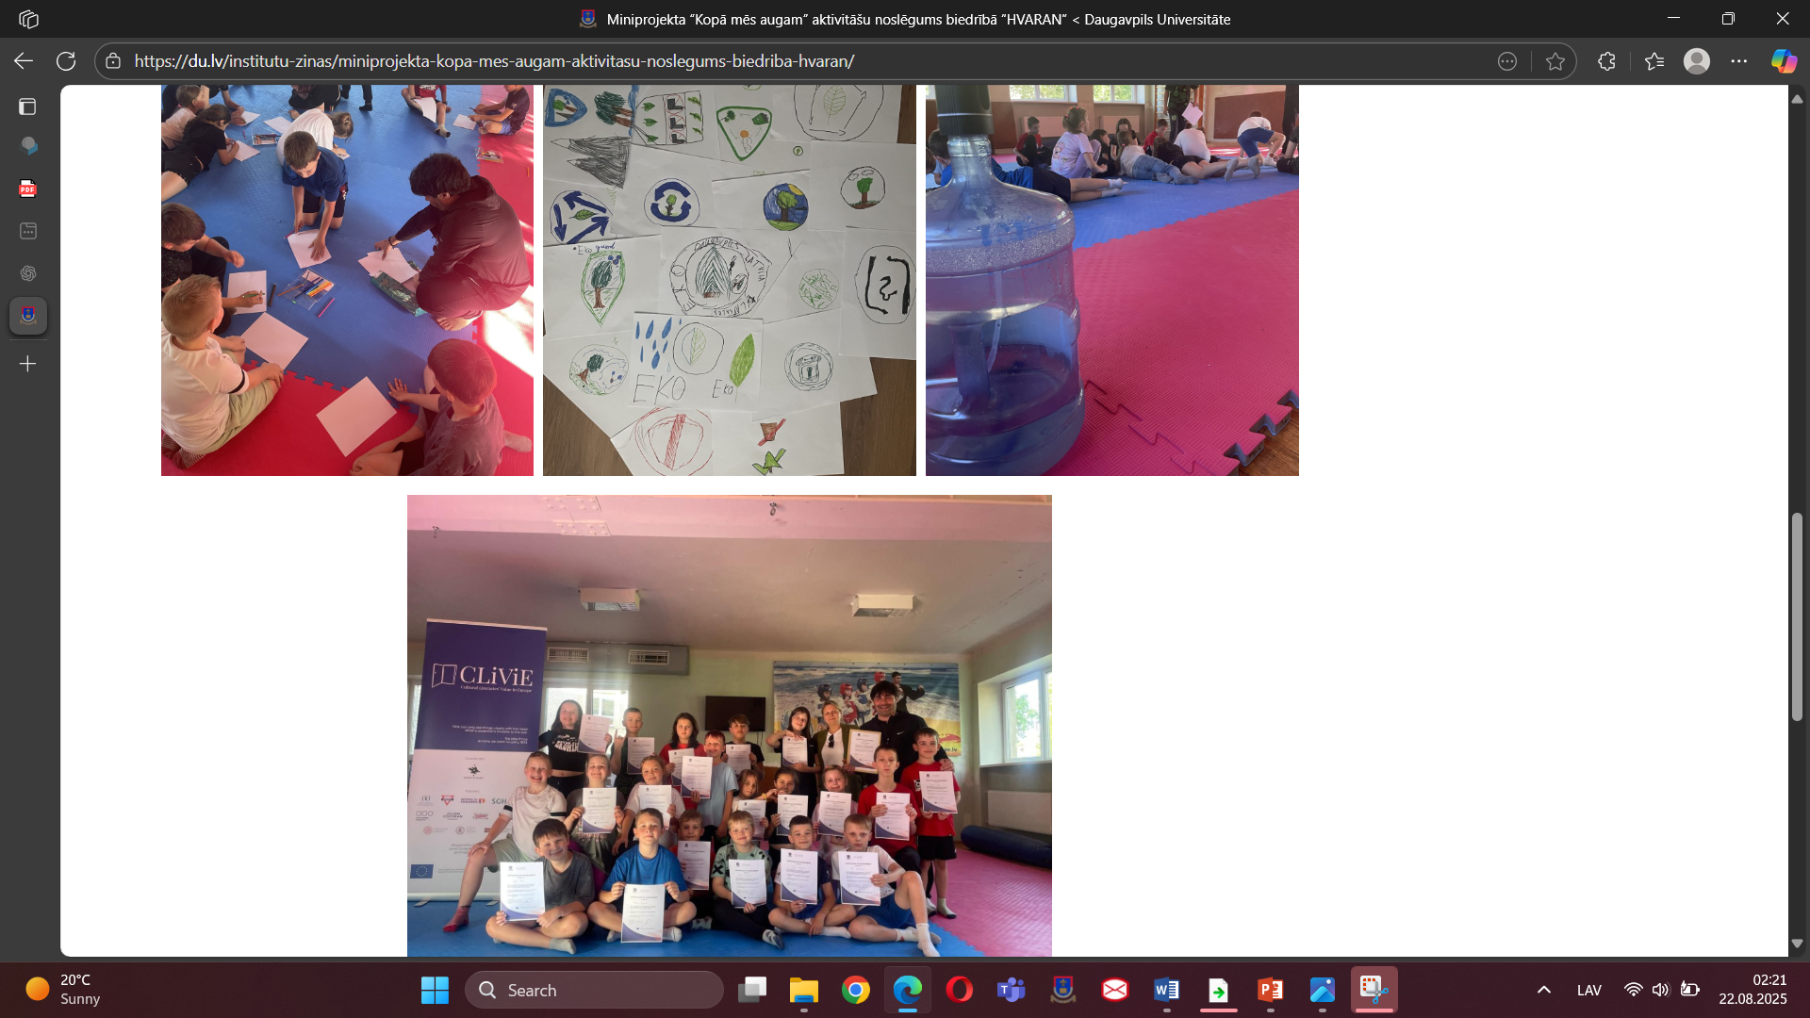
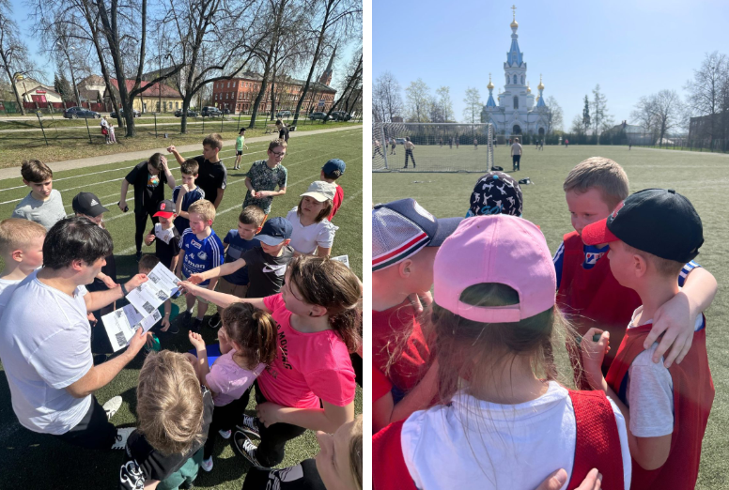
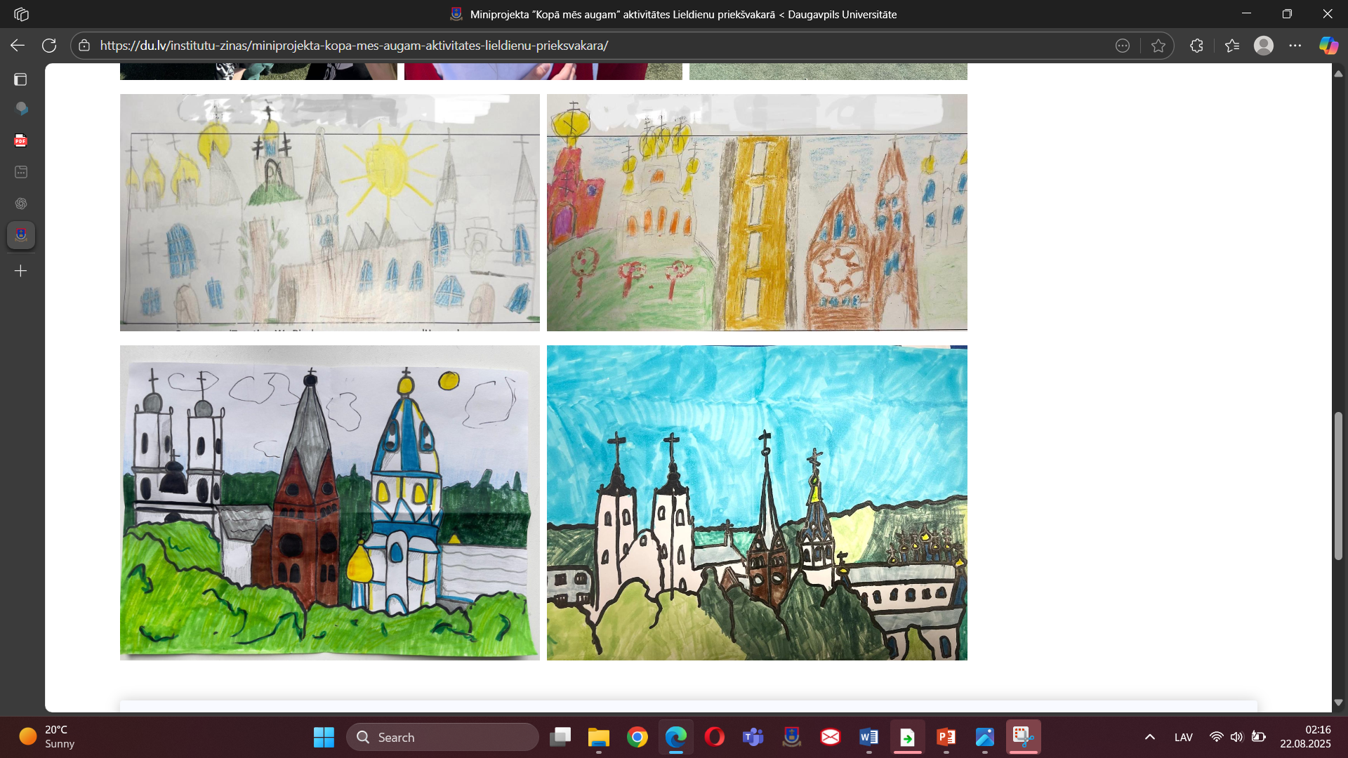
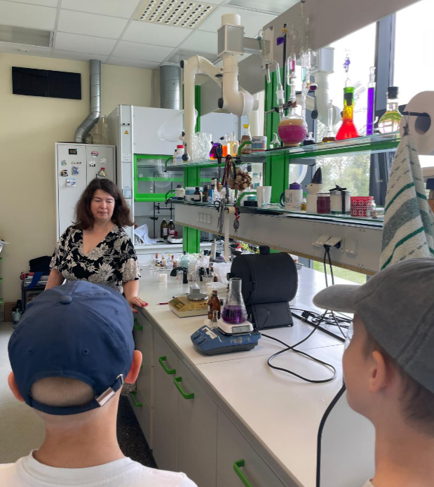
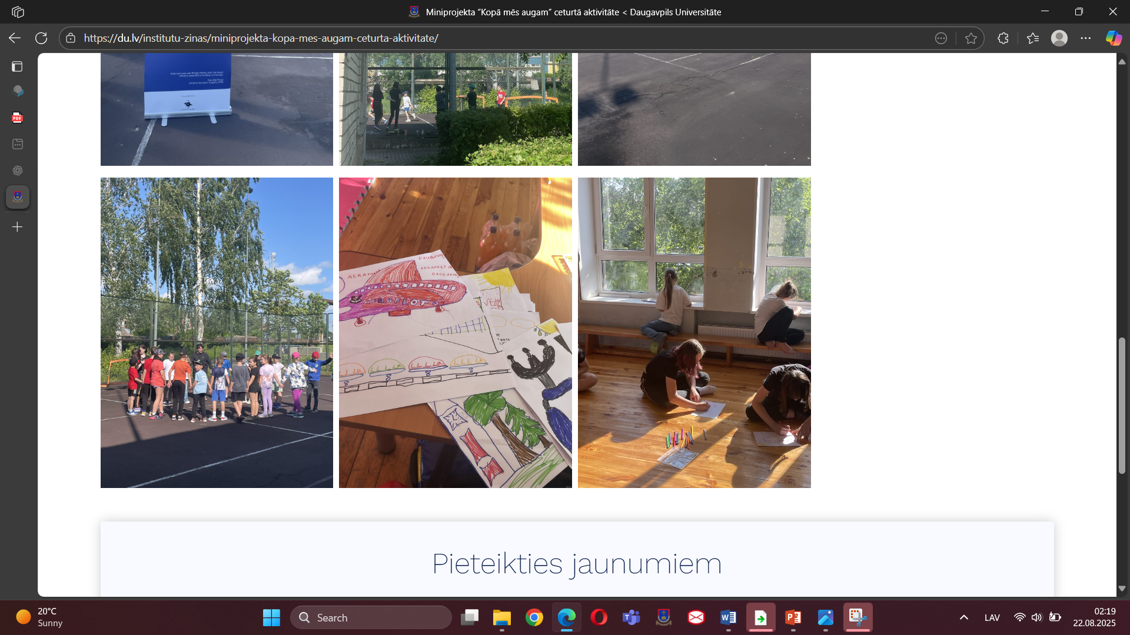
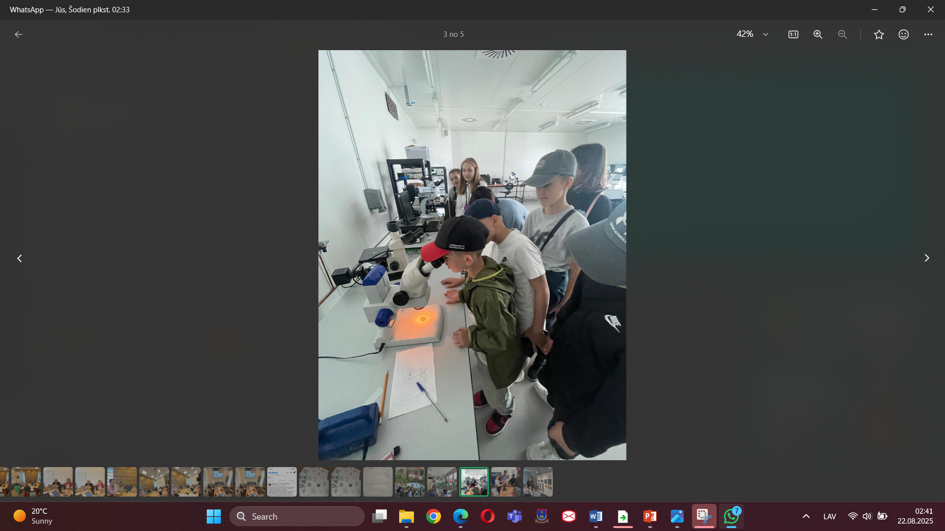
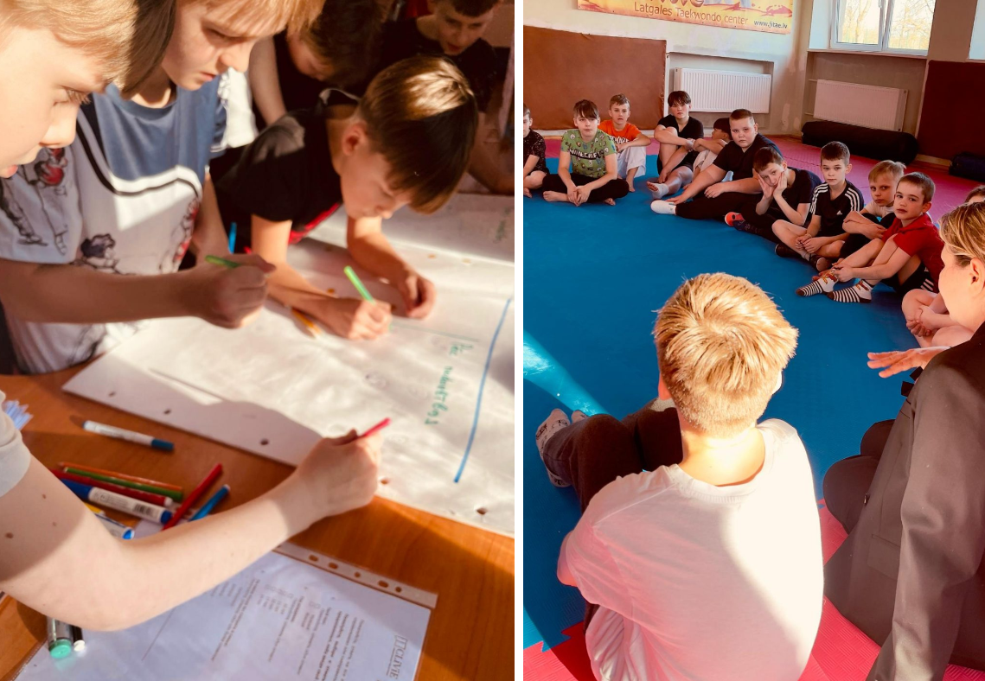
nnn

Slide 5
Towards social cohesion through collective identity building
“We are one team”, reflects an intrinsic connection to a sense of belonging and collective identity, which is essential for their emotional stability and self-esteem.
“We are friends not only at school but also at training”, illustrates the sport’s role as a facilitator of social connections, enhancing their sense of identity and belonging within both their peer group and cultural context.
“Support is there during competitions”, encapsulates the essence of solidarity and communal encouragement inherent in their experiences.

Slide 6
Towards social cohesion through collective identity building
The role of cultural education in early childhood (Banks, 2016; Rogoff, 2003).
Since social cohesion is built through the strengthening of relationships, trust, solidarity, and a sense of belonging within a group and society, non-formal cultural education provides a significant contribution to fostering these elements by creating inclusive spaces for participation, shared experiences, and mutual understanding.
The interviews with young people reveal a significant intertwining of sports education with the development of shared experiences, and mutual understanding.
The participation in team sports fosters social responsibility and ethical behaviour (Fraser-Thomas, 2005).
Research indicates that social bonds formed through shared activities are crucial for fostering a sense of belonging (Baumeister & Leary, 1995).
“Sport often provides the social glue that binds individuals together through shared experience and collective identity.” (Donnelly et al. 2011, p. 593) )
That said, the narratives derived from the children's interviews encapsulate the multifaceted benefits of participating in sports, addressing not only emotional and cultural education but also the cultivation of lifelong values and social networks.
As evidenced by the interview data, participants developed greater self-confidence, strengthened their social networks, and fostered a stronger sense of community belonging.

Slide 7
Towards social cohesion through intercultural dialogue
communicative and cognitive in nature;
new cognitive avenues in relation to themselves and others;
YP reflect on:
their own beliefs,
values,
assumptions,
YP gain new perspectives on:
others’ cultures,
identities,
experiences,
YP expand their thinking by considering viewpoints they may not have encountered before;
intercultural dialogue invites to re-think heritage and to build inclusive identity

Slide 8
Conclusions
Non-formal cultural education:
creates inclusive spaces for participation, shared experiences, and mutual understanding;
cultivates lifelong values and social networks;
encourages co-learning, collaboration and learner agency;
fosters an inclusive identity, serving as the foundation for effective intercultural dialogue;
fosters critical awareness, empathy and the ability to navigate diverse social environments;
offers an important foundation for strengthening social cohesion.

Slide 9


LinkedIn / @CLiViE Project - Cultural Literacies’ Value in Europe
Facebook / @Cultural Literacies’ Value in Europe Project
Instagram / @clivieproject
www.clivieproject.eu

