Slide 1

Film Literacy in Latvia
Experience and Lessons from the Film FLOW ('Straume’)
Dr.Art Dita Rietuma, LAC, RSU, National Film Centre of Latvia

Slide 2
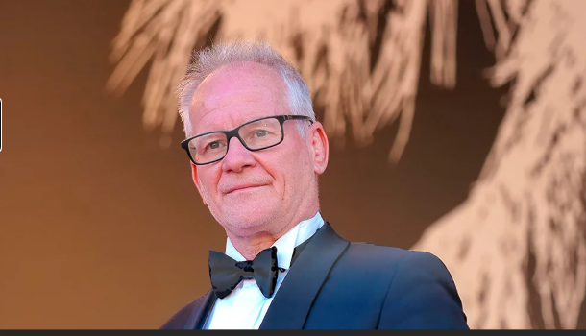
Film Literacy
European context
Policy
Latvia’s examples
Film language is everywhere, even on Instagarm.
Thiery Fremaux, 2026
Then why we still struggle to teach the film language and to implement
film literacy in the educational system?
Notes:
Intro presentation

Slide 3
What is a Film Literacy?
Understanding film, critical viewing, creative production
‘The level of understanding of a film, the ability to be conscious and curious in the choice of films; the competence to critically watch a film and to analyse its content, cinematography and technical aspects; and the ability to manipulate its language and technical resources in creative moving image production’
European Comission. Screening Literacy: Executive Summary. 2013
Notes:
Quote: level of understanding… critically watch… create moving images

Slide 4
EU Policy Context
Term film literacy appears in several European Commission and EU-related documents and studies, especially from around 2011–2015 within audiovisual/media policy and education contexts.
In July 2011, the European Commission published an invitation to tender for a European-scale experts’ Study on film literacy in Europe, asking for evidence-based recommendations to inform policy making in the forthcoming Creative Europe framework.
The European Commission’s definition of film literacy from the original tender specification:
‘the level of understanding of a film, the ability to be conscious and curious in the choice of films and the competence to critically watch a film and to analyse its content, cinematography and technical aspects’.
The tender specified coverage of the formal, informal, and audio-visual sectors in film education (but not including Higher education).

Slide 5
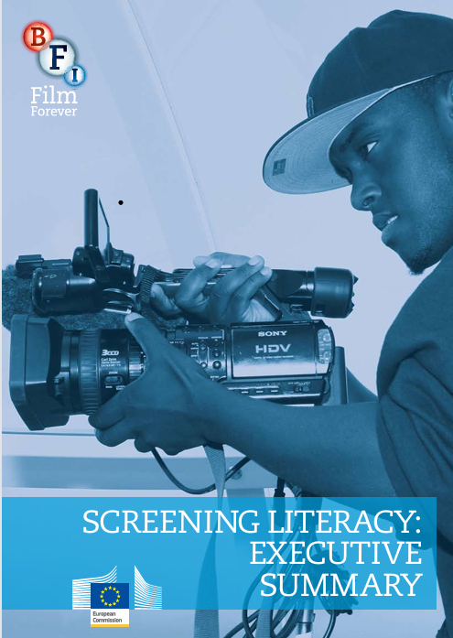
EU Policy Context
The tender was won by a consortium of UK and European partners, led by the British Film institute. Report Screening Literacy: Film Education in Europe (2013)
Authors: Mark Reid, British Film Institute, and Andrew Burn, London University institute of Education.
British film institute is the governmental body responsible for the film policy and subsidies for the film industry.
-------------------
It is important to note, that governmental film institutions (not universities) were the ones that, during the given time period, brought the issue of film literacy to the forefront.

Slide 6
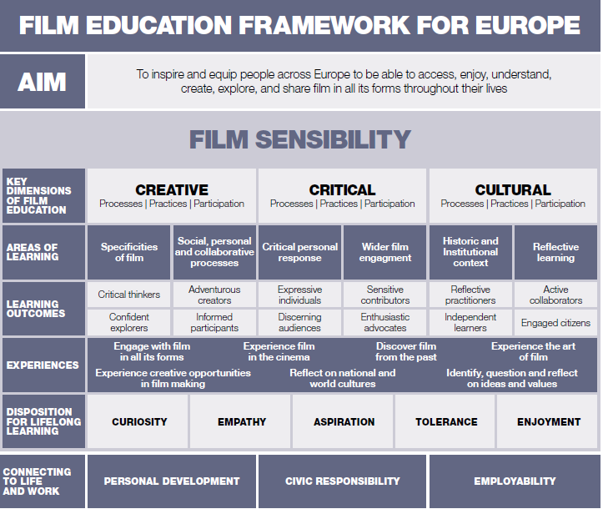
AIM: To inspire and equip people across Europe to be able to access, enjoy and understand, create, explore and share film in all its forms through their lives

Slide 7
Findings and challenges
Where does film education happen?
In the school curriculum; after school; outside school
School curriculum is central to European policy because it is the main area where states can ensure access for all students. Findings show that film education is usually integrated into other subjects, which can weaken its quality and visibility.
Only rarely is film education a separate subject in the core curriculum, and this occurs in very few countries and education levels.

Slide 8
14 Recomendations
Draft a model of film education for Europe, including appreciation of film as an art form, critical understanding, access to national heritage, world cinema and popular film, and creative film-making skills.
Recommendation to adpot revised definition of film education /../:
WHAT IS FILM EDUCACTION?:
‘The level of understanding of a film, the ability to be conscious and curious in the choice of films; the competence to critically watch a film and to analyse its content, cinematography and technical aspects; and the ability to manipulate its language and technical resources in creative moving image production

Slide 9
Recomendations
Establish a Film Literacy Advisory Group (FLAG) to develop the model and guide implementation.
Support policy exchange between countries
Create a “translation fund” for sharing best practices and training.
Strengthen film education in schools
Ensure provision at primary & secondary levels and track participation/data.
Provide curriculum guidance
Define minimum standards, teaching methods, and links to arts/media education.
Fund outreach programmes
Especially in newer EU member states, based on successful models.
Promote industry–education partnerships
Support learning materials, industry access, and free educational screenings.
Clarify archive use in education
Provide guidelines on licensing and copyright for classroom use.
Support adult film education
Target diverse, migrant, and older audiences.
Create EU online resource bank. Share best practices and teaching materials.
Include film education in teacher training
Integrate into initial teacher education programmes.
Provide in-service teacher training guidance
Share best practices across the EU.
Develop advanced training programmes
Support collaborative, accredited (e.g. Master’s-level) courses.
Research and guide funding levels
Define minimum investment and effective funding strategies.
Reid, M, Brun, A. Screening literacy: Executive summary, 2013

Slide 10
EU Goal
Build audiences
Support European cinema
Promote heritage
Calls for proposals for EU action grants in the field of the MEDIA strand under the Creative Europe Programme - Audience Development and Film Education
Different projects supported by Creative Europe Media.
Problems: fragmentation, limited time freame etc.
Notes:
Quote: build long term audience

Slide 11
Strong Example: France
National system supported by CNC.
The national “Ma classe au cinéma” is generally estimated at: €20–30 million per year
Concept: introduce children to cinema as an art form since 1994
regular cinema access during the school year
Around 2 million students participate annually
Each student attends ~3 screenings per year
Cinema as digital detox!
Notes:
France example

Slide 12
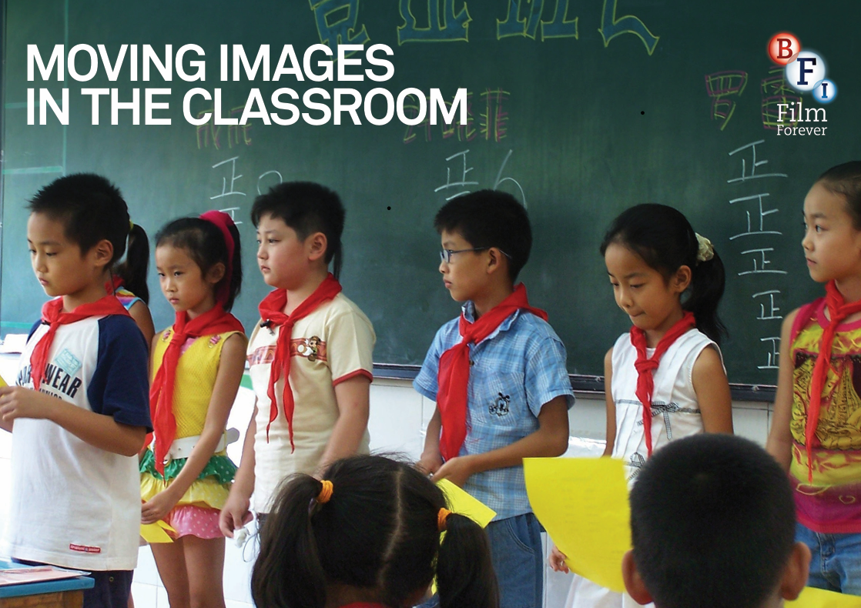
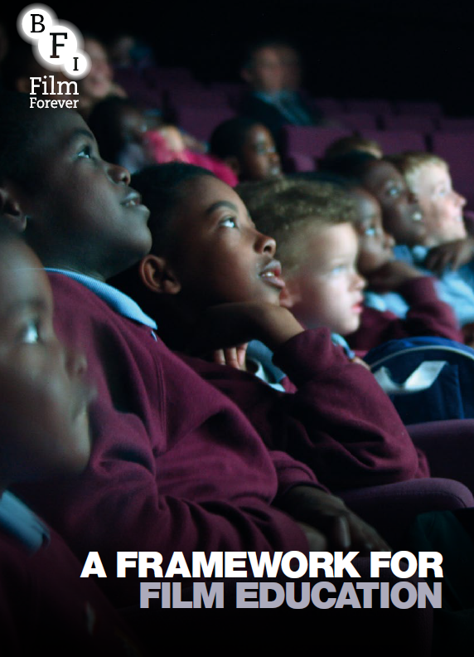
Strong Example: Great Britain
Several tutorials by BFI.
The eight basic techniques designed to help unravel the codes and conventions of the moving image, and enable to use a wider range of film and moving image texts in the classroom.
Moving Images in the Classroom. Tutorial by BFI, 2019
British Film Institute. Moving Images in the Classroom. 2019
British Film Institute. A Framework for Film Education, 2014

Slide 13
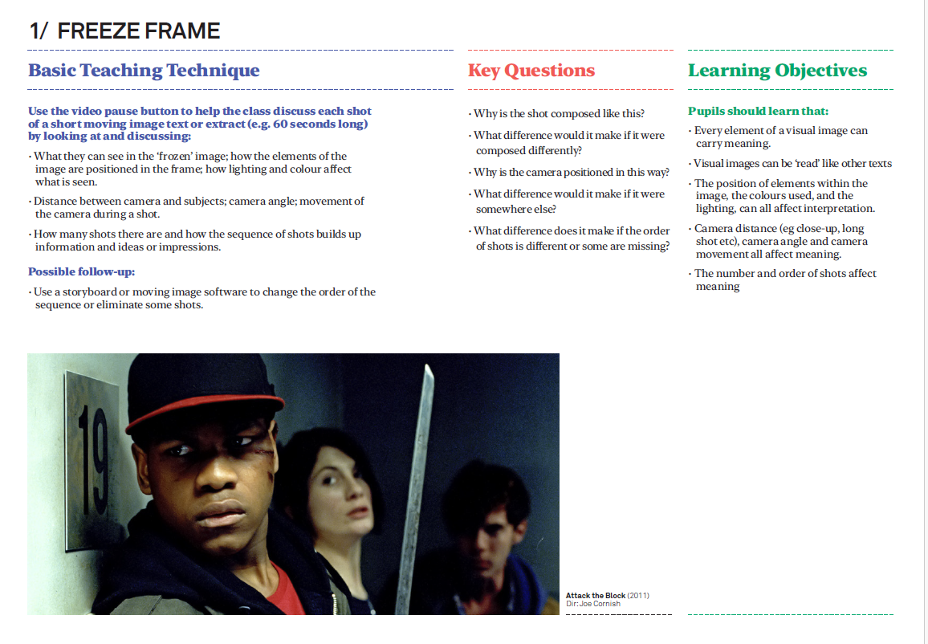
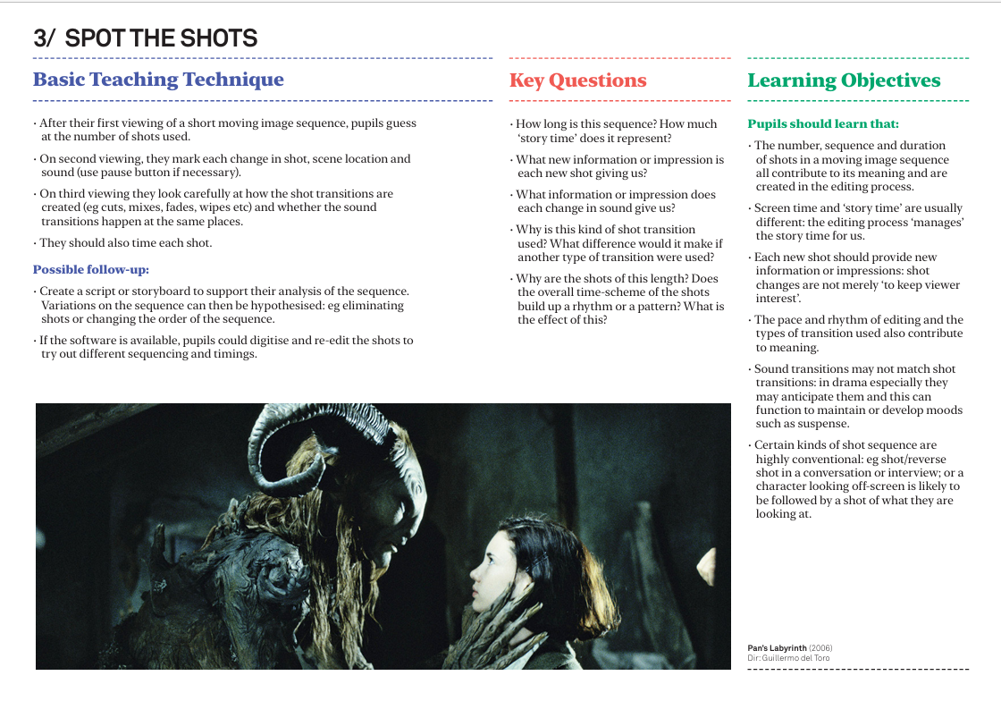
Moving Images in the Classroom
The first three techniques concentrate on the language of the moving image
Technique 1, Freeze Frame, concentrates on the visual language of moving images.
Technique 2, Sound and Image, helps pupils (students) see how important sound is in the interpretation of moving image texts.
Technique 3, Spot the Shots, draws their attention to the editing
Techniques 6, 7 and 8, deal with the ways in which moving image texts are produced and circulated to audiences.
Generic Translations,
Crossmedia Comparisons and
Simulation, offer more substantial classroom activities to explore ways of making changes to moving image texts and relating them to other media
British Film Institute. Moving Images in the Classroom. 2019

Slide 14
Latvia. Context
Cultural policy
Audience development
Notes:
Latvia overview

Slide 15
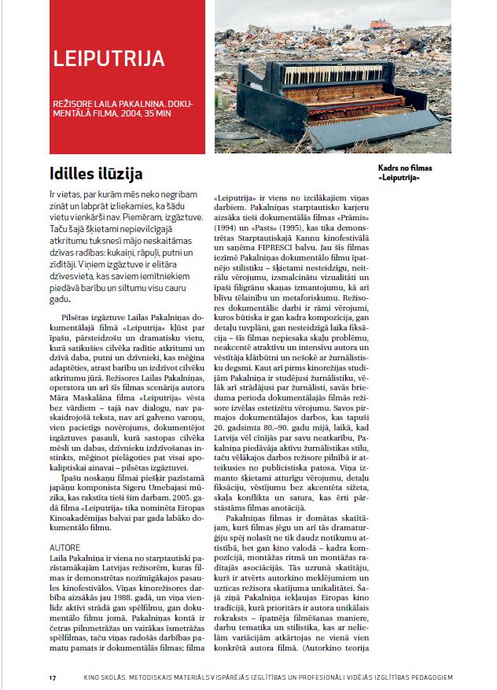
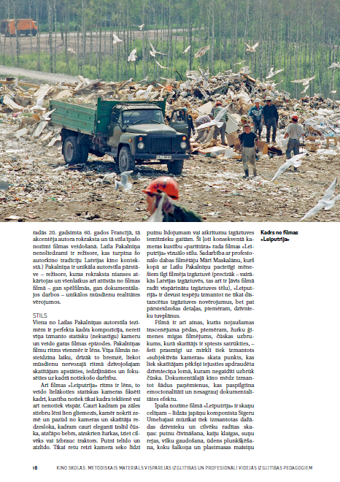
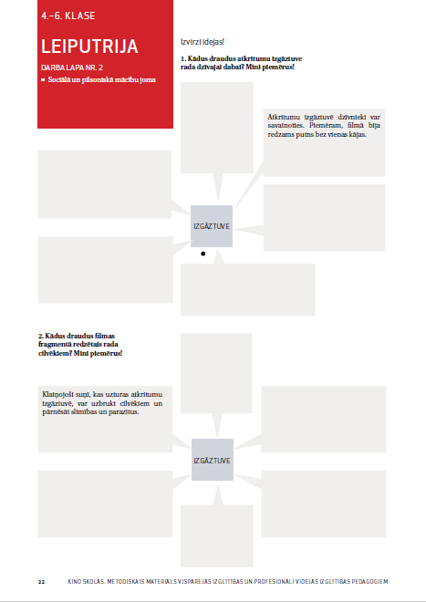

Kino skolās (Film in Schools - since 2015)
Teaching materials on 63 Latvian films – fictions, documentaries, animnation
Available on Filmas.lv – platform of National Film Centre of Latvia (Ministry of Culture)
1500 registered teachers in Latvia and abroud (diaspora)
Notes:
Programme explanation

Slide 16
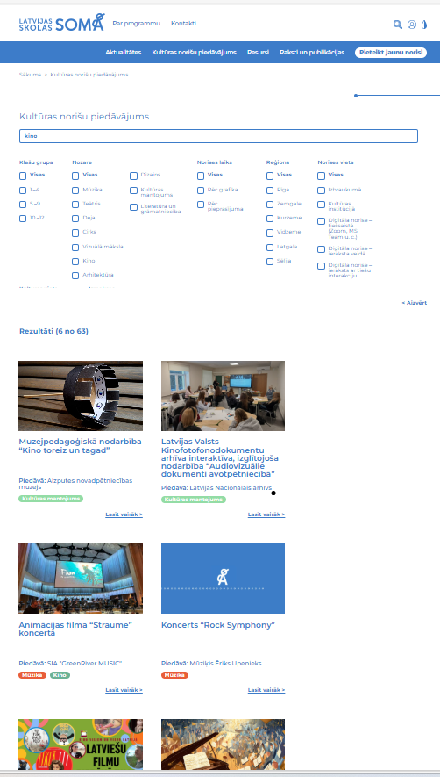
Latvijas skolas soma (Latvian School Bag - since 2018)
Since 2018
Cultural access. Ministry of Culture, Nacionālais kultūras centrs.
230k students/semester
2026: 63 film related activities available (activities provided by NGO’s, independent cultural managers etc.)
Demonstrates a relevant impact as an audience development tool.
2025: 23 000 admissions, 37 filmas (28 – Latvian films).
Notes:
Programme importance

Slide 17
Challenges
Limited institutional resources by instiitutons of the Ministry of Culture
Ignorance of the Ministry of Education – absence marginalisation/absence of film within the formal curriculum.
Film is frequently employed as a pedagogical tool to support the teaching of other subjects, rather than being studied as a discipline in its own right.
Teachers often lack the necessary skills, training, and critical awareness to engage with film as a distinct medium and artistic form.
New reality with the dominance of the social media and futher marginalisation of film as art form and media.
Notes:
Film often marginal

Slide 18


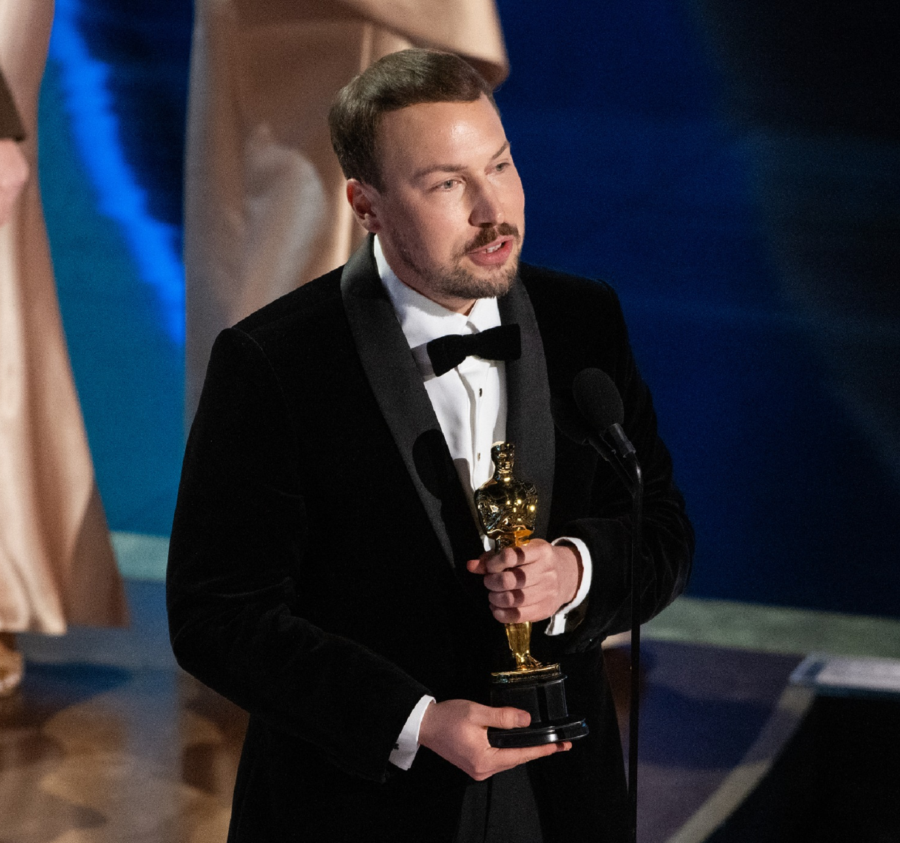
Case study: Flow (2024)
Latvian success with a global reach
Visual storytelling: understanding that visual, film images can be ‘read’ like other texts
Freeze frame and anayze film language elements: composition, framing, colors, lightning, camera distance, the number of shots effect. Every element of a visual image can carry meaning.
Sound effects: music, sound effects, voice and silence.
Spot the Shots: the pace and rhythm of editing and the types of transition used also contribute to meaning.
Notes:
Example analysis

Slide 19

Top and tale: Information about who made the film,who financed it, and who owns it, can alert you to the interests it represents
Attracting audiences: Marketing and promotional strategies are central to most of the moving image industries.
Simulation: Most moving image texts are produced within editorialand institutional constrains: time, budget, context, purpose etc.

Slide 20
Thank You
European Comission. BFI. Screening literacy: Executive Summary, 2013. Available: https://www.europacreativamedia.ca
British Film Institute. A Framework for Film Education, 2015. Available: Film education research and advocacy | BFI; https://www.bfi.org.uk/
British Film Institute. Moving Images in the Classroom, 2019. Available: Film education research and advocacy | BFI, https://www.bfi.org.uk/
Nacionālais kino centrs: Kino skolās. Aivailable: https//www.filmas.lv
Nacionālais kultūras centrs. Latvijas skolas soma. https://latvijasskolassoma.lv
Notes:
Closing

