Slide 1
Vaccine and SAMT-247 continuous released by intravaginal ring (IVR) decreased the risk of SIV acquisition in macaques
Mohammad Arif Rahman
Staff scientist
Dr. Franchini’s lab
AMRVS/NCI/NIH
11.21.2024

Slide 2
Completed Phase IIb/III HIV vaccine efficacy trials
Hypothesis
tested :
Binding Abs
Binding Abs
Passive VRC-01 transfer
Binding Abs
CD8
CD8/CD4
CD8/CD4
Neutralization + ADCC
1995
2000
2005
2010
2015
2023
Futile vaccine trials
VAX004 & VAX003
7x gp120/Alum
STEP
Phambili
Ad5-HIV
HVTN-505
DNA-HIV
Ad5-HIV
HVTN-702
ALVAC-HIV
gp120/MF59
HVTN-705/
HVTN-706
Ad26.Mos.HIV gp140/Alum
HVTN-704
HVTN-703
RV144
ALVAC-HIV gp120/Alum
31.2% vaccine efficacy
Flynn et al. J Infect Dis. 2005.
Pitisuttithum et al. J Infect Dis. 2006.
Buchbinder et al. Lancet. 2008.
Rerks-Ngarm et al. NEJM. 2009.
Hammer et al. NEJM. 2013.
Gray et al, NEJM. 2021
Corey et al. NEJM. 2021.
Notes:
There are several vaccine efficacy trials. However, only RV144 showed moderate vaccine efficacy

Slide 3



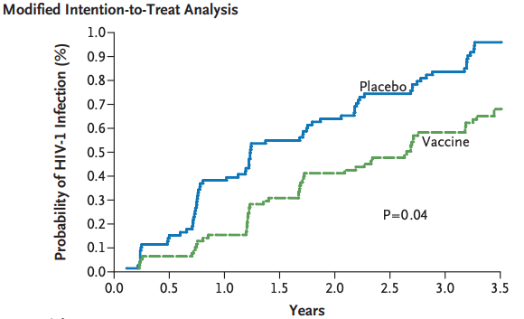
The SIV_{mac251} model produces a similar result to the RV144 human trial
RV144 Trial
ALVAC
gp120/Alum
ALVAC
0
4
12
24
Weeks
Dr. Franchini’s macaque studies
Males & Females
Females
RV144-Vaccine efficacy 31.2%
Vaccine efficacy 44%
Vaccine efficacy 50%
Rerks-Ngarm et al. N Engl J Med, 2009
Vaccari et al. Nature Medicine, 2016
Gorini et al. Plos Pathogen, 2020
Notes:
RV144 was conducted in male and female
At Dr. Franchini's lab, RV144 trial like study was conducted using macaque model
in male and female the vaccine efficacy was 44% through rectal challenges
In female it was 50% by vaginal challenges

Slide 4
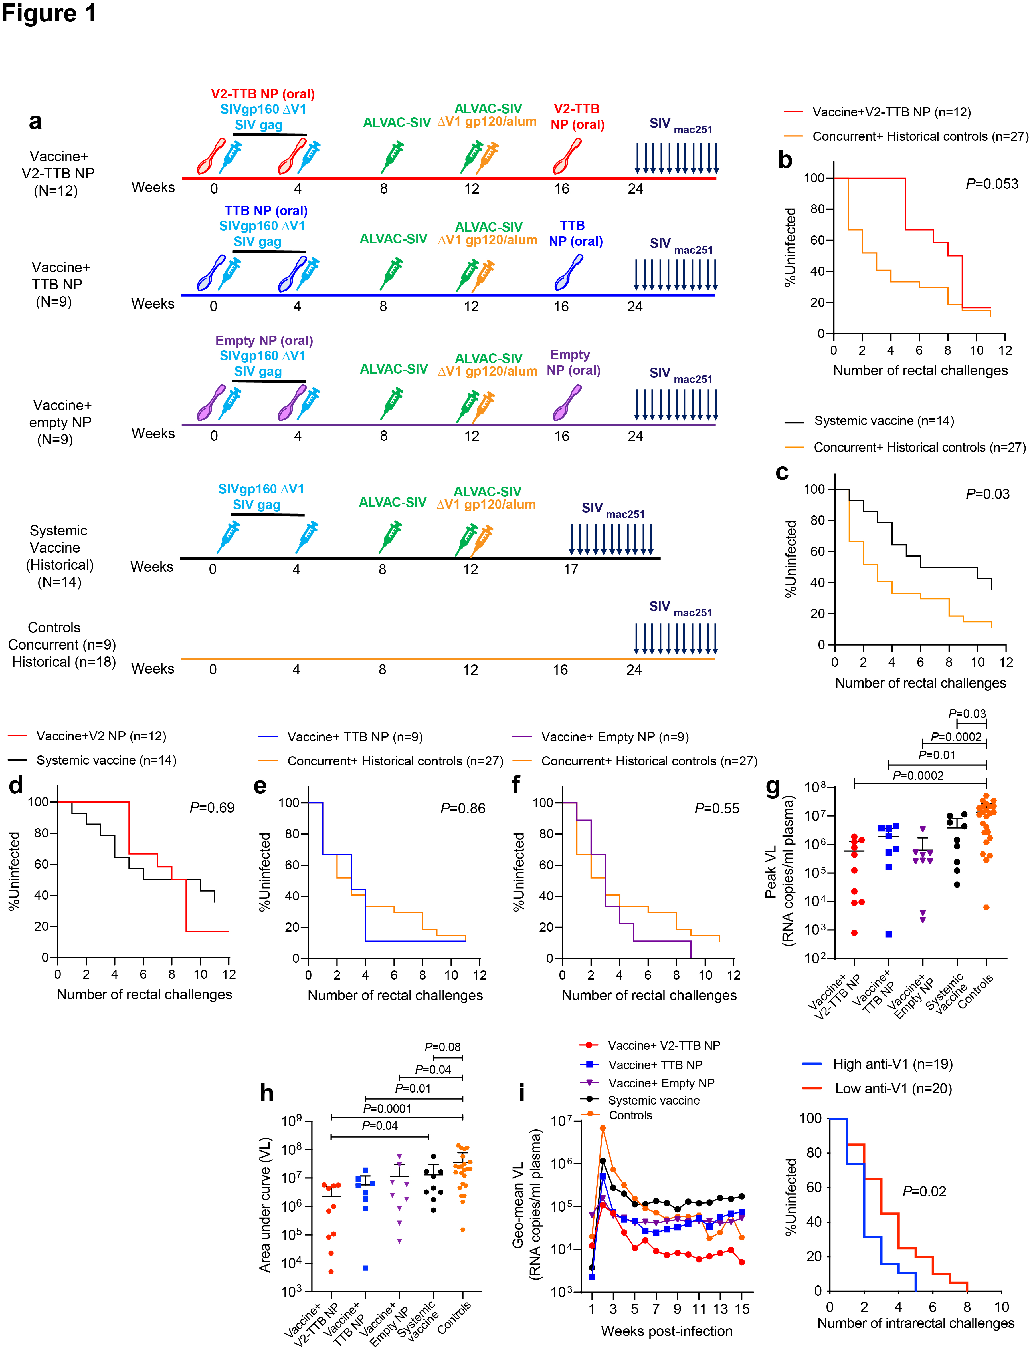
Animals with high anti-V1 antibodies were more likely to get infected
Silva de Castro et al. iScience 2021
Notes:
Out of these animals, we look for V1 antibody and saw that animals with high V1 antibody were more likely to get infected

Slide 5
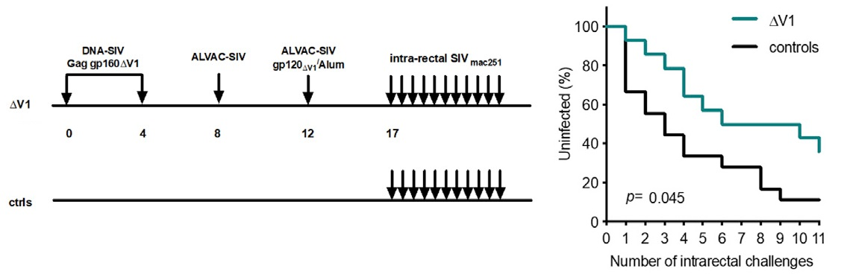
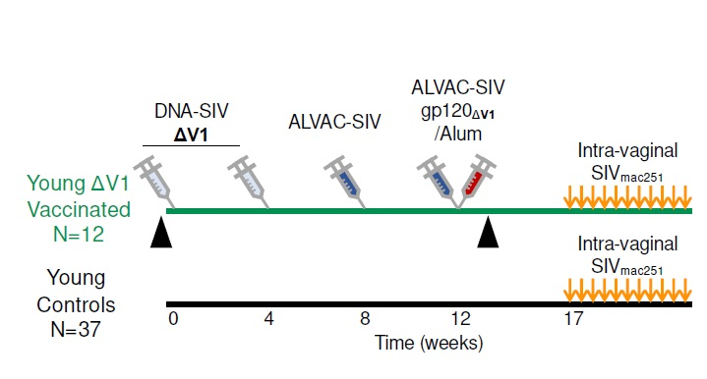
Modified DNA/ALVAC/dV1 vaccine protocol to improve vaccine efficacy
Male: Vaccine efficacy 57%
Silva de Castro et al. iScience 2021
Female: Vaccine efficacy 65%
Rahman et al. N. Microbiology, 2023
Notes:
Thus we design a vaccine by modifying the RV144 trial.
WE deleted the V1 loop, since it was associated with high risk of SIV infection
We did DNA prime and ALVAC gp120 boost
We observed 57% vaccine efficacy in male
We also observed 65% vaccine efficacy in female macaques

Slide 6
How to increase the vaccine efficacy?

Slide 7
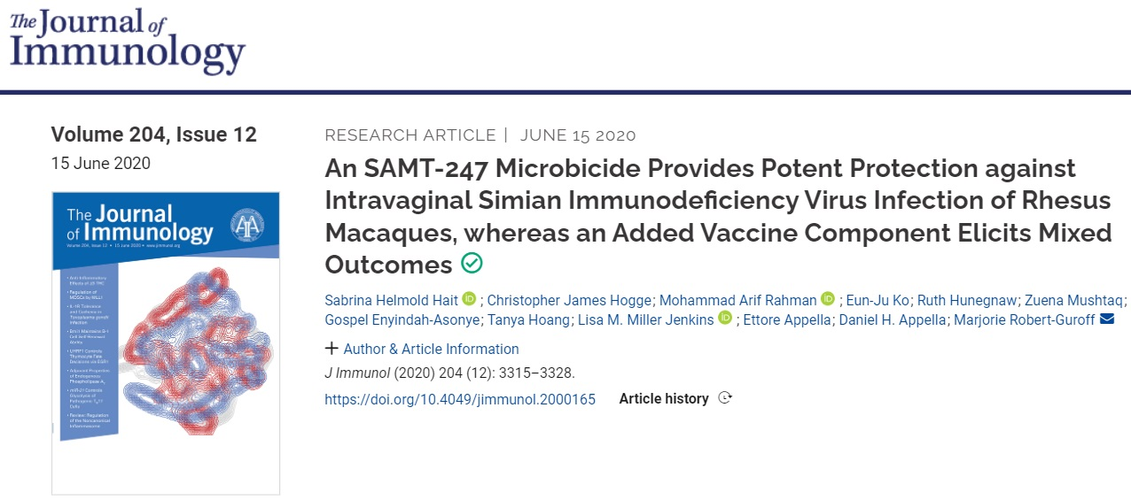
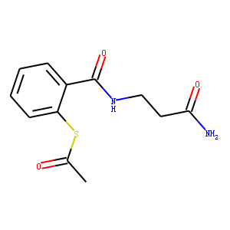
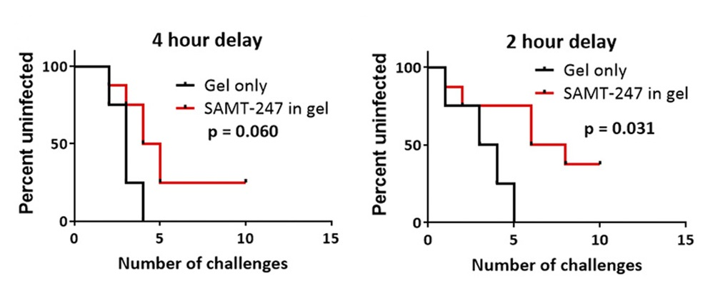
SAMT-247 vaginal gel provide protection against SIV infection
SAMT-247
(S-acyl-2-mercaptobenzamide thioester)
A potent HIV-1 nucleocapsid protein inhibitor.
Notes:
SAMT-247 is a microbicide. Which is a potent HIV-1 necleocapside protein inhibitor. It was able to protect the animals from SIV infection when the microbicide was applied 2 hours before the challenge.

Slide 8
Hypothesis
SAMT-247 in combination with DNA/ALVAC/gp120ΔV1 vaccination would show a better vaccine efficacy against SIVmac251 vaginal challenge.

Slide 9
Immunization schedule
SAMT-247 in Natrosol™ hydroxyethylcellulose gel administered 4 hours prior vaginal exposure

Slide 10
Vaccine efficacy
Rahman et al. N. Microbiology, 2023

Slide 11
We performed in vitro studies to understand the mechanism of this protection

Slide 12
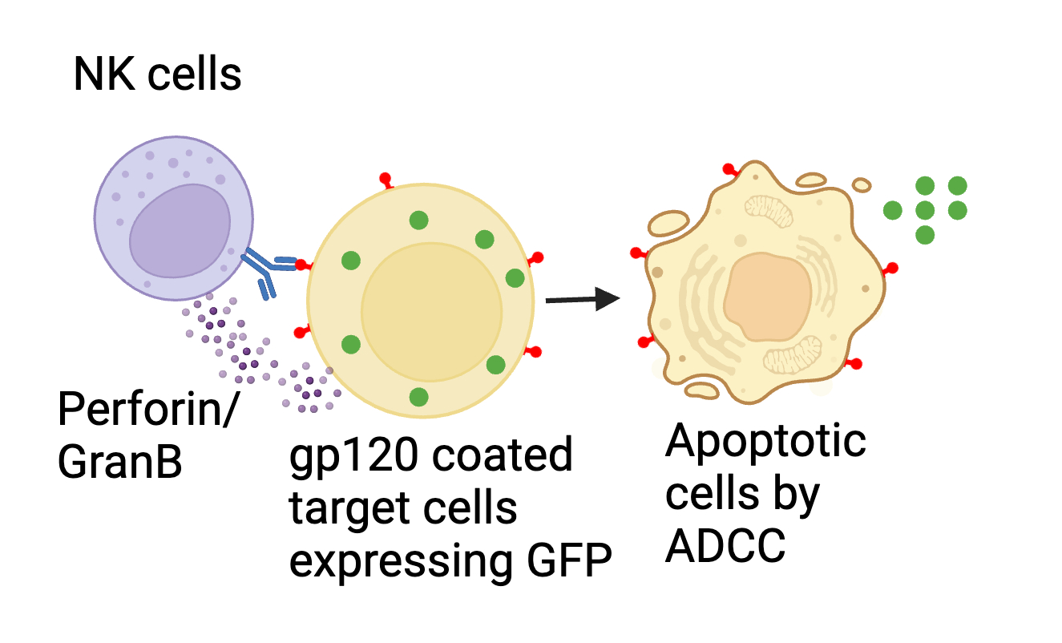
Antibody-dependent cellular cytotoxicity (ADCC)
Treated with SAMT-247

Slide 13
SAMT-247 induced ADCC correlated with reduced risk in vaccine+SAMT-247 group
ADCC increases in presence of SAMT-247
SAMT-247 induced ADCC cause protection
High GranB/perforin by SAMT-247 increases ADCC

Slide 14
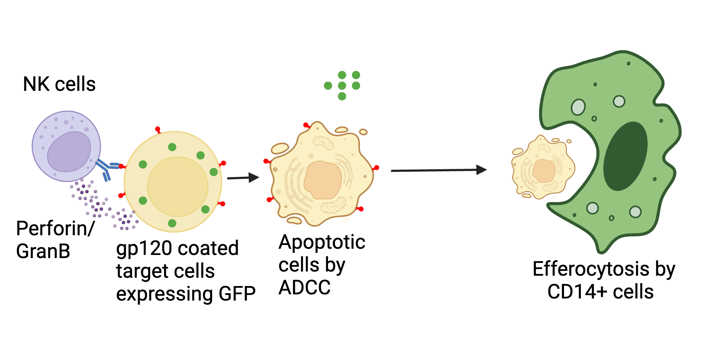
CD14⁺ cell mediated efferocytosis help to maintain immune equilibrium
Treated with SAMT-247

Slide 15
CD14⁺ cell mediated efferocytosis correlated with reduced risk of SIV infection

Slide 16
Mucosal NKp44⁺IL-17⁺ cells help to maintain mucosal integrity

Slide 17
Mucosal NKp44⁺IL-17⁺ cells correlated with reduced risk of SIV infection

Slide 18
Working Model

Slide 19
Translate to human

Slide 20
Conclusions
Mucosal treatment with SAMT-247 synergizes with the DNA/ALVAC/gp120/alum vaccine
SAMT-247 modulates vaccine-induced adaptive and innated immune responses in vivo
This approach could significantly decrease HIV transmission in vulnerable female populations

Slide 21
Acknowledgements
Animal Models and Retroviral Vaccines Section, NCI, NIH
Synthetic Bioactive Molecules Section, NIDDK,NIH, Bethesda, Maryland, United States
Genoveffa Franchini
Emmanuel Woode
Massimiliano Bissa
Sophia Brown
Isabela Silva-De Castro
Anna Gutoskwa
Sarkis Sarkis
Luca Schifanella
Melvin N. Doster
Daniel Appella
Oak Crest Institute of Science, Monrovia, CA, USA
Marc Baum
John Moss
Manjula Gunawardana
NCI animal facility, Maryland, USA
Office of Collaborative Biostatistics, CCR, NCI, Bethesda, MD, USA
Hyoyoung Choo-Wosoba
Josh Kramer
Kristin Killoran
And all the people involved in animal care

