Slide 1


Use of innovative spectroscopy methods and chemometrics for rapid authentication of herbals
Leading researcher Agnese Brangule
Professor, Head of Department Pēteris Tretjakovs
Riga Stradiņš University, Department of Human Physiology and Biochemistry

Slide 2


OUTLINE
About the Postdoc project
FTIR sampling methods (DRIFT and PAS)
Samples and sample preparation
Spectra processing and analysis
Examples

Slide 3
Project Goal
To develop quality control methods for herbal medicine (HMs) using innovative, rapid, integratable into production process spectroscopy (Raman SERS, LIBS, PAS-FTIR) methods and multivariate data processing methods.
Objectives
To test non-destructive FTIR spectroscopy techniques: photoacoustic spectroscopy (PAS), diffuse reflectance (DRIFT) for herbals.
To design and test HMs sample preparation methods for non-destructive spectroscopy techniques PAS and DRIFT.
To design a model for unsupervised statistical data analyses (PCA, HCA).

Slide 4
Environmental vs Industry
Variable materials – intraspecific variation
Variation is raw material
for natural selection
Samples collected under difficult conditions
Error due to collection artifacts
Laboratory analysis of environmental samples is more prone to interference.
Homogeneous materials
Outliers identified & excluded
Aim is to produce uniformity!
Data collected under stand. cond.
Range of expected values known
Laboratory methods better
Sample size larger

Slide 5
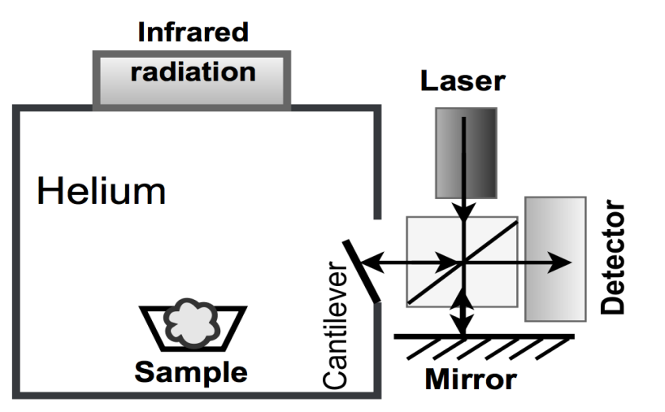
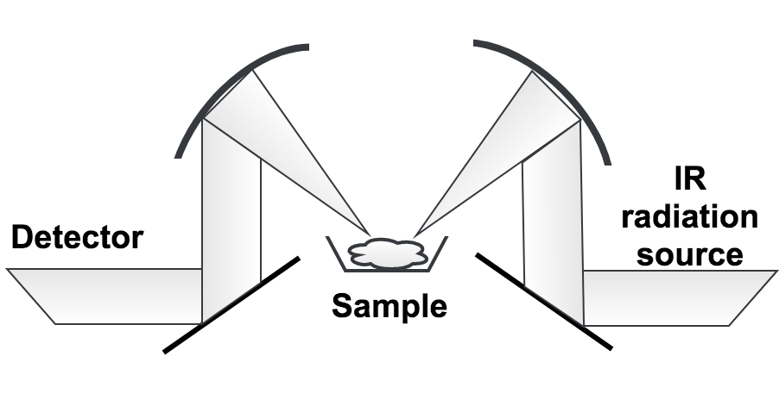
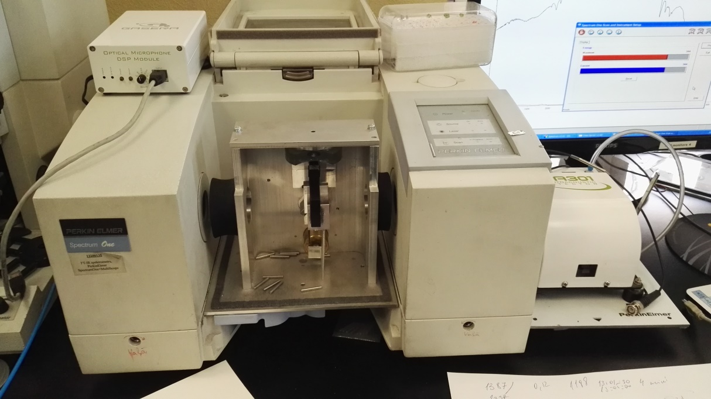
1. FTIR sampling methods
Cantilever-enhanced
photoacoustic spectroscopy (PAS)
Diffuse reflectance (DRIFT)
DRIFT Al sampling cup
PAS cell
Notes:
Photoacoustic spectroscopy is based on the photoacoustic effect, which was discovered in 1880 by scientist A. G. Bell. If the substance is irradiated with a pulsating light, the substance emits acoustic waves that have the same frequency as the pulsating light. In subsequent experiments, he added a hearing tube and fixed sounds [10]. A. G. Bell's initial works encouraged such scientists and researchers as Roentgen, Tyndall and Price to do the research in the field of photoacoustic spectroscopy.
In this work, the innovative cantilever – enhanced PAS was used. In 2003, the silicon console, invented by J. Kaupinen's group, replaced the less sensitive microphone membrane. In addition, the movement of the console could be read with both the optical beam deviation and the interferometer. The J. Kaupinen’s group chose the interferometric reading because it offered a larger dynamic range.

Slide 6
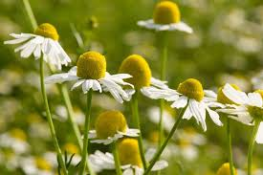
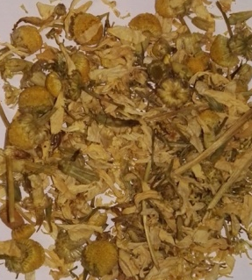
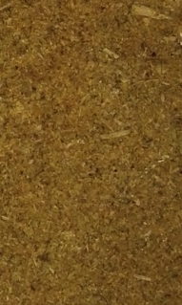
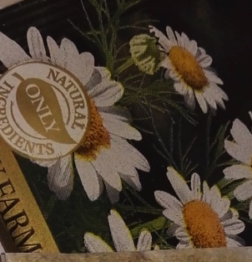
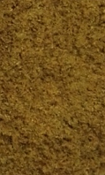
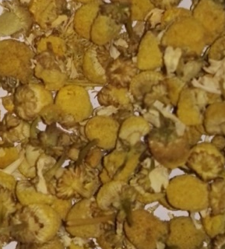
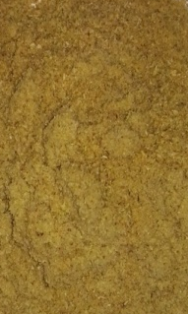
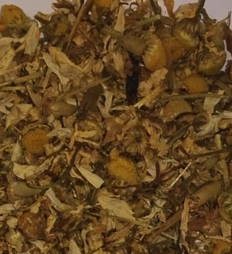
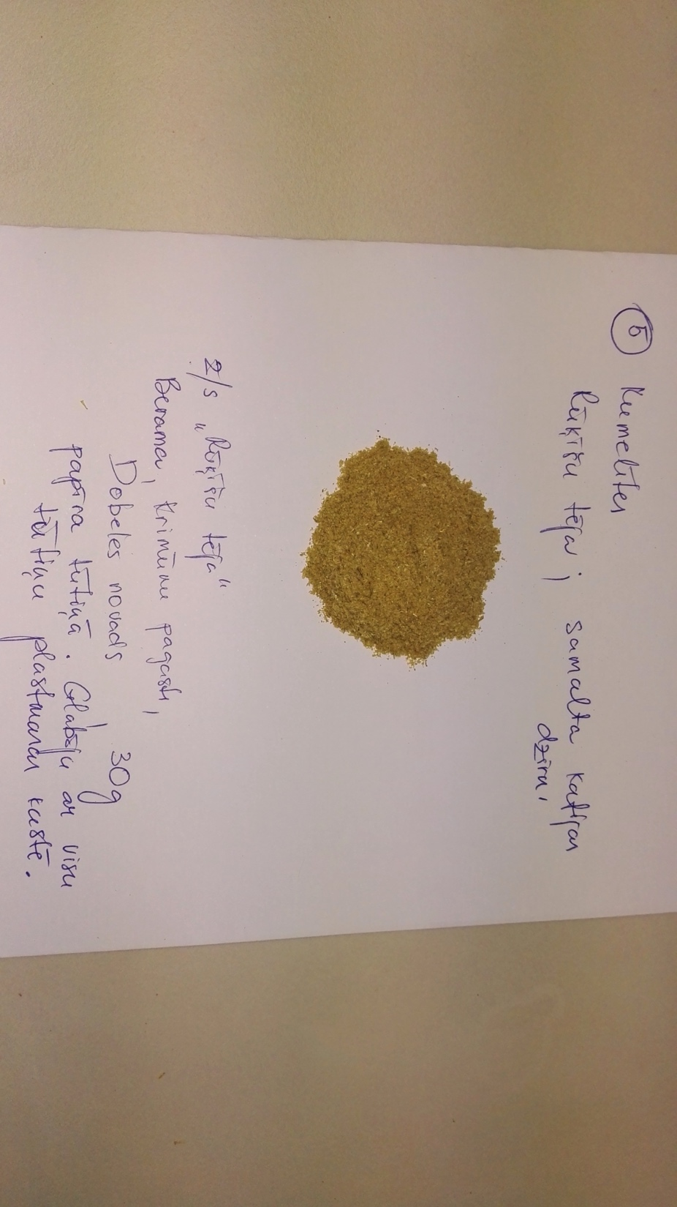
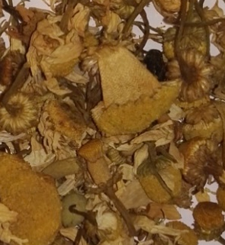
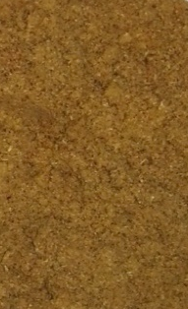
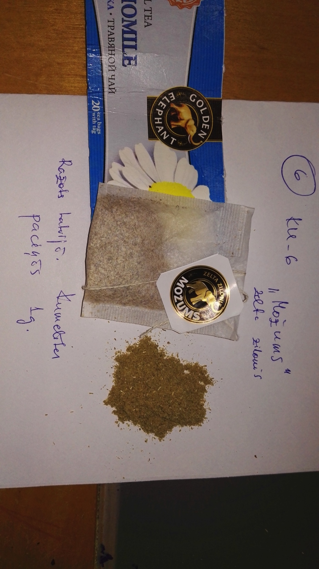
2. Sample preparation
Chamomile
Chamomilla recutita
“Linda Griin”,
Flowers, LV
KU_1
“Apsara”,
Teabags, LV
KU_4
“RFF”,
Flowers, LV
KU_2
“Rūķīšu tēja”,
Flowers, LV
KU_5
“RIMI”,
Flowers, POL
KU_3
“Možums”,
Teabags
KU_6

Slide 7

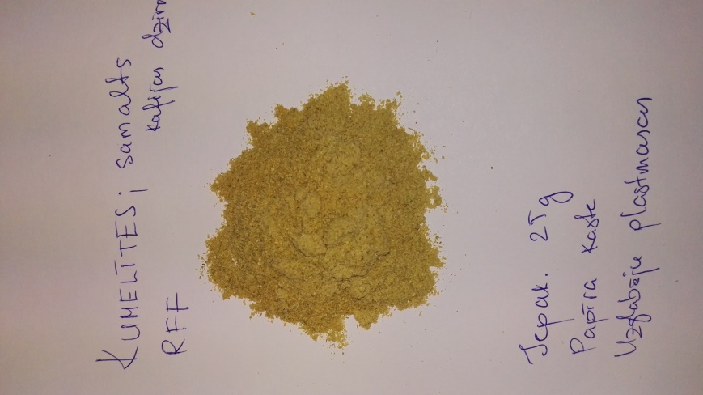
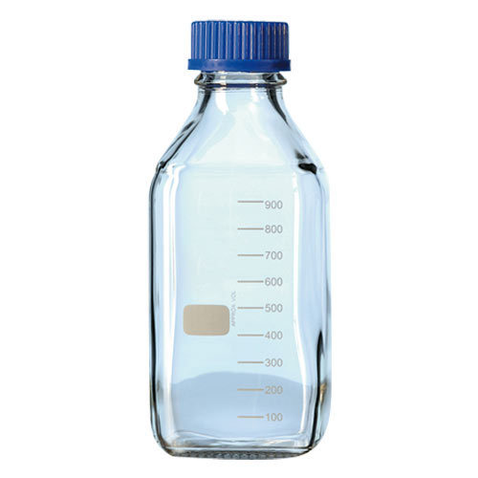
2. Sample preparation
?
Raw vs Homogenised
Solid vs Liquid (extraction)
or
or with
H₂O
EtOH
40%
EtOH

Slide 8
3. Spectrum processing and multidimensional statistical analysis
The main tasks of the multidimensional analysis are:
Description of data and modelling of the structure of general data matrix.
Discrimination, classification and grouping of data to divide all data into two or more groups (objects).
Regression and forecasting. A method that binds two variables by quantifying them with each other.

Slide 9
3. Spectrum processing and multidimensional statistical analysis
The FTIR spectrum processing is essential, can be divided into two stages:
pre-processing (background correction, spectrum alignment, normalization) needed to improve the appearance of spectra and increase spectrum interpretation and analysis;
spectrum processing (derivation, deconvolution, and Fourier self-deconvolution) required to mathematically improve resolution when equipment options are already exhausted.

Slide 10
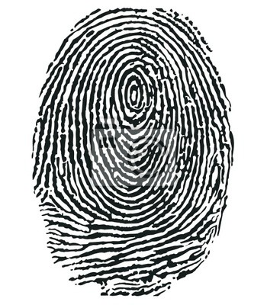
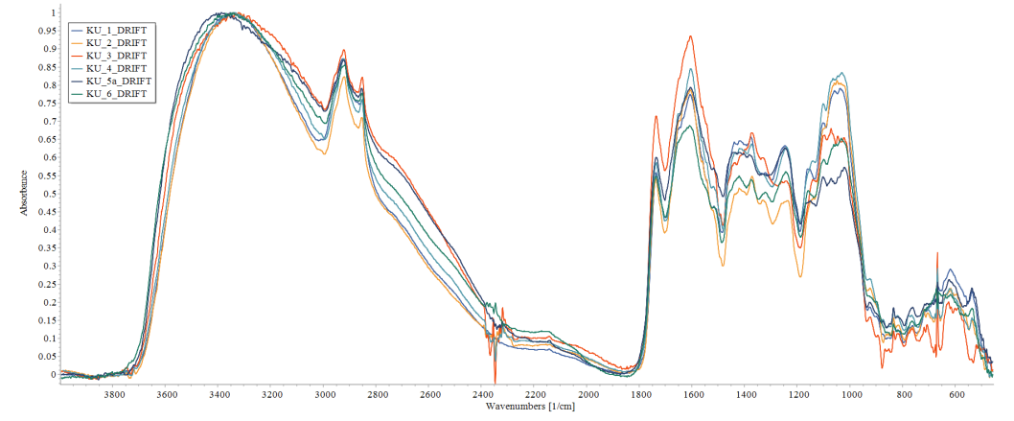
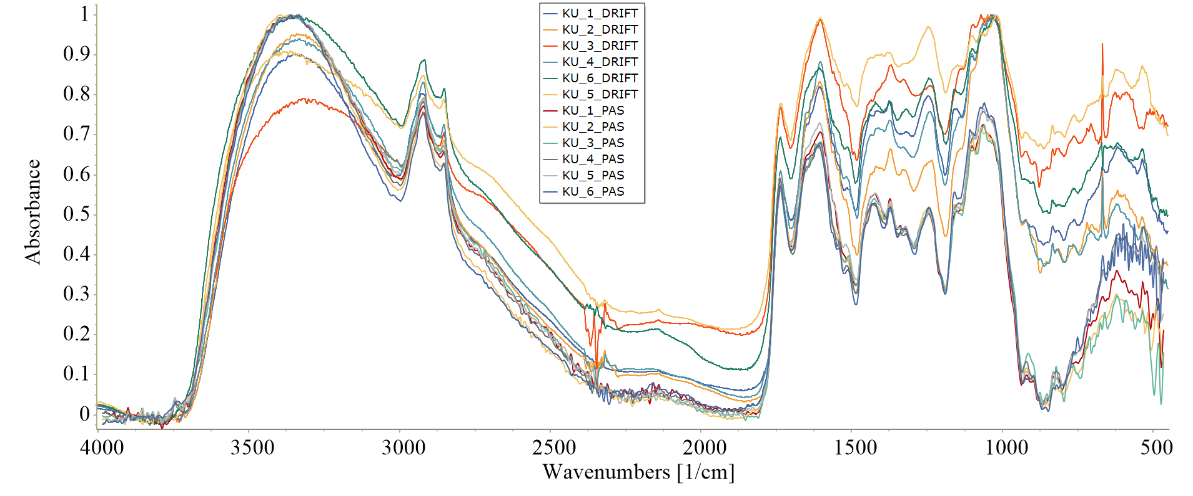
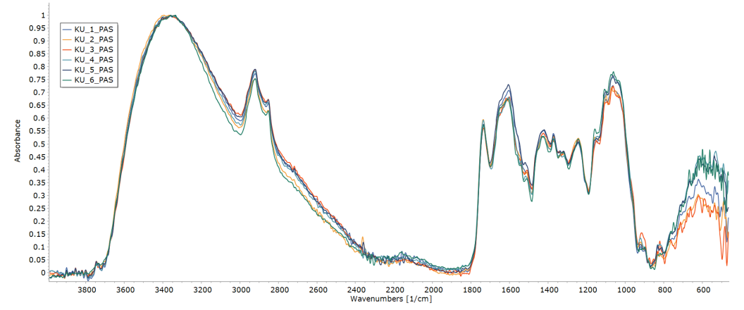
RESULTS. Spectra
DRIFT and PAS
Fingerprint
DRIFT
Chamomile
Chamomilla recutita
PAS

Slide 11
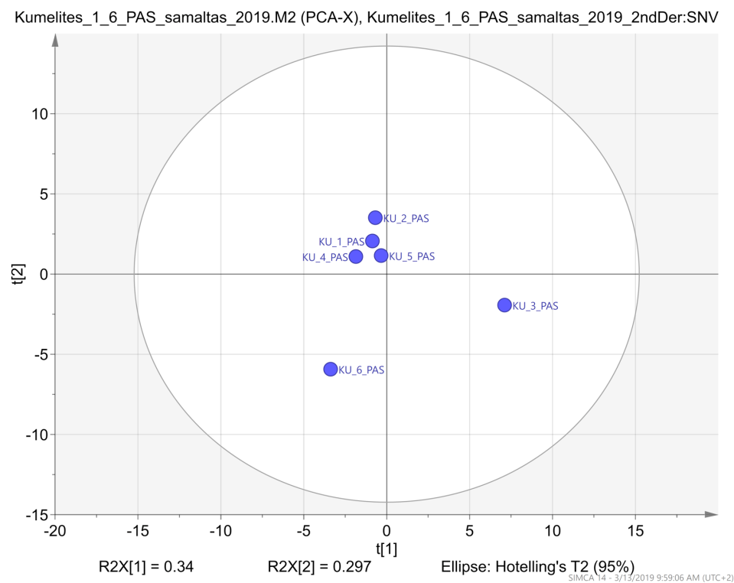
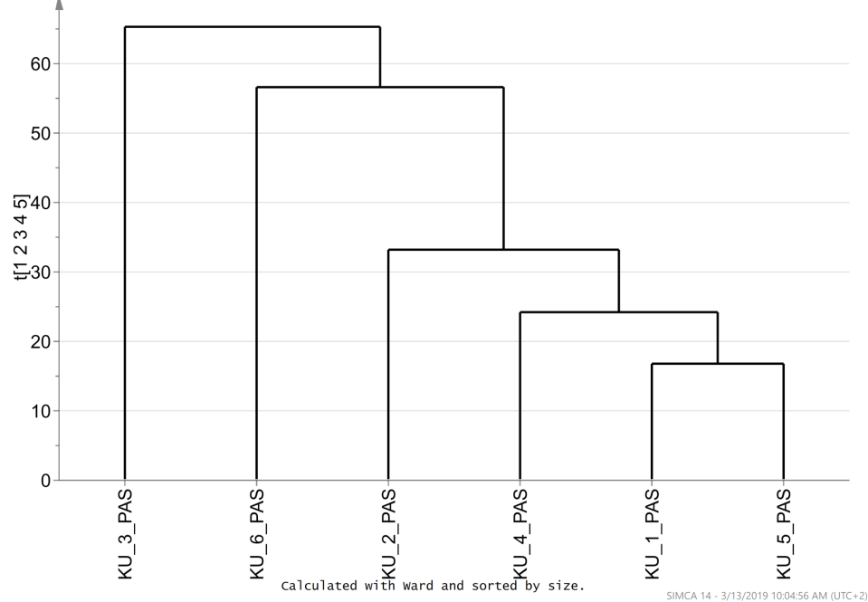
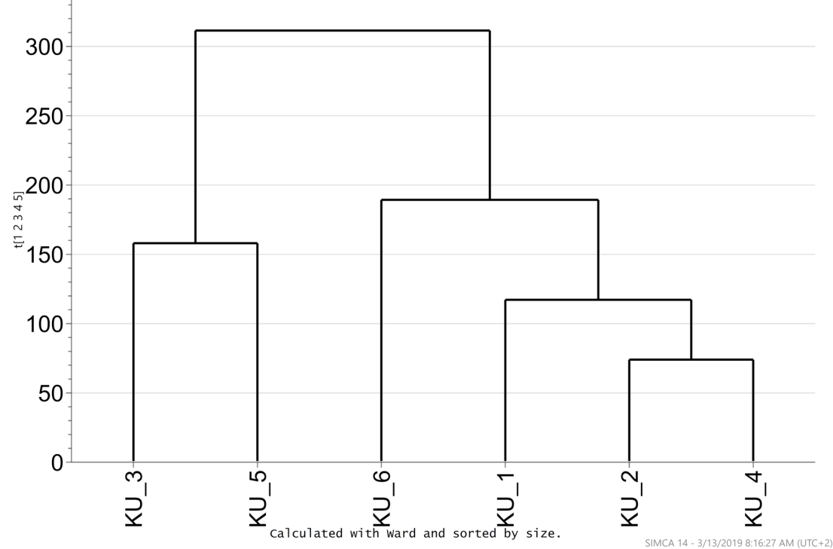
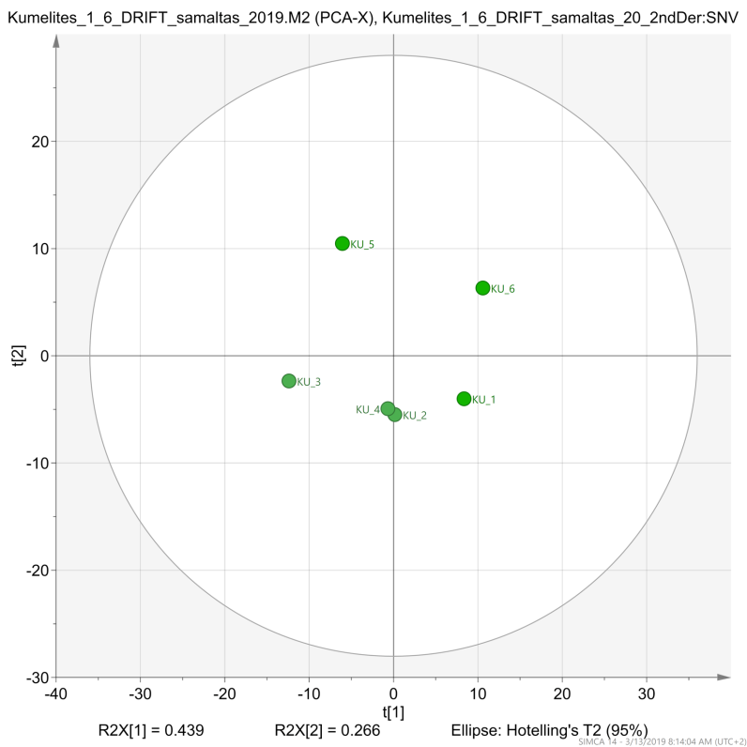
RESULTS. HCA and PCA diagram
PAS
PAS
DRIFT
DRIFT

Slide 12
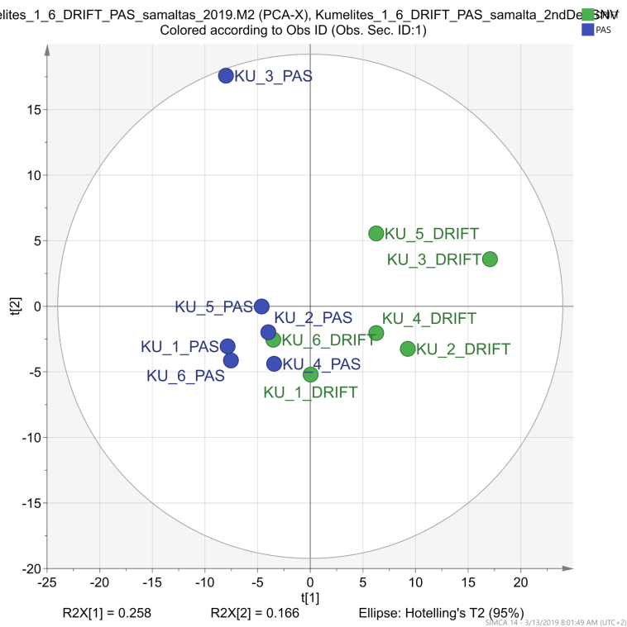
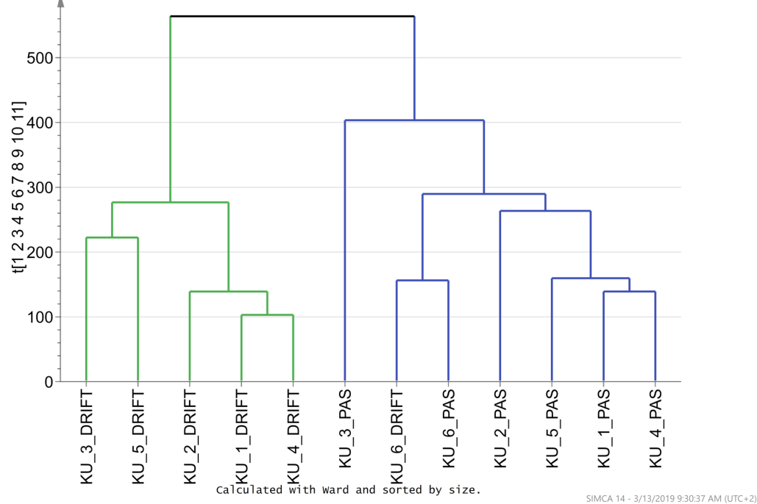
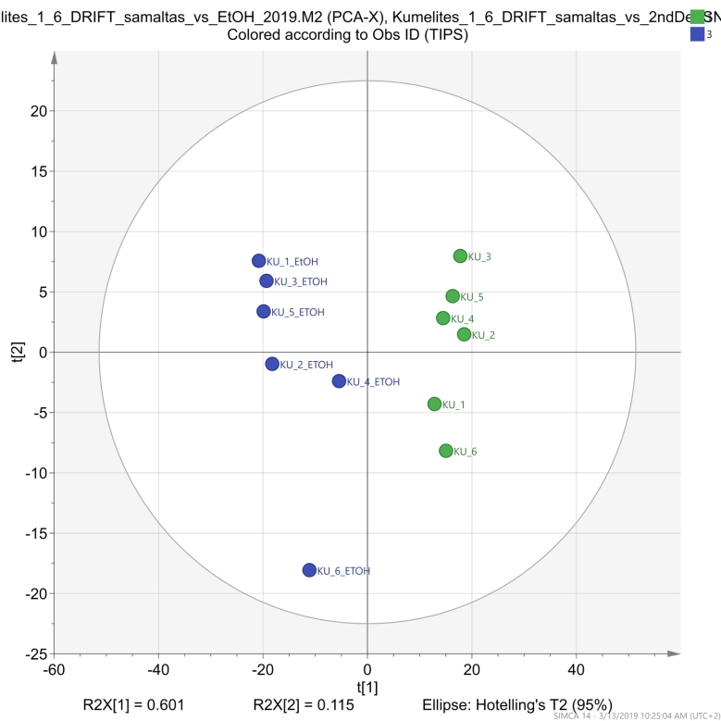
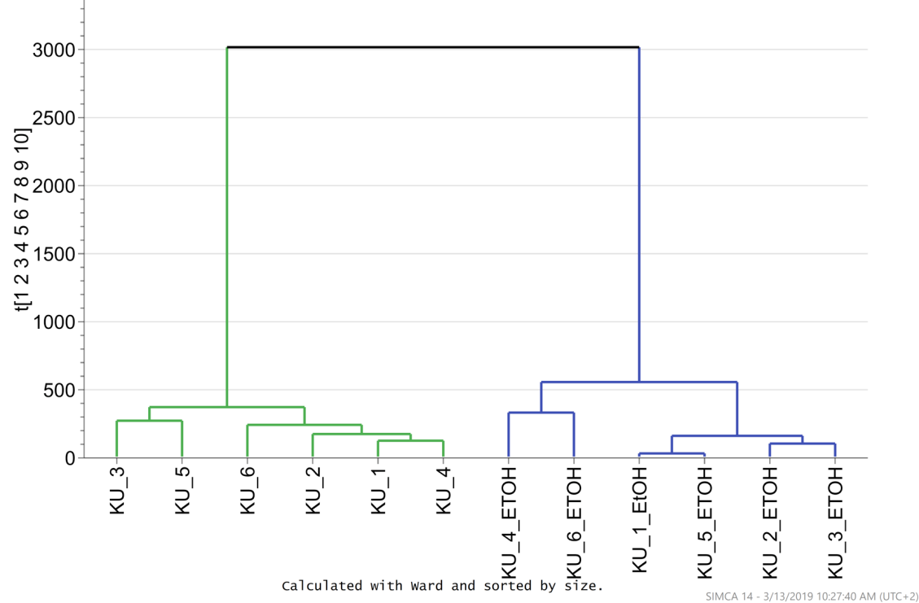
RESULTS. PCA and HCA diagram
DRIFT vs PAS
DRIFT
Powder vs
EtOH extract

Slide 13
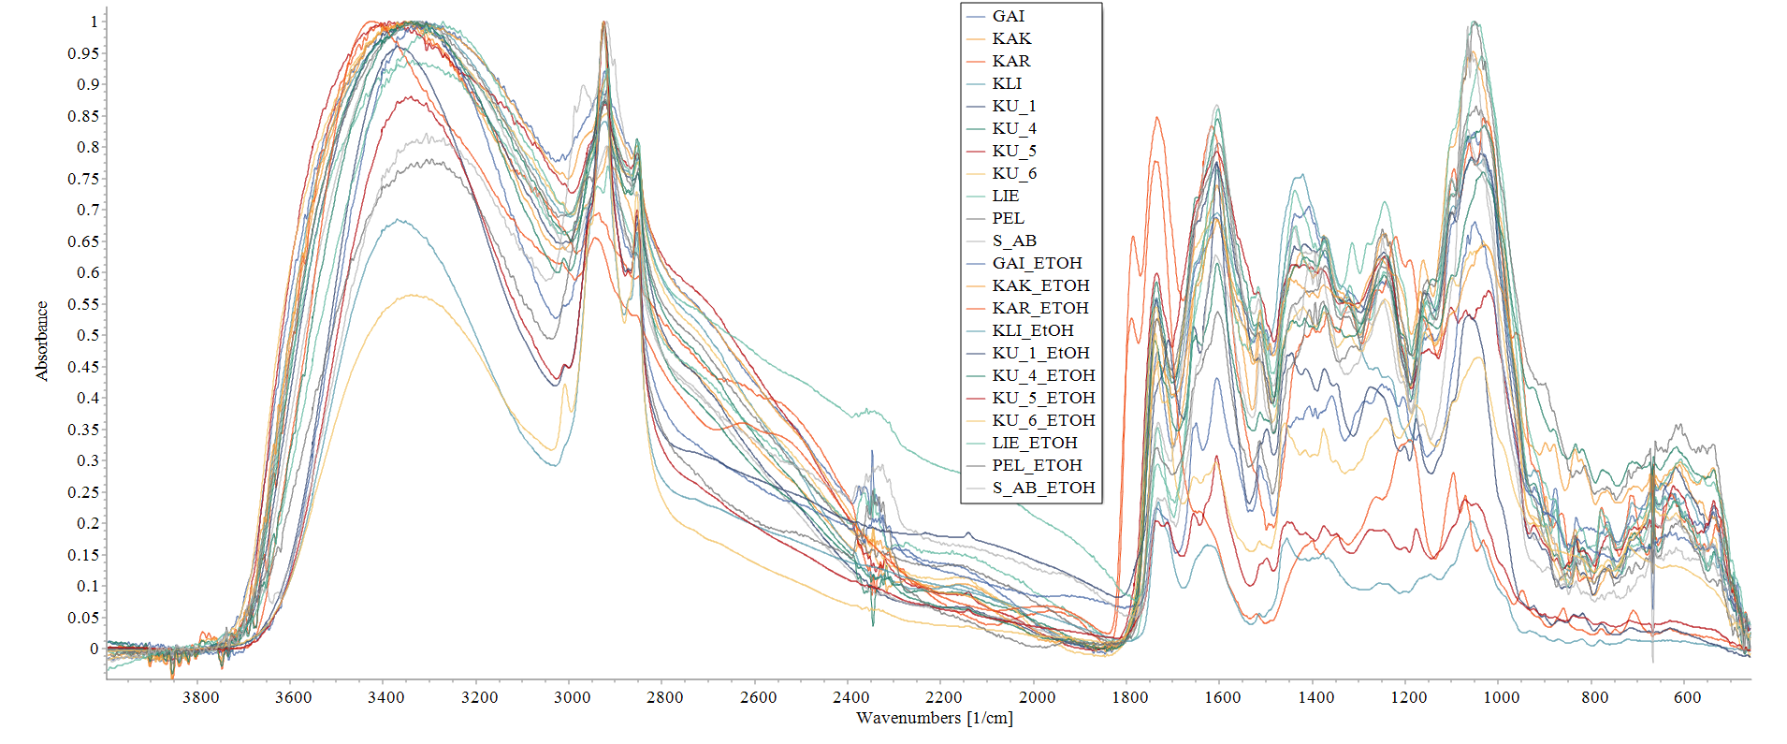
RESULTS
DRIFT
Powder vs
EtOH extract
Chamomile (Chamomilla recutita), cowslip (Primula veris),
small-leaved lime (Tilia cordata), dwarf everlast (Helichrysum arenarium), marigold (Calendula officinalis), yarrow (Achillea millefolium), red clover (Trifolium pratense)

Slide 14
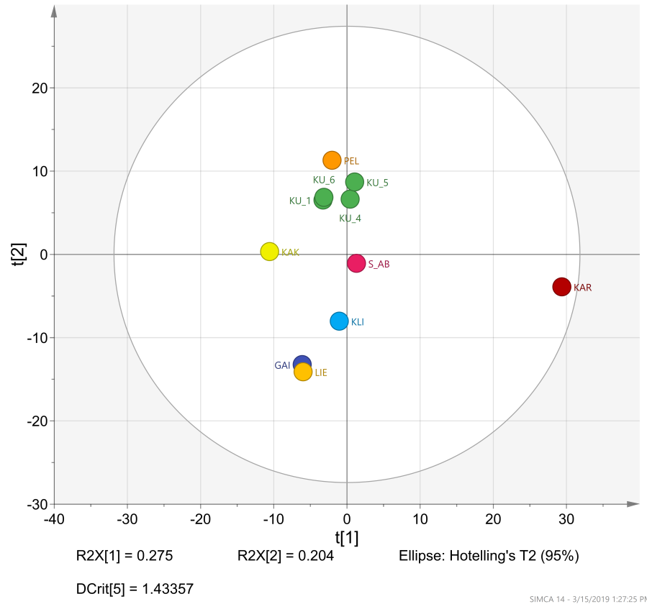
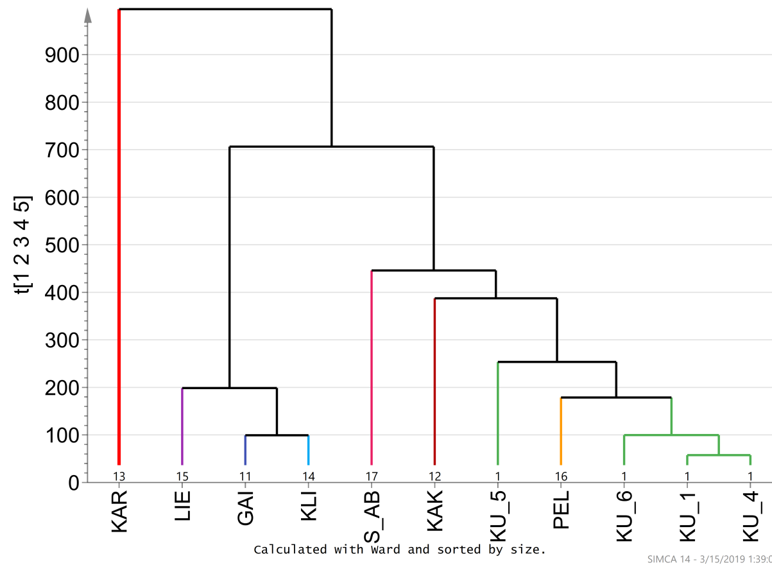
RESULTS
DRIFT
Powder
Chamomile (Chamomilla recutita), cowslip (Primula veris),
small-leaved lime (Tilia cordata), dwarf everlast (Helichrysum arenarium), marigold (Calendula officinalis), yarrow (Achillea millefolium), red clover (Trifolium pratense)

Slide 15
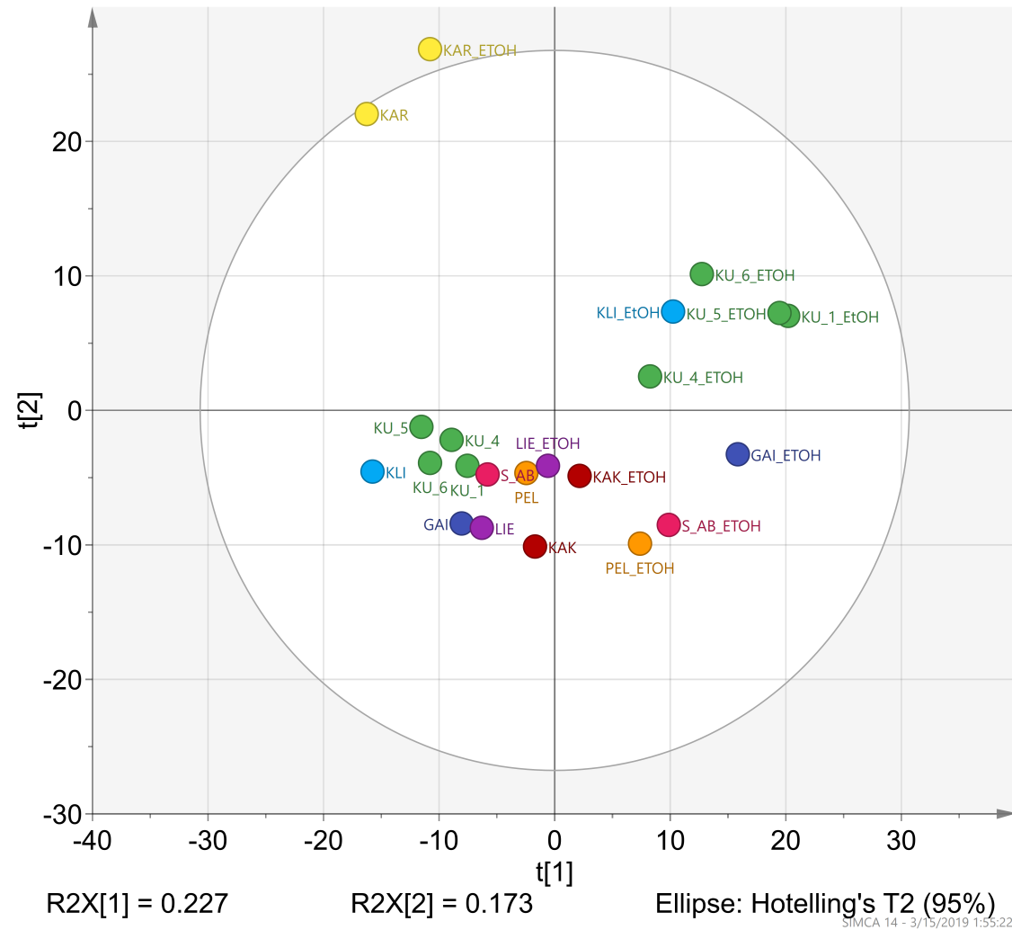
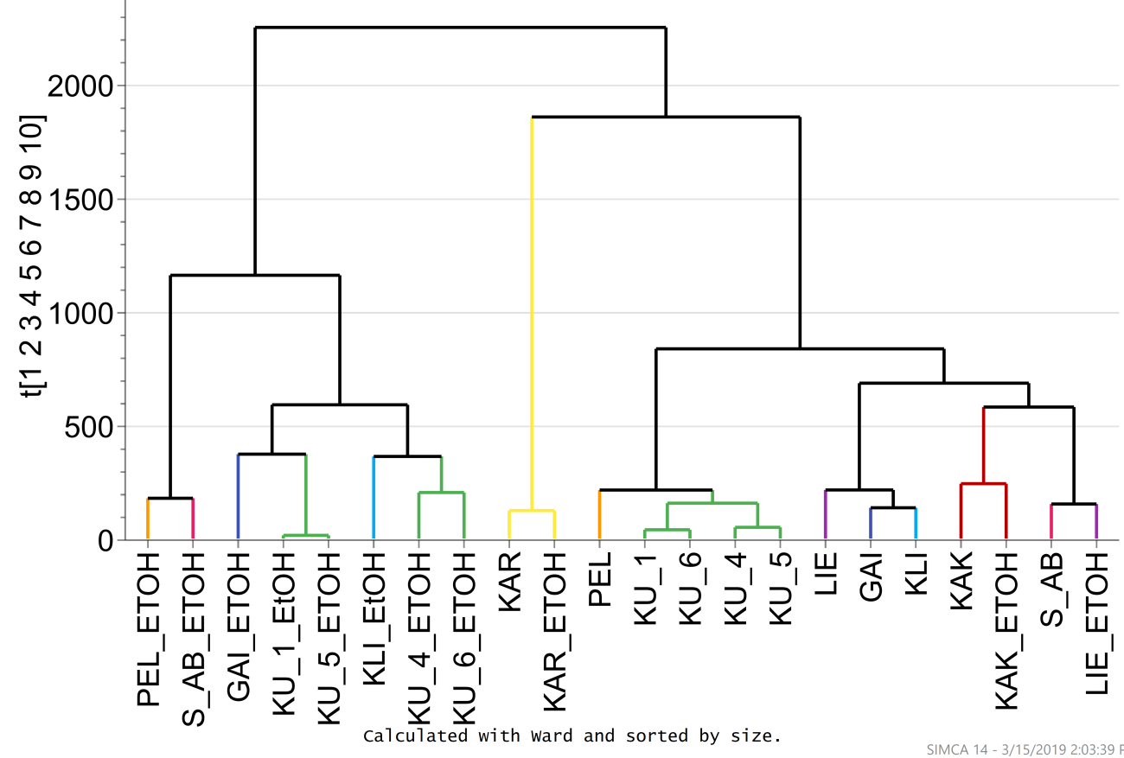
RESULTS
DRIFT
Powder vs
EtOH extract
Chamomile (Chamomilla recutita), cowslip (Primula veris),
small-leaved lime (Tilia cordata), dwarf everlast (Helichrysum arenarium), marigold (Calendula officinalis), yarrow (Achillea millefolium), red clover (Trifolium pratense)

Slide 16
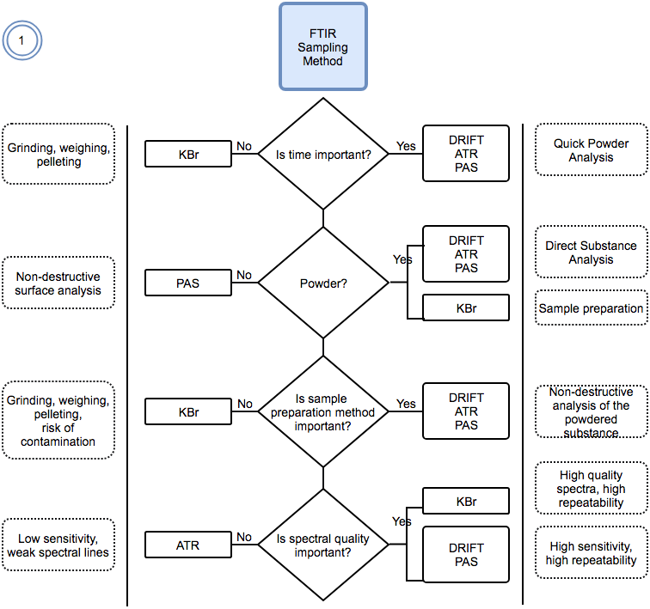
Conclusions

Slide 17
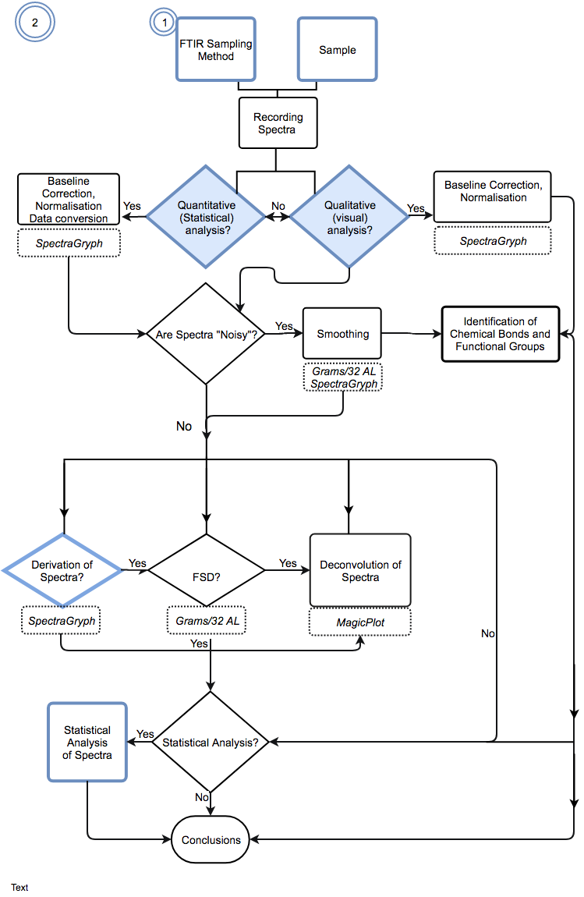
Conclusions

Slide 18
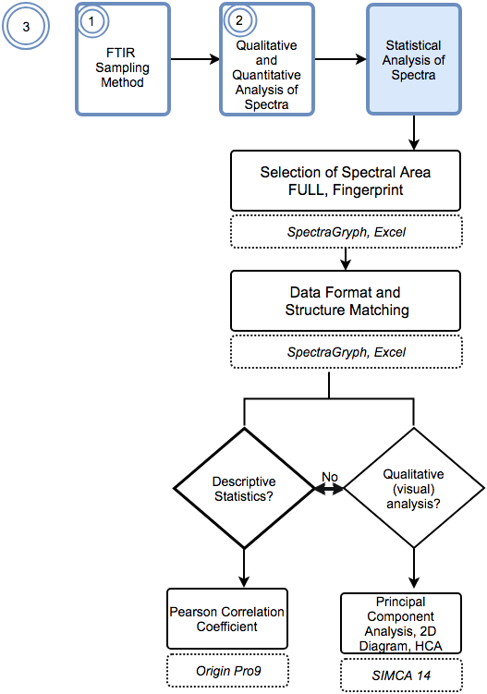
Conclusions

Slide 19
Conclusions
Comparison between spectra recorded by PAS and DRIFT showed high sensitivity and good resolution.
It has been demonstrated that PAS and DRIFT can be a useful experimental tool for the characterization and discrimination of herbals.
The results obtained provide information about the spectral behavior of homogenized herbal powder can be useful for establishing identification and discrimination criteria.
FTIR spectroscopy, in conjunction with multidimensional statistical analysis (Chemometrics), offers an extensive scope for herbal medicine studies.

Slide 20
Thank you!
Acknowledgments.
The research received funding from the ERAF Post-doctoral Research Support Program project Nr. 1.1.1.2/16/I/001 Research application "Development of screening methods by innovative spectroscopy techniques and chemometrics in research of herbal medicine", Nr. 1.1.1.2/VIAA/2/18/273.
Latvian Assay Office (VSIA Latvijas proves birojs) for
permission to use the DRIFT and PAD equipment.

