Slide 1
Courtney Queen, Ph.D. Fulbright Scholar Rīga Stradiņš University Institute of Public Health Assistant Professor Director for Undergraduate Studies Graduate School of Biomedical Sciences Department of Public Health
international Relationships &
Translational Actions Toward Health Equity

Slide 2
International Relationships & Translational Actions Toward Health Equity
Improving Cultural Competency to Reduce Health Disparities

Slide 3
Disclosure
J. William Fulbright Scholar, Latvia, Spring 2022
National Institutes of Health, NIAMS, R21
National Science Foundation, Commercialization
TTUHSC Clinical Research Institute, Proof-of-Concept Study
TTU Innovation Hub, Prototype Development
Health Equity Leadership Institute Scholar
NIH, National Institute of Minority Health and Health Disparities Scholar

Slide 4
Objectives
Develop an understanding of cultural competency issues related to race, gender, class and other difference and explore the interconnectedness of identities across differences, critical consciousness and relationship to cultural competence.
Scholar will be able to develop a framework for cultural competency within the context of one’s environment.

Slide 5
Cultural Competency
What is cultural competency?

Slide 6
What is Cultural Competence?
“The state of being capable of functioning effectively in the context of cultural differences.”
“A set of congruent behaviors, attitudes, and policies which come together in a system, agency, or amongst professionals to work effectively in cross-cultural situations.”
Towards a Culturally Competent System of Care. Cross et. al., 1989, Georgetown University Child Development Center

Slide 7
Cultural Competence in Healthcare
Cultural forces are powerful determinants of health-related behavior
A lack of knowledge about or sensitivity to health beliefs and practices of different cultures can limit one’s ability to provide quality healthcare

Slide 8
Culture
What is cultural?

Slide 9
What Is Culture?
“The body of learned beliefs, traditions, principles, and guides for behavior that are commonly shared among members of a particular group. Culture serves as a roadmap for both perceiving and interacting with the world.”
Increasing Multicultural Understanding: A Comprehensive Model. Don Locke, SAGE Publications, 1992

Slide 10
What is Ethnicity?
Refers to particular social groups in complex societies, groups differentiated not only on the basis on a range of shared cultural content, but also on the bases of social attitudes and economic and political considerations.
Working with Latino Youth: Culture, Development and Context. Joan D. Koss-Chioino and Luis A. Vargas

Slide 11
What Shapes Culture?
Political values
Experience with oppression or discrimination
Socioeconomic factors
Rituals
Family roles and structure
Degree of opposition to acculturation
Response of majority culture

Slide 12
Examples of Cultural Health Beliefs
Illness or disease is caused by stress or working too hard or as a punishment for something
Eating protein (meat or eggs) will counteract the effects of x-rays
Everyone has dormant diseases in body, whether or not they develop depends on how well you take care of yourself
Importance of balancing Yin and Yang, e.g. hot/cold theory

Slide 13
Cultural Competence
What is cultural competence in a healthcare setting?

Slide 14
Influence of Cultural and Social Factors
Health-seeking behavior
Perceived causes of illness
Understanding of disease process
Treatment decisions

Slide 15
Health Seeking Behavior
Is the symptom serious?
How long has the symptom lasted?
Is there a cause for the symptom?
Anyone else with similar symptoms?
Who should I seek help from?

Slide 16
Perceived Causes of Illness
Some people believe that the cause of their disease is the result of some “other” force outside the individual (supernatural or spiritual forces such as punishment for behaviors, etc.)

Slide 17
Understanding the Disease Process
Perception of messages from different healthcare providers
Stigma/fear
Social networks
Contacts

Slide 18
Treatment Decisions
What is necessary for healing to occur
Risk assessment (cost-benefit analysis)
Lifestyle factors
Healthcare worker/patient interactions

Slide 19
Cultural Competence
Frameworks and models

Slide 20
Purnell Model for Cultural Competence

Slide 21
Domains of Model
Global Society
Community
Family
Person
Heritage
Communication
Family Organization
Workforce Issues
Biocultural Ecology
High-Risk Health Behaviors
Nutrition
Pregnancy & Childbearing
Death and Dying
Spirituality
Healthcare Practices
Healthcare Practitioners

Slide 22
Dominant Cultural Characteristics
Beliefs, values, and practices
Standard for the entire group of people
Dominant socially, politically, economically

Slide 23
Variant Cultural Characteristics
Determines the degree which the dominant culture varies
Ethnicity
Race
Gender
Age
Spirituality/religion
Socioeconomic Status
Educational Status
Marital Status
Sexual Orientation
History of the culture
Caste/status
Sexual orientation
Language or dialect
Military Experience
Political Beliefs
Urban/Rural Residence
Immigration Status, Time and Reasons

Slide 24
Cultural Competent Care
Examples of cultural competence in healthcare settings

Slide 25
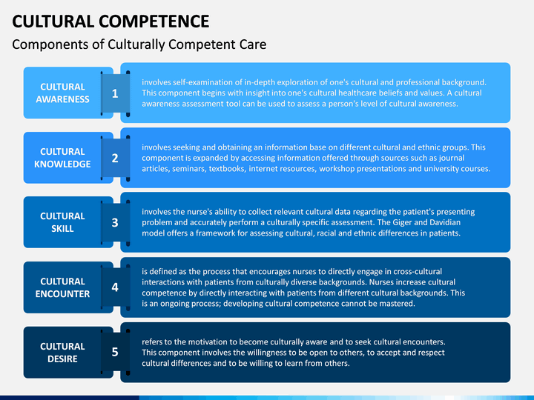
Components of Culturally Competence Care

Slide 26
Exercising Cultural Sensitivity
Knowledge of patient population
Acceptable social behaviors
Cultural health beliefs
Conveying respect
Working with interpreters
Cultural sensitivity

Slide 27
Characteristics of the Patient Population
What cultures are predominantly represented in your program?
What are the values, beliefs, traditional concepts particular to these groups?
Who are the “gatekeepers” of health within these groups?
What is the group’s perception of health and illness?

Slide 28
Know the Patient Population
Non-US born
Migrant workers
Persons with international travel histories
Racial and ethnic minorities
Elderly
Refugees

Slide 29
Know Acceptable Social Behaviors
In some cultures, the following behaviors can be seen as offensive or may not be reciprocated:
Handshake
Staring, direct questioning, or direct eye contact
Getting “down to business” immediately - asking “how are you?” in passing without truly listening for response

Slide 30
Examples of Cultural Competence
Convey respect, working with interpreters, cultural sensitivity

Slide 31
Conveying Respect
Build rapport and trust
Explain why you must ask personal or sensitive questions (suspicion of TB, HIV status); may require an expression of sympathy for doing so
Watch for patient’s verbal and non-verbal cues; allow patient to ask questions at frequent intervals
Acknowledge non-traditional living situations (e.g., joint or extended families, homeless shelter)
Acknowledge the stigma attached to a diagnosis of TB
Do not ask about immigration status
Provide appropriate health education

Slide 32
Working with Interpreters
In medical setting, use of a trained, medical interpreter is necessary
Avoid use of family or non-medically trained staff to interpret
Keep a list of available interpreters and schedule patients accordingly
Introduce yourself to the interpreter and patient; explain ground rules of interpretation and confidentiality
Address patient directly, in the first person and make eye contact
Check that interpreter is engaged in working with the patient; make sure pace is appropriate and direct
Avoid local jargon and phrases

Slide 33
Exercising Cultural Sensitivity
Do you have posters on the wall that depict people of different racial/ethnic groups?
Do you have books and pamphlets addressed to people of different genders?
Is staff trained to take calls from a call relay operator for hearing-impaired patients
Do you have an appointment line with a TTY line?
How do you make people of different ethnicities, gender, age, etc. comfortable in your setting?
Are the front-line office or clinic staff (e.g. receptionists and intake workers) trained in cultural competency?

Slide 34
Summary
Develop an understanding of cultural competency issues related to race, gender, class and other difference and explore the interconnectedness of identities across differences, critical consciousness and relationship to cultural competence.
Scholar will be able to develop a framework for cultural competency within the context of one’s environment.

Slide 35
Conclusion
Culture is not defined exclusively by ethnicity, but rather a shared system of values, beliefs, history, and learned patterns of behaviors
This system of values, beliefs, and behaviors may also be influenced by variables such as:
Gender
Language
Disability
Sexuality
Age

Slide 36
Just for Fun!
American Psychological Association
https://www.apa.org/monitor/2015/03/cultural-competence
Centers for Disease Control
https://npin.cdc.gov/pages/cultural-competence

Slide 37
Food for Thought!
“If we could give every individual the right amount of
nourishment and exercise, not too little and not too much,
we would have found the safest way to health.”
- Hippocrates
Notes:
Slide 40: Food for Thought!
A few more sources, but I have also added them directly to Sakai as a document titled: Module Outline. Go ahead and download this document for your reference.

Slide 38
References
Please see Bibliography.
Notes:
Slide 41: References
The References for this Module is your textbook, Introduction to Public Health.

Slide 39
Thank You!
Questions? Please feel free to reach out to me with any questions, by email at: Courtney.queen@rsu.lv or courtney.m.queen@ttuhsc.edu
Notes:
Slide 42: Thank You!
Thank You! If you have any questions, please feel free to reach out to me. You can find my contact information here, on this slide, and it is also on the syllabus.
If you think that you might be interested in the Social and Behavioral Sciences professionally, then I have added a few good videos that explore the knowledge, skills, and abilities of someone who works as a social scientist in public health.
Lastly, as a part of your Master’s in Public Health, you will take the course, Introduction to the Social and Behavioral Sciences. This course will give you a more in-depth experience about the theory and methods in the social sciences as they apply to public health, the tools and tricks, of the trade, and it is a course that I think you will find both fascinating and intriguing.

Slide 40
Final Slide.
Notes:
Slide 32: Final Slide

