Slide 1
Courtney Queen, Ph.D. Fulbright Scholar Rīga Stradiņš University Institute of Public Health Assistant Professor Director for Undergraduate Studies Graduate School of Biomedical Sciences Department of Public Health
international Relationships &
Translational Actions Toward Health Equity

Slide 2
International Relationships & Translational Actions Toward Health Equity
Interventions to Improve
Health Literacy for Health Equity

Slide 3
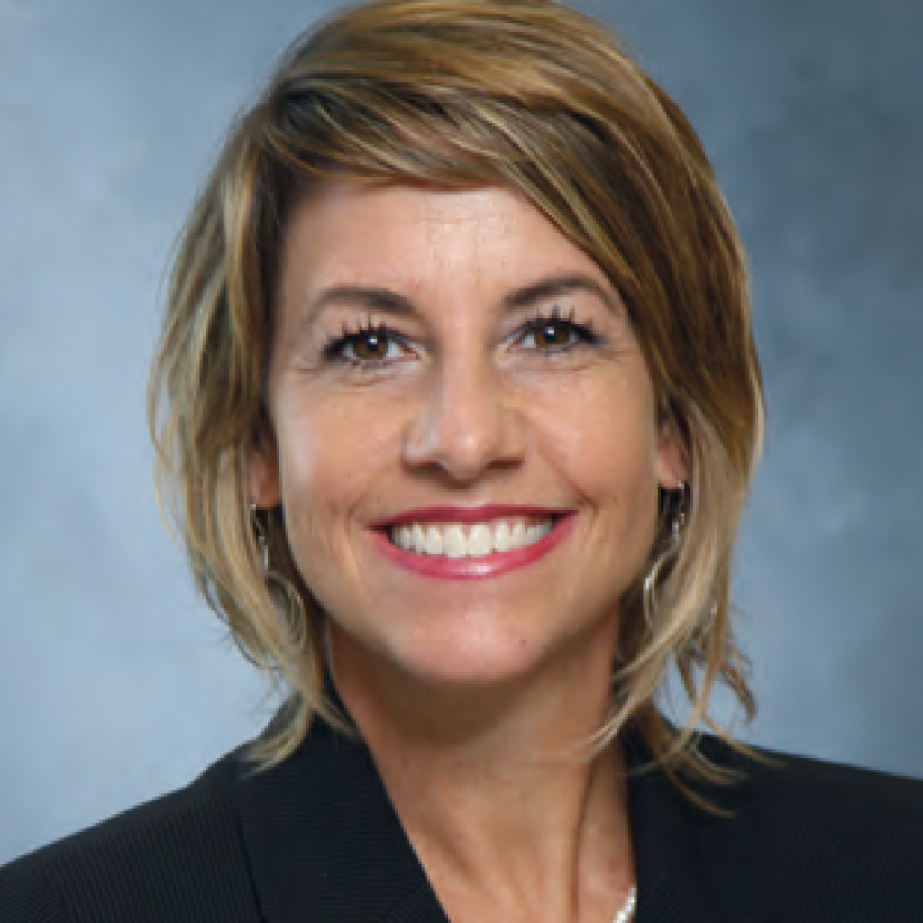
Disclosure
J. William Fulbright Scholar, Latvia, Spring 2022
National Institutes of Health, NIAMS, R21
National Science Foundation, Commercialization
TTUHSC Clinical Research Institute, Proof-of-Concept Study
TTU Innovation Hub, Prototype Development
Health Equity Leadership Institute Scholar
NIH, National Institute of Minority Health and Health Disparities Scholar

Slide 4
Objectives
Describe the problem of health literacy in the US and Europe,
Understand how levels of health literacy are determined, consequences of low health literacy and
Explore strategies for designing, implementing and disseminating tailored health information for patient groups/populations with different levels of literacy and different cultural backgrounds.

Slide 5
Health Literacy
What is health Literacy?

Slide 6
What Is Health Literacy?
Clients/Patients:
Education/Literacy/Language
Health Literacy: The capacity to
Obtain, process, understand basic health information and services
Make appropriate health care decisions (act on information)
Access/navigate health care system

Slide 7
Red Flags of Low Health Literacy
Frequently missed appointments
Incomplete registration forms
Non-compliance with medication
Unable to name medications, explain purpose or dosing
Identifies pills by looking at them, not reading label
Unable to give coherent, sequential history
Ask fewer questions
Lack of follow-through on tests or referrals

Slide 8
Health Literacy Universal Precautions Approach
Structuring the delivery of care as if everyone may have limited health literacy
You cannot tell by looking
Higher literacy skills ≠ understanding
Anxiety can reduce ability to manage health information
Everyone benefits from clear communications

Slide 9
Measuring Health Literacy
how is health Literacy determined?

Slide 10
How do we measure health literacy?
Health literacy is the degree to which individuals have the capacity to obtain, process, and understand basic health information and services needed to make appropriate health decisions. AHRQ-funded researchers have developed a variety of tools to measure an aspect of health literacy—individuals' reading comprehension in a medical context.
The AHRQ-supported tools are for the assessment of health literacy in speakers of English and Spanish, the languages most frequently spoken in the United States.
These tools can be used for research, training, or program planning purposes as long as credit is given to AHRQ as the source. (Users of the tools who publish their findings can find a link listed with each tool to the paper that describes its initial development and validation.) The tools available from AHRQ are the:
Short Assessment of Health Literacy–Spanish and English
Rapid Estimate of Adult Literacy in Medicine–Short Form
Short Assessment of Health Literacy for Spanish Adults

Slide 11
National Assessment of Health Literacy
National assessment of health literacy skills of US adults
Assessed both reading and math skills
Focused on health-related materials and tasks
36% of adults were identified as having serious limitations in health literacy skills

Slide 12
Improving Health Literacy
Interventions to improve health Literacy?

Slide 13
The Clinical Encounter
Patient’s
continuum
of confusion
Pre-visit
Scheduling the
appointment
Pre-visit
Visit reason, obtain
records, directions
In office, PP
Registration, new
forms, insurance
In office, PP
Problem, health
status, history
See Clinician
Med list, sources
of care
With Clinician
Adjust/Add med, new
Tests or referrals
See Educator
Pamphlets, charts,
videos
Checkout
New tests, samples,
instructions
Checkout
Schedule f/u,
referrals, insurance,
billing
Prevention (eating, exercise, sunscreen)
Immunization
Self Assessment of Health Status
Peak flow meter
Glucose testing
Self-treatment
Insulin adjustments
Health Care Use
When to go to clinic/ER
Referrals and follow-up
Insurance/Medicare

Slide 14
How do we improve health literacy?
Focus on “need-to-know” & “need-to-do”
Use Teach-Back Method
Demonstrate/draw pictures
Use clearly written education materials

Slide 15
Patient Understanding
What do patients need to know/do…?
When they leave the exam room
When they check out
What do they need to know about?
Taking medicines
Self-care
Referrals and follow-ups
Filling out forms

Slide 16
Teach- Back Method
Patients recalled < 50% of new concepts
Physicians assessed understanding using teach-back 12% of time
Use of teach-back was associated with good glycemic control
Visits that assessed recall were not longer
Audio taped visits – 74 patients, 38 physicians

Slide 17
Teach-Back Method

Slide 18
Patient Education
Written materials, when used alone, will not adequately inform.
Patients prefer receiving key messages from their clinician with accompanying pamphlets.
Focus needs to be “need-to-know” & “need-to do”
Patients with low literacy tend to ask fewer questions.
Bring a family member and medication to appointments.

Slide 19
Summary
Describe the problem of health literacy in the US and Europe,
Understand how levels of health literacy are determined, consequences of low health literacy and
Explore strategies for designing, implementing and disseminating tailored health information for patient groups/populations with different levels of literacy and different cultural backgrounds.

Slide 20
Conclusion
Strategies to Improve Understanding
Use plain language
Limit information (3-5 key points)
Be specific and concrete, not general
Demonstrate, draw pictures, use models
Repeat/summarize
Teach-Back (confirm understanding)
Be positive, hopeful, empowering

Slide 21
Just for Fun!
Health Resources and Services Association https://www.hrsa.gov/about/organization/bureaus/ohe/health-literacy/index.html
Centers for Disease Control https://www.cdc.gov/healthliteracy/learn/index.html
National Institutes of Health
https://www.nih.gov/institutes-nih/nih-office-director/office-communications-public-liaison/clear-communication/health-literacy

Slide 22
Food for Thought!
“If we could give every individual the right amount of
nourishment and exercise, not too little and not too much,
we would have found the safest way to health.”
- Hippocrates
Notes:
Slide 40: Food for Thought!
A few more sources, but I have also added them directly to Sakai as a document titled: Module Outline. Go ahead and download this document for your reference.

Slide 23
References
Please see Bibliography.
Notes:
Slide 41: References
The References for this Module is your textbook, Introduction to Public Health.

Slide 24
Thank You!
Questions? Please feel free to reach out to me with any questions, by email at: Courtney.queen@rsu.lv or courtney.m.queen@ttuhsc.edu
Notes:
Slide 42: Thank You!
Thank You! If you have any questions, please feel free to reach out to me. You can find my contact information here, on this slide, and it is also on the syllabus.
If you think that you might be interested in the Social and Behavioral Sciences professionally, then I have added a few good videos that explore the knowledge, skills, and abilities of someone who works as a social scientist in public health.
Lastly, as a part of your Master’s in Public Health, you will take the course, Introduction to the Social and Behavioral Sciences. This course will give you a more in-depth experience about the theory and methods in the social sciences as they apply to public health, the tools and tricks, of the trade, and it is a course that I think you will find both fascinating and intriguing.

Slide 25
Final Slide.
Notes:
Slide 32: Final Slide

