Slide 1


Valuing Arts Education via SROI
1. Quantifying the Intangible: SROI Framework and Project Appraisal in Arts-Based Education – Lessons from CLiViE
2. Measuring the Social Value of Cultural Literacy: Applying Social Return on Investment (SROI) in Arts-Based Education in Latvia
International conference "Art as an Agent of Change: Cultural Literacy for Societal Resilience"
22/04/2026
Grzegorz Maśloch & Kamil Flig,
SGH Warsaw School of Economics, Poland
gmslo@sgh.waw.pl
https://www.sgh.waw.pl/

Slide 2
Presentation Structure
Scope of SROI Analysis: Theoretical Foundations
Methodology: Estimating SROI within the CLiViE Project
Applying SROI in Arts-Based Education in Latvia
Key Findings and Recommendation

Slide 3


SROI definition and purpose
SROI is a framework for calculating and communicating social impact using the universal language of money!
ENVIRONMENTAL
SOCIAL
ECONOMIC
A key principle of SROI is understanding how and what changes occur as a result of an intervention (e.g., social, environmental or economic).
SROI

Slide 4
SROI: Historical and Geographical Evolution
Years | Region | Key Scope and Breakthrough Moments
1990s | USA | Birth of the Concept: The REDF Foundation (Roberts Enterprise Development Fund) in San Francisco develops SROI to measure the "Double Bottom Line" (financial + social profit) in social enterprises employing marginalized groups.
2000 – 2008 | UK | Standardization: The think-tank nef (new economics foundation) brings the method to Europe. The "SROI Network" is established. The British government begins testing SROI in health and municipal services.
2009 – 2012 | EU, Australia, Canada | Institutionalization: The publication of "A Guide to Social Return on Investment" (2009) by the UK Cabinet Office becomes the global manual. Australia (SVA) begins using SROI to evaluate programs for indigenous populations.
2013 – Present | Global (Asia, Africa, LatAm) | Mainstreaming: SROI becomes part of the ESG (Environmental, Social, and Governance) strategies of major corporations. Countries in the Global South adapt the method to evaluate development and humanitarian projects.

Slide 5
Methodological Perspectives in Literature
Perspective | Core Assumptions | Key Authors
Economic | Focus on efficiency, monetization, and financial proxies. | Emerson, J. (2003) Blended Value Proposition: Integrating Social and Financial Returns. California Management Review, 45. http://dx.doi.org/10.2307/41166187
Social | Well-being, empowerment, and reduction of inequalities. | Nicholls, J., Lawlor, E., Neitzert, E., & Goodspeed, T. (2012). A guide to Social Return on Investment. The SROI Network. https://socialvalueselfassessmenttool.org/wp-content/uploads/intranet/758/pdf-guide.pdf
Relational | Value as a process of building social capital and trust. | Arvidson, M., Lyon, F., McKay, S., & Moro, D. (2013). Valuing the social? The nature and controversies of measuring Social Return on Investment (SROI). Voluntary Sector Review, 4(1), 3-18. https://doi.org/10.1332/204080513X661554
Critical | Warning against reductionism and the "seduction of numbers". | McLoughlin, J. et al. A strategic approach to social impact measurement of social enterprises: The SIMPLE methodology. Soc. Enterp. J. (2009).

Slide 6

Thematic Scope and Application Examples
SROI is applied wherever traditional economic indicators (e.g., GDP, net profit) fail to capture "hidden value."
Labor Market and Social Integration (Broadest Scope)
Example: Vocational activation programs for prisoners or people with disabilities.
Scope of Analysis: Savings for the state budget (lower welfare spending, reduced recidivism) and the increase in the psychological well-being of participants.
Health and Social Care
Example: Investment in high-quality childcare in foster families.
Scope of Analysis: Long-term benefits from better education for children, reduced chances of unemployment in adulthood, and improved public health.
Environmental Protection and Circular Economy
  Example: Recycling firms that simultaneously employ people following mental health crises.
  Scope of Analysis: Combining ecological value (avoiding landfills) with therapeutic value (savings in the healthcare system).

Slide 7
The stages of a Social Return on Investment (SROI) study
SROI analysis comprises six steps:
SROI is an innovative approach used to measure and account for value created by an intervention or a policy.
It places a monetary value on the social impact (the benefit) of an activity, and compares it with the cost incurred in creating that benefit.
SROI analysis allows organisations to assess the cost/benefit ratio and to better communicate the value of their
activities to external stakeholders.
1. Defining scope and identifying stakeholders
2. Developing a theory of change and impact map
3. Evidencing outcomes and giving them a value
5. Calculating SROI ratio
6. Reporting and embedding
4. Establishing impact

Slide 8

In global practice, two main types of analysis have emerged, used depending on the research objective:
Evaluative SROI: Conducted ex-post. It assesses real effects that have already occurred, based on data collected from stakeholders. Most commonly used in annual reporting and project evaluations (e.g., in the CLiViE project for completed Case Studies).
Forecast SROI: Conducted ex-ante. It predicts how much social value will be created if the project achieves its intended goals. Key for securing funding or strategic planning.

Slide 9
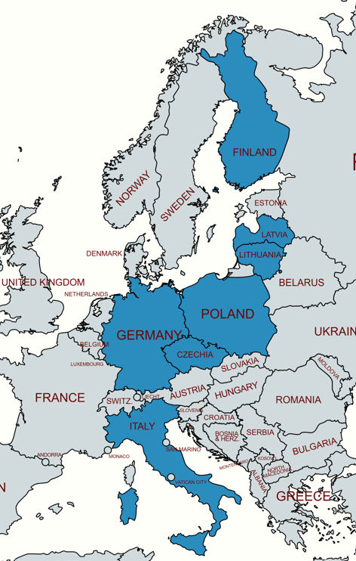
How did we work on SROI estimation?
We had 28 case studies in 7 European countries
We began our work in December 2024 by defining the report's scope and data collection methods.
The next step involved developing an Excel worksheet for data collection and preparing the workshops.
In January 2025, we conducted workshops for our partners regarding the collection of data necessary to develop the SROI report.
Since then, partners have been collecting data while conducting their case studies.
From September 2025 to February 2026, SGH worked with the partners to develop the final reports.
During this period, we held over 100 meetings with our partners (online and in person) as well as within the SGH team.

Slide 10
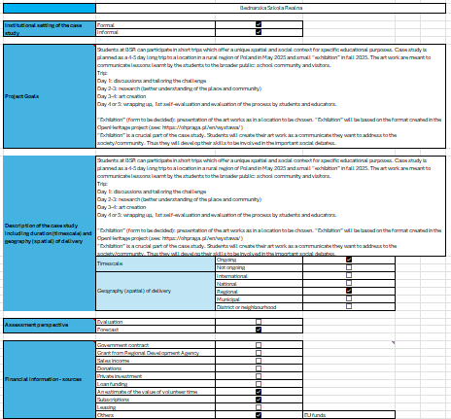
Report on SROI in arts-based education
1. Executive Summary
1.1. Background
1.2. Aim and Objectives
1.3. Methods
1.4. Results
2. Contents
3. Introduction
4. About the entity organizing and conducting the case study
5. Social Return on Investment (SROI)
6. Identifying scope and stakeholders
7. Mapping inputs, outputs and outcomes
8. Evidencing and valuing outcomes
8.1. Evidencing outcomes
8.2. Observed changes for participants
8.3. Wider, longer-term community impacts
8.4. Valuing outcomes
9. Estimating impact (Net social value)
10. Calculating the SROI
11. Discussion and Recommendations
12. References

Slide 11
Four Case Studies
in Daugavpils
CS1
CS2
CS3
CS4
The Other in Art and Life
Polish Cultural-Historical Heritage
Learn from Ancestors
Together We Rise
Partner: Rothko Museum
Age group:
16–18
Participants:
30
Setting:
Informal / Museum
Focus:
Intercultural dialogue through art workshops
Partner: J. Piłsudski Gymnasium
Age group:
17–18
Participants:
24
Setting:
Formal / School
Focus:
Quest-based heritage learning
Partner: Daugavpils Secondary School
Age group:
10–13
Participants:
28
Setting:
Formal / School
Focus:
Traditional crafts & multicultural integration
Partner: NPO HVORAN / Jitai Centre
Age group:
10–13
Participants:
30
Setting:
Informal / NGO
Focus:
Martial arts for social cohesion

Slide 12
CS1: The Other in Art and Life
SROI Analysis — Rothko Museum Partnership
Outcome Breakdown (Year 1)
€1 : €3.85
Skills development (employment & wages)
€3,224.71
63%
Persists 5 years with drop-off
Participation in cultural life
€1,620.00
31%
Social Return
per € Invested
Year 1 only
Mental well-being
€337.50
6%
Year 1 only
Financial Summary
Total Investment | Total PV | NPV
€3,660 | €14,086.76 | €10,426.76

Slide 13
CS3: Learn from Ancestors
SROI Analysis — Traditional Crafts for Multicultural Integration
Four Measured Outcomes (Year 1)
€1 : €3.30
Craft skills development
€1,518.75
62%
Persists 3 years
Communication skills
€1,350.00
14%
Social Return
per € Invested
Persists 5 years
Mental well-being
€337.50
14%
Persists 3 years
Financial Summary
Total Investment | Total PV | NPV
€2,345.29 | €7,741.46 | €5,396.17

Slide 14




Key Findings
High Social Returns
Completed SROI analyses show strong positive returns: more than € 3 per €1 invested, demonstrating that arts-based education is a cost-effective social intervention.
Skills as Primary Value Driver
Skills development (employment-related competencies, digital literacy, craft skills) accounts for 60%+ of total social value in cases, with benefits persisting 3–5 years.
Multi-Stakeholder Value Creation
Value extends beyond direct participants to families, institutions, educators, and the wider community — though participant outcomes dominate the SROI calculation.
Diverse Art Forms, Consistent Impact
Whether through museum workshops, heritage quests, traditional crafts, or martial arts — all interventions improved mental well-being, social cohesion, and cultural participation.

Slide 15
Recommendations
01
Standardise Data Collection
04
Engage Stakeholders in Valuation
Implement consistent pre/post questionnaires and attendance tracking across all case studies to strengthen outcome evidence and enable cross-case comparison.
Conduct valuation workshops where participants, families, and educators assess and validate outcome importance and financial proxy appropriateness.
02
Refine Financial Proxies
05
Scale Successful Interventions
Validate monetisation proxies with local stakeholders and use conservative estimates. Research Latvian-specific costs for comparable services (training, counselling, courses).
Use SROI evidence to advocate for expanding arts-based education programmes in Daugavpils and other multicultural regions of Latvia and Europe.
03
Track Longitudinal Outcomes
06
Report for Multiple Audiences
Extend measurement beyond the intervention period to capture the persistence and drop-off of outcomes over 3–5 years, particularly for skills and employment effects.
Produce both detailed academic reports and accessible summaries for policymakers, funders, and community partners to maximise the evidence impact.

Slide 16

Arts-Based Education Works
Every €1 invested in cultural literacy programmes
generates multiple in value.

Slide 17
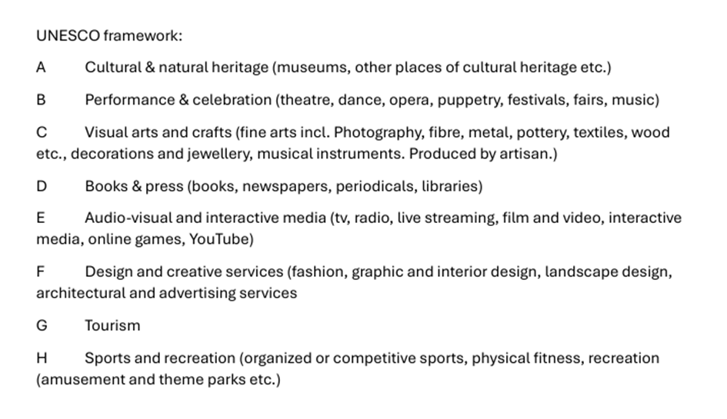
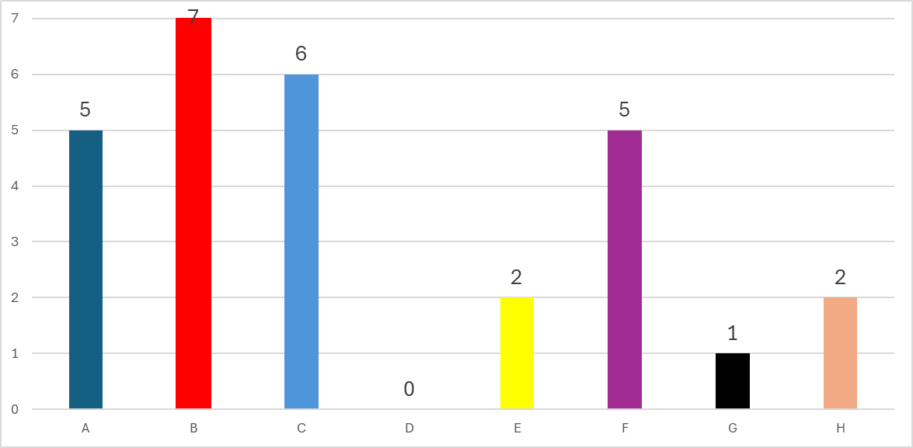

Slide 18
Final Conclusions
The CLIVIE project is the first to utilise the SROI method to estimate the impact of cultural education.
Furthermore, the CLIVIE project applies for the first time the SROI framework to relatively small-scale projects in terms of investment.

Slide 19
Final Conclusions
SGH performed a crucial "moderator function," harmonizing different cultural and organizational perspectives across 7 countries.
By providing a unified SROI framework and assigning dedicated advisers to each partner, SGH ensured that despite local differences, the final results are comparable and meet rigorous scientific standards.

Slide 20
Final Conclusions
The 28 Case Studies conducted across 7 countries (Poland, Germany, Czech Republic, Lithuania, Latvia, Finland, Italy) proved that the SROI framework is universal and can be successfully applied in diverse national contexts.

Slide 21
Final Conclusions
Through the application of SROI, it has been proven that increasing cultural literacy among youth yields tangible socio-economic value.
The demonstrated positive SROI provides a powerful argument for the continued public funding of arts programs (e.g., within the Horizon Europe framework).

Slide 22
Final Conclusions
The final analysis validated the causal pathway: from engagement in the arts (Input), through the growth of empathy and critical thinking (Outcome), to enhanced social cohesion and reduced polarization among youth (Impact).

Slide 23

Final Conclusions
Beyond the calculation of ratios, the project facilitated a transfer of "evaluative thinking" to cultural and educational institutions.
Partners gained a new set of skills in identifying and valuing their social impact, which will strengthen their position in future funding applications and stakeholder negotiations.

Slide 24
Final Conclusions
  CLiViE’s results suggest that spending on culture and arts education should not be treated as a cost, but as an investment with a high rate of social return.
  It is recommended to integrate social value analysis into standard grant-awarding procedures within the creative and educational sectors.

Slide 25
Final Conclusions
CLiViE’s results demonstrate that investing in cultural literacy is an investment in Europe’s long-term social resilience.

Slide 26
Thanks!
www.clivieproject.eu

