Slide 1




Courtney Queen, Ph.D. Fulbright Scholar Rīga Stradiņš University Institute of Public Health Assistant Professor Director for Undergraduate Studies Graduate School of Biomedical Sciences Department of Public Health
international Relationships &
Translational Actions Toward Health Equity

Slide 2

International Relationships & Translational Actions Toward Health Equity
Translational Research for Health Equity

Slide 3
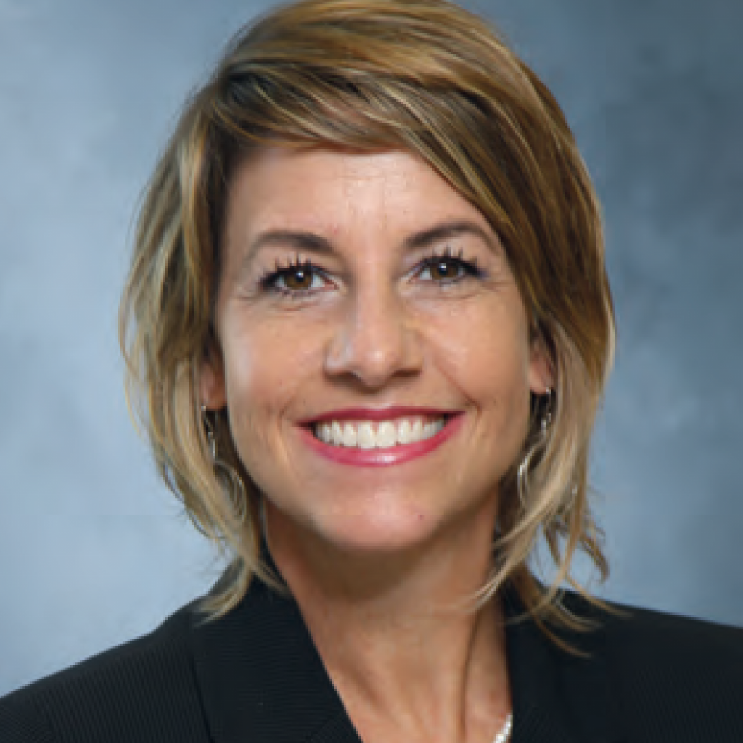
Disclosure
J. William Fulbright Scholar, Latvia, Spring 2022
National Institutes of Health, NIAMS, R21
National Science Foundation, Commercialization
TTUHSC Clinical Research Institute, Proof-of-Concept Study
TTU Innovation Hub, Prototype Development
Health Equity Leadership Institute Scholar
NIH, National Institute on Minority Health and Health Disparities Scholar

Slide 4
Objectives
Define and discuss translational research
Define and discuss health equity versus health disparities
Discuss successful examples of interdisciplinary collaboration for health equity
Recognize the complexity and multi-disciplinary aspect of health disparities research

Slide 5
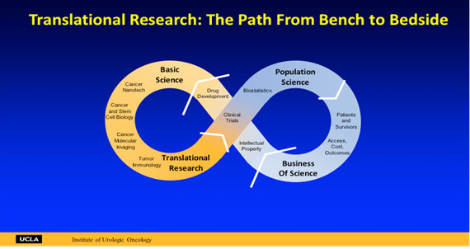
Translational Research Model

Slide 6
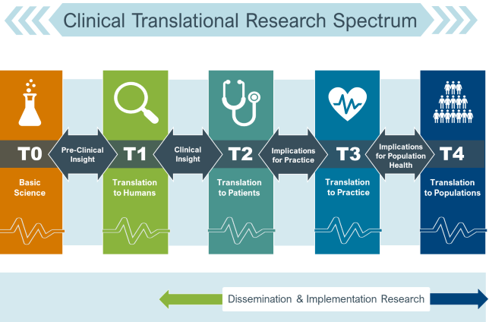
Biomedical Translational Model

Slide 7
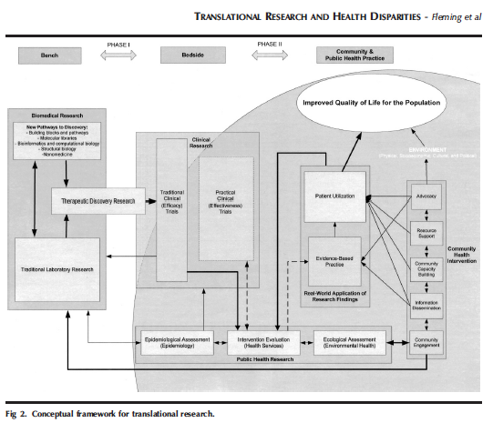
Translational Research & Health Disparities

Slide 8
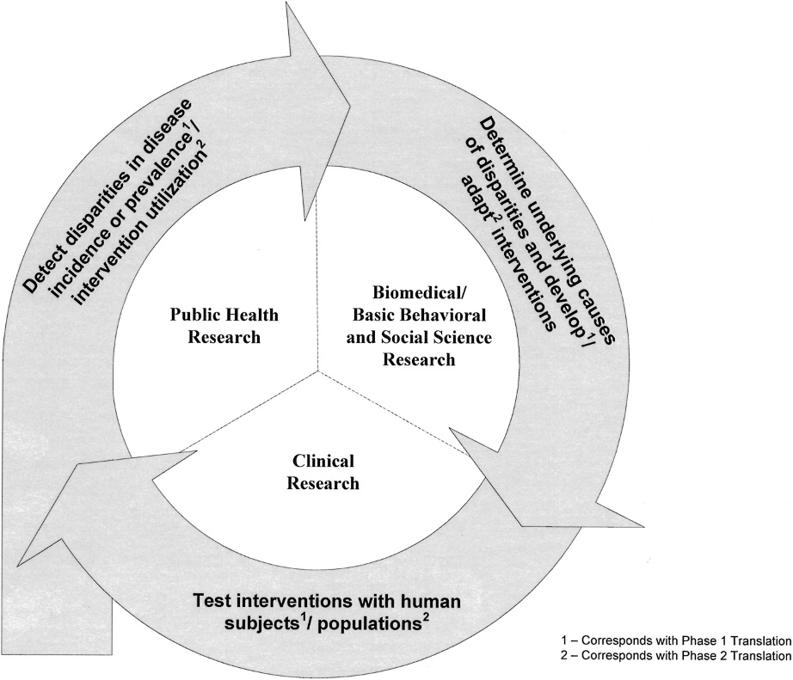
Health Disparities Research Framework
Fig 1. Health disparities research framework.
TRANSLATIONAL RESEARCH AND HEALTH DISPARITIES - Fleming et al

Slide 9
What is Health Equity?
that pursuing health equity–that is, striving to eliminate health disparities
strongly associated with social disadvantage—can be thought of as striving
for equal opportunities for all social groups to be as healthy as possible, with
selective focus on improving conditions for those groups who have had fewer opportunities.
Drawing upon human rights concepts, pursuing health equity
means removing obstacles for groups of people—such as the poor, disadvantaged
racial/ethnic groups, women, or persons who are not heterosexual—who historically
have faced more obstacles to realizing their rights to health and other human
rights.
Braveman, 2006.

Slide 10
What are “Health Disparities”?
Full version:
A health disparity/inequality is a particular type of difference in health or in the most important influences on health that could potentially be shaped by policies; it is a difference in which disadvantaged social groups (such as the poor, racial/ethnic minorities, women, or other groups that have persistently experienced social disadvantage or discrimination) systematically experience worse health or greater health risks than more advantaged groups.
Braveman, 2006.

Slide 11

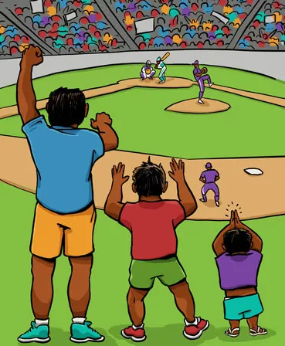

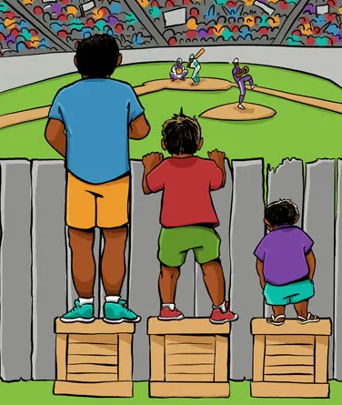

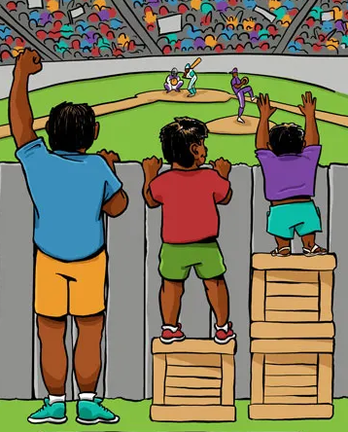


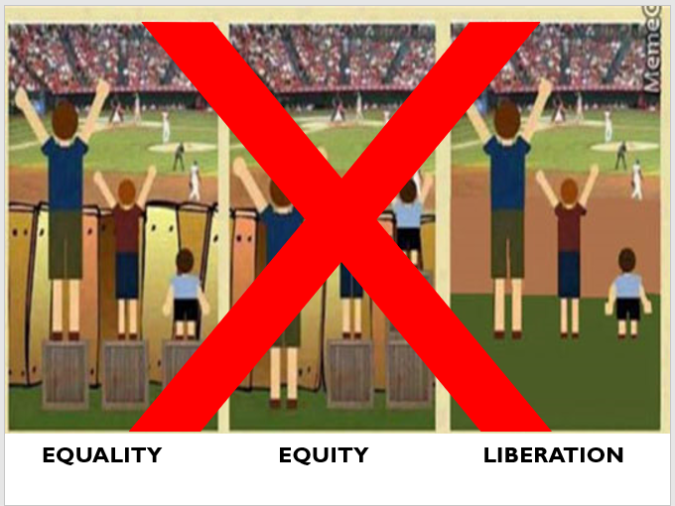

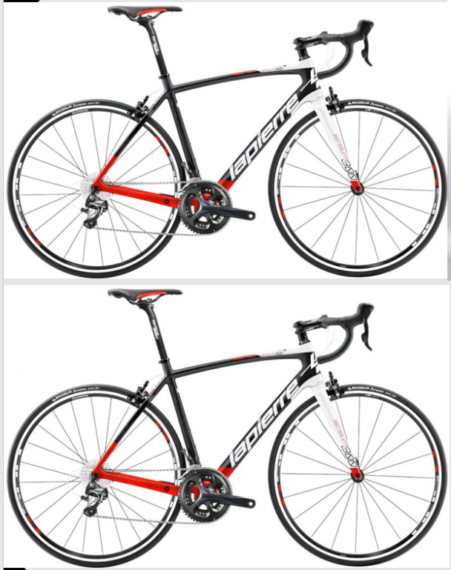

Discussion
6
2
3
4
9
7
1
10
8
5

Slide 12
Summary
Define and discuss translational research
Define and discuss health equity versus health disparities
Discuss successful examples of interdisciplinary collaboration for health equity
Recognize the complexity and multi-disciplinary aspect of health disparities research

Slide 13
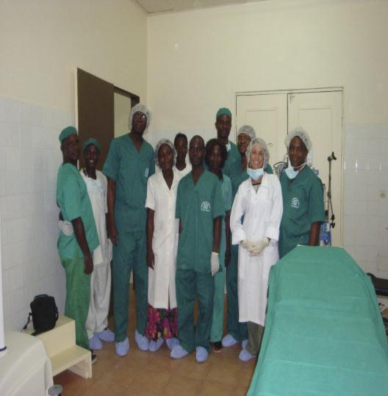
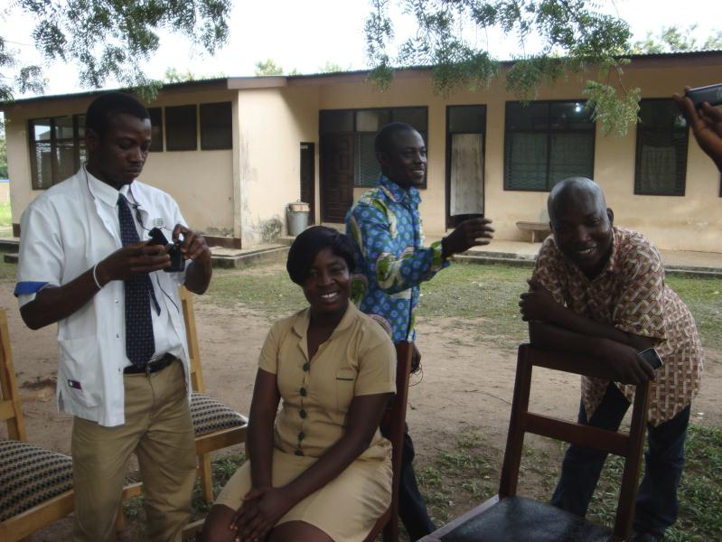
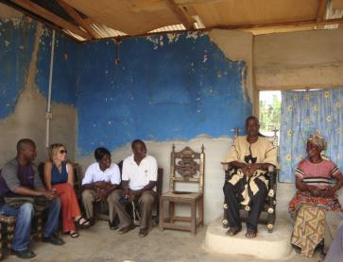
Translational Research for Health Equity – Buruli Ulcer
Notes:
Identify health trends related to chronic disease during the second half of the twentieth century
Explain primary, secondary, and tertiary care
Explain modifiable and non-modifiable risk factors
Identify the leading causes of death in the United States
Describe how the Affordable Care Act is working to improve healthy lifestyles
Explain the determinants of health

Slide 14
Conclusion - Successful Translational Collaborations
Opportunities
New knowledge!
Exciting Collaborations and Partnerships!
To Truly Advance the Core Mission to Improve Human Health
Challenges
Physical and Cultural Separation
Policy Challenges for Promotion
Funding and Time

Slide 15
Just for Fun!
Interaction Institute for Social Change. Artist: Angus Maguire. www.interactioninstitute.org and www.madewithangus.com
National Institutes of Health, National Center for Advancing Translational Sciences
Translational Science Education & Training
https://ncats.nih.gov
Clinical and Translational Science Awards (CTSA) Program
https://ncats.nih.gov/ctsa
National Institutes of Health, National Institute on Minority Health and Health Disparities
https://nimhd.nih.gov
Schillinger, Heidi. 2017. Fakequity. Can we stop using the box graphic when we talk about racial equity? www.fakequity.com

Slide 16
Food for Thought!
“If we could give every individual the right amount of
nourishment and exercise, not too little and not too much,
we would have found the safest way to health.”
- Hippocrates
Notes:
Slide 40: Food for Thought!
A few more sources, but I have also added them directly to Sakai as a document titled: Module Outline. Go ahead and download this document for your reference.

Slide 17
References
Braveman P. (2006). Health disparities and health equity: concepts and measurement. Annual review of public health, 27, 167–194. https://doi.org/10.1146/annurev.publhealth.27.021405.102103
Fleming, E. S., Perkins, J., Easa, D., Conde, J. G., Baker, R. S., Southerland, W. M., Dottin, R., Benabe, J. E., Ofili, E. O., Bond, V. C., McClure, S. A., Sayre, M. H., Beanan, M. J., & Norris, K. C. (2008). The role of translational research in addressing health disparities: a conceptual framework. Ethnicity & disease, 18(2 Suppl 2), S2–160.
Interaction Institute for Social Change. Artist: Angus Maguire. www.interactioninstitute.org and www.madewithangus.com
Narayan, K. M., Gregg, E. W., Engelgau, M. M., Moore, B., Thompson, T. J., Williamson, D. F., & Vinicor, F. (2000). Translation research for chronic disease: the case of diabetes. Diabetes care, 23(12), 1794–1798. https://doi.org/10.2337/diacare.23.12.1794
Ogilvie, D., Craig, P., Griffin, S., Macintyre, S., & Wareham, N. J. (2009). A translational framework for public health research. BMC public health, 9, 116. https://doi.org/10.1186/1471-2458-9-116
Schillinger, Heidi. 2017. Fakequity. Can we stop using the box graphic when we talk about racial equity? www.fakequity.com
Notes:
Slide 41: References
The References for this Module is your textbook, Introduction to Public Health.

Slide 18
Thank You!
Questions? Please feel free to reach out to me with any questions, by email at: Courtney.queen@rsu.lv or courtney.m.queen@ttuhsc.edu
Notes:
Slide 42: Thank You!
Thank You! If you have any questions, please feel free to reach out to me. You can find my contact information here, on this slide, and it is also on the syllabus.
If you think that you might be interested in the Social and Behavioral Sciences professionally, then I have added a few good videos that explore the knowledge, skills, and abilities of someone who works as a social scientist in public health.
Lastly, as a part of your Master’s in Public Health, you will take the course, Introduction to the Social and Behavioral Sciences. This course will give you a more in-depth experience about the theory and methods in the social sciences as they apply to public health, the tools and tricks, of the trade, and it is a course that I think you will find both fascinating and intriguing.

Slide 19

Final Slide.
Notes:
Slide 32: Final Slide

