Slide 1
Courtney Queen, Ph.D. Fulbright Scholar Rīga Stradiņš University Institute of Public Health Assistant Professor Director for Undergraduate Studies Graduate School of Biomedical Sciences Department of Public Health
international Relationships &
Translational Actions Toward Health Equity

Slide 2
International Relationships & Translational Actions Toward Health Equity
Frameworks, Theories and Concepts for
Addressing Health Disparities

Slide 3
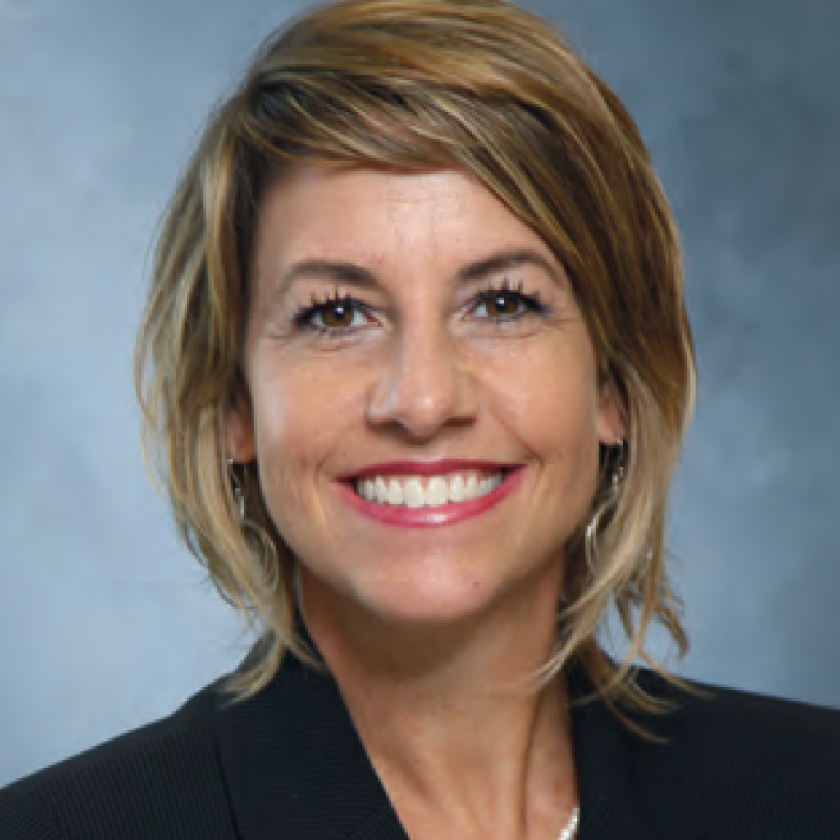
Disclosure
J. William Fulbright Scholar, Latvia, Spring 2022
National Institutes of Health, NIAMS, R21
National Science Foundation, Commercialization
TTUHSC Clinical Research Institute, Proof-of-Concept Study
TTU Innovation Hub, Prototype Development
Health Equity Leadership Institute Scholar
NIH, National Institute of Minority Health and Health Disparities Scholar

Slide 4
Objectives
Describe various frameworks and theories for addressing health disparities, including:
Single-focused conceptual approaches based on consideration of healthcare, law and policy, biology, or social/environmental factors, and
Multi-focused conceptual approaches based on consideration of life course, human development and non-biological pathways.
Practical Application

Slide 5
Conceptual Approaches
A. The Genetic Model
B. The Fundamental Cause Model
C. The Pathways Model
D. The Interaction Model

Slide 6
Conceptual Approaches
Source: Ana V. Diez Roux, 2013

Slide 7
Single-focused Models
Genetic Model, Fundamental cause

Slide 8
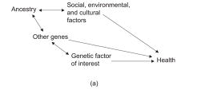
A. The Genetic Model

Slide 9
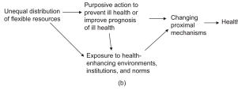
B. The Fundamental Cause Model

Slide 10
Multi-focused Approaches
Life Course Perspective, points on translational research

Slide 11
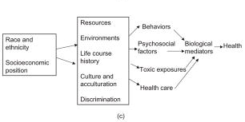
C. The Pathways Model

Slide 12
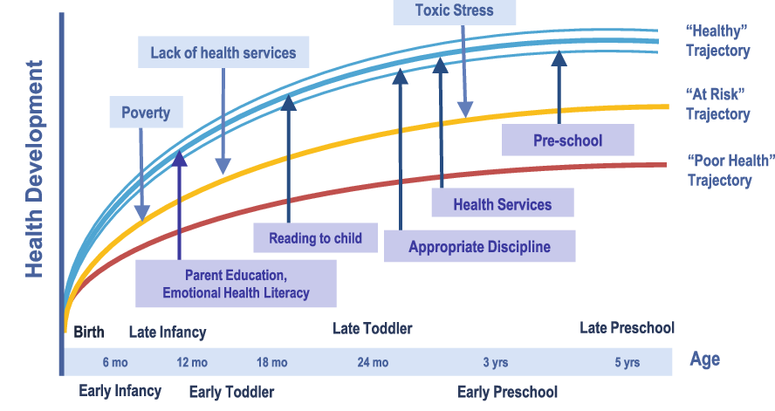
Life Course Perspective

Slide 13
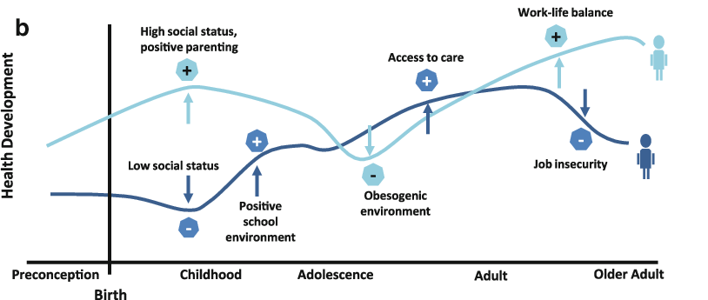
Life Course Perspective

Slide 14
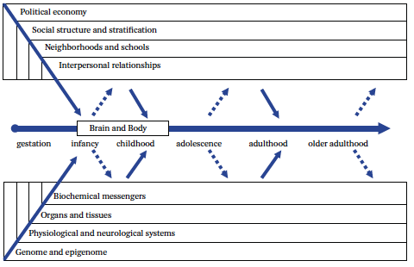
Biosocial Dynamics Across the Life Course
Source: Harris and McDade, 2018

Slide 15
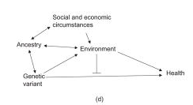
D. The Interaction Model

Slide 16
Summary
Describe various frameworks and theories for addressing health disparities, including:
Single-focused conceptual approaches based on consideration of healthcare, law and policy, biology, or social/environmental factors, and
Multi-focused conceptual approaches based on consideration of life course, human development and non-biological pathways.
Practical Application

Slide 17
Practical Application
Behavioral model for vulnerable populations (BMVP)

Slide 18
RQ: Do inequities exist in a public system?
Null hypothesis: No healthcare disparities exist in a publically-funded, safety-net healthcare network
Model: Behavioral Model for Vulnerable Populations
Methodology: Primary data collection using survey methods and instrument design using standardized measures of access to healthcare. N= 1,048.
Analysis: Descriptive statistics, Hierarchal logistic regression

Slide 19
Behavioral Model for Vulnerable Populations
Predisposing Domain | Enabling Domain | Health Need Domain | Utilization/Access
Traditional Variables | Traditional Variables | Self-Reported Health | 1. Problems accessing healthcare
Age | Employment Status |  | 2. Emergency department use
Gender | Insurance Coverage |  | 3. Problems accessing prescription medications
Marital Status | No Insurance |  | 4. Forgoing healthcare to meet other basic needs
 | Usual Source of Care
Vulnerable Variables | Vulnerable Variables
Race/Ethnicity | Paid Time-Off
Language at Home | Paid Sick Time
Citizenship | Accompanying Person
Birthplace | Interpretation
Number of Years in the U.S. | Paperwork
 | Transportation
 | Competing needs for food, housing, clothing
Source: Gelberg, Andersen, and Leake, 2000.

Slide 20
Findings
** Switch Screen to
Table: Nested logistic regression analyses for problems accessing healthcare in a safety-net health network.

Slide 21
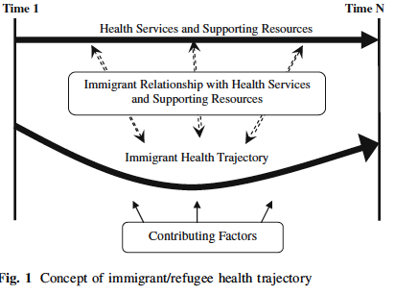
Refugee and Immigrant Health
Source: Edberg, et al., 2010

Slide 22
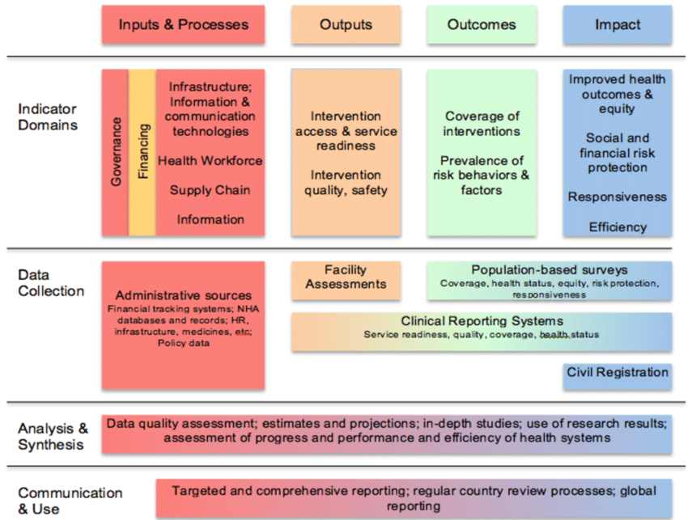
Conclusion
Source: WHO Health Systems Strengthening M&E Framework

Slide 23
Just for Fun!
Analyzing Health Systems to Make them Stronger
http://www.strengtheninghealthsystems.be

Slide 24
Food for Thought!
“If we could give every individual the right amount of
nourishment and exercise, not too little and not too much,
we would have found the safest way to health.”
- Hippocrates
Notes:
Slide 40: Food for Thought!
A few more sources, but I have also added them directly to Sakai as a document titled: Module Outline. Go ahead and download this document for your reference.

Slide 25
References
Diez Roux, A. V. (2012). Conceptual Approaches to the Study of Health Disparities. Annual Review of Public Health, 33(1), 41-58. doi:10.1146/annurev-publhealth-031811-124534
Edberg, M., Cleary, S., & Vyas, A. (2011). A trajectory model for understanding and assessing health disparities in immigrant/refugee communities. Journal of immigrant and minority health, 13(3), 576–584. https://doi.org/10.1007/s10903-010-9337-5
Halfon, N., & Hochstein, M. (2002). Life course health development: an integrated framework for developing health, policy, and research. The Milbank quarterly, 80(3), 433–iii. https://doi.org/10.1111/1468-0009.00019
van Olmen J, Criel B, Van Damme W, Marchal B, Van Belle S, Van Dormael M et al.: Analysing Health Systems to Make Them Stronger. Antwerpen: Institute of Tropical Medicine; 2010. [Van Lerberghe W, Kegels G, and De Brouwere V: Studies in Health Services Organisation & Policy]
Notes:
Slide 41: References
The References for this Module is your textbook, Introduction to Public Health.

Slide 26
Thank You!
Questions? Please feel free to reach out to me with any questions, by email at: Courtney.queen@rsu.lv or courtney.m.queen@ttuhsc.edu
Notes:
Slide 42: Thank You!
Thank You! If you have any questions, please feel free to reach out to me. You can find my contact information here, on this slide, and it is also on the syllabus.
If you think that you might be interested in the Social and Behavioral Sciences professionally, then I have added a few good videos that explore the knowledge, skills, and abilities of someone who works as a social scientist in public health.
Lastly, as a part of your Master’s in Public Health, you will take the course, Introduction to the Social and Behavioral Sciences. This course will give you a more in-depth experience about the theory and methods in the social sciences as they apply to public health, the tools and tricks, of the trade, and it is a course that I think you will find both fascinating and intriguing.

Slide 27
Final Slide.
Notes:
Slide 32: Final Slide

