Slide 2


Slide 3
Notes:
Unconscious decision that your nervous system is making that is keeping dramatically affecting your wellbeing,
and the two choices that you can make to rectify that once you recognize it.

Slide 4


Slide 5


Slide 6
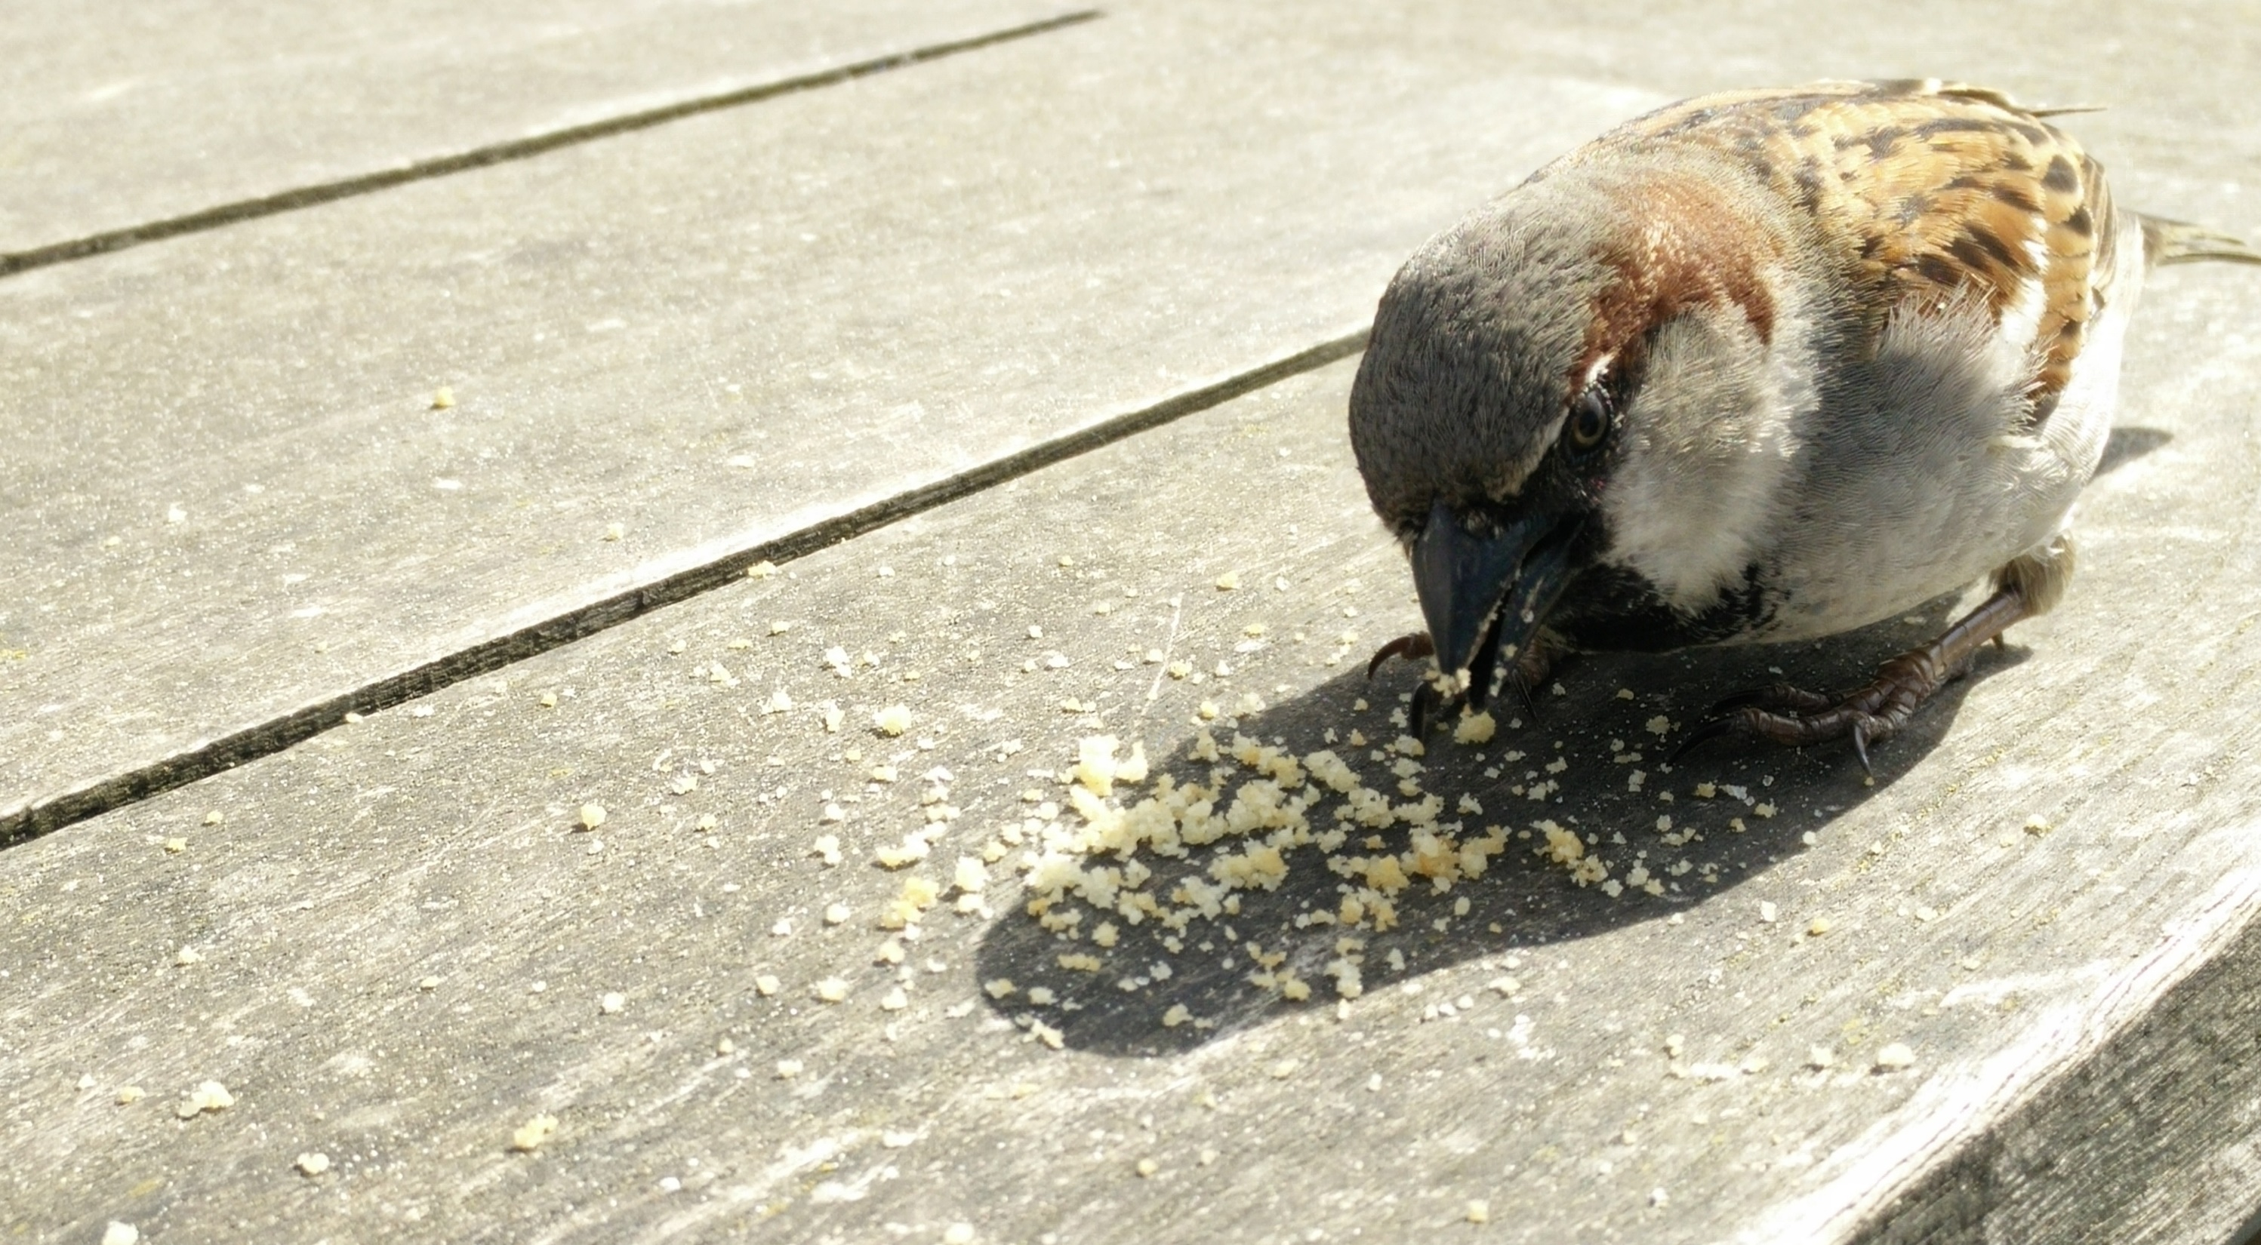
Notes:
Bird/Bread
Survival instinct
From very early
We all have it

Slide 7
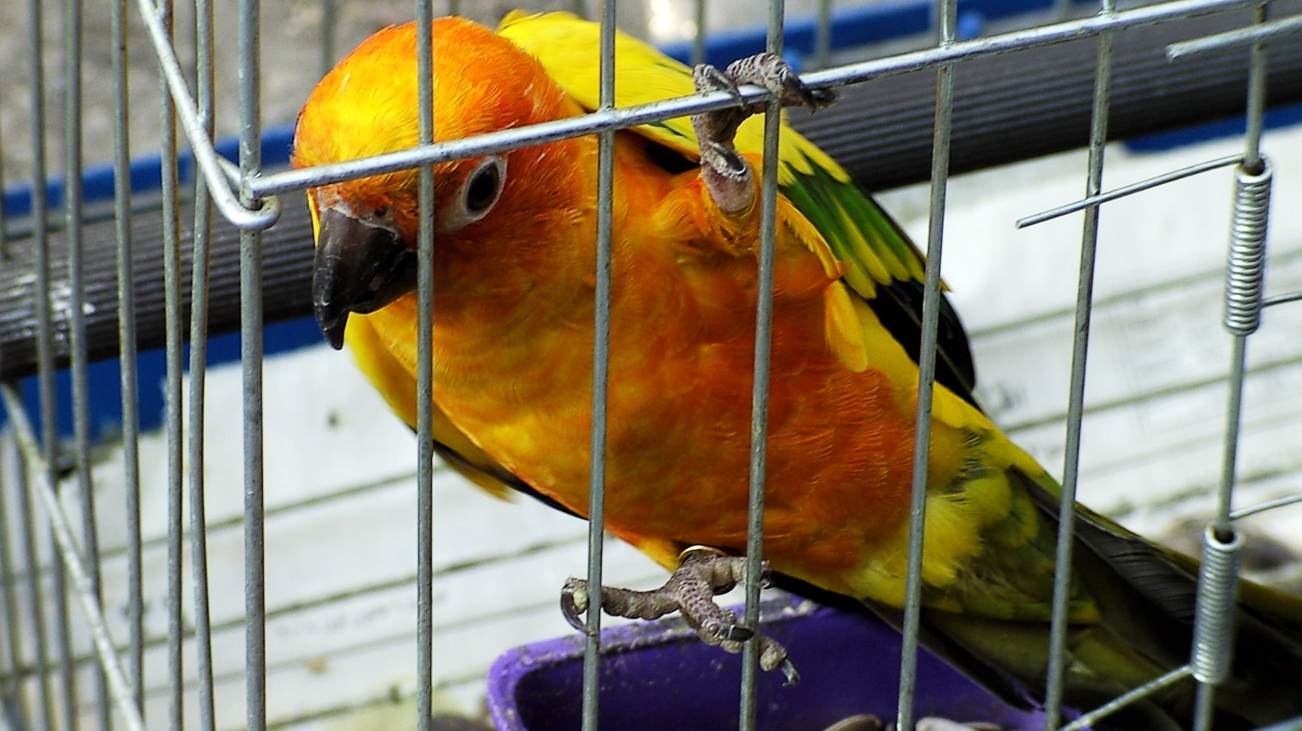
Notes:
Even true for Eric’s caged bird

Slide 8
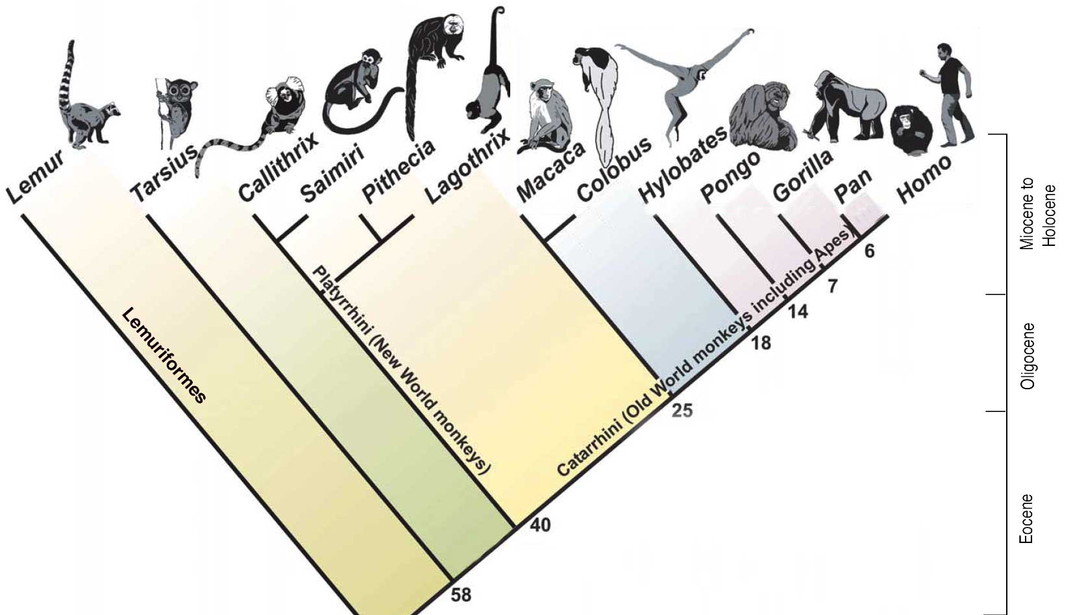
This Photo by Unknown Author is licensed under CC BY-SA
This Photo by Unknown Author is licensed under CC BY
Notes:
We are all animals
We all have this core survival system built in

Slide 9

Notes:
How many of you have goals?
Why?
Something just doesn't seem right in the moment - like the bird
That's your survival instinct

Slide 10

Notes:
<1 = Behaviorism
Touch a hot stove, etc…
1-3 years old, episodic memory kicks in
New type of problem solving emerges
What's happening at age 3?
Relationships issues, work issues, etc? -- No
The survival issues are external. They are basic physical survival issues
Problem solver binds tightly to Survival Instinct during that time

Slide 11
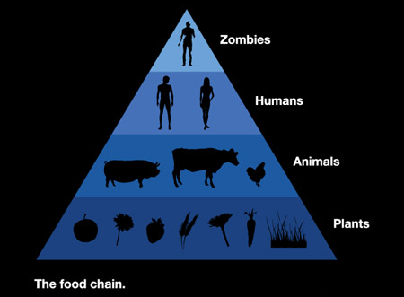
Notes:
As you grow and mature, this process remains at your core
If you think about it…In our Western lifestyles we're at the top of the food chain
We live safe lives…

Slide 12



Notes:
But, this problem solver remains…
And this process maps itself onto your current life issues.
Divorce, loss of job, etc. -- feel like tiger ripping your arm off
Why? Plenty of potential spouses, jobs, etc.
All external things…

Slide 13
Notes:
Problem Solver is tightly bound to your early survival, all of which was external concerns
Thus, it constantly looks outside you to try to solve its feeling that something might not be right in this moment.
Thus, goals are often mapped to the external.
Job, house, car, relationship, school, kid, etc.

Slide 14

Notes:
How many of you have achieved at least one of your goals?
What happens when you do?
Temporary relief, then a new goal.
Why does solving one goal simply lead to another one?
It's because of this tight mapping and the external orientation

Slide 15


Unconscious Decision-making
Notes:
This problem/solution dynamic feels like it lies at the very heart of your nature. It's been with you, essentially, from the beginning.
It's an unconscious choice that your nervous system is making.
Wired into you and functioning from before the sophistication of your current conscious mind was around.
Most of the things you've done to produce deeper, lasting improvements in your wellbeing leave it intact as well.
You can no more consciously control your survival instinct and what's bound to it from the first moments of your exitance, than you can the mitochondria in a specific cell on your big toe.
Worse, this part of your nervous system is essentially setting you up for ultimate failure.
No matter how much success you achieve in the world, you'll always have discontent in the moment.
For the most part, no matter how many goals you establish and achieve, it will remain.

Slide 16
Step 1…
Notes:
The first and most important step is to realize this.
To realize that you've been a victim of an unconscious choice made in your nervous system for most if not all of your life.
Once you realize this, you have a choice to make.

Slide 17

“The Choice”
U. C.
Manage
Solve
Notes:
Three choices actually.
Choice 1 is to just keep defaulting to this unconscious behavior pattern.
Choice 2 is to accept that this is the way your nervous system is wired, that you'll always have discontent in the moment, and try to manage it as best you can.
Choice 3 is to solve he core problem, which in many ways is the fundamental problem of the human condition.
For most people, once they realize this, Choice 1 is not desirable.
So, the real choice is between Choice 2 and Choice 3.
And, this is a choice with real consequences.

Slide 18
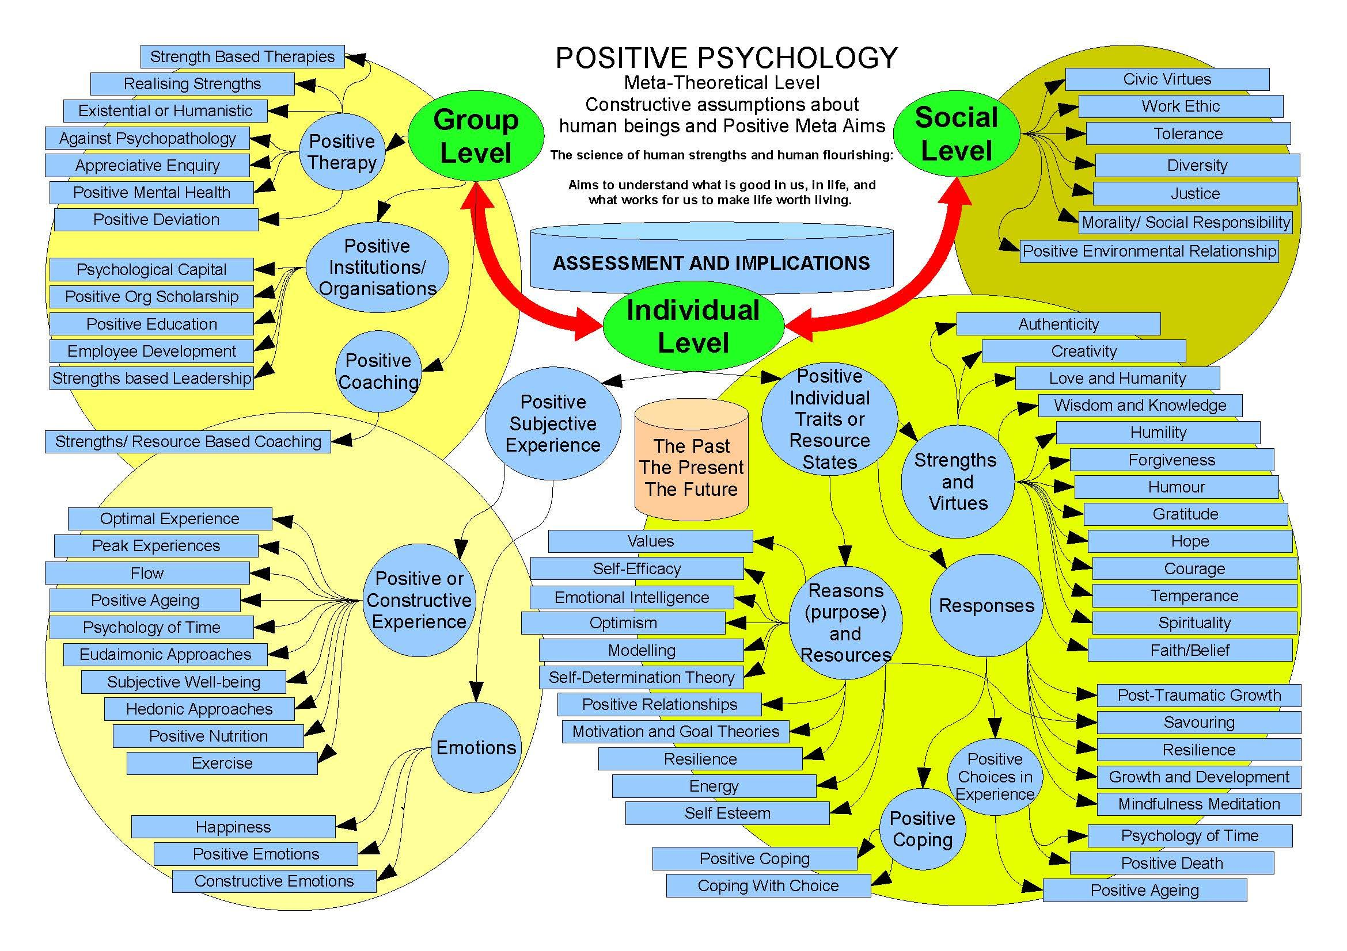

Slide 19
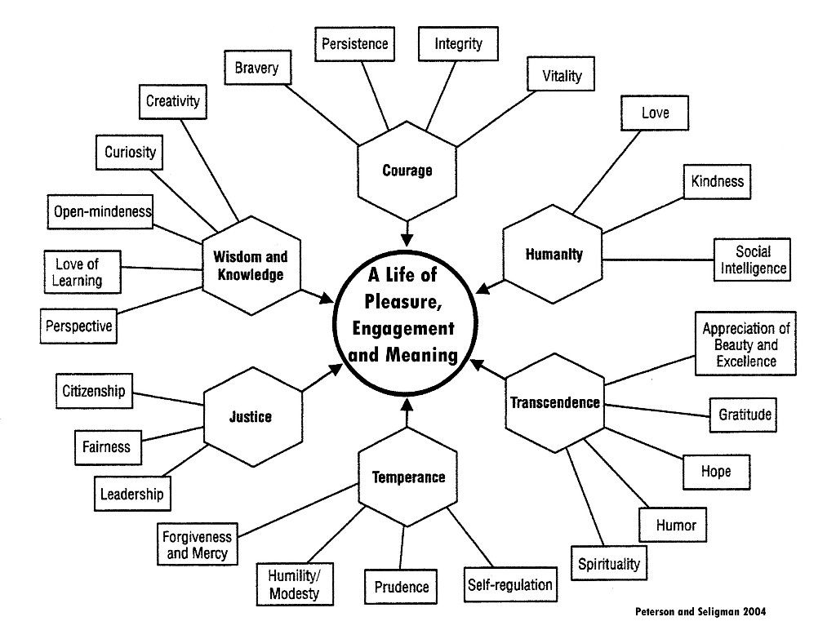

Slide 20
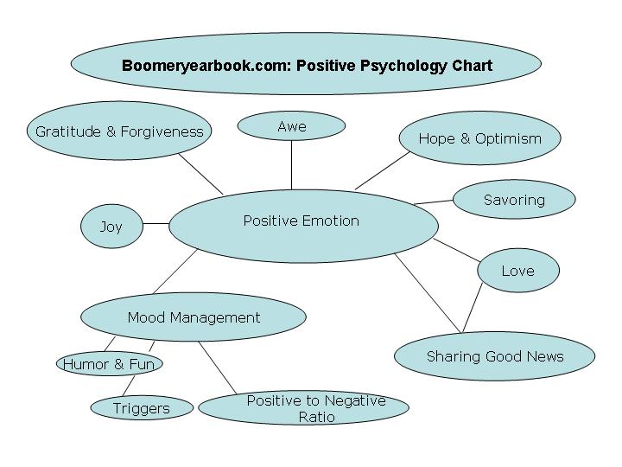

Slide 21
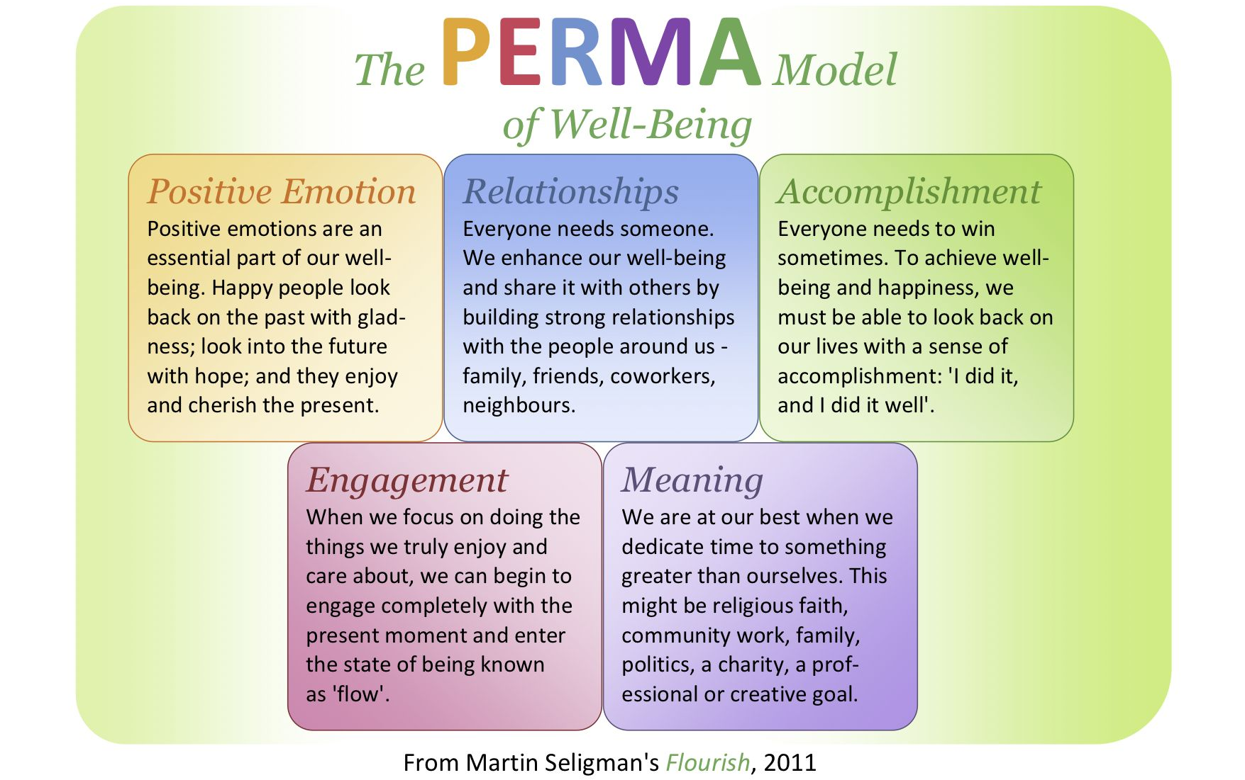

Slide 22
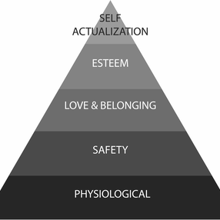
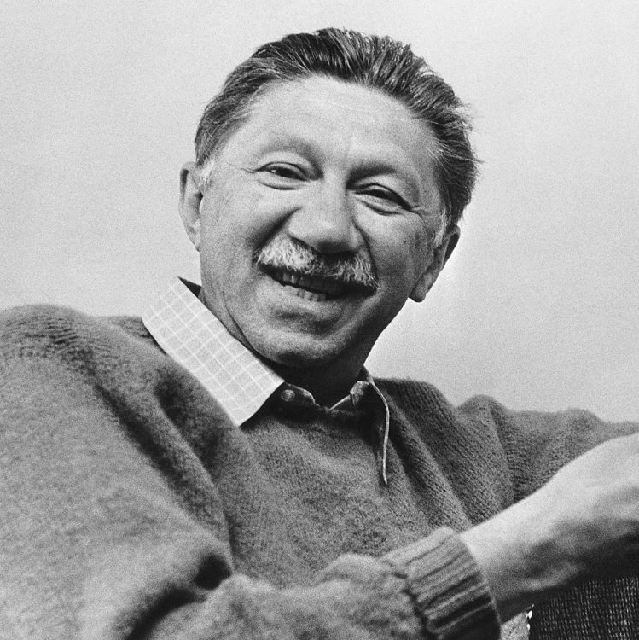

Slide 23
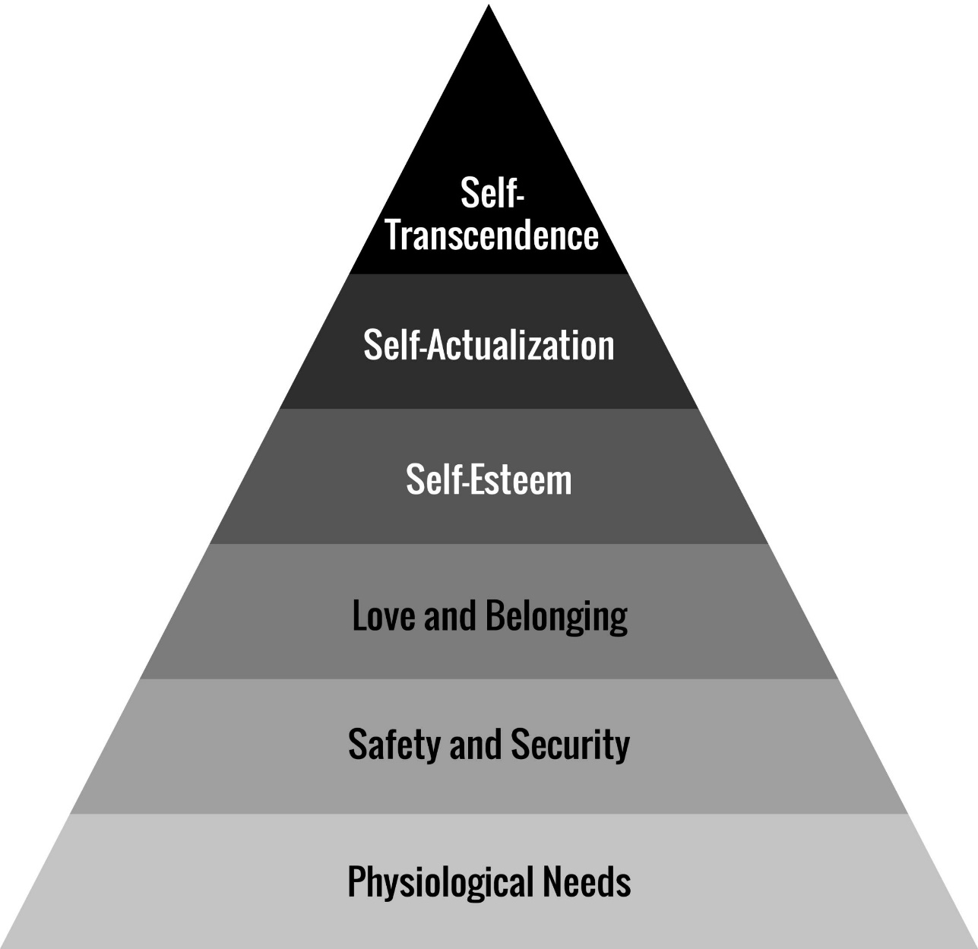

Slide 24
Persistent shift in your baseline state away from anxiety, fear, worries, etc. to a fundamental sense that everything is okay
Fundamental ‘okayness’ or contentment
Sense that you don’t need to add anything to yourself, but that its okay to explore
Reduced or eliminated mental chatter
Increased or total freedom from thoughts impacting mood
Increased or total focus on Now, rather than painful pasts and anxious futures
Increased sense of connectedness and possibility
‘Life Flow’ instead of ‘Task Flow’

Slide 25
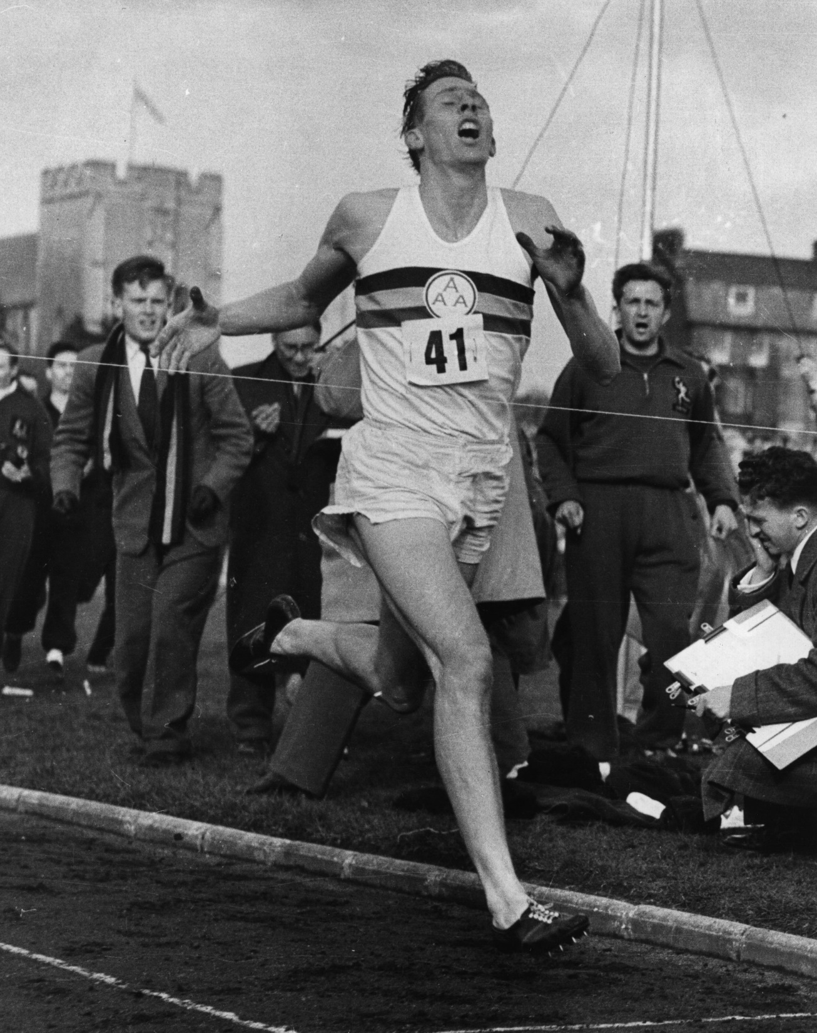

Slide 26
Academic Measures
Overall

Slide 27
Outcomes from a 4-month, 2-3 hour per day meditation and positive psychology program
Measure | FC2-FC9
Happiness | +14-17%
Wellbeing | +19%
% Time Happy | +31% (>60% of time)
% Time Unhappy | -41% (<16% of time)
% Time Neutral | -28%
Positive Emotions | +19
Negative Emotions | -40
Measure | FC2-FC9
Depression | -46%
Bad Meaning | -18%
Good Meaning | +15%
Gratitude | +7%
Relationships | +14%
Engagement | +9%
Loneliness | -40%

Slide 28
Difference Between FW and nFW
Measure | FW M3 | FW M3 - M1 | FW Chg | Significance | nFW M3 | nFW M3 - M1 | nFW Chg | Diff nFW to FW
Wellbeing - SWLS | 28.65 | 4.643 | 19% | p < 0.000001 | 21.75 | 3.119 | 17% | 24%
Happiness - AHI | 3.89 | 0.551 | 16% | p < 0.000001 | 3.09 | 0.252 | 9% | 21%
Happiness - PERMA | 8.72 | 1.339 | 18% | p < 0.000001 | 6.75 | 0.836 | 14% | 23%
Happiness - FEQ | 8.2 | 1.009 | 14% | p < 0.000001 | 6.81 | 0.831 | 14% | 17%
% Time Happy - FEQ | 73.42 | 18.125 | 33% | p < 0.000001 | 45.9 | 7.22 | 19% | 37%
% Time Neutral - FEQ | 19.37 | -11.048 | -36% | p < 0.000001 | 37.39 | -2.542 | -6% | -93%
% Time Negative - FEQ | 6.61 | -7.065 | -52% | p < 0.000001 | 16.46 | -5.017 | -23% | -149%
Positive Affect - PERMA | 8.53 | 1.444 | 20% | p < 0.000001 | 6.49 | 0.819 | 14% | 24%
Negative Affect – PERMA | 1.57 | -1.556 | -50% | p < 0.000001 | 3.17 | -0.742 | -19% | -102%
Relationships - PERMA | 8.51 | 1.127 | 15% | p < 0.000001 | 6.63 | 0.47 | 8% | 22%
Depression - CES-D | 4.12 | -5.214 | -56% | p < 0.000001 | 10.54 | -4.339 | -29% | -156%
Presence - MLQ | 26.59 | 2.607 | 11% | p < 0.000001 | 22.36 | 0.542 | 2% | 16%
Search - MLQ | 14.9 | -3.738 | -20% | p < 0.001 | 21.03 | -2.814 | -12% | -41%
Gratitude | 40.12 | 2.583 | 7% | p < 0.000001 | 36.8 | 2.695 | 8% | 8%
Engagement - PERMA | 8.53 | 0.864 | 11% | p < 0.000001 | 6.9 | 0.169 | 3% | 19%
Loneliness - PERMA | 1.25 | -1.433 | -53% | p < 0.000001 | 3.07 | -0.797 | -21% | -146%
Meaning - PERMA | 8.81 | 1.204 | 16% | p < 0.000001 | 6.93 | 0.724 | 12% | 21%

Slide 29
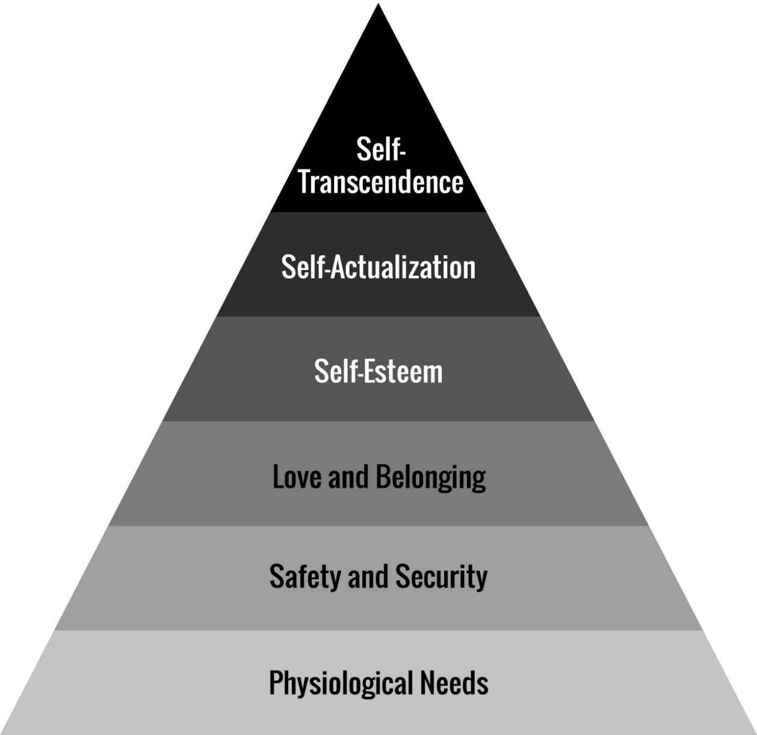
Choice 2
Choice 3
OR

Slide 30
Choice 2
Choice 3
OR
Make the best of it.
Solve it.
Notes:
So, for next year we're releasing a comprehensive program that supports people regardless of which choice they are making.
Regardless of whether you want to move from Choice 1 to Choice 2, or Choice 3; or just deepen and root more into one of the Choices
This is all based on work we've been doing for nearly 20 years at this point, and we've assembled a great team to roll it out

Slide 31
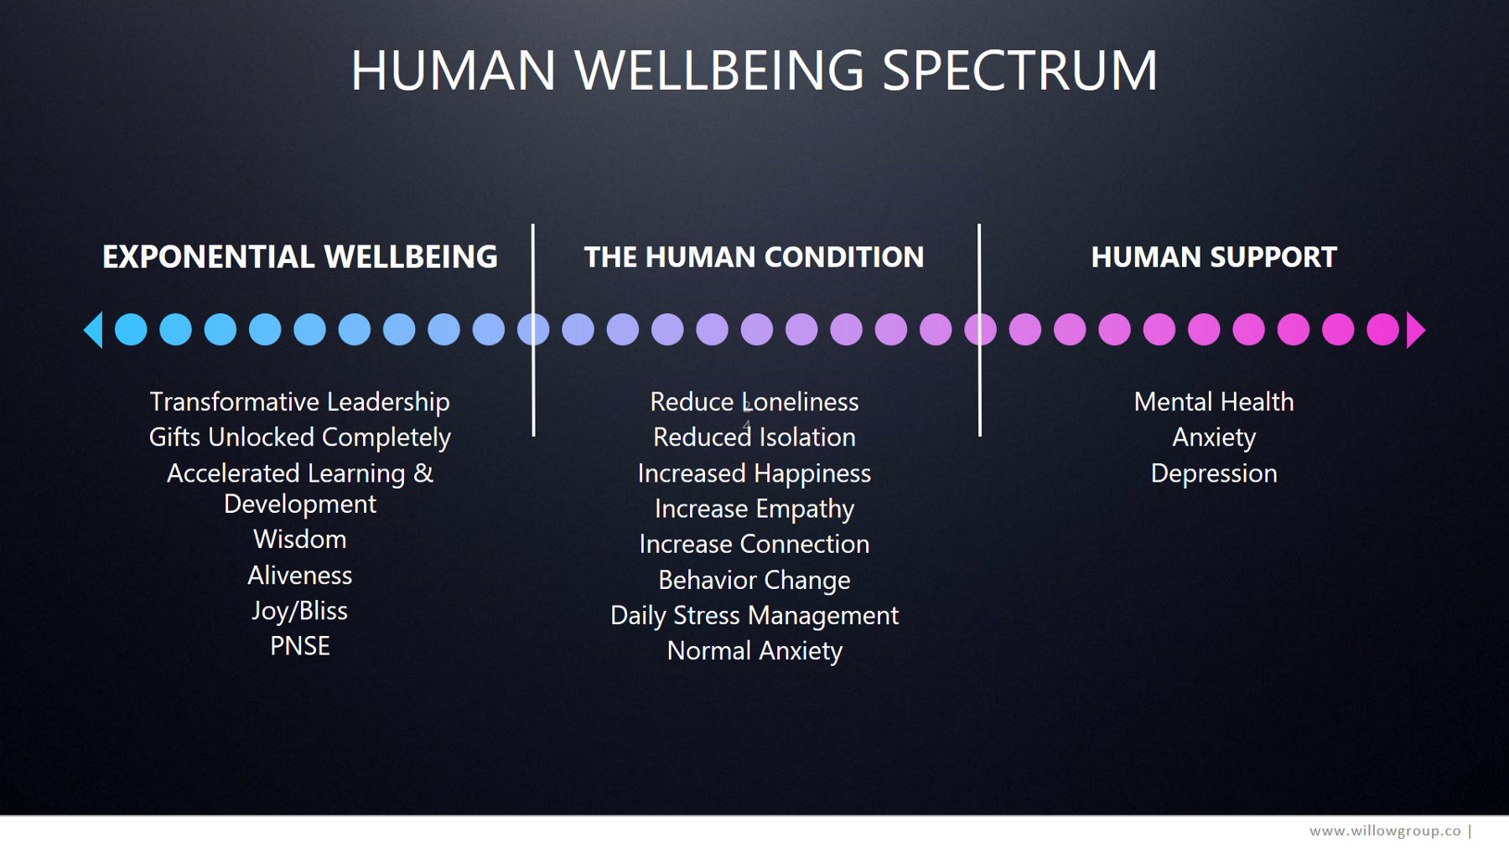

Slide 32


What are people willing to pay
to have MORE BLUE AND less grey?
Stress
Empathy
Connection
Loneliness
Happiness
Anxiety
Behavior change
Depression
Healthy brains
Social Anxiety
(Across Aging)
Limitless
potential
Saddness
Pain relief
Bad Habits
Notes:
So answer this question…what are people willing to do to have more blue and less grey?

Slide 33


Technology For Mental And Emotional Wellbeing
Notes:
Transtech has a simple mission
1) to support human mental and emotional wellbeing.
2) to provide a new mirror – through data, sensors, feedback – to understand ourselves and others better.
3) to use new tools to stimulate and shape our psychology and most importantly…to become able to choose.
Our outer world has been deeply redesigned by technology but our inner development hasn’t…until now.

Slide 34

The TransTech Market is Hidden Within Other Markets
MEDITATION $1BN (no hw/sw) | YOGA $27BN US | FITNESS & MIND/BODY $446BN WW
PREVENTATIVE HEALTH $432BN WW | WORKPLACE WELLNESS $40BN US | ALTERNATIVE HEALTH $186BN WW
DEPRESSION, STRESS, & ANXIETY DRUGS WW $22BN | COST OF US STRESS ($300BN) | WEIGHT LOSS $150BN WW
WEARABLES 80MN Units WW | ADDICTION TREATMENT $35BN US | SELF-HELP $10BN
Notes:
The market for Transtech exists, hidden inside of other markets dedicated to altering our states, changing our lives, making us happier, or trying to fill the “hole” inside
On one end you have people who need support for anxiety, stress, and depression.
In the middle you have those needing skills to navigate happiness, loneliness, connection, and to develop compassion
And on the far side, you have people pushing the limits of human performance and ability through the mind.

Slide 35

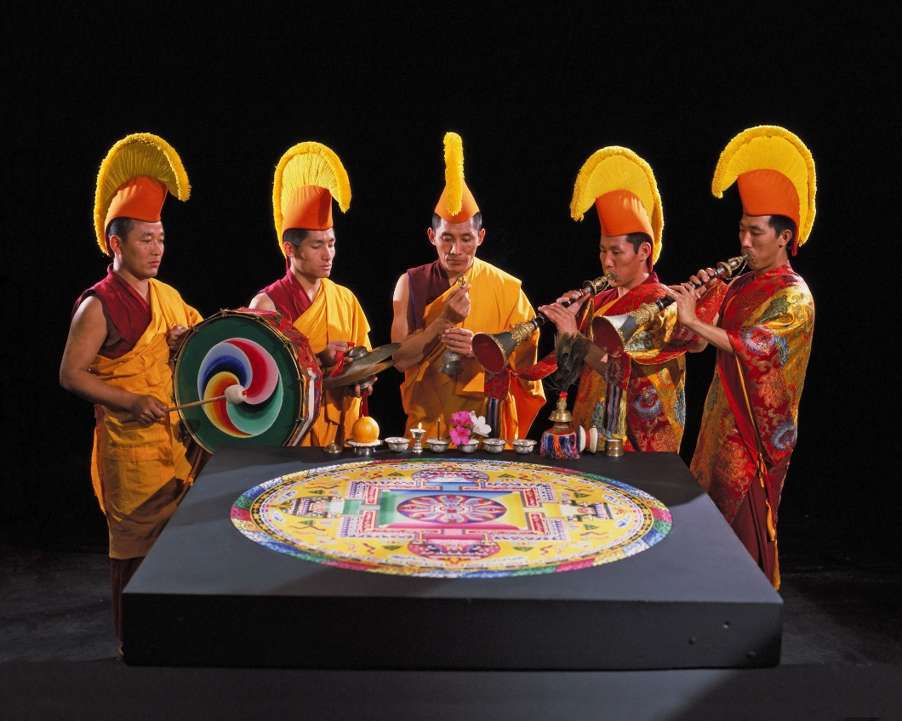
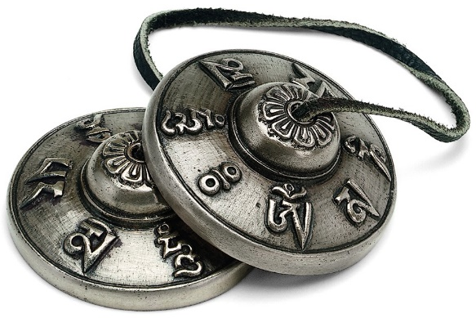


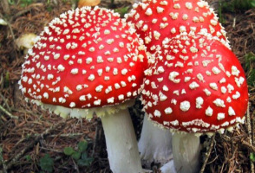

Slide 36
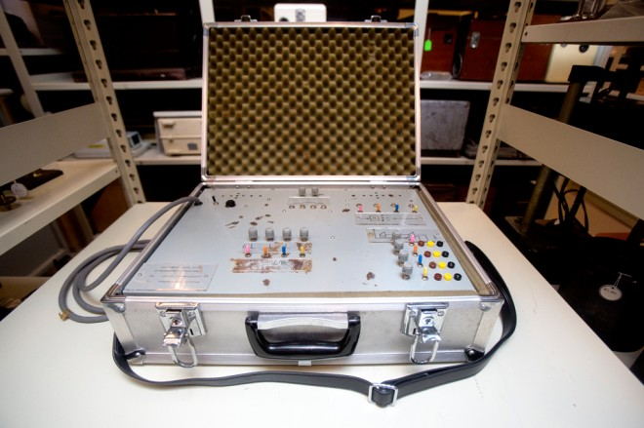
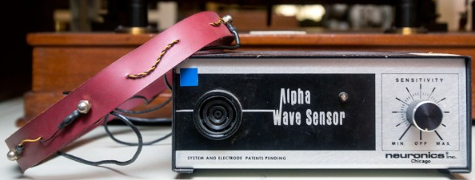
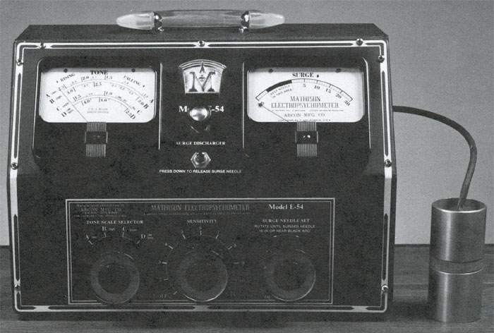
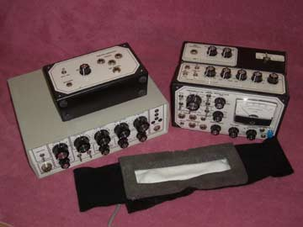
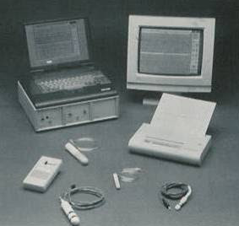
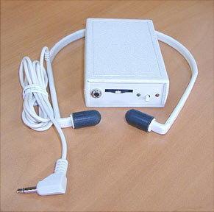
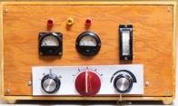
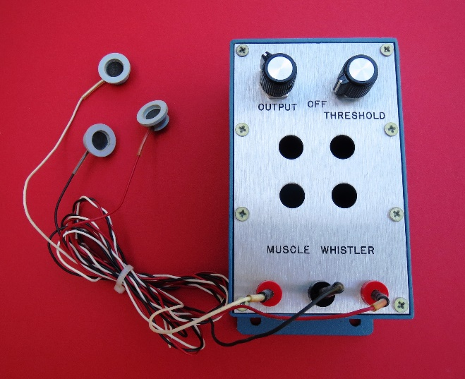
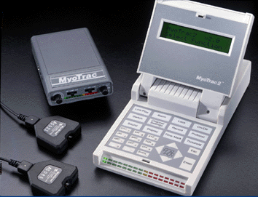
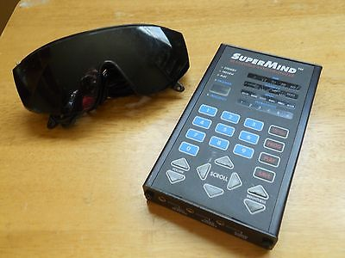
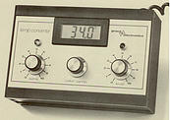

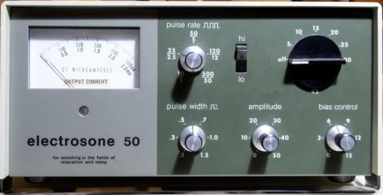
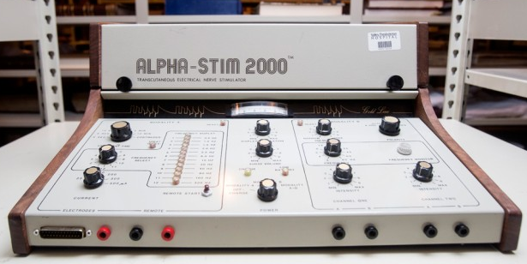
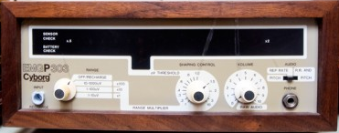

Slide 37
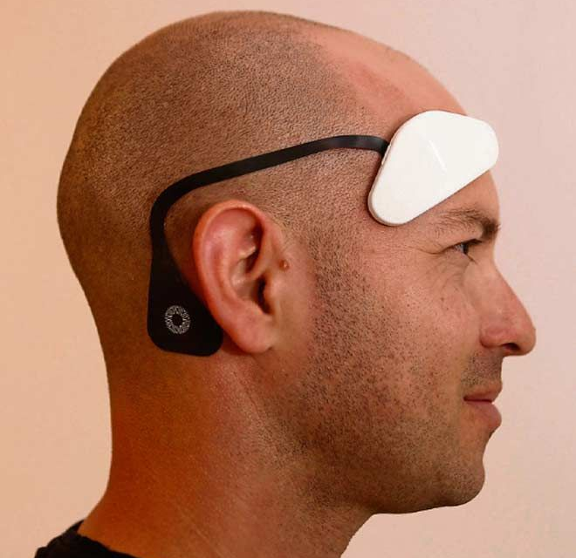
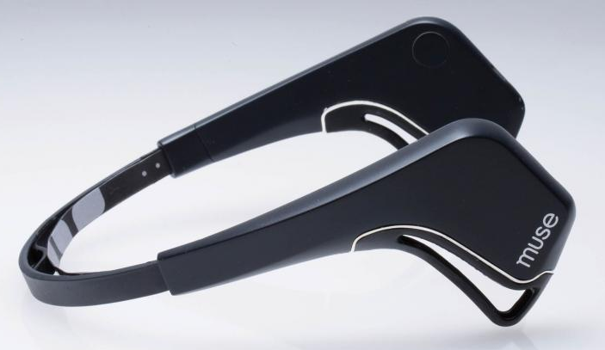

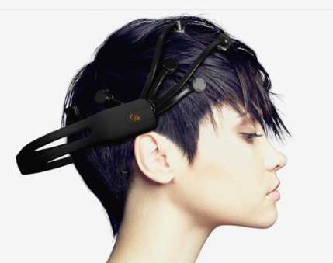
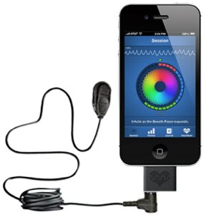
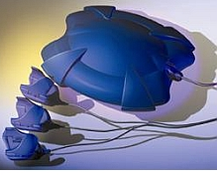

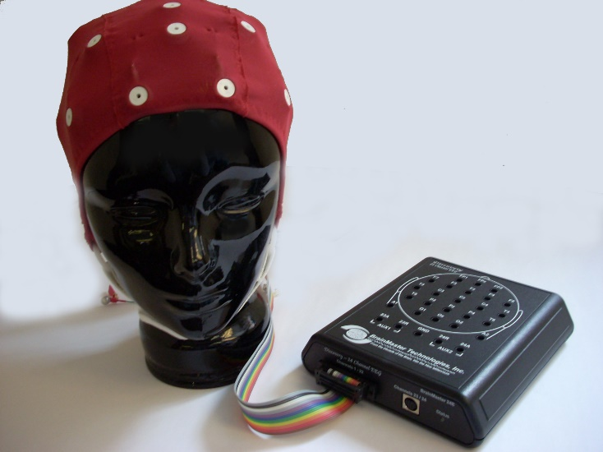
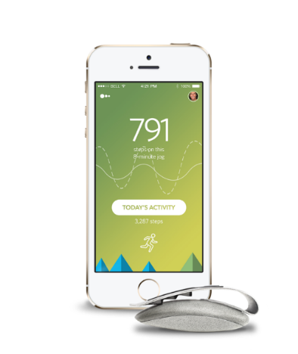
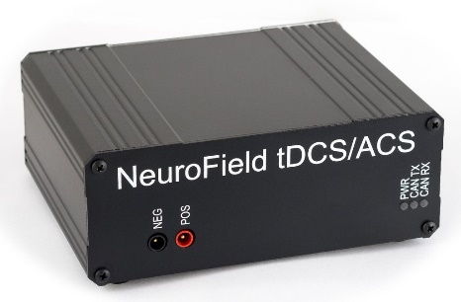
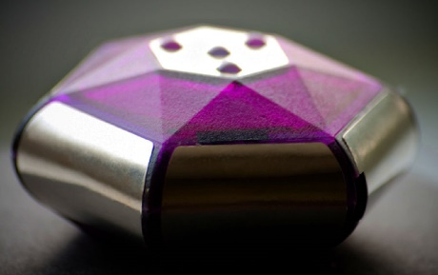
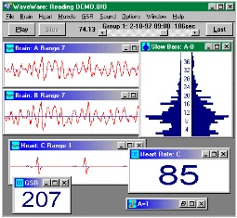
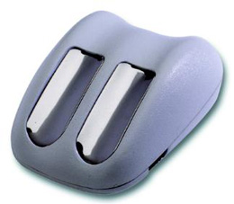
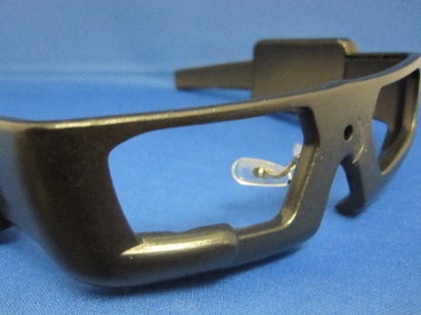
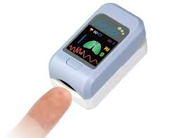
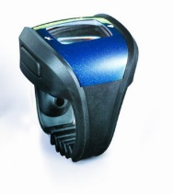
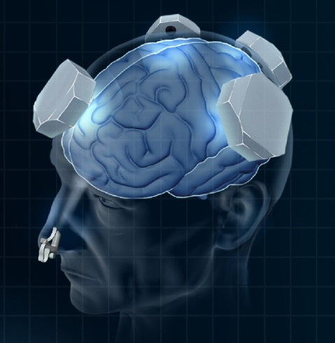
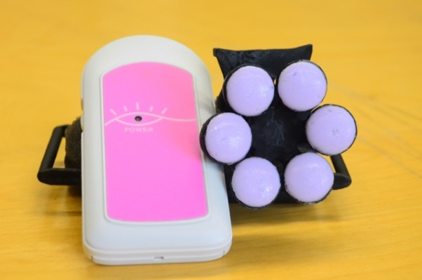
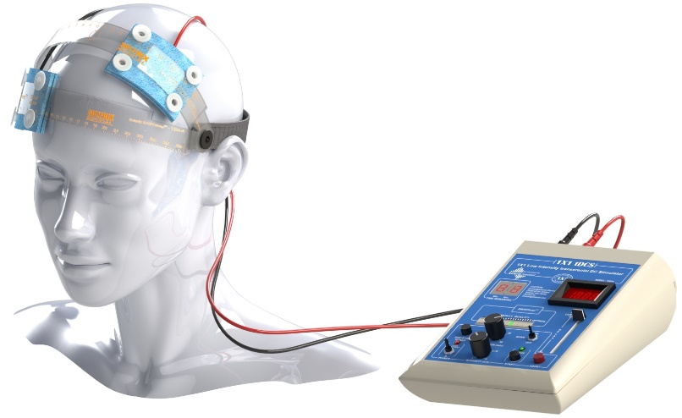
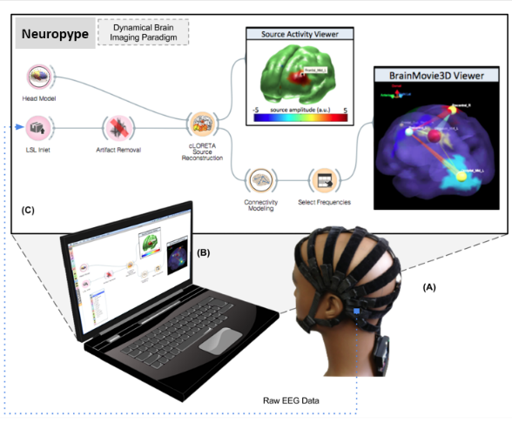
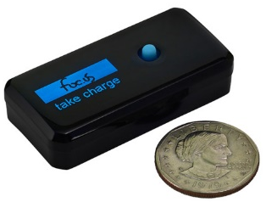

Slide 38


Slide 39


Slide 40



Some of the Tech…
Feedback
  Neuro
  Other Bio
Stimulation
  Neuro
  Other Bio
Traditional tools
  Augmented or
  redesigned with tech

Slide 41
Biofeedback
Pupil dilation
Facial muscles
Eye blink strength
Eye tracking
Galvanic skin response
Heart rate
Breathing
Temperature
Breath gasses
Hormones, neurotransmitters, etc.
Blood
…

Slide 42


tDCS
Notes:
Manipulates membrane potential

Slide 43



tACS
Neuling, Rach, & Herrmann,
Front Hum Neurosci, 2013
Brittain et al, Current Biology, 2013

Slide 44



TUS
Hameroff, et al.,2012

Slide 45

Light
Red and IR light => Cytochrome Oxidase => ATP

Slide 46
Key Trends
Background
Foreground
Software
Hardware
Measurement
Programmatic/
Coaching

Slide 47


Slide 48
Thank You!
Jeffery.A.Martin@gmail.com
TransformativeTech.org | Nonsymbolic.org | DrJefferyMartin.com

