Slide 1
Varieties of Spiritual Experiences
Andrew Newberg, M.D.
Director of Research, Marcus Institute of Integrative Health
Department of Integrative Medicine and Nutritional Sciences
Thomas Jefferson University and Hospital

Slide 2
What Are Spiritual Experiences?
Knowledge – Gnosis – Wisdom – Science – Reason Oneness – Unity – Ecstasy – Awakening – Bliss – Purity Liberation – Insight – Truth – Transcendence
Transformation – Self-Realization – Illumination
Clarity – Inner Peace – Holiness – Revelation – God
Emptiness – Selflessness – Pure Consciousness

Slide 3
Types of Spiritual Experiences
“Everyday” experiences being or participating in synagogue or church
Creative/aesthetic experiences
Meditation and prayer experiences
Intense religious or spiritual experiences
Mystical or enlightenment experiences
Is there a religious/spiritual continuum?

Slide 4
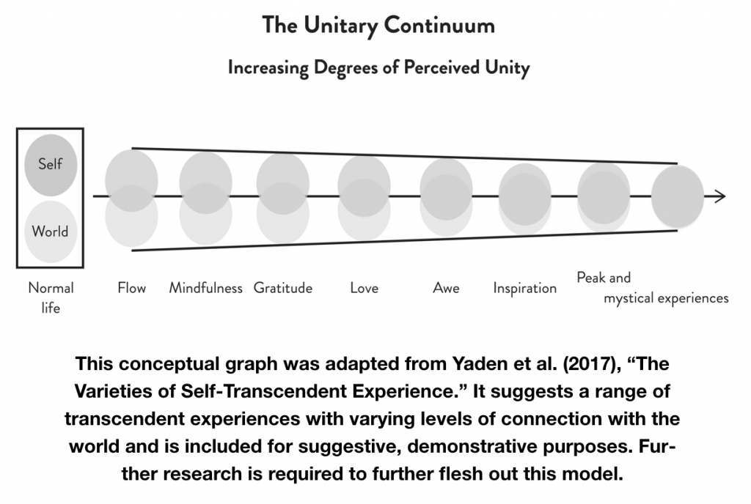

Slide 5
Spiritual Experiences in Monotheistic Religions
Jewish Kabbalah: Mystical union with God is emphasized.
Christianity: The Cloud of Unknowing and being in God’s presence.
Sufism: Mystical union with God through Quranic teachings and surrender to God
Term “enlightenment” is not typically used

Slide 6
Spiritual Experiences Around the World
Hinduism: Consciousness is seen as the essence from which the universe emerged, and spiritual experiences or enlightenment means you have become one with this fundamental reality.
Taoism: Spiritual experiences occurs when you are in harmony with the principles of nature – with the “flow” of life.
Buddhism: Enlightenment is personal, brought about through a process of continual self-reflection.
Zen: Students reach Enlightenment only when they realize the radical truth that everything is an illusion of the mind.

Slide 7
Where in the brain do spiritual experiences occur?

Slide 8
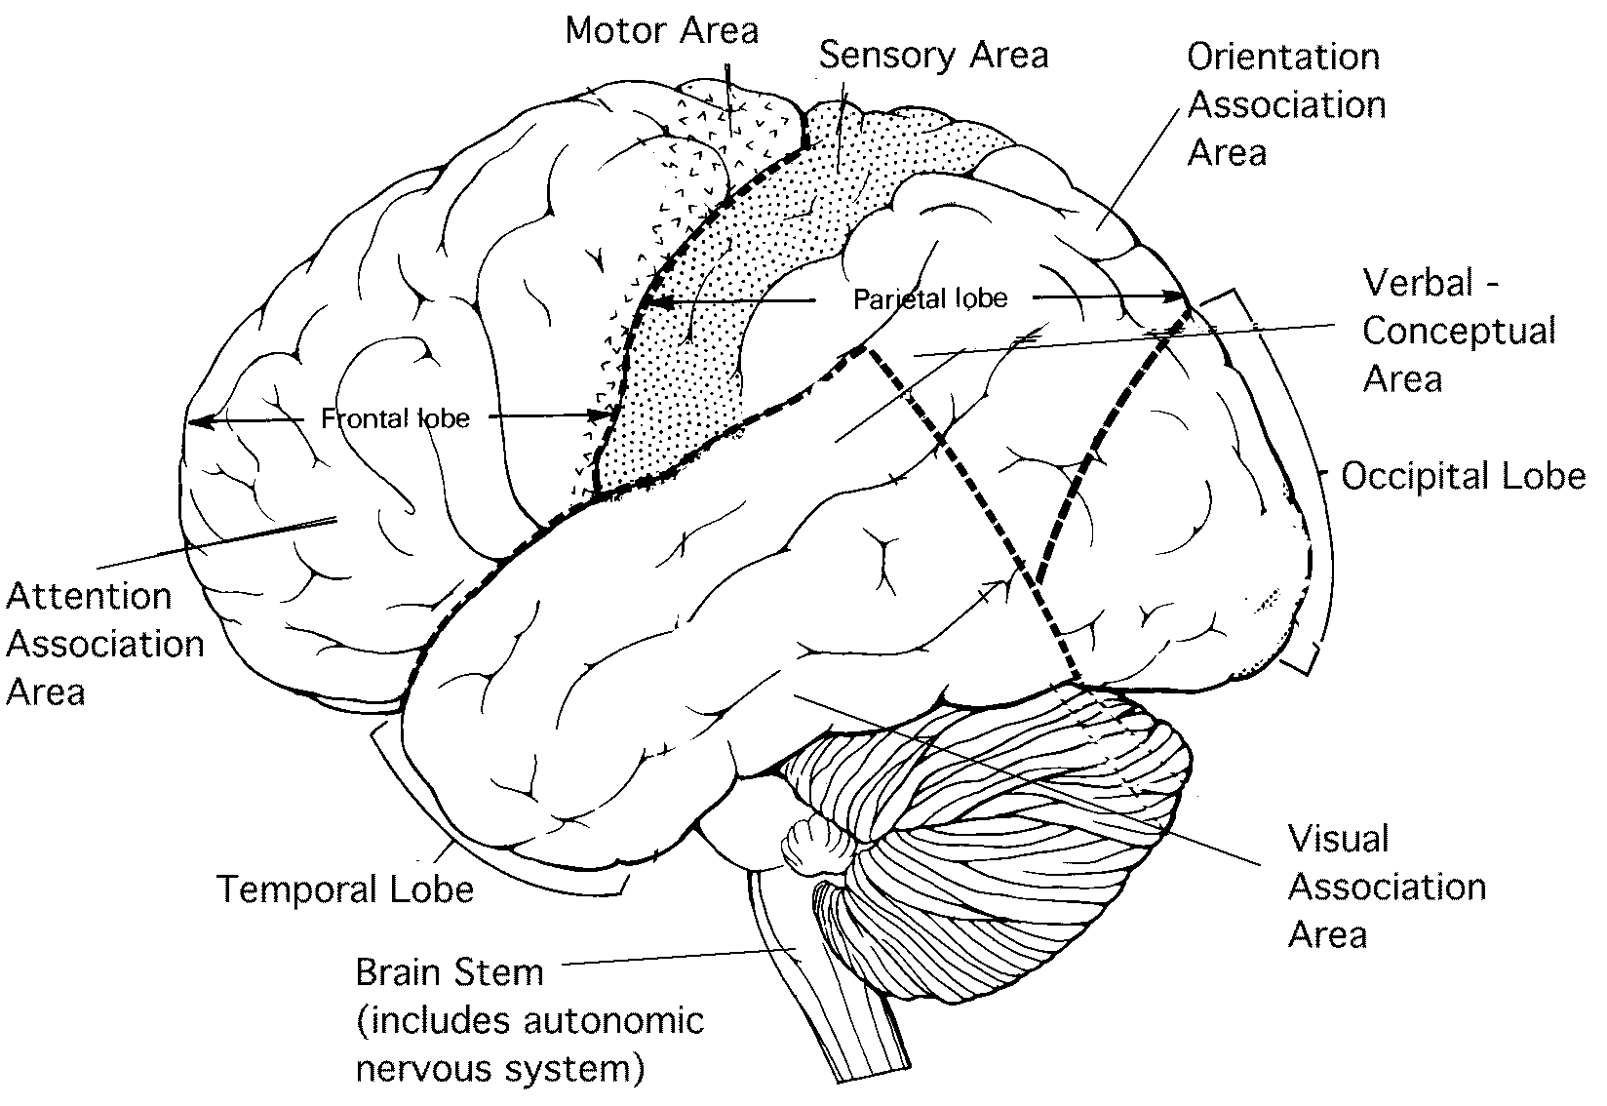
Functional Areas of the Brain

Slide 9
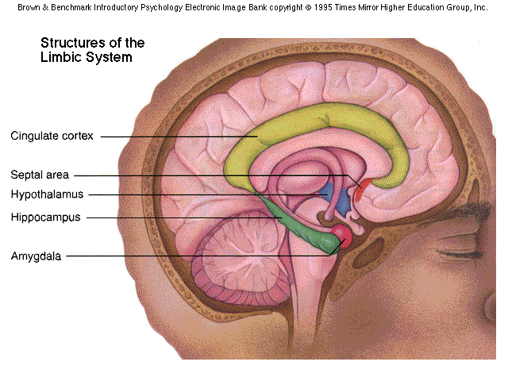

Slide 10
Elements of Spiritual Experiences
Cognitive – sense of oneness, clarity
Beliefs and Faith – creates or fosters specific beliefs
Emotional – feelings of joy, awe, peace
Experiential – visual or auditory elements
Health Impact – reduces anxiety, depression, source of coping
Transformational – changes in the person’s attitudes, relationships, meaning and purpose

Slide 11
Survey of Spiritual Experiences
5 year online survey of people’s most intense enlightenment or spiritual experiences
Received about 2000 respondents
Obtained demographic and religious background data
People provided a narrative of the experience.
People answered questionnaires about their spirituality, psychology, beliefs

Slide 12
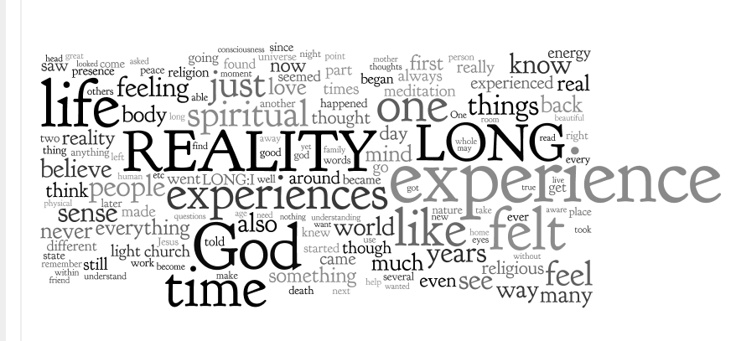

Slide 13
What are the Core Components of Intense Spiritual Experiences?
1. Intensity
2. Clarity
3. Unity
4. Surrender
5. Permanence

Slide 14
Intensity in the Experience of a 43 Year Old Male
“I, as an un-namable but individual being, was travelling down an infinite rollercoaster like waves of pure white ecstatic light. The ecstasy was overwhelming and rose and fell in intensity with the waves of light. The light path seemed infinitely long in both directions. The sense of the being and the light was INFINITELY MORE REAL than anything I had ever experienced”

Slide 15
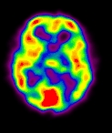
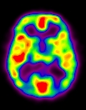

Slide 16
Clarity in the Experience of a 37 Year Old Female Scientist
“Everything in life seemed to click. I had this clarity and it was as if I was looking at life from the inside out. Despite my trepidation, this experience seemed to satisfy my proof-oriented mentality with the concept of intuition. It was almost as if my intuition from somewhere "deeper" had offered some sort of direct experience that offered up proof.”

Slide 17
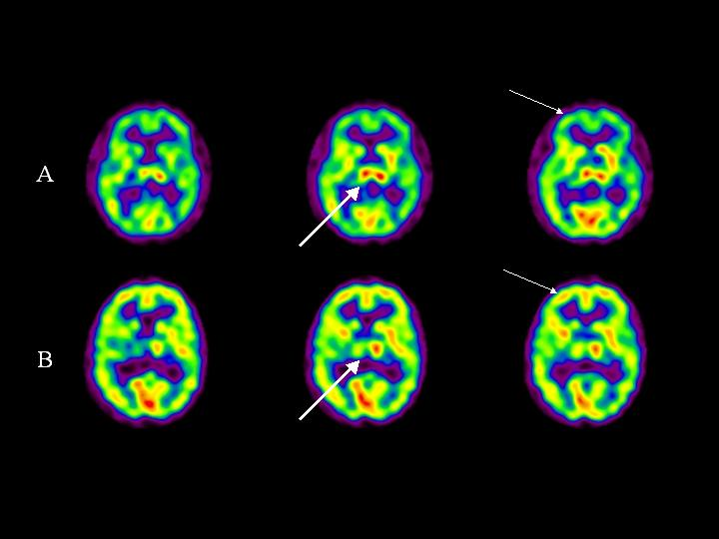

Slide 18
Feeling of Unity
Oneness of all things
Oneness of God
Importance of the concept of God as a unifying force
Involves the parietal lobes

Slide 19
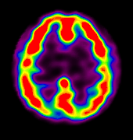
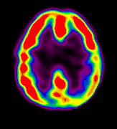

Slide 20
Surrender in the Experience of 48 Year Old Catholic Woman
“I surrendered everything, including my faith and my salvation, and only for one reason. I loved God so much that I would truly give up everything to be connected with Him. I said “yes” and in an instant, God returned everything to me, transformed. From that day forward, a new relationship exists between God and me. It is ever present, no distance, no separation. I am not attached to doctrine, dogmas, or rituals. I see God’s action all around me.”

Slide 21
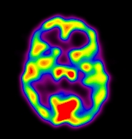
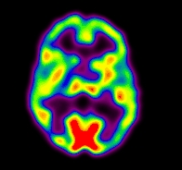
Notes:
Decreased frontal during Sufi meditation

Slide 22
Transformational Results of Spiritual Experiences

Slide 23
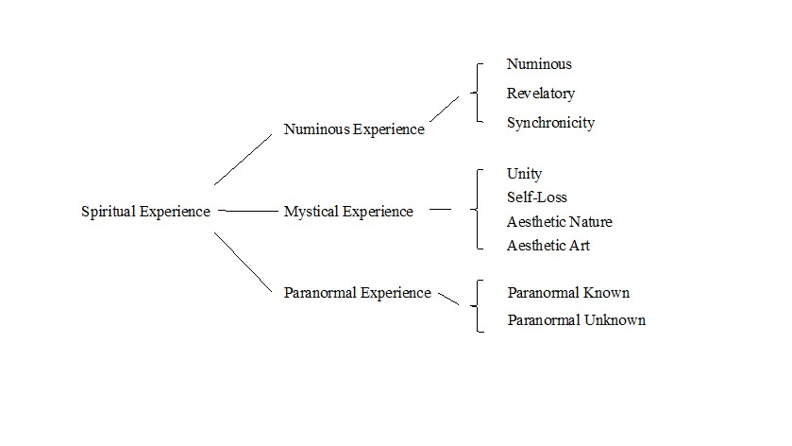

Slide 24
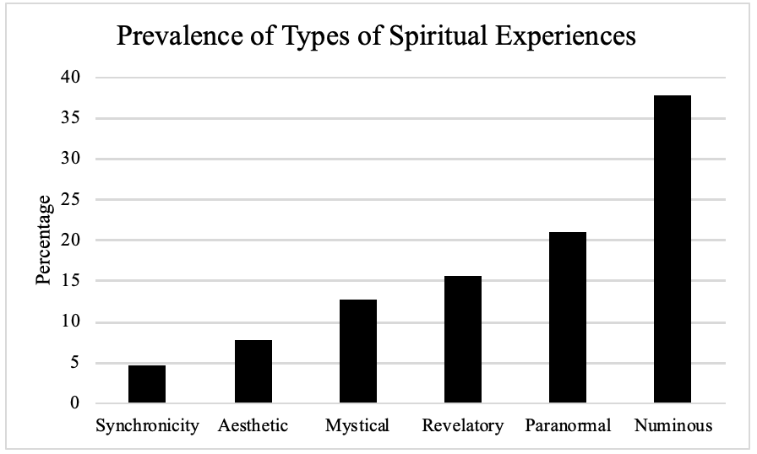

Slide 25
How Do Spiritual Experiences Change the Brain Over Time?
Combine imaging and other scientific measures with subjective and phenomenological evaluation
Longitudinal findings
  Comparison of long-term meditators with non-meditators
  Do religious/spiritual practices affect the brain over time?

Slide 26
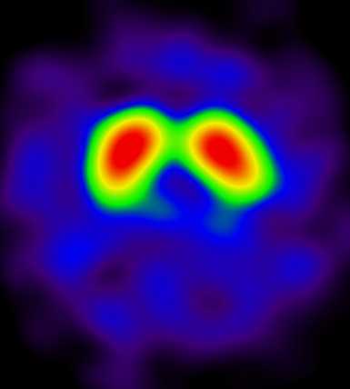
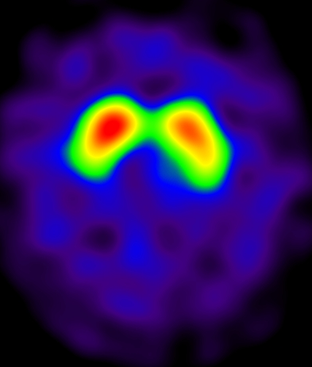
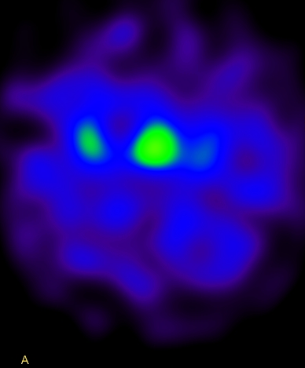
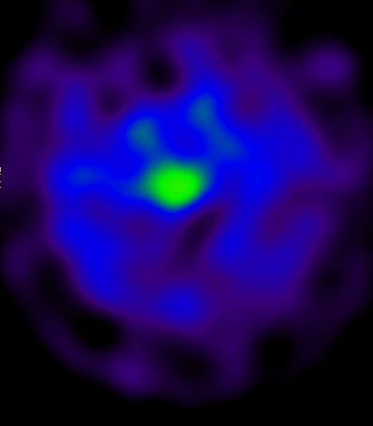
Pre Retreat
Post Retreat
DAT Binding
SERT Binding

Slide 27
What is Neurotheology?
“Neurotheology” is a unique field of scholarship that seeks to understand the relationship specifically between the brain and theology, and more broadly between the mind and religion.
“Neuro” and “theology” should be defined broadly
Studies can evaluate the effect of religion and spirituality on the brain
Studies can evaluate health related effects of various practices and beliefs
Neurotheology can provide information regarding specific paths to attain religious and spiritual experiences

Slide 28
Conclusions
Religious and spiritual experiences have a tremendous impact on the brain and person
These experiences transform a person’s views of reality, relationships, jobs, God, science, religion, and spirituality
Anyone can have spiritual experiences
Everyone can have spiritual experiences

Slide 29
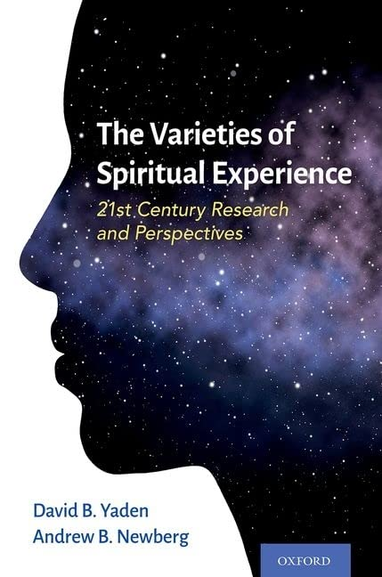

Slide 30
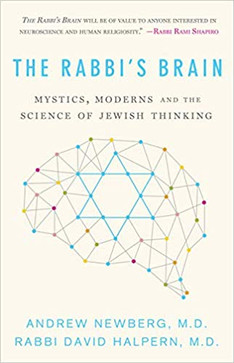
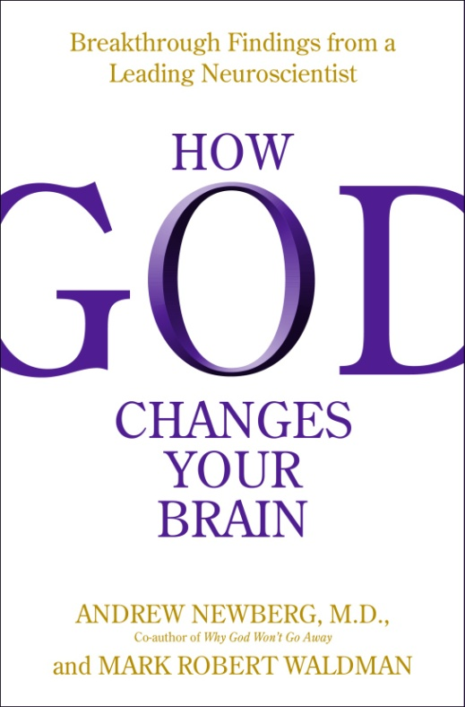
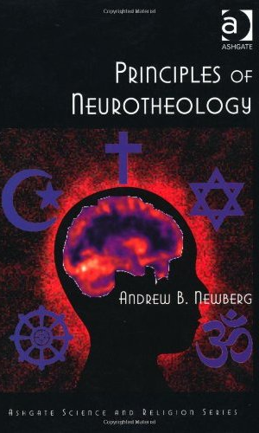
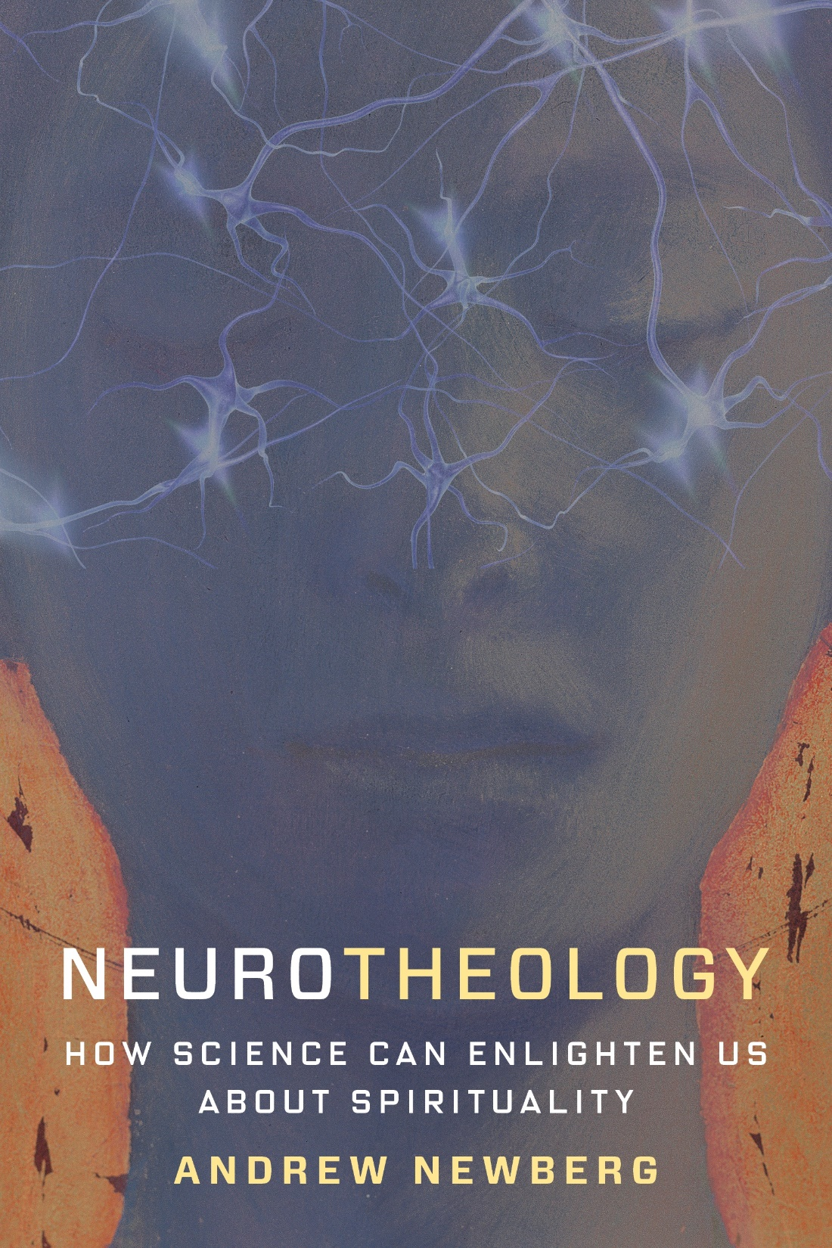
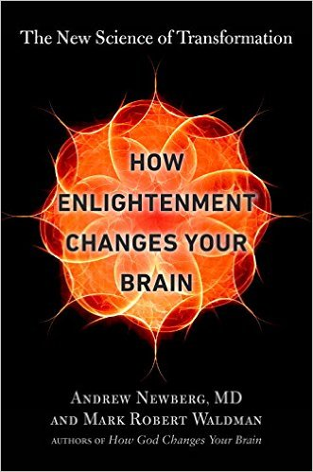

Slide 31
The End
Andrew Newberg
  www.andrewnewberg.com
  Follow on Instagram @ dr.andrewnewberg

