Slide 1








Arts for the Blues: a collaborative partnership
Funded by
https://sites.edgehill.ac.uk/rcaw/
#EHUartswellbeing

Slide 2
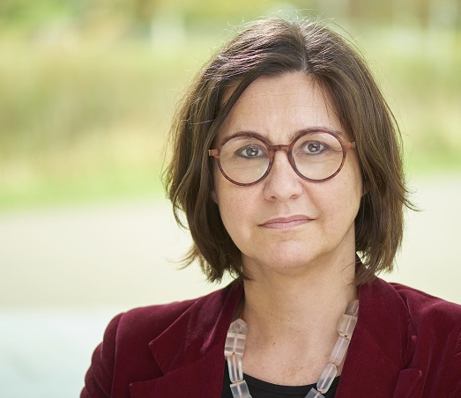
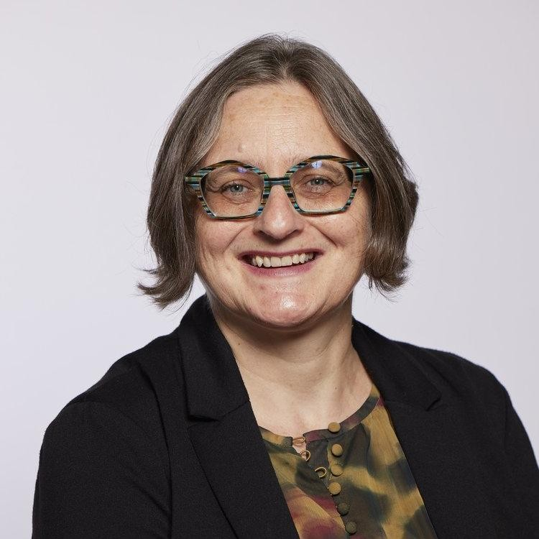
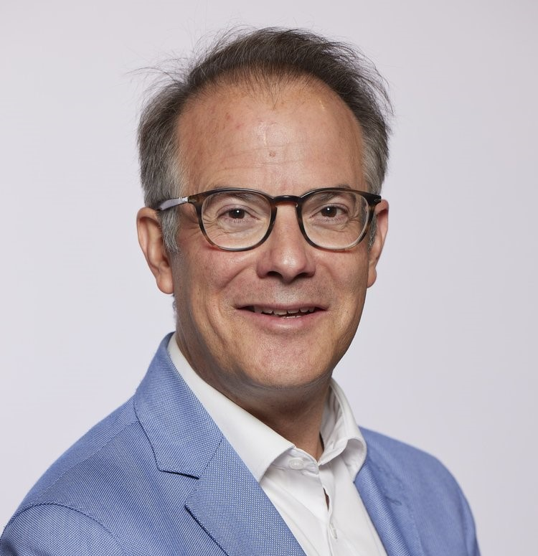
Professor Vicky Karkou Arts Psychotherapist, Edge Hill University Dr Joanna Omylinska-Thurston Counselling Psychologist GMMH, University of Salford
Professor Scott Thurston Poet, University of Salford
https://sites.edgehill.ac.uk/rcaw/
#EHUartswellbeing

Slide 3
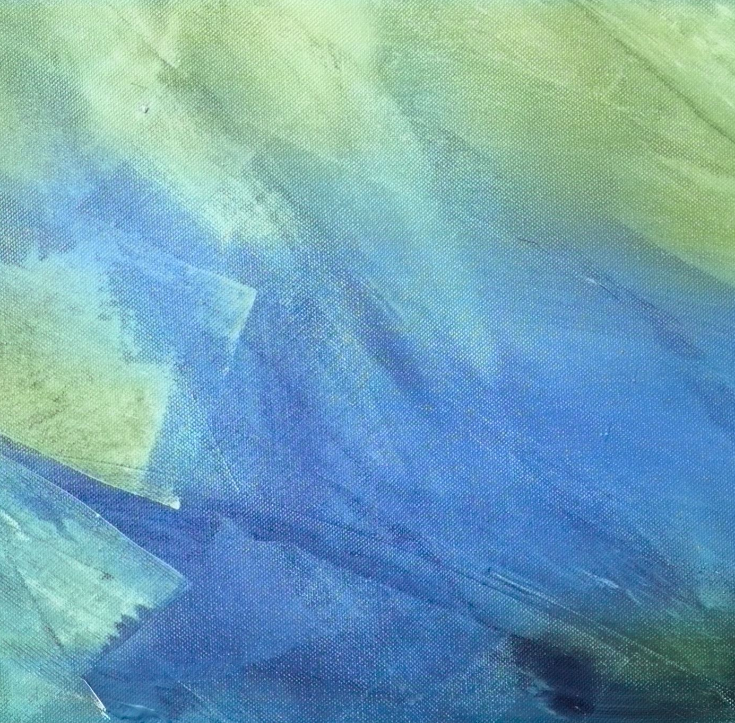
Background
Research and model
https://sites.edgehill.ac.uk/rcaw/
#EHUartswellbeing

Slide 4
Arts for the Blues:
Development of the model
Thematic synthesis of 78 papers on client- and therapist-reported helpful factors and outcome studies (Parsons et al, 2019)
Workshops and focus groups with the public (Haslam et al, 2019)
Workshops and focus groups with patients and staff in Improving Access to Psychological Treatment (IAPT) services in the NHS (Karkou et al, 2022)
Research in mainstream schools (Moula et al, 2020a,b, 2022)
Contributions and feedback during training from over 400 counsellors/psychotherapists
https://sites.edgehill.ac.uk/rcaw/
#EHUartswellbeing

Slide 5
The Arts for the Blues model
https://sites.edgehill.ac.uk/rcaw/
#EHUartswellbeing

Slide 6
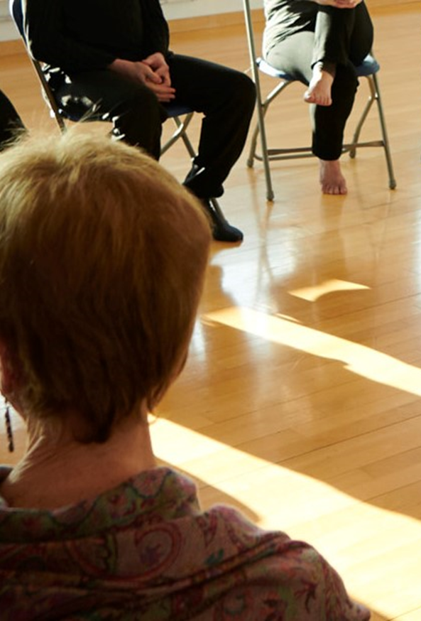
Arts for the Blues - overview
Groupwork
Pluralistic (humanistic base but use of different therapeutic approaches depending on clients’ goal)
Uses a range of creative modalities (e.g. movement, mark making, writing words) as well as talking
Structured framework but flexible content
https://sites.edgehill.ac.uk/rcaw/
#EHUartswellbeing

Slide 7
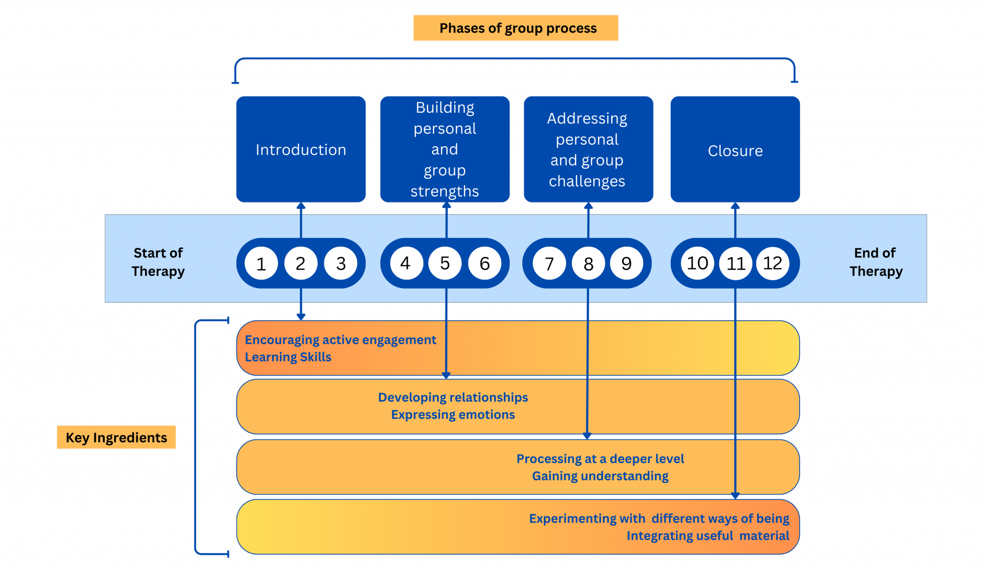
https://sites.edgehill.ac.uk/rcaw/
#EHUartswellbeing

Slide 8
The eight key ingredients
https://sites.edgehill.ac.uk/rcaw/
#EHUartswellbeing

Slide 9
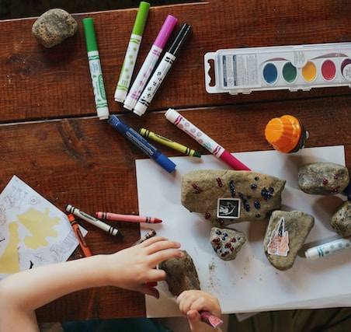
Key Ingredients 1 and 2: Introduction
Encouraging active engagement
e.g. check-ins; mandalas; musical call and response; using objects; drawing
Learning skills
e.g. mindful movement; playing a tune; Grandma's footsteps; mindful colouring; acrostic poem
https://sites.edgehill.ac.uk/rcaw/
#EHUartswellbeing

Slide 10
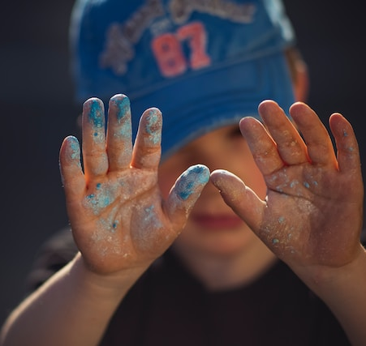
Key Ingredients 3 and 4: Building Strengths
Developing relationships
e.g. mirroring exercises; group soundscape; puppet master; squiggle game
Expressing emotions
e.g. using puppets; sharing a song; showing feelings in gestures, drawing, poetry
https://sites.edgehill.ac.uk/rcaw/
#EHUartswellbeing

Slide 11

Key Ingredients 5 and 6: Addressing challenges
Processing at a deeper level
e.g. authentic movement (witnessing); adding percussion and rhythm to movement
Gaining understanding
e.g. creative writing; telling stories with gestures; viewing drawings differently; a group mural
https://sites.edgehill.ac.uk/rcaw/
#EHUartswellbeing

Slide 12
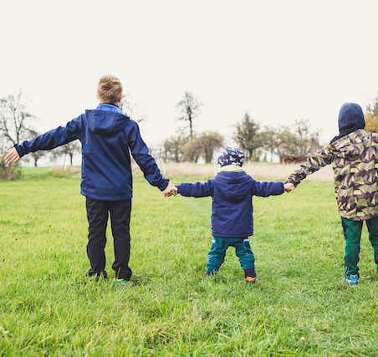
Key Ingredients 7 and 8: Closure
Experimenting with different ways of being
e.g. role play; experimenting with new ways of moving, making sounds and making marks
Integrating useful material
e.g. the Sankofa bird; using music, movement and collage to represent relationship to the past and future
https://sites.edgehill.ac.uk/rcaw/
#EHUartswellbeing

Slide 13
Who is this group for?
Adults:
Primary mental health care - GMMH NHS FT
University of Salford Clinic
Mothers and babies / parents and infants / mothers and pre-school children with lived experience of domestic abuse – community organisations
Children and young people:
Schools in the North West of England
Children’s hospital - Alder Hey Children’s NHS FT CAMHS
Training for therapists - Greater Manchester CAMHS
RCT feasibility study - RfPB application
Helping professionals:
Multi-level intervention via Staff Psychology Support Service – LUFT
Doctors in training – HEE funding
Mental health staff - RfPB application in preparation
https://sites.edgehill.ac.uk/rcaw/
#EHUartswellbeing

Slide 14
An Arts for the Blues Intervention for the Mental Health and Wellbeing of Children in Mainstream Schools: To Investigate its Effectiveness and Mechanisms of Change Lydia Pringle PhD Student
#EHUartswellbeing

Slide 15
Research Questions
How useful?
Mechanisms of change?
Feasibility of the intervention?
Acceptability for children
Engagement of children in the intervention
Sensitivity and acceptability of the measures used to capture change
#EHUartswellbeing

Slide 16
So far…
5 schools in Liverpool area
9 intervention groups, delivered by 7 facilitators
Recruitment of 80 children (pre-intervention)
8-week intervention delivery
75 children (post-intervention)
RCADS – hot off the press results…
#EHUartswellbeing

Slide 17
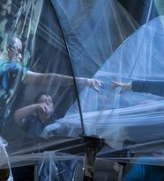

Together Un/Tethered (performance following 6 sessions of A4B)
https://sites.edgehill.ac.uk/rcaw/
#EHUartswellbeing

Slide 18
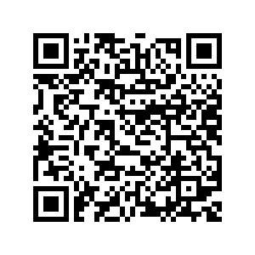
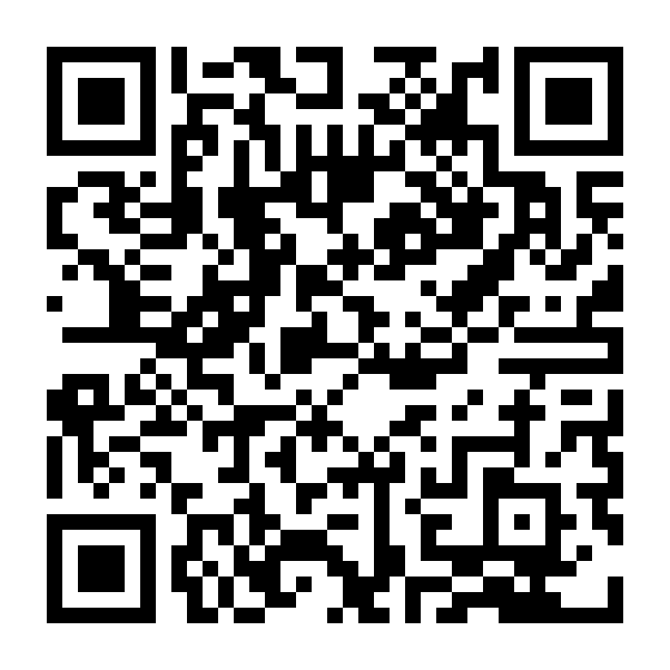
Arts for the Blues training
Scan here to book for the Salford training
12th June, 2024 at University of Salford
Scan here to book for the Edge Hill training
12th July, 2024 at Edge Hill University

Slide 19
Questions
https://sites.edgehill.ac.uk/rcaw/
#EHUartswellbeing

