Slide 1
How does Latvian Family Medicine Training compare with Wonca/ EURACT training requirements?
Dr. Cindy Heaster (presenter), Dr. Michael Harris, Ieva Grike, Dr. Matiss Kore, Dr. Arita Kohva, Dr. Beate Livdanska, Prof. Ilze Grope
Notes:
Good afternoon colleagues, It is a real honour to be here at the WONCA conference to share our work on how Latvian Family Medicine training compares with the EURACT training requirements.

Slide 2
Conflict of interest
Funded by: VPP-VM-Sabiedrības_Veselība-2024/1-0002
(Latvian ministry of health)

Slide 3
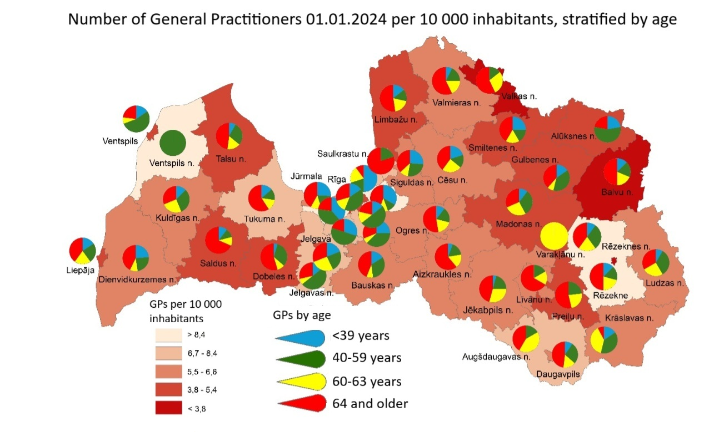
Background
Over 30% Latvian GPs retirement age, exceeding 60% in some rural areas
PVA ziņojums 09/03/2024 Dr. Liga Kozlovska
Notes:
Latvia, like many countries worldwide, is facing a GP recruitment and retention crisis. Over 30% of our general practitioners are already at retirement age, and in some rural areas that number exceeds 60%.

Slide 4
Background
In 2024 only 37 of 55 government funded residency places filled – why?
Part of exploring low demand for residency places – is the course of high quality?
EURACT 2018 – training standard recommendations
Notes:
Yet, in 2024, only 37 out of 55 government-funded residency places were filled. Why is demand so low? Is the training programme unattractive? Or is it a matter of quality? As part of our multi-dimensional study, we turned to EURACT’s 2018 recommendations on training standards as the benchmark.

Slide 5
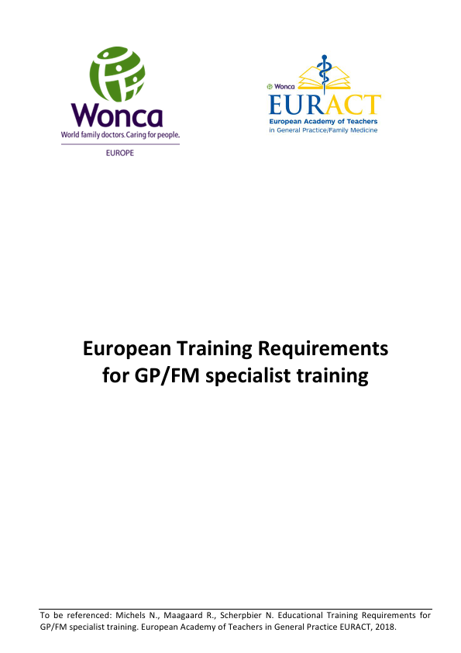
EURACT
European training requirements, 3 domains:
Requirements for Trainees:
Requirements for Trainers
Requirements for Training Institutions
Notes:
EURACT defines requirements in three domains:
Requirements for trainees
Requirements for trainers
And requirements for training institutions

Slide 6
Methods
- Over 150 separate indicators of excellence in GP/FM training identified
- Latvian GP/FM curricula were obtained from both Latvian medical schools (LU and RSU)
Curricula compared to Euract training indicators in each of the 3 main domains
Notes:
Within those domains, we identified 150 indicators of excellence in GP and FM training. We then compared Latvian curricula from both of our medical schools — the University of Latvia and Riga Stradiņš University — against those indicators.

Slide 7
Results 1. Requirements for Trainees: How trainees acheive competency: (42/46 indicators)
Concept of clinical audit is not currently included in study programmes
Outcomes based and learner centred
Safe learning environment
Regular exposure to GP/FM from start of training
Protected study time
Person centred care 100%
Specific problem solving skills 100%
Notes:
The results were encouraging. Latvia met 42 out of 46 indicators for how trainees achieve competency.
For example: Person-centred care? 100%. Specific problem-solving skills? 100%. Regular exposure to general practice from the start? Yes.
Protected study time? Yes.
However, one notable gap is the concept of clinical audit. Unlike many European countries where audit is central to quality improvement, this is not systematically taught in Latvian GP programmes, at the moment

Slide 8
Results 1. Requirements for Trainees: Assessment (46/56 indicators)
Clinical audits, PSQ/patient based feedback ratings not commonly used
Multi-source feedback often not possible- solo practices
Group discussions, direct and indirect observation of practice
Patient feedback mostly informal
OSCE in final exam
Dependent on practice:
Record reviews
Notes:
When it came to assessment methods for trainees, Latvia achieved 46 out of 56 indicators. We do use OSCEs and case-based discussions. However, multi-source feedback is often not possible due to our traditional solo practice model, and patient satisfaction questionnaires are rarely applied in a structured way.

Slide 9
Results: 1. Requirements for Trainees: Length of training (4/4 indicators)
3 years, at least 50% in GP
1.5 years specialist hospitals/ clinics (>6 months)
1.5 years in GP/FM
5 days per week practical training with regular release for protected learning time.
Notes:
Training length fully met EURACT standards — three years, with 50% in family medicine and 50% in specialist hospital rotations – many of which occur in outpatient departments to make it more relevant to General Practice. Trainees spend five days per week in practice, with protected time for learning.

Slide 10
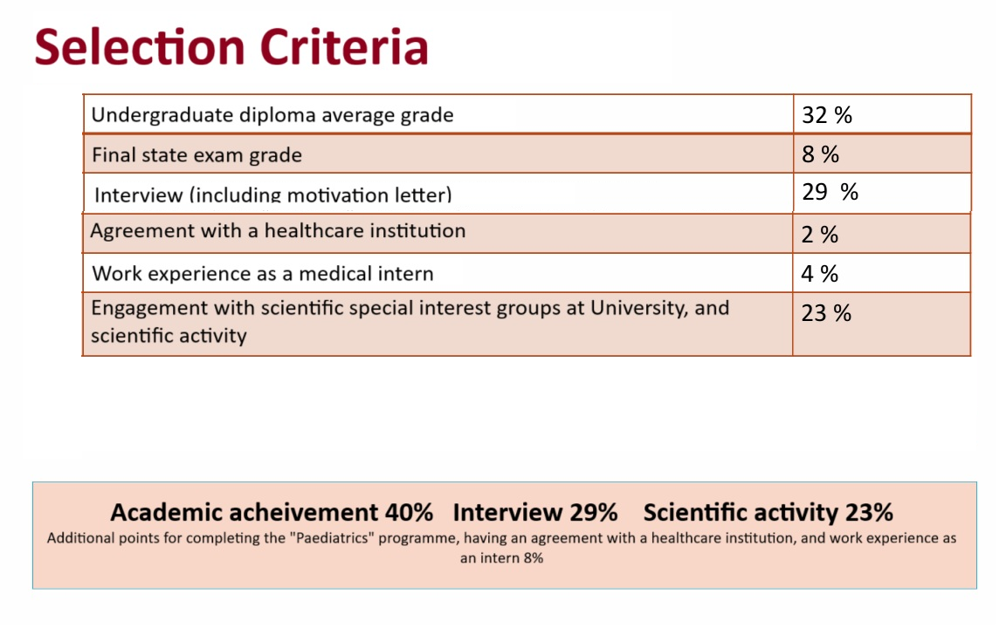
Results: 1. Requirements of Trainees:
Vienotās uzņemšanas rezidentūrā 2025./2026. akadēmiskajam gadam informatīvā semināra prezentācija
https://www.rsu.lv/sites/default/files/imce/Dokumenti/prezentacijas/prezentacija_vu_infodiena_12122024.pdf accessed 19/9/25
Notes:
Candidate selection is through a Combined University selection process:
Fair, credible, publicly defensible, as specified by EURACT

Slide 11
Results – 2. Requirements of trainers, hospital requirements (19/24 indicators)
Protected time with GP trainer
Access to educational resources through universities
Solo pratices – continuity at cost of multi professional training environment
Training developed by active GPs
Learning needs appraised
GP Trainers not currently required to be specially trained teachers
No audit of educational activity
Notes:
For trainers, Latvia achieved 19 of 24 indicators. Trainers are practising GPs with trainees having good access to educational resources and protected teaching time. But trainers they are not currently formally required to be trained teachers, and their educational activity is not audited.

Slide 12
Results: 3. Requirements of Training Institutions: Infrastructure, Governance, Educational facilities (27/31 indicators)
Infrastructure:
Safe, well equipped, continuity of care.
Educational facilities: Course linked to universities who oversee training.
Governance:
Role modelling, patients informed of trainees
Practice dependent for significant incidence reporting/ complaints
No audit, practice meetings (solo practices), no PSQ
Notes:
For institutions, Latvia achieved 27 of 31 indicators. Training is well integrated with universities, facilities are safe and well-equipped, and patients are informed when trainees are involved in care. However, practice governance, such as auditing complaints or significant incidents, is inconsistent, and practice dependent.

Slide 13
Discussion
Strengths: Training programmes overseen by universities, continuity of care and learning experience, robust programme
Areas for consideration:
Predominantly Solo practices – MSF, PSQ not used
Concept of clinical audit not common in Latvian GP/FM
Google images: Stopinu Ambulance accessed 18/9/25
Notes:
So what do we take from this? The strengths are clear: our training is university-led, well structured, and robust. Continuity of care is strong.
The challenges are also clear:
Predominantly solo practices make multi-source feedback and interprofessional learning more difficult.
Clinical audit is not embedded.
Trainer education and monitoring could be improved.

Slide 14
Conclusions
Latvian GP/FM programmes have a high degree of concordance with EURACT training recomendations (86%)
Multiple domains exhibit 100% compliance
The predominent solo practice model makes multi-source difficult to obtain
The concept of audit and use of PSQ could be expanded in Latvian GP/FM
Notes:
Overall, Latvian Family Medicine training demonstrates a high degree of concordance — 86% — with EURACT recommendations. In some domains, compliance is 100%. This is reassuring, but there is some room for improvement.

Slide 15
Suggestions for future research
Future research for European GP/GM training programmes throughout Europe:
How do other GP/FM training programmes compare with EURACT training requirements?
How is the concept of clinical audit implemented?
What training do GP trainers receive?
How does the course content of family medicine residency training compare throughout Europe?
Notes:
Looking ahead, we see opportunities for further European research:
How does training in other countries compare with EURACT standards? I look forward to reading the new ones soon to be published.
How is clinical audit currently embedded in GP training elsewhere?
What kind of formal preparation do GP trainers receive?
These questions will not only help Latvia but also contribute to strengthening Family Medicine training across Europe.

Slide 16
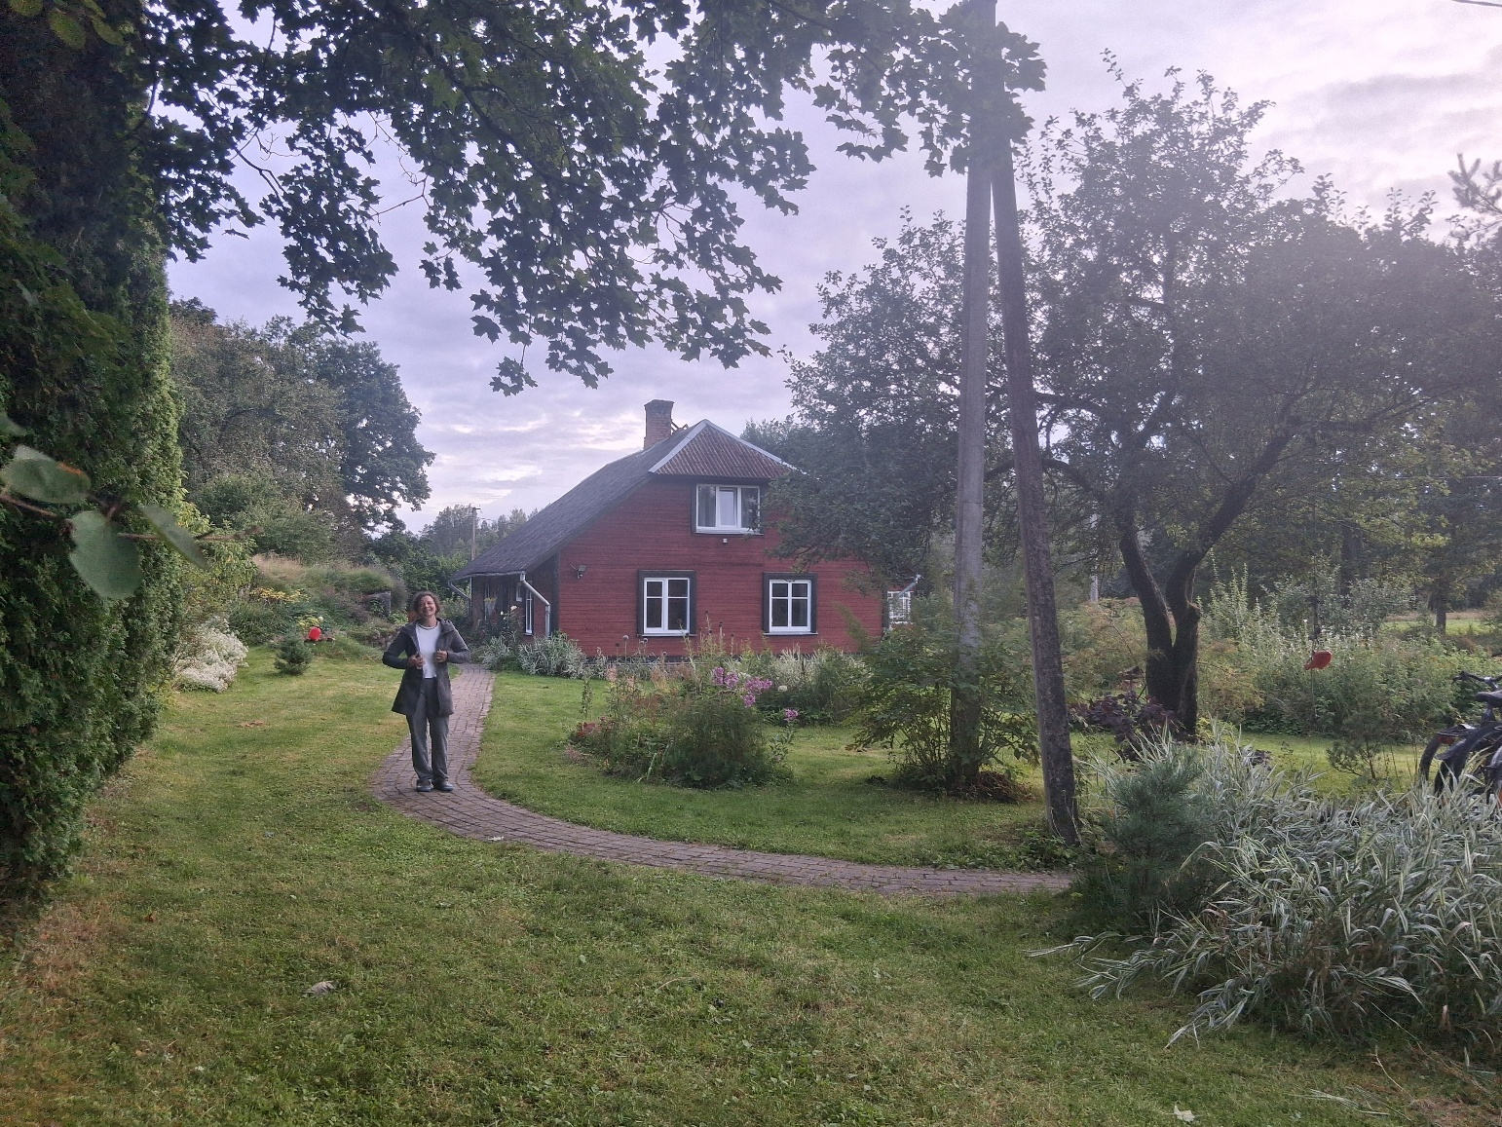
Thank you! CindyLisa.Heaster@rsu.lv
Notes:
Strong training programmes ultimately improve care for all patients, and are vital to ensuring those in rural areas of Latvia like this have access to well trained GPs in the future. Thank you very much for your attention, I’ve really enjoyed meeting so many inspirational doctors and researchers at the conference this year.

