Slide 1
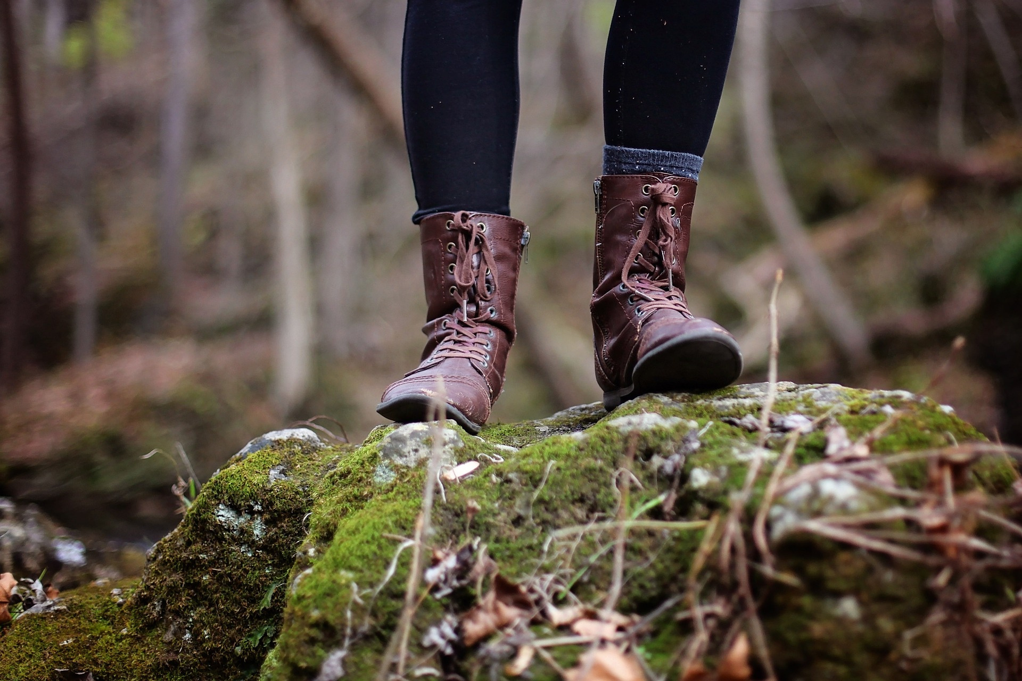
TO BE OR NOT TO BE
agency and resilience of early career general practitioners
Inguna Potetinova
MAnth, MPA
PhD student, researcher
Rīga Stradiņš University

Slide 2


DISCLAIMER
  Research is part of the State Research Programme project “Enhancing General Practitioner Resilience in Latvia: Challenges and Solutions” and my PhD thesis
  Early-stage findings and assumptions
  Not sufficient data at this point
Project Agreement No. VPP-VM-Sabiedrības_Veselība-2024/1-0002.

Slide 3
CONTEXT
  Primary health care (PHC) — key health care through lifetime
  The shortage of general practitioners (GP)
  Little motivation to pursue a career in family medicine
  30% of existing GPs are of pension age in Latvia
  Resilience affects patient safety, and the quality of care provided
  Lack of knowledge, potential to extend

Slide 4
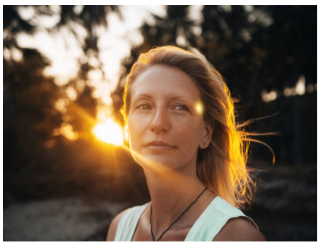
CENTRAL QUESTIONS
  What makes final-year students turn away from such pressing collective needs?
  How the choice for PHC is made and what factors motivate to stay in the profession?
  What actors and/or processes make up resilience besides individual capabilities, and what role more-than-humans play in it?

Slide 5
MAIN GOALS
  To provide recommendations for improvements in PHC in Latvia
  To create new conceptual knowledge and offer a socio-anthropological perspective, integrating more-than-human actors in understanding the phenomenon of resilience

Slide 6
METHODS
  1st part
    23 semi-structured interviews covering all regions of Latvia;
  2nd part
    semi-structured interviews
    participant observation
    photography

Slide 7
FIRST RESULTS
Stigma, low prestige, precarity and bureaucracy
  Who is a real doctor?
  Structural violence
  Precarity

Slide 8
FIRST RESULTS
Agency
  Freedom to choose & decide
  Resistance
  Personal goals over collective needs
Ties
  Ties — most important value
  Reconciliation of work and private life

Slide 9
FIRST RESULTS
Resilience
  Hardships to reflect
  Different things to different people

Slide 10

FUTHER QUESTIONS
  What ideas and practices are there about resilience?
  Is resilience only about “bouncing back”?
  What role are other species playing in human resilience?
  How can posthumanism ideas contribute to the creation of new knowledge?
  Is there a possibility to propose a new viewpoint of this phenomenon?

Slide 11
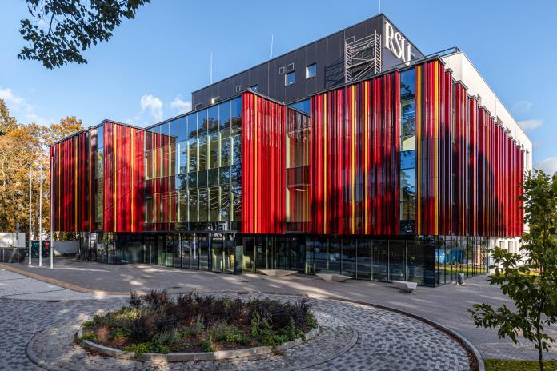
THANK YOU
ANY QUESTIONS?
Inguna.Potetinova@rsu.lv
Project Agreement No. VPP-VM-Sabiedrības_Veselība-2024/1-0002.

