Slide 1
Orientation Week
International Students' Association

Slide 2
Index
The International Students' Association
Academic Staff
RSU Study Venues
Course Structure
Other Useful Information
Semester and Group Leader Elections

Slide 3
The International Students' Association

Slide 4
The ISA Board

Slide 5
The ISA Academic Affairs Department
HEAD OF ACADEMIC AFFAIRS
ASST. TO THE HEAD OF ACADEMIC AFFAIRS
Bárbara N. Silva
BARBARA.SILVA@RSU.LV
Bayron Granillo
BAYRON.GRANILLO@RSU.LV

Slide 6
Academic Staff
https://www.rsu.lv/par-rsu/struktura

Slide 7
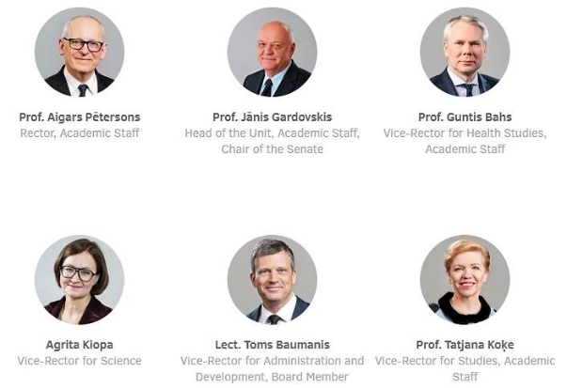
Senior Management

Slide 8
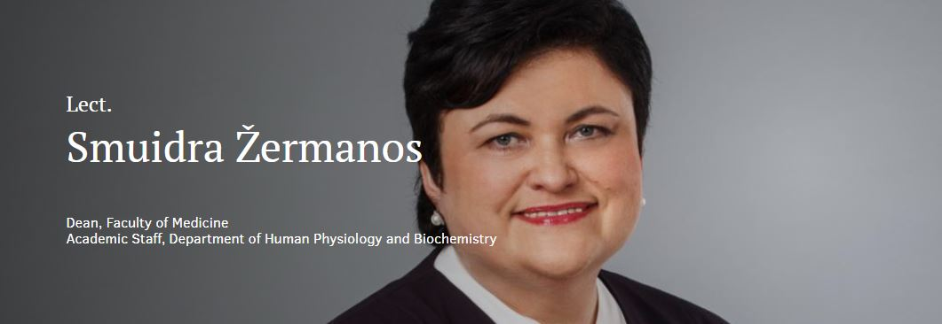

Slide 9
RSU Study Venues
https://www.rsu.lv/par-rsu/studiju-norises-vietas

Slide 10
RSU Study Venues
Dzirciema ielā 16
Anniņmuižas bulvāris 26a
Kronvalda bulvāris 9
Dzirciema ielā 20

Slide 11
Course Structure
https://www.rsu.lv/en/isa/academic-affairs

Slide 12
Your Study Group
ASNMF2023Z13
International Student Department
Ārvalstu Studentu Nodaļa
Semester
Ziema - Winter
Vasara - Summer
Medicine Faculty
Medicīnas Fakultāte
Dentistry Faculty
Zobārstniecības Fakultāte
The year you joined RSU
Your Group

Slide 13
1ˢᵗ Semester Courses
Medicine
Dentistry
Medical Physics
Molecular and Cellular Biology
Bioethics
History of Medicine and Life Sciences
First Aid and Civil Protection
Human Anatomy, incl. Dissection Course
Medical Terminology in Latin
Medicinal Chemistry
Latvian Language in Medicine
Human Molecular Biology
Medical Physics
Human Anatomy
Philosophical Anthropology
Medical Terminology in Latin
Latvian Language in Dentistry
Civil and Environmental Protection
First Aid
General Medical Chemistry
Histology

Slide 14
Class
Lecture (Theoretical)
Practical Class
Can be on-site or previously recorded and available on E-Studies
The theoretical material that will be needed in the practical class
With your entire semester
Given by a lecturer that won't necessarily be evaluating you
Can be on-site or online, via Zoom or Panopto
Only with your study group or a few others
Attendance will be checked
Given by the professor who will be evaluating you
Require previous studying: protocols, laboratory work, mini-tests...

Slide 15
Evaluation
Examination and Autopass System
Grades
Colloquia (written) and seminars (oral)
You need to pass ALL evaluations with a minimum grade of 4
Each evaluation can be done 3 times (1ˢᵗ attempt + 2 retakes)
When all evaluations are passed successfully, you are eligible for the end of course examination, which can be done twice (1ˢᵗ attempt + 1 retake)
Autopass System: If you obtain a grade ≥7 on all examinations on the first try you are exempt from taking the end of course examination. This does not apply to all subjects!
96-100%: With Distinction (10)
85-95%: Excellent (9)
75-84%: Very Good (8)
70-74%: Good (7)
65-69%: Almost Good (6)
60-64%: Satisfactory (5)
55-59%: Almost Satisfactory (4)
40-54%: Weak (3)
20-39%: Poor (2)
0-19%: Very poor (1)
THIS IS THE SYSTEM IN PLACE UNLESS OTHERWISE STATED BY THE DEPARTMENT.

Slide 16
Academic Appeal
You have the right to contest assessment of the examinations.
You can review your work before submitting an academic appeal.
You must submit it within 3 days from the moment of notification of assessment, not including the date of the assessment.

Slide 17
Attendance
Planned Absence
Unplanned Absence
If a student has not taken the examination or has not attended classes for a valid reason.
Submit an application to the Student Services, enclosing copies of documents certifying the absence no later than 2 weeks prior to the planned absence.
Present a document certifying incapacity for work within 5 weekdays after returning to studies.

Slide 18
Other Useful Information

Slide 19
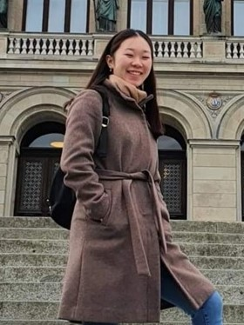
Research
ISA MEDICAL SCIENCE DEPARTMENT
How do I get started?
ISA Research Wall
MyRSU Research Platform
RSU pages of specific departments
Express your interest to professors
Contact specific Academic Societies
ISA How To Research
MEDICAL SCIENCE DIRECTOR
ASST. TO MEDICAL SCIENCE DIRECTOR
Linda Vuong
LINDA.VUONG@RSU.LV
Luxsana Mathiyalagan
LUXSANA.MATHIYALAGAN@RSU.LV

Slide 20
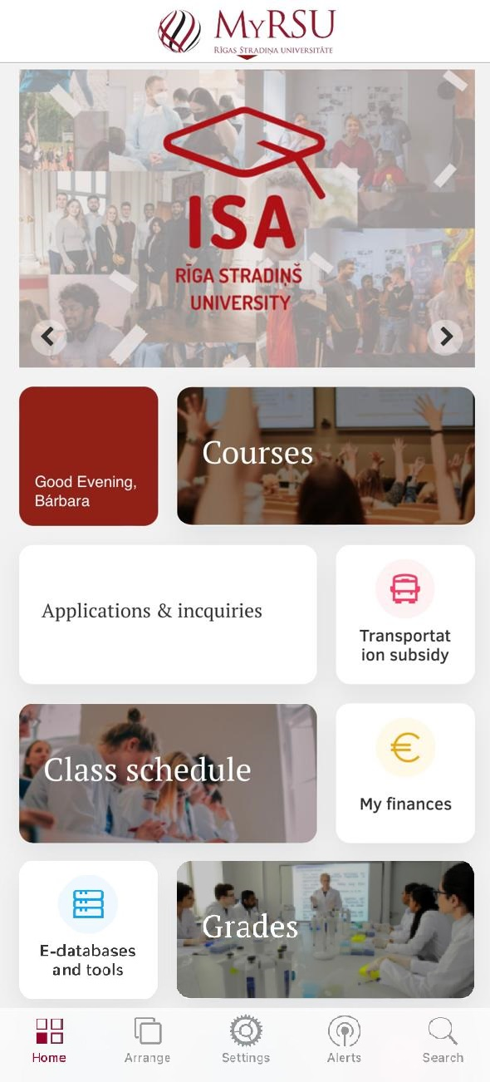
MyRSU
Transportation (E-Talons)
Applications & Inquiries - Reference Request (If you don't have a Latvian Personal Code)
Transportation Subsidy (If you have a Latvian Personal Code)
Grades Transcript
Applications & Inquiries - Transcript of Records
Academic Appeal
Applications & Inquiries - Academic Appeal
IT Department
Useful Links - IT Helpdesk - FAQ + Useful Links
Free Online Study Resources
E-databases and Tools

Slide 21
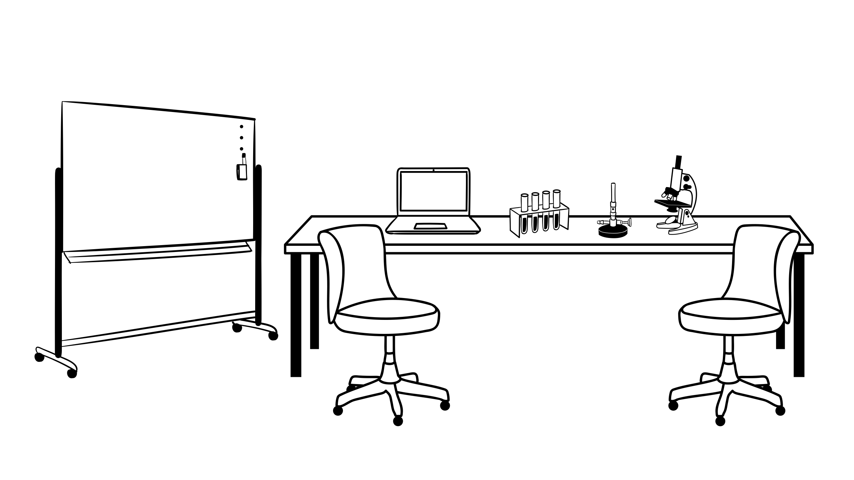
Semester and Group Leader Elections
Group Leader Elections
Semester Leader Elections
REPRESENT YOUR STUDY GROUP
Inform us of your choice by 06 Feb
BAYRON.GRANILLO@RSU.LV
REPRESENT YOUR ENTIRE SEMESTER
Send us a short description of yourself and a picture to BAYRON.GRANILLO@RSU.LV
until 06 Feb.
Online Voting
07 Feb 12:00 – 09 Feb 17:00
Results will be announced 10 Feb at 12:00

Slide 22
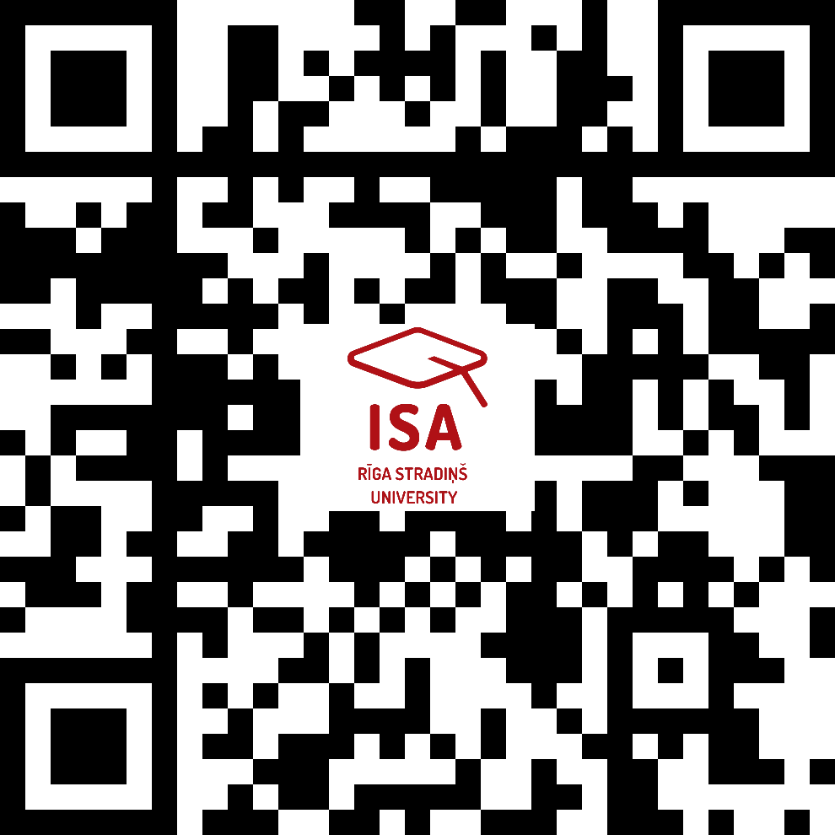
Questions?
Check the ISA Website
Contact ISA at
ISA@RSU.LV

Slide 23
"Sleep more than you study, study more than you enjoy life, and enjoy life as much as you can."
ISA wishes you a great academic journey at RSU!

