Slide 1

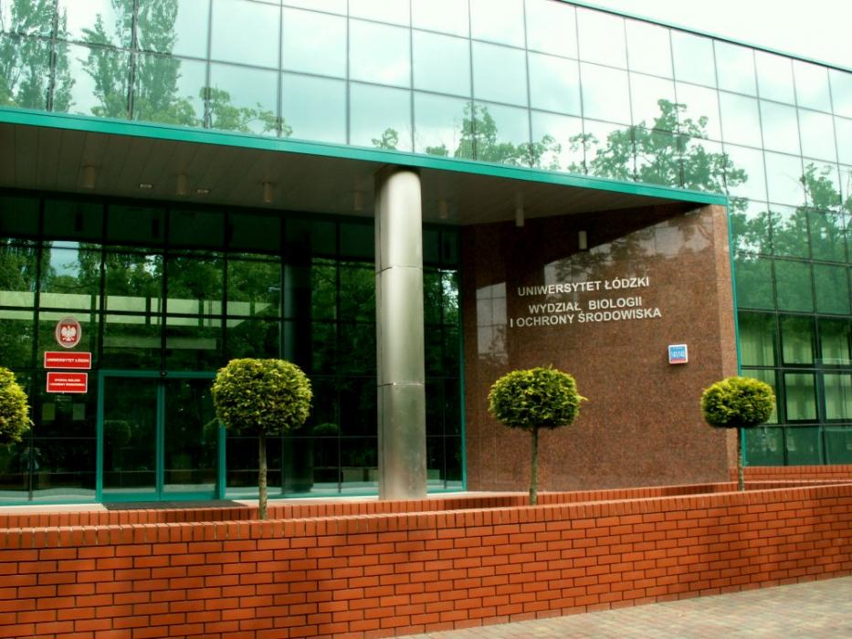
Magdalena Kluska
University of Lodz
Faculty of Biology and Environmental Protection
Institute of biochemistry
Department of Molecular Genetics

Slide 2
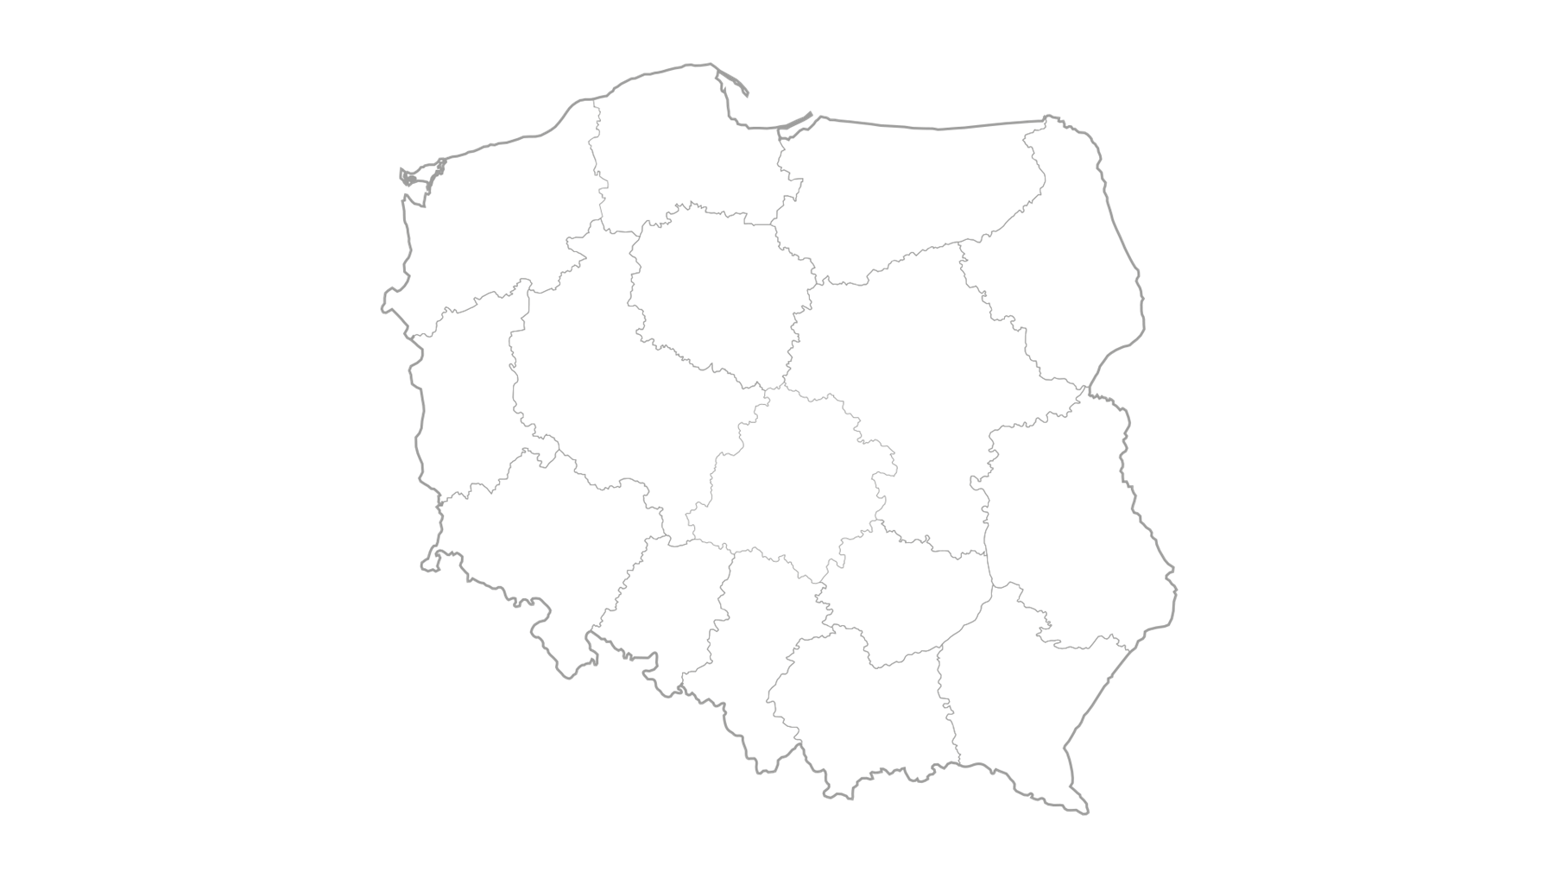




Lodz a university city
Poland
Łódź

Slide 3

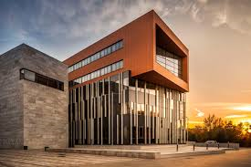
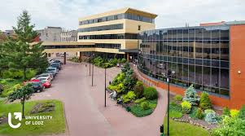
The University of Lodz
12 faculties
60 specializations
32 000 students
2600 international students
www.uni.lodz.pl

Slide 4

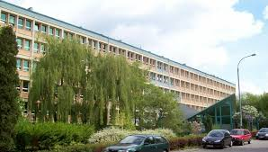
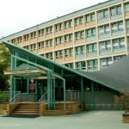
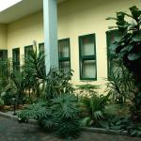
Faculty of Biology and Environmental Protection
www.biol.uni.lodz.pl

Slide 5
Faculty's structure
INSTITUTE OF BIOCHEMISTRY
DEPARTMENT OF CYTOBIOCHEMISTRY
DEPARTMENT OF GENERAL BIOCHEMISTRY
DEPARTMENT OF MOLECULAR GENETICS
INSTITUTE OF BIOPHYSICS
INSTITUTE OF ECOLOGY AND ENVIRONMENTAL PROTECTION
INSTITUTE OF EXPERIMENTAL BIOLOGY
INSTITUTE OF MICROBIOLOGY, BIOTECHNOLOGY AND IMMUNOLOGY

Slide 6
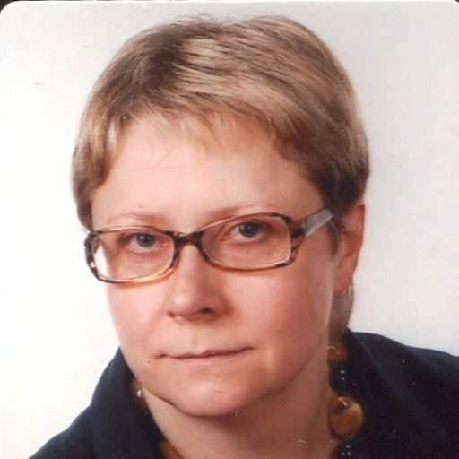
Department of Molecular Genetics
Head of Department: Prof. dr hab. Katarzyna Woźniak
4 full professors
4 doctors
8 PhD students
8 MSc students
Cooperation with the national centers:
Laboratory of Molecular Bases of Aging, Nencki Institute of Experimental Biology PAS, Warsaw
Department of Ophthalmology, Medical University of Warsaw,
Department of Gastroenterology and Internal Diseases, Medical University of Lodz,
Neurosurgery and CNS Oncology Department, Medical University of Lodz,
Department of Orthodontics, Medical University of Lodz,
Department of Biophysics of Environmental Pollution, University of Lodz.
Cooperation with foreign centers:
Department of Structural Biology, University of Texas, Health Science Center, San Antonio, TX, USA,
Department of Ophthalmology, University of Eastern Finland, Kuopio, Finland,
Pharmaceutical Sciences, Wilkes University, USA.

Slide 7
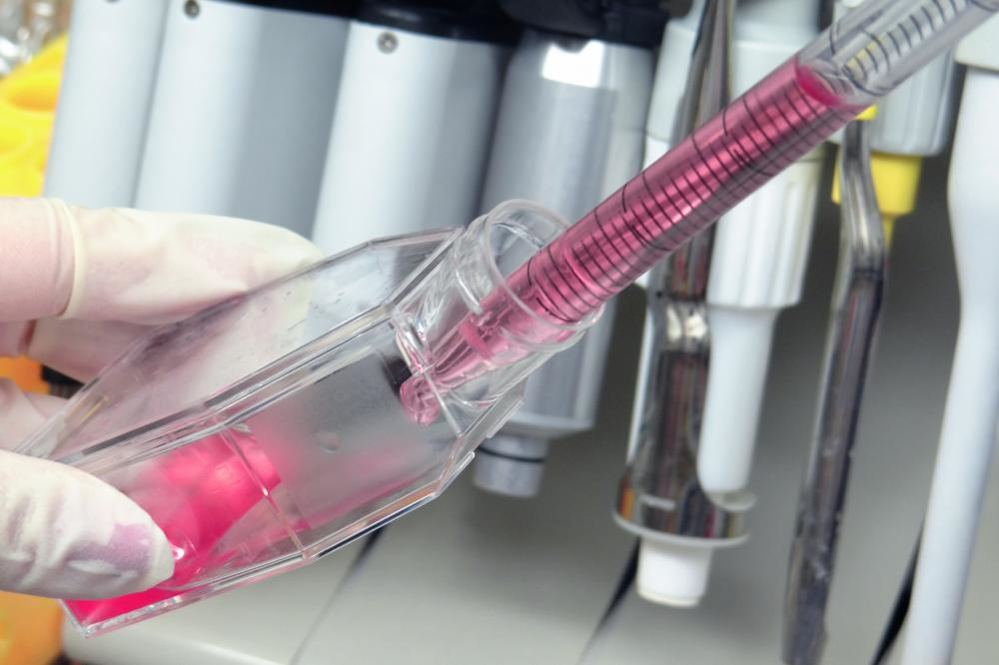
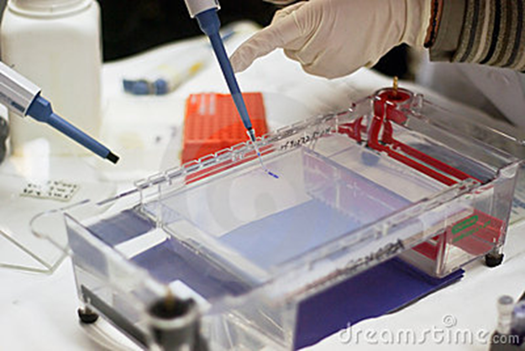
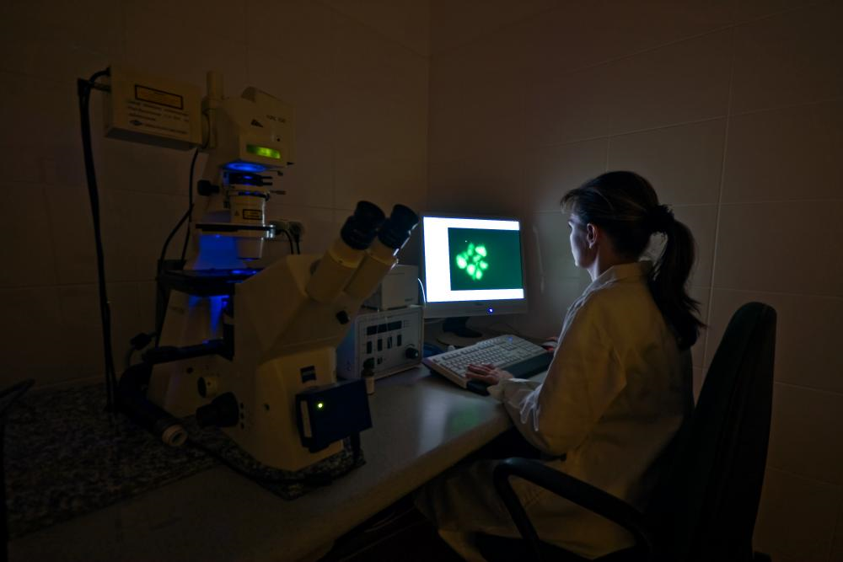
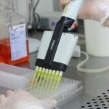
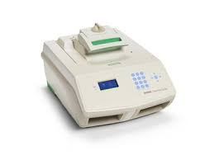
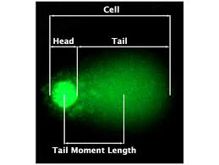
Methods used in Department of Molecular Genetics
Cells assays
Gel electroforesis
Fluorescence microscopy
PCR

Slide 8
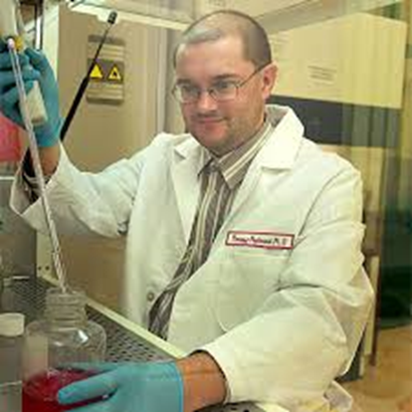
Research topics
Department of Molecular Genetics explore the following issues:
Regulation of cell cycle and DNA repair
The importance of epigenetic modification in response of cells to DNA damage
Genetic variability of miRNAs in human cancers
Analysis of the biological properties of synthetic thiosugars in tumor cells Biomolecular computers
Gene expression of BER pathway in Alzheimer's disease
DNA repair genes variability in depressive diseases
Proteins of DNA double-strand breaks repair as targets for personalized anti-cancer therapy based on synthetic lethality

Slide 9
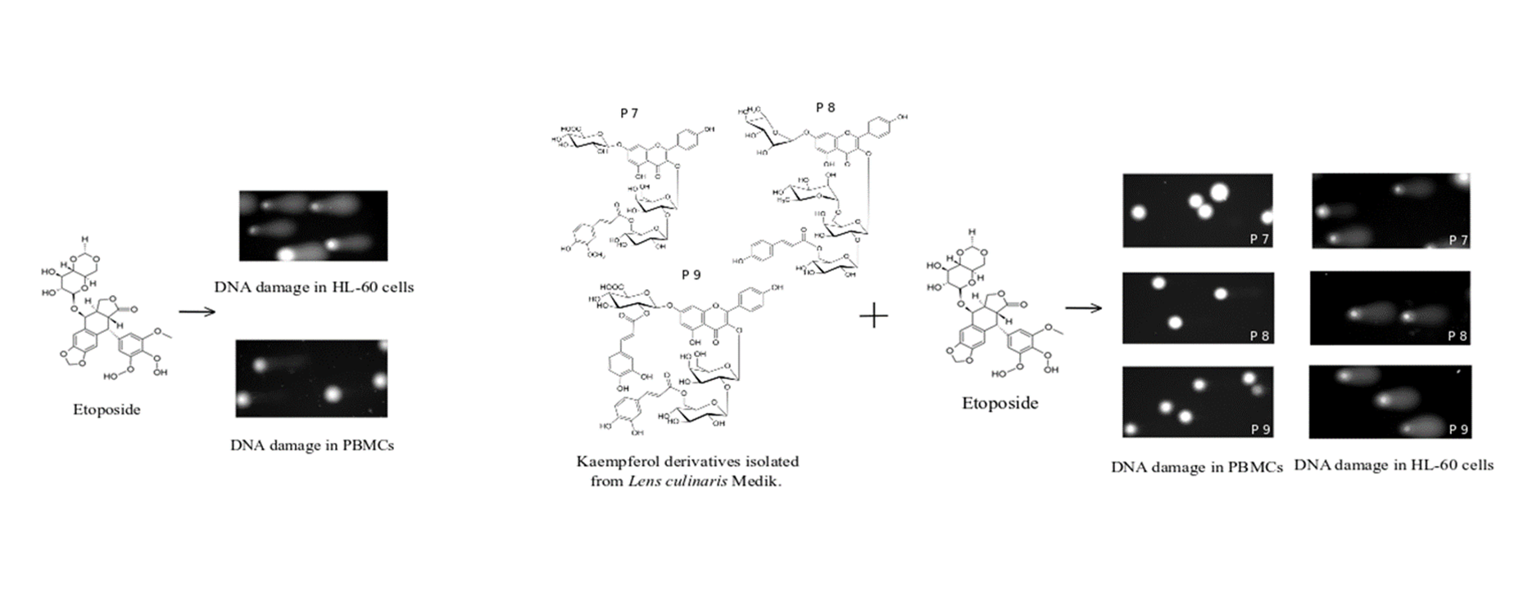
Doctoral dissertation
,,Kaempferol and its derivatives as compounds modulating the anticancer activity of etoposide”
Advisor: Professor Katarzyna Woźniak

Slide 10
During intership in Riga I would like to:
Increase my competences
Learn to work with animal models
Learn in vivo imaging techniques
Learn to creat a bank of organs and tumors samples

Slide 11
Thank you for your attention

