Slide 1




Candidate plant-made therapeutic vaccines for human cancers
Ed Rybicki
Dept MCB / IIDMM
University of Cape Town

Slide 2
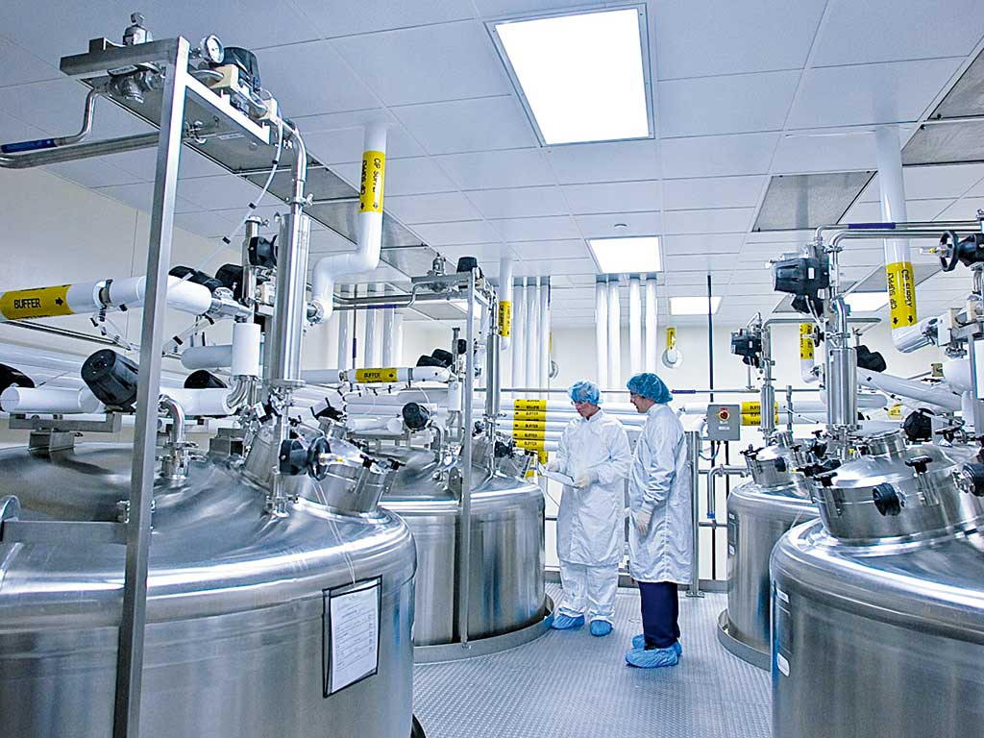
Conventional biologics manufacture:
Stainless steel cell fermenters:
large, VERY expensive to set up, costly to run and to maintain
http://www.theneweconomy.com/i40-2013

Slide 3
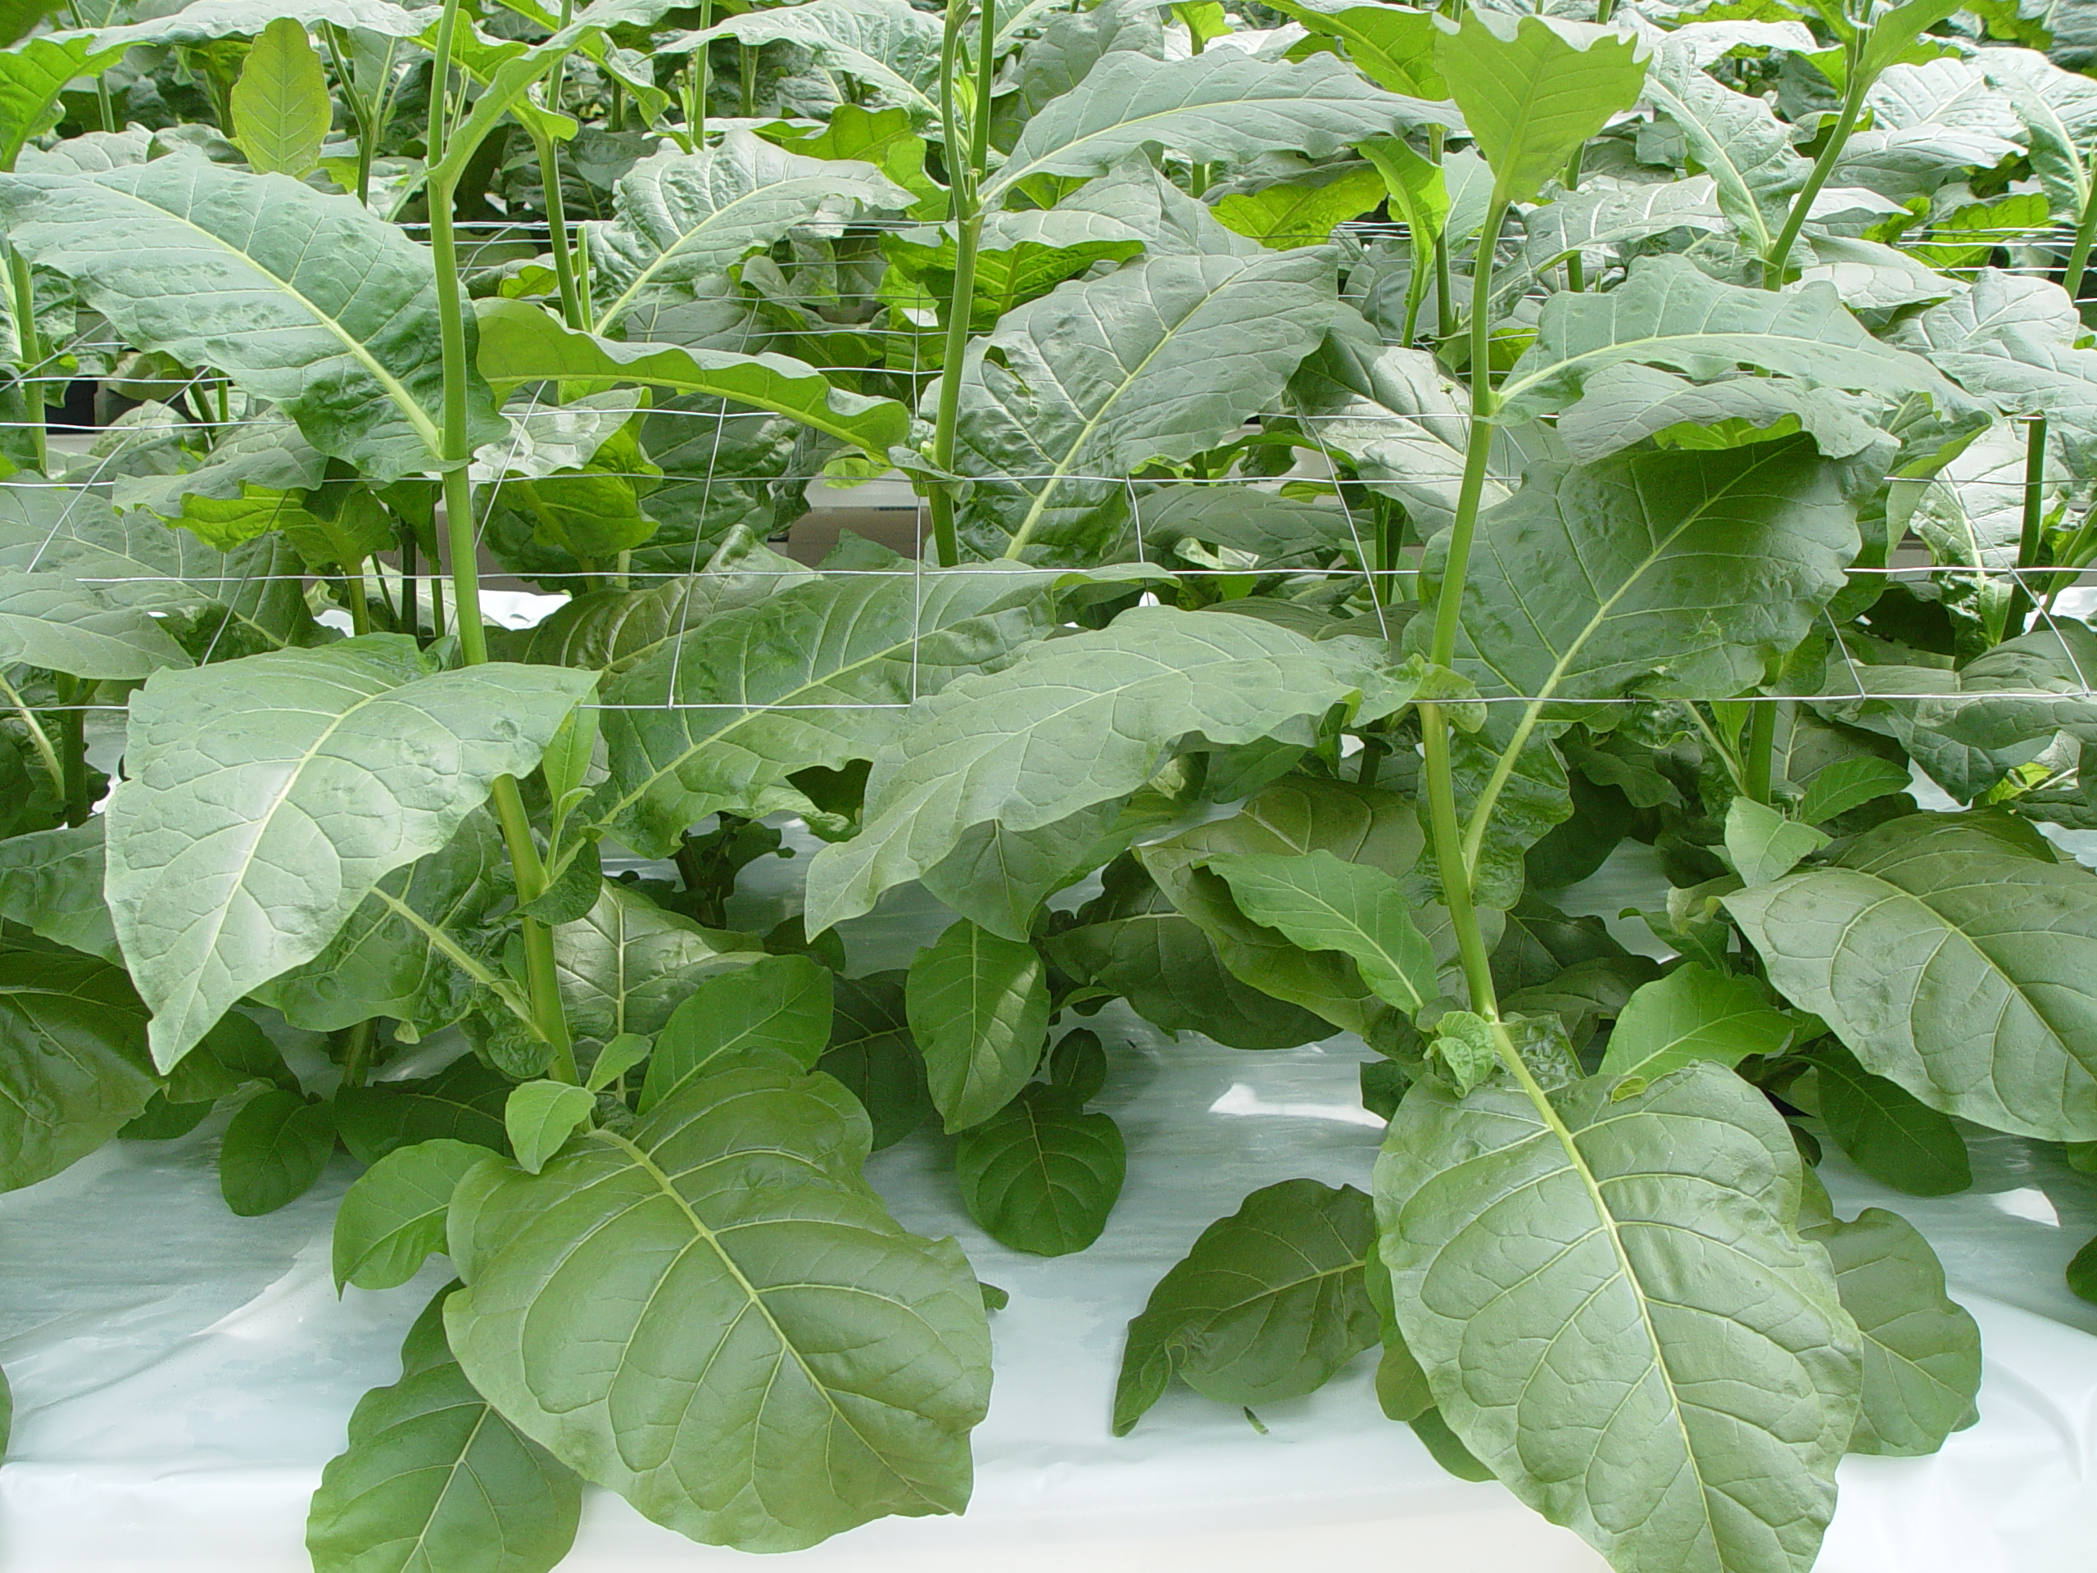
Biofarming: using the plant or plant cell as factory to make complex biologics
- since 1988
https://www.jic.ac.uk/news/2013/02/growing-medicines-in-plants-requires-new-regulations/
Credit: Stefan Schillberg, Fraunhofer IME

Slide 4

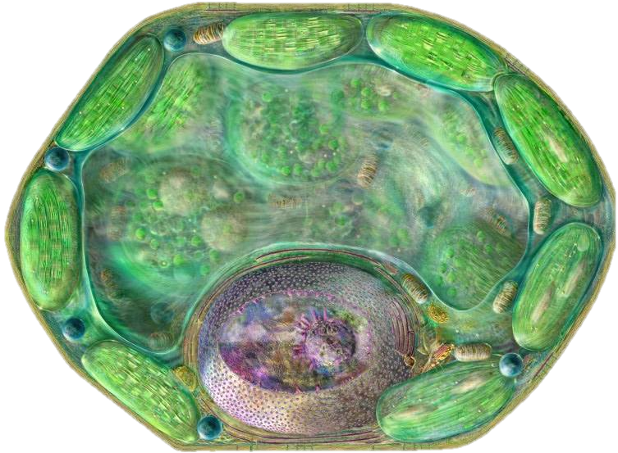



Expression of proteins in plants
100 – 1000-fold < animal cell and 10 – 100-fold < bacterial or yeast cell production
DNA coding
for protein
Introduce into plants or cells
by stable OR transient Agrobacterium transfection
Cheap bit
Expensive bit
Harvest,
extract protein
DOSE HUMANS
OR ANIMALS
Formulate for
Injection OR oral
dosing

Slide 5
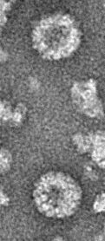
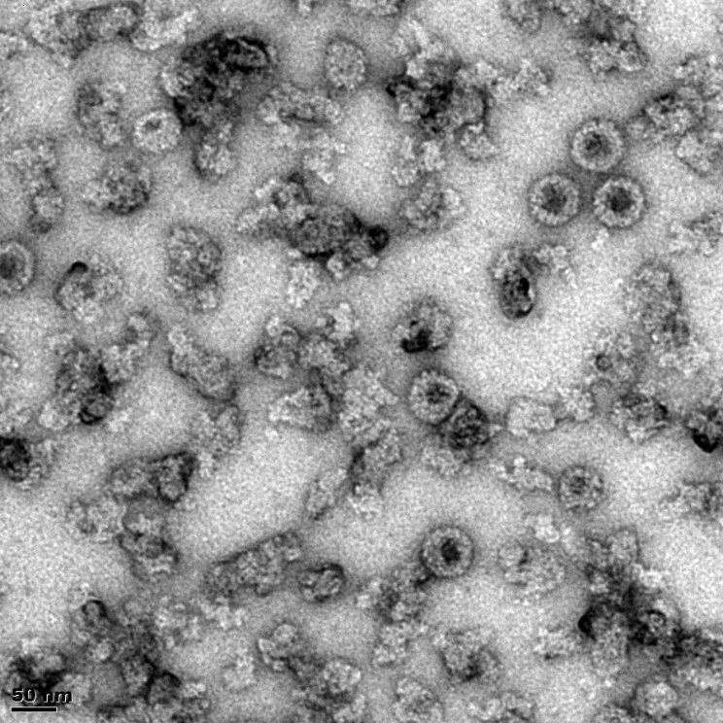
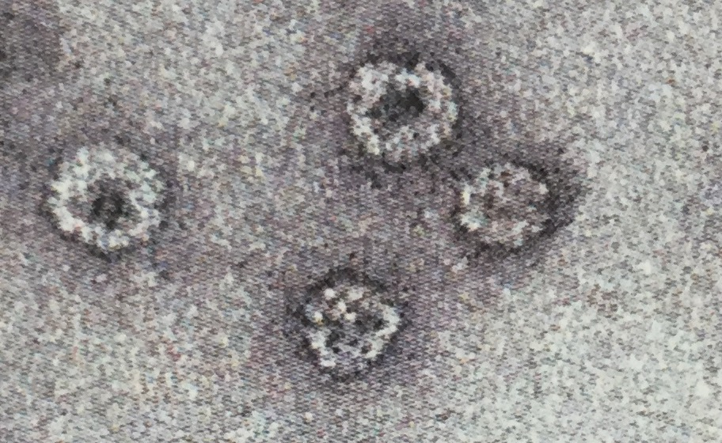


New HPV VLP Work:
Alta van Zyl with Medicago
1 2 3 4 5 6 7 8 9 10
Gradient purified VLPs
58 kDa
46 kDa
For 10 HPV types

Slide 6
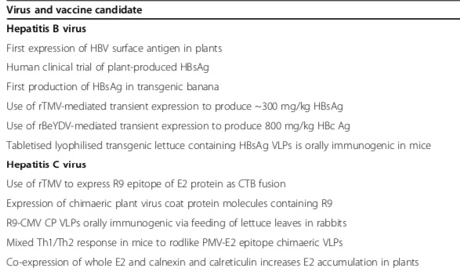
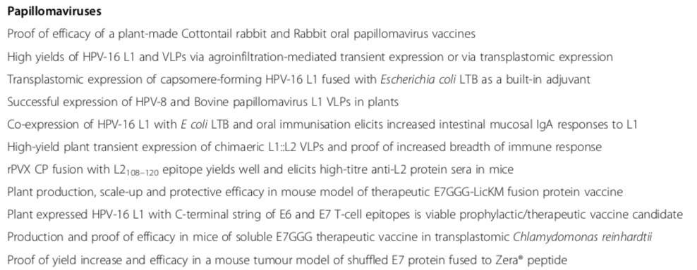
Vaccines for cancer-causing viruses

Slide 7
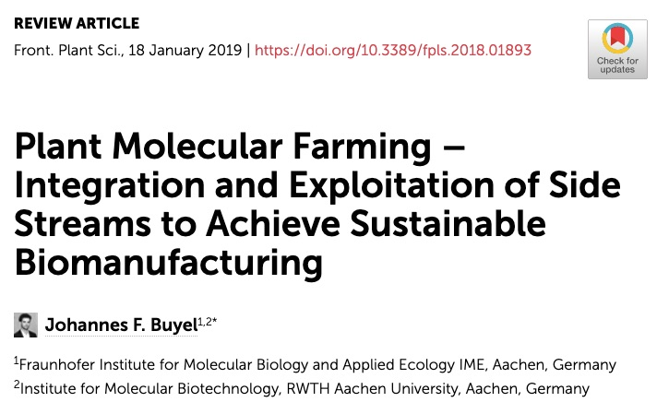
Cancer therapeutics
“transgenic plants and plant cell cultures have been established that allow the recombinant protein to receive an authentic human glycosylation pattern”
“Plants can be used to produce intrinsically disordered proteins or to facilitate the manufacturing of products like viscumin, a lectin with anti-cancer activity. These cannot be synthesized efficiently in mammalian cells or prokaryotes due to their toxicity and complex structure”
“plants contain a vast number of secondary metabolites with various applications, e.g., as anti-cancer agents”
“Among tobacco metabolites, rutin has potential applications in breast cancer therapy. Recently, rutin was isolated using a non-optimized procedure from tobacco leaves yielding 0.2–0.7 g kg-1 biomass”

Slide 8
Plant-made virus nanoparticles
Plant virus-derived VNPs enhance immune responses through their intrinsic properties governing clearance, as well as targeting cells involved in the immune response.
TMV VNPs are preferentially taken up by DCs in draining lymph nodes in mice, where DC activation can result in potent antigen-specific CD8+ T-cell responses if the VNPs display a foreign peptide
CPMV binds to vimentin, displayed on cell lines derived from bone, brain and lymph node metastases of human prostate tumours, meaning CPMV VNPs can target these tumours.
Semi-specific targeting of VNPs to tumour cells can be achieved by engineering surface display of a integrin-binding RGD oligopeptide motif, as several tumours display integrin

Slide 9
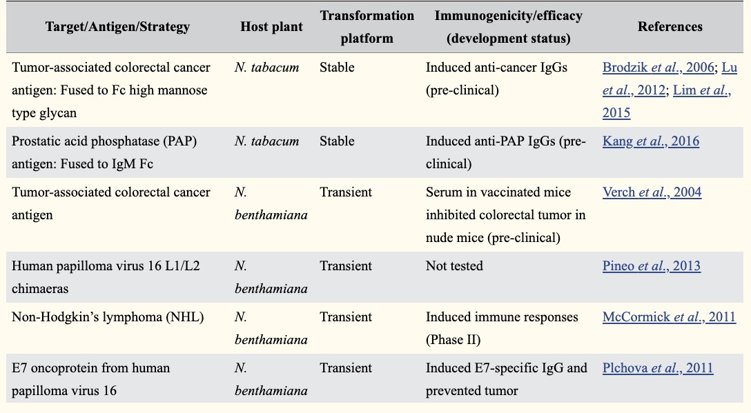
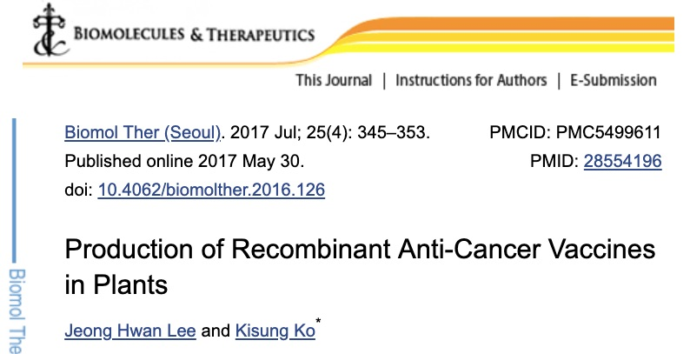
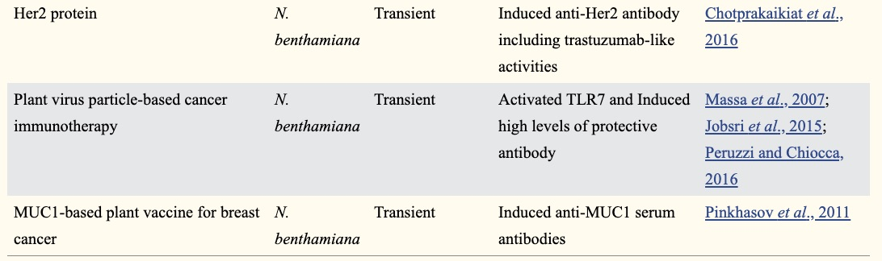

Slide 10
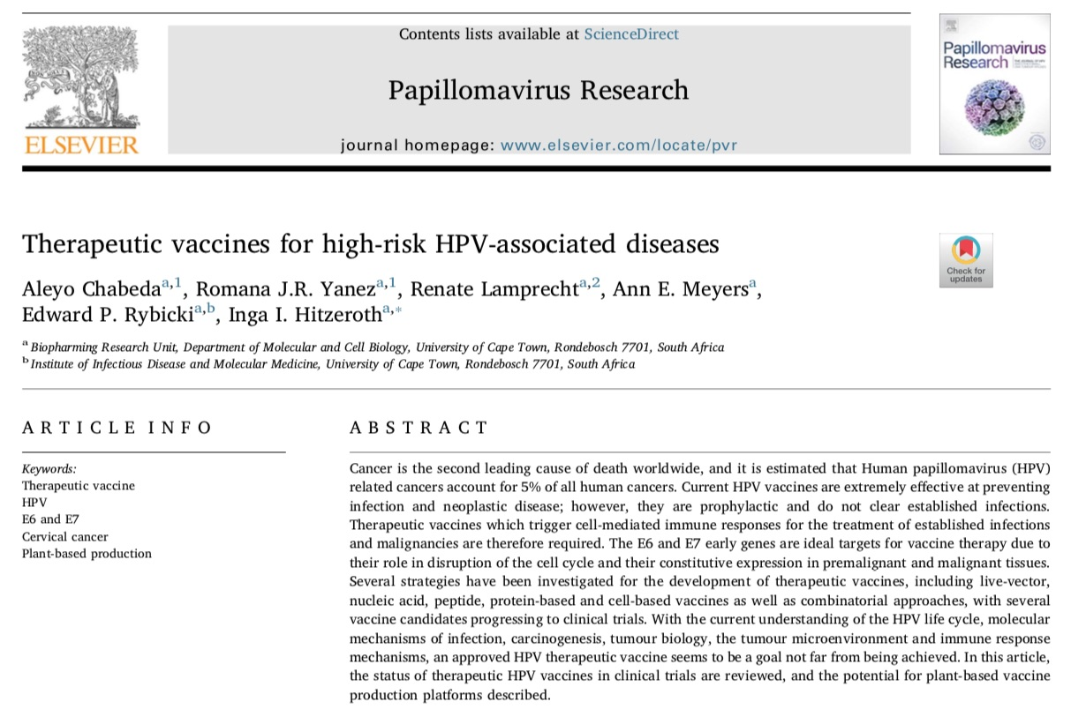
Papillomavirus Research 5 (2018) 46–58

Slide 11
Cervical Cancer and HPV
Cervical cancer is the second most prevalent cancer in women worldwide and the most common cancer in women in developing countries (IARC 1999)
in 2001 women in developing countries accounted for ~85% of both annual cases of cervical cancer (~500 000 cases worldwide) and annual deaths from cervical cancer (~300 000 worldwide)
Sub-Saharan Africa and SE Asia are the areas of highest cervical cancer mortality rates
100% of cervical cancers are caused by high-risk HPVs (at least 50% HPV-16)

Slide 12
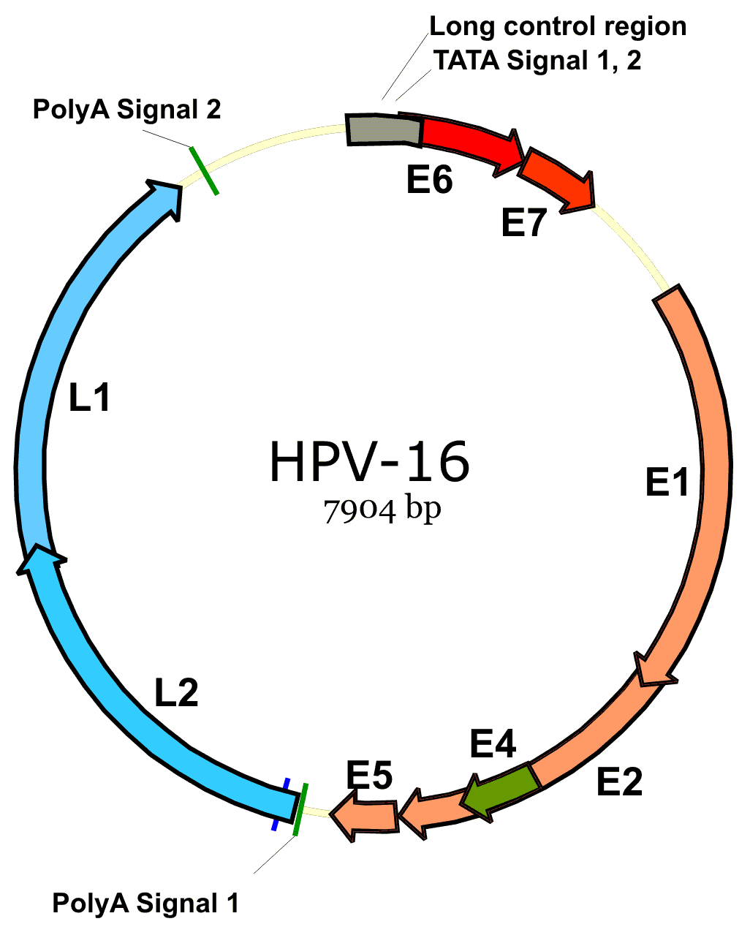
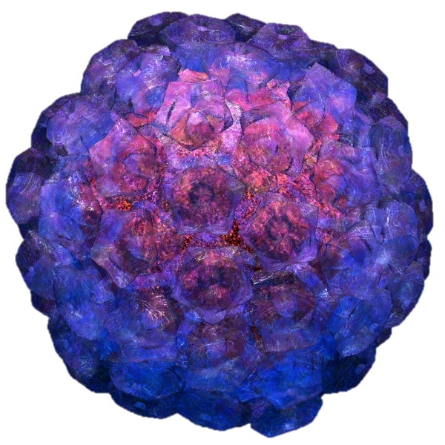
The Virus
Isometric unenveloped particles, ~60 nm diameter, T=7 symmetry
~8 kbp circular dsDNA genome
Capsid has 72 pentamers of 55 kDa L1 major capsid protein; 12-72 copies of 55 kDa L2
E6, E7 oncoproteins bind p53 and Rb, prevent apoptosis and promote cell cycle progression – expressed in tumours
"HPV-16 genome organization" by Xmort - en:wiki. Licensed under GFDL via Wikimedia Commons - http://commons.wikimedia.org/wiki/File:HPV-16_genome_organization.png#/media/File:HPV-16_genome_organization.png

Slide 13
Other Cancers and HPV
Recent studies have strongly linked HPV with cancers of the vulva, penis, anal canal, and head-and-neck.
73% of oral cavity tumours tested positive for HPV-16 DNA.
80% of anal cancers positive for either HPV-16 or 18 DNA.
A 2012 population study showed an association between cutaneous HPV subtypes and the development of squamous cell skin cancer (SCC). The role of the virus in the development of the disease is not yet clear.
https://www.cancerquest.org/cancer-biology/viruses-and-cancer

Slide 14
Prophylactic Vaccines
HPV prophylactic vaccines are VLPs made by recombinant expression and assembly of the major capsid protein L1
Merck’s yeast-made Gardasil targets HPV-16 and HPV-18 found in 70% of cervical cancer cases and genital wart-causing viruses HPVs −6 and −11
GSK’s insect cell-made Cervarix contains only HPVs −16 and −18.
Merck’s nonavalent VLP vaccine was approved by FDA in December 2014 – may prevent >80% of Ca cervix
“Protection against the targeted HPV types has been found to last for at least 8 years with Gardasil and at least 9 years with Cervarix“ - NIH’s NCI

Slide 15
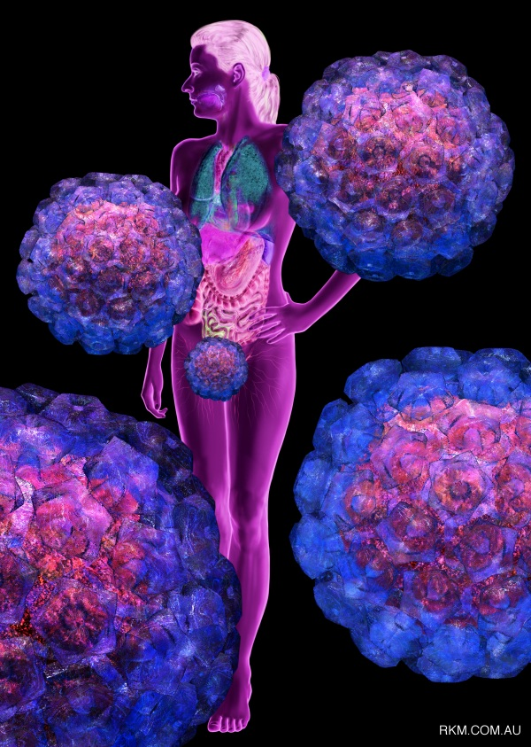
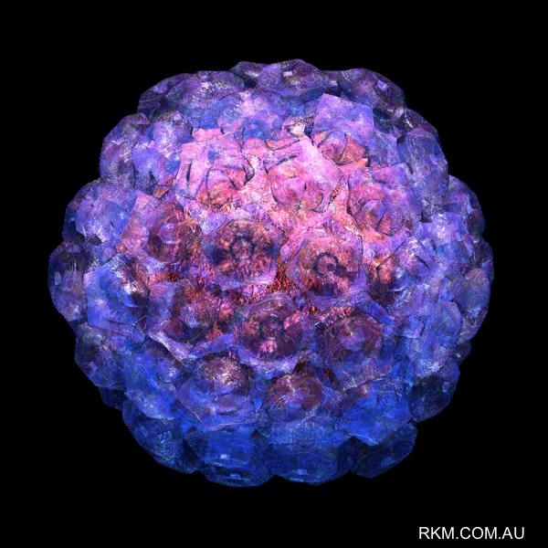
Problems with HPV vaccines:
Cost: 2-3 doses needed, lowest price $4.50/dose for 2-4-valent vaccines ONLY with GAVI in SOME developing countries
Virus coverage: developing country prevalence differences and different spectrum of HPVs in HIV+ people means inadequate coverage
Non-therapeutic: neither Gardasil nor Cervarix are effective against pre-established infections or cancers
Next-generation multivalent or chimaeric or L2-based vaccines will not address this
NEED CHEAP, PROPHYLACTIC AND THERAPEUTIC VACCINES

Slide 16
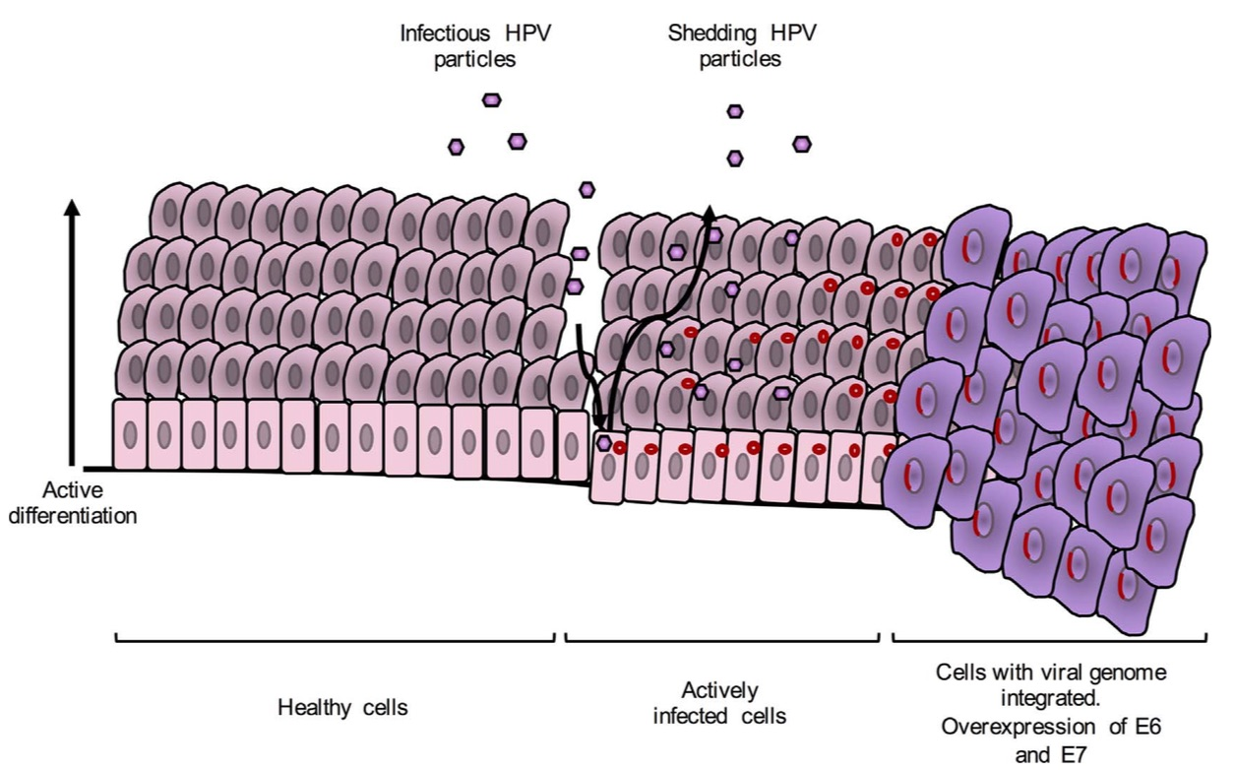
HPV Infection 1
Infection occurs at basal epithelial cells through anatomically accessible points such as microlesions.

Slide 17
HPV Infection 2
The HPV genomes stay as episomes in the host's cell nuclei. Cells proliferate and differentiate. The expression of structural proteins, L1 and L2, viral assembly and release only occur at late stages of the cell differentiation cycle.
Infectious virions shed
Late gene expression
Early gene expression

Slide 18
HPV Infection 3
Integration of the viral genome into the host's genome leads to disruption of the E2 gene, which is the transcriptional repressor of E6 and E7: this leads to their overexpression, which disrupts the cell life cycle regulation, which promotes prolonged cell life leading to genomic instability and cancer.

Slide 19
Therapeutic Vaccine Targets
Spontaneous clearance and slow progression of HPV infections associated with a strong cell-mediated immune response involving mainly T-helper type 1 cells and cytotoxic T-cells (so why emphasis on Ab response for current vaccines??)
Targets in early viral infections could be E1 (helicase) and E2, expressed at higher level than E6/E7
Targets for later stage infection and especially post-transformation are E6 and E7
Ideal therapeutic vaccine would target E1, E2, E6&7 to induce strong tumour-specific Th1 and CTL responses able to kill infected and transformed cells

Slide 20
Therapeutic Agents
Checkpoint inhibitors: prevent cancer cells from avoiding T-cell mediated killing
PD-1 and CTL-associated transmembrane receptor 4 (CTLA-4) are expressed on the surface of CTLs; binding them prevents attenuation of CTL activation
TLR agonists: immunopotentiators which increase activation of cell-mediated responses and viral clearance.
Pentarix - E7 sequences from the hrHPV types 16, 18, 31, 45 and 52 – elicited strong CMR with TLR3 agonist poly(I:C) and TLR9 agonist CpG DNA
Nanoparticles: eCPMV particles induced potent anti-tumour immune responses in melanoma, ovarian, colon and breast cancer models; HPV PsVs preferentially target tumour cells.

Slide 21
Current Vaccine Trials
http://news.cancerconnect.com/adxs11-001improves-survival-advanced-cervical-cancer/
The clinical trial included 26 patients with advanced cervical cancer that had not responded to, or had recurred, following prior treatment with chemotherapy; 31% had also received prior therapy with Avastin® (bevacizumab). The patients in this trial were not considered curable with standard therapeutic options, with less than a 30% survival rate at one year.
At 12 months, the overall survival rate was 38.5%.
Among patients who completed all doses of therapy (3), had median overall survival of over one year, with 55.6% of these patients alive at 12 months.
“…promising safety and efficacy results, including the encouraging 12-month 34.9% combined OS rate, warrant further investigation of ADXS11-001 for treatment of recurrent/refractory cervical cancer.”
Basu et al. (2018) Int J Gynecol Cancer. 2018 May; 28(4): 764–772

Slide 22
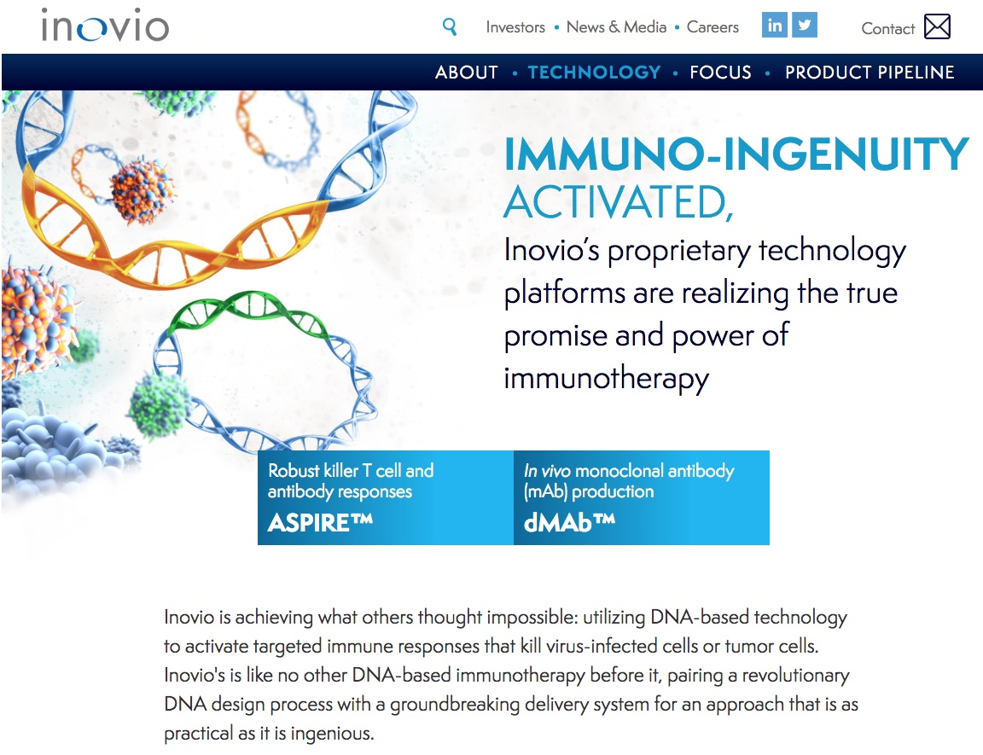
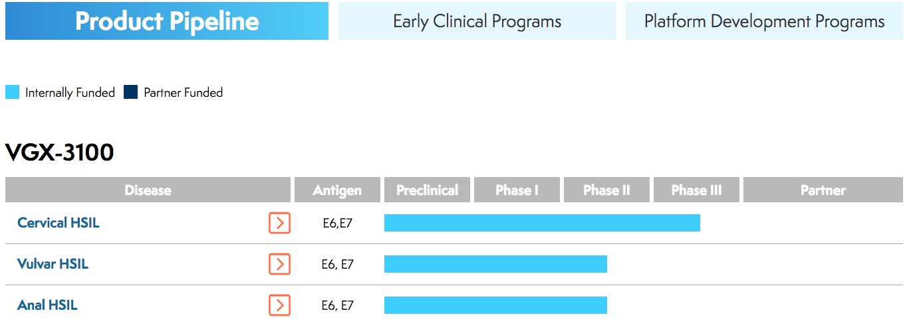
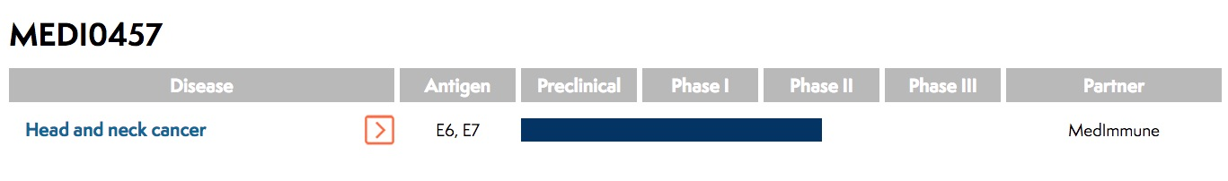
Current Vaccine Trials
Inovio Begins Phase 3 Clinical Trial of VGX-3100 for the Treatment of HPV-Related Cervical Pre-Cancer
June 08, 2017
FDA removes clinical hold on phase 3; Inovio to immediately begin recruiting subjects
PLYMOUTH MEETING, Pa., June 08, 2017 (GLOBE NEWSWIRE) -- Inovio Pharmaceuticals, Inc. (NASDAQ:INO) today announced that it has commenced its phase 3 clinical program to evaluate the efficacy of Inovio’s DNA-based immunotherapy, VGX-3100, to treat cervical dysplasia caused by human papillomavirus (HPV). Inovio’s study will assess the efficacy of VGX-3100 in regressing cervical HSIL (high-grade squamous intraepithelial lesions), a direct precursor to cervical cancer, and eliminating the HPV infection that causes these lesions. The pivotal data from this program will support the potential licensure of VGX-3100 as the first immunotherapy for this disease.
VGX-3100 demonstrated in a phase 2b study (published in The Lancet) its ability to clear HPV-16 and HPV-18 infection and pre-cancerous lesions.
In a randomized, double-blind, placebo-controlled phase 2b study in 167 adult women with histologically documented HPV 16/18 cervical HSIL(CIN2/3), treatment with VGX-3100 resulted in a statistically significantly greater decrease in cervical HSIL and clearance of HPV infection vs. placebo.

Slide 23
Main limitations of present vaccines
Live vectors (bacteria, viruses) | Proteins or peptides | Cell-based (ACT, DCs etc) | Nucleic acids (RNA, DNA)
Vector response may be immunodominant | MHC-specific responses | Complex and highly expensive to make | Potential integration of DNA vectors
Pre-existing immunity to vector | Subunit proteins / peptides poorly immunogenic | No defined route for vaccination | Poor immunogenicity
Generation of nAbs to vector, precluding re-use | Require adjuvants | Inconsistent vaccine quality
Potential pathogenicity in immuno-compromised individuals | Predominantly Ab responses | Very limited lifespan
Chabeda et al. Papillomavirus Research

Slide 24
Current Vaccine Trials
“…there have been numerous and extensive studies that have generated promising vaccine candidates tested in clinical trials.
Despite the current success of these vaccine candidates, there remains the concern that conventional expression methods might result in expensive products, making them inaccessible to the poorer countries who have the highest incidences.”

Slide 25
Plant-made HPV therapeutic vaccine candidates
2014 | Plant expressed HPV-16 L1 with C-terminal string of E6 and E7 T-cell epitopes is viable prophylactic/therapeutic vaccine candidate (Monroy-Garcia et al., 2014)
2002 | Plant-derived HPV 16 E7 oncoprotein induces immune response and specific tumour protection in mice (Franconi et al., 2002)
2007 - 2012 | Plant production, scale-up and protective efficacy in mouse model of therapeutic E7GGG-LicKM fusion protein vaccine (Massa 2007; Venuti 2009; Buyel 2012)
2013 | Production and proof of efficacy in mouse tumour model of soluble E7GGG therapeutic vaccine in transplastomic Chlamydomonas reinhardtii (Demurtas et al., 2013)
2014* | Proof of yield increase and efficacy in a mouse tumour model of shuffled E7 protein fused to Zera® peptide (Whitehead et al., 2014)

Slide 26
https://doi.org/10.1186/1471-2407-14-367

Slide 27
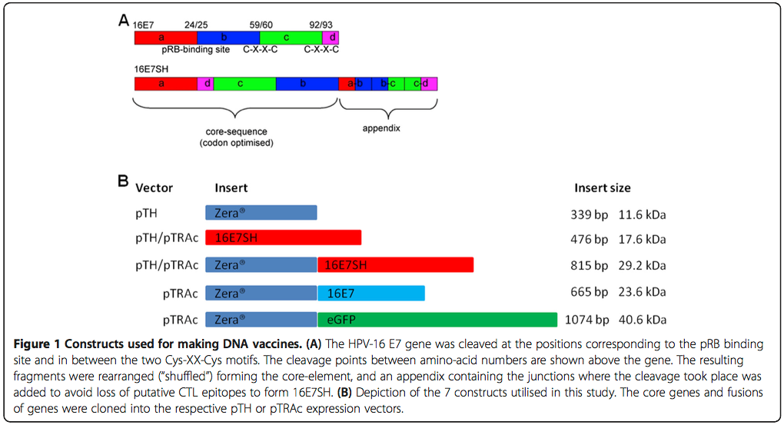
Shuffled E7 Gene

Slide 28
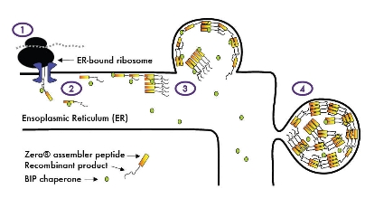
Zera® Signal Peptide
N-terminal 112 aa proline-rich domain of maize-derived γ-zein = Zera
StorPro™ organelles
Significantly increases protein yields
Simplifies purification
Dramatically enhances immunogenicity of subunits
Acts as an adjuvant, in protein and DNA-based vaccines
Proof of anticancer efficacy for HPV E7 in mouse model
Era Biotech / Zip Solutions funded Whitehead et al. 2014 BMC Cancer 14:367
Notes:
RNA traduction (fusion of Zera® peptide and product)
Internalization via signal peptide
Zera® peptides interact with the ER membrane, self-assemble, associate with chaperones, and induce the formation of de novo storage organelles
The fusion of Zera®-peptide and protein of interest are sequestered inside the StorPro™ organelles and are insulated from proteolytic degradation

Slide 29
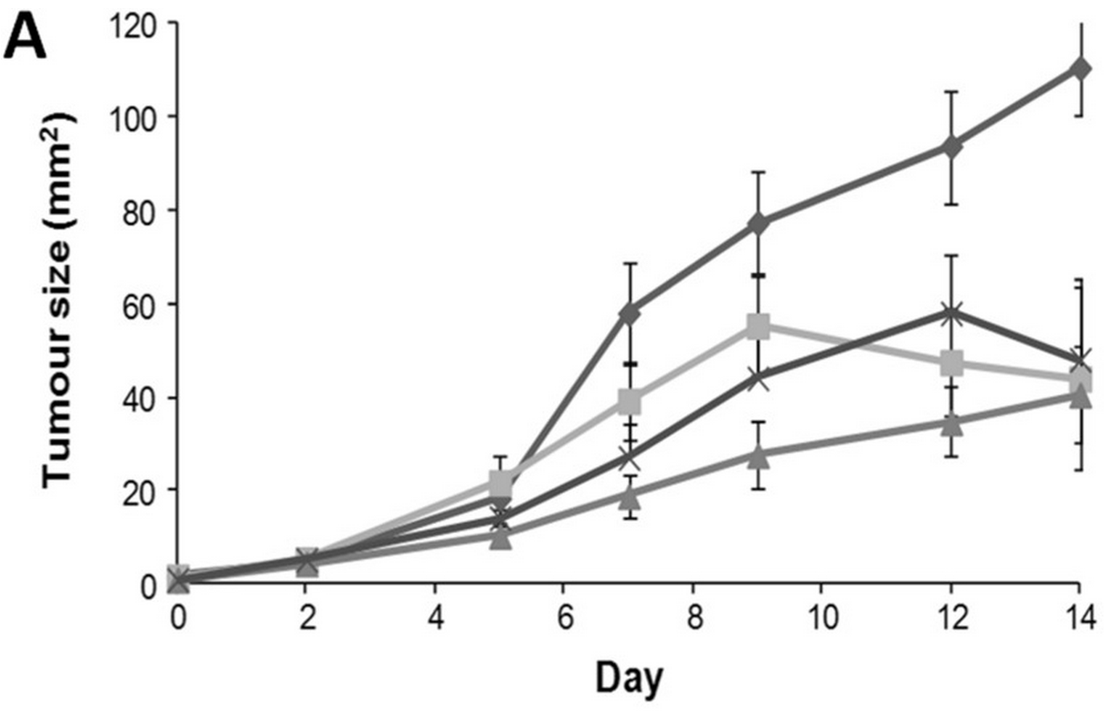
Mouse tumour regression challenge
Mice were inoculated with 0.5 × 10⁶ C3 tumour cells to induce tumours and subsequently injected with vaccine (5 μg protein or 100 μg DNA in 100 μl) in two sites per animal when the tumours were clearly palpable.
Whitehead et al., 2014, http://www.biomedcentral.com/1471-2407/14/367
Control empty plasmid
E7SH-Zera + IFA
E7SH vaccine plasmid
E7SH Zera protein
Following up with improved E6/E7 gene and DNA prime / protein boost regime
NB: mixing free PBs and 16E7SH also enhanced immune responses, indicating an adjuvant activity for the Zera® PBs

Slide 30
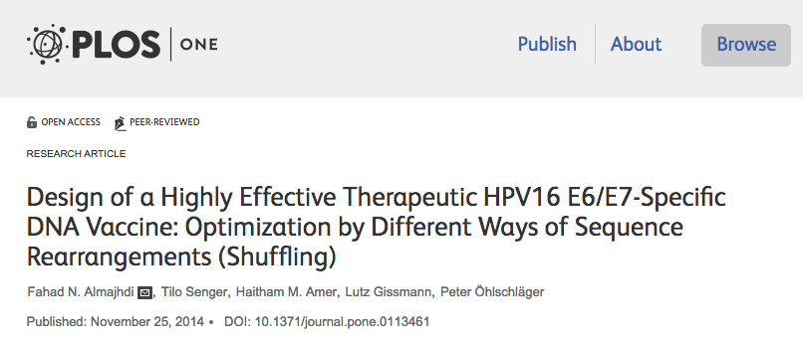
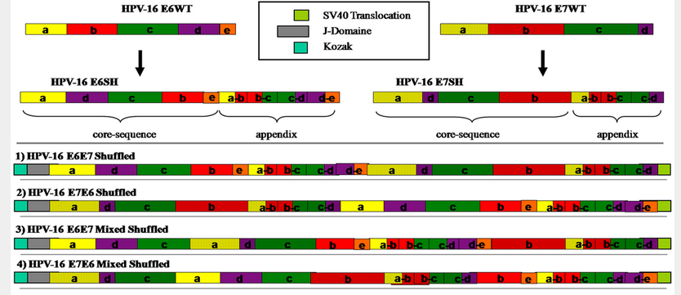

Slide 31
New HPV VLP Work:
Alta van Zyl with Medicago
1 2 3 4 5 6 7 8 9 10
Gradient purified VLPs
58 kDa
46 kDa
For 10 HPV types
Therapeutic if differently adjuvanted??
- Evidence from animal models

Slide 32
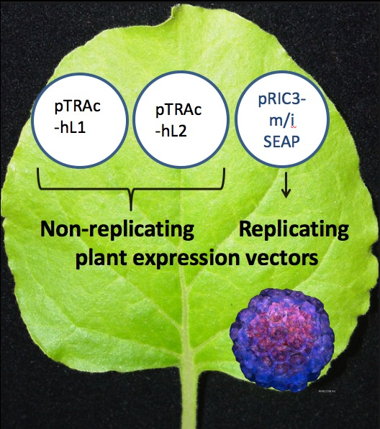
Plant-made infectious HPV pseudovirions
1st evidence that DNA vaccines can be made in plants

Slide 33
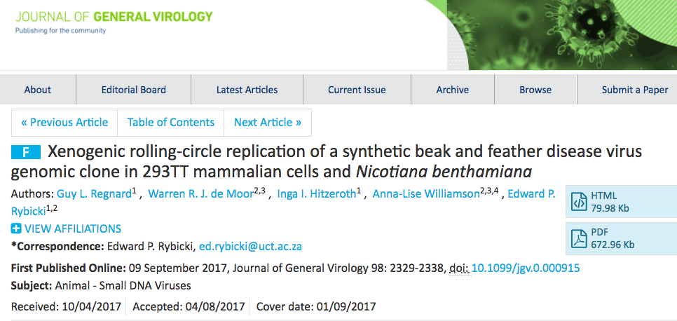
…and add novel replicating DNA expression vectors…?

Slide 34
What about the future?
Clinical trial of plant-made E7-based vaccine candidates in cancer patients? Eg: Zera-E7SH / E6E7SH; Saporin E7GGG?
Combination prophylactic / therapeutic vaccines could be trialled – eg: L1 with E6 / E7 epitopes; HPV pseudovirions + replicating DNA vaccine

Slide 35



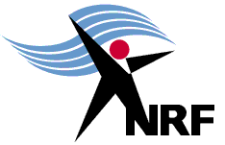

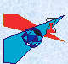




With special thanks to the HPV green team, present and past:
A.-L. Williamson, Inga Hitzeroth, Ann Meyers, Alta van Zyl, Renate Lamprecht, Megan Hendrikse, Mark Whitehead, Guy Regnard, Aleyo Chabeda
Sue Huddy, Paul Kennedy, Benjamin Singo, James Maclean, Arvind Varsani, Thomas Kohl, Ramon Pereira
Cathy Pineo
And to:
Rainer Fischer, Thomas Rademacher - RWTH Aachen University
Neil Christensen – Univ Pennsylvania
Martin Muller – DKFZ, Heidelberg
Peter Oelschlager – Univ Konstanz
PRF

