Slide 1
Well-being of older adults in Baltic states
Antanas Kairys, Olga Zamalijeva
Vilnius University, Lithuania

Slide 2
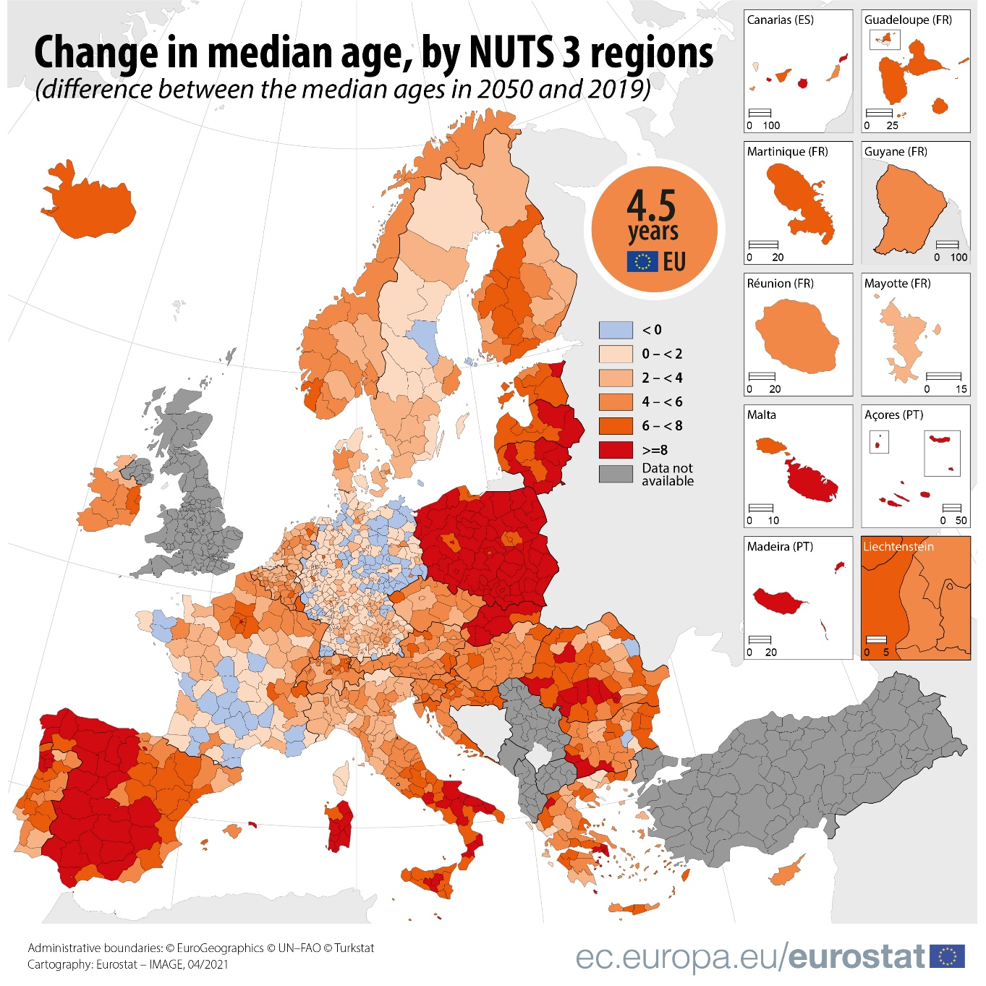
Why do we need to talk about ageing...
Eurostat

Slide 3
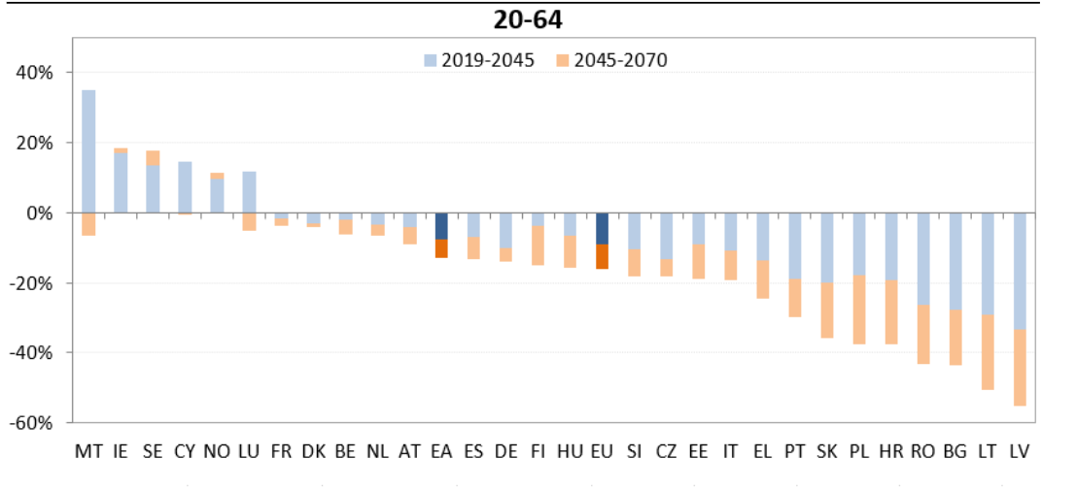
Percentage changes in total labour supply of the population aged 20-64
European Commission
The 2021 Ageing Report

Slide 4
Sample
An analysis was based on data from the Survey of Health, Ageing and Retirement in Europe (SHARE) Wave 7.
Number of participants (50+):
Estonia – 5105
Latvia - 1752
Lithuania – 2024

Slide 5
The Control, Autonomy, Self-realization and Pleasure (CASP) (Knesebeck et al., 2005)

Slide 6
Life satisfaction
65+

Slide 7
Life satisfaction
50-64 year old participants

Slide 8
Health and well-being
Subjective health
CASP
Life satisfaction

Slide 9
Control variables:
Age
Gender
Place of residence
Health:
Multimorbidity
Affective disorders
14 %
CASP
Unmet health care needs:
Price
Waiting time
Etc.
5 %
Notes:
CASP – nepatenkinti sveikatos priežiūros poreikiai yra kur kas svarbesni jaunesnėje (50-64 amžiaus grupėje – 7%) nei vyresnėje (65+ - 3%) grupėje

Slide 10
Unemployment history and well-being
t (4553) = 3,24; p < 0,01; d = 0,22

Slide 11
Unemployment history and well-being
Conscientiousness
ADL

Slide 12
Work quality and well-being

Slide 13
Thank you for your attention
Kontaktai: antanas.kairys@fsf.vu.lt
https://www.fsf.vu.lt/mokslas/share
www.share-eric.eu

