Slide 1
Courtney Queen, Ph.D. Fulbright Scholar Rīga Stradiņš University Institute of Public Health Assistant Professor Director for Undergraduate Studies Graduate School of Biomedical Sciences Department of Public Health
European Economic Area and Norway Grants (EEA/N) programme Research and Education Scholarship

Slide 2
Promotion of healthy ageing, welfare and social security
Health research utilizing health equity frameworks among the elderly in the Baltic nations

Slide 3
Disclosure
J. William Fulbright Scholar, Latvia, Spring 2022
National Institutes of Health, NIAMS, R21
National Science Foundation, Commercialization
TTUHSC Clinical Research Institute, Proof-of-Concept Study
TTU Innovation Hub, Prototype Development
Health Equity Leadership Institute Scholar
NIH, National Institute of Minority Health and Health Disparities Scholar

Slide 4
Objectives
Describe various frameworks and theories for addressing health disparities, including:
Single-focused conceptual approaches based on consideration of healthcare, law and policy, biology, or social/environmental factors, and
Multi-focused conceptual approaches based on consideration of life course, human development and non-biological pathways.
Practical Application

Slide 5
What is Health Equity?
… that pursuing health equity–that is, striving to eliminate health disparities
strongly associated with social disadvantage—can be thought of as striving
for equal opportunities for all social groups to be as healthy as possible, with
selective focus on improving conditions for those groups who have had fewer opportunities.
Drawing upon human rights concepts, pursuing health equity
means removing obstacles for groups of people—such as the poor, disadvantaged
racial/ethnic groups, women, or persons who are not heterosexual—who historically
have faced more obstacles to realizing their rights to health and other human
Rights (Braveman, 2006).

Slide 6
What are “Health Disparities”?
Full version:
A health disparity/inequality is a particular type of difference in health or in the most important influences on health that could potentially be shaped by policies; it is a difference in which disadvantaged social groups (such as the poor, racial/ethnic minorities, women, or other groups that have persistently experienced social disadvantage or discrimination) systematically experience worse health or greater health risks than more advantaged groups (Braveman, 2006).

Slide 7
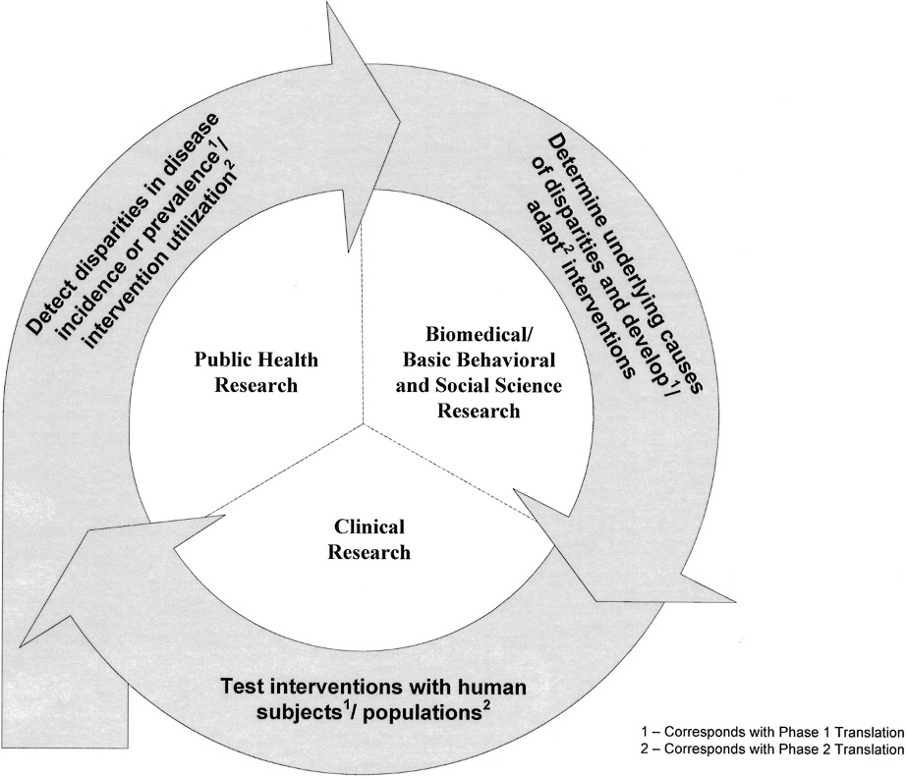
Health Disparities Research Framework
Fig 1. Health disparities research framework.
TRANSLATIONAL RESEARCH AND HEALTH DISPARITIES - Fleming et al

Slide 8
Social Determinants of Health

Slide 9
Stratification
Within-country inequality exists between subgroups within a country, based on disaggregated data and summary measures of inequality
For example, comparing the difference between infant mortality rates among urban and rural subgroups
There are several equity stratifiers that are used to distinguish groups and individuals:
Socioeconomic status
Education
Place of residence (rural, urban etc.)
Race or ethnicity
Occupation
Gender
Religion
Notes:
Within Country Inequities
Within-country inequality exists between subgroups within a country, based on disaggregated data and summary measures of inequalityOther equity stratifiers like education also explain health outcomes. Education increases health literacy, which is the ability to obtain, read, understand and use health care information to make appropriate health decisions and follow instructions for treatment.
Equity stratifiers (dimensions of inequality) used in inequality monitoring typically reflect social conditions, such as level of wealth or education, place of residence and gender.
Inequalities such as in income distribution, socioeconomic status and learning outcomes are often transferred into the field of health - health inequalities tend to stem from social inequalities. When a society has large social and economic inequalities, it also has large inequalities in health. Health is therefore, a good measure of social and economic progress.
Measuring health inequalities allows us to identify differences that represent part of the pathway through which inequities in health are arising. These differences can be acted on and can be used to measure progress toward achieving health equity. Inequalities between subpopulations can be identified by disaggregating health indicators using equity stratifiers. An equity stratifier refers to a characteristic – such as demographic, social, economic, racial or geographic descriptor – that can identify population subgroups for the purpose of measuring differences in health that may be considered unfair or unjust.
Historically, the greatest emphasis has been placed on health equality by economic status. However, there are many other policy-relevant equity stratifiers to describe health inequality, including education, social class, gender, place of residence (rural or urban), race or ethnicity.
Monitoring health inequalities reveals differences in how social groups experience health; it does not explain the drivers that cause and perpetuate inequality.
Not all equity stratifiers are equally relevant in all populations, depending on the characteristics of that population. For example, in some cultures an individual’s religion may – or may not – be closely tied to health-impacting behaviours or the types of health services that are accessed.
Equity stratifiers may also vary in relevance depending on the health measure in question. For example, monitoring inequalities in traffic accidents may involve different dimensions of inequality than monitoring inequalities in modern contraceptive use.

Slide 11
Conceptual Approaches
A. The Genetic Model
B. The Fundamental Cause Model
C. The Pathways Model
D. The Interaction Model

Slide 12
Conceptual Approaches
Source: Ana V. Diez Roux, 2013

Slide 13
Single-focused Models
Genetic Model, Fundamental cause

Slide 14
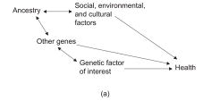
A. The Genetic Model

Slide 15
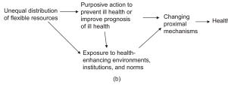
B. The Fundamental Cause Model

Slide 16
Multi-focused Approaches
Life Course Perspective, points on translational research

Slide 17
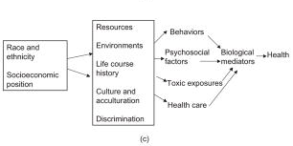
C. The Pathways Model

Slide 18
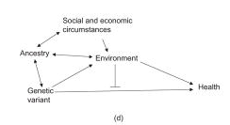
D. The Interaction Model

Slide 19
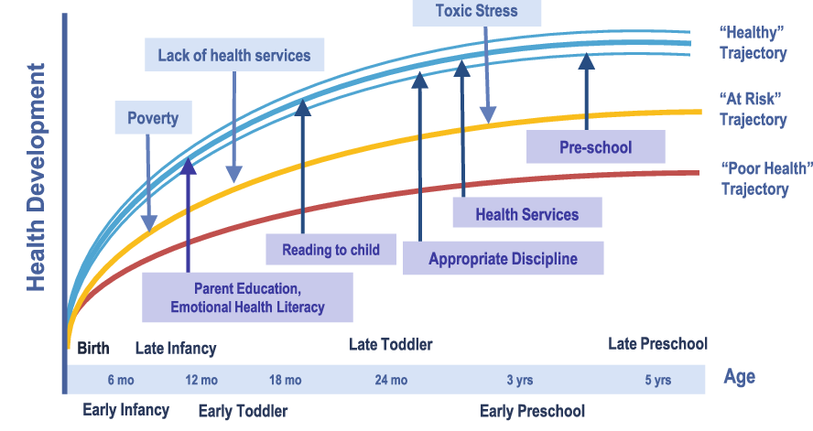
Life Course Perspective

Slide 20
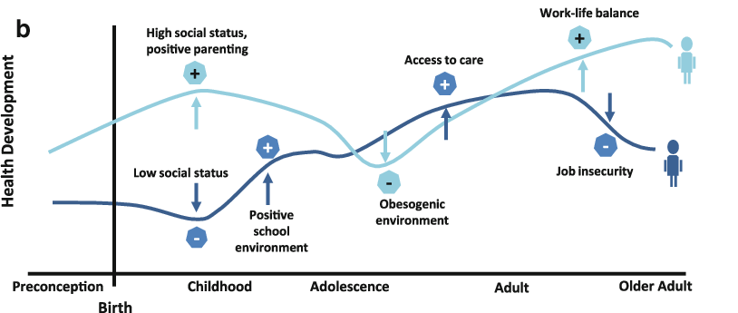
Life Course Perspective

Slide 21
Summary
Describe various frameworks and theories for addressing health disparities, including:
Single-focused conceptual approaches based on consideration of healthcare, law and policy, biology, or social/environmental factors, and
Multi-focused conceptual approaches based on consideration of life course, human development and non-biological pathways.
Practical Application

Slide 22
Psychological Distress Among the Elderly in the Baltic Nations During the Beginning of the COVID-19 Pandemic
Behavioral model for vulnerable populations (BMVP)

Slide 23
Introduction
The Baltic countries responded quickly to the COVID-19 pandemic in the Spring and Summer of 2020 declaring a state of emergency with fewer than 30 cases in each country. The early adoption of public health measures to prevent the transmission of COVID-19 resulted in early lockdown, state-funded testing, a robust contact tracing program and changes to service provision for greater infection control. At the same time, the population, especially the elderly, were experiencing symptoms associated with psychological distress.
The primary objective of this study is to identify differences in symptoms of psychological distress among the elderly living in the Baltic nations of Latvia, Estonia and Lithuania. A secondary objective of this study is to determine if differences in psychological distress are based on gender.
This study tests the null hypothesis that no differences exist.

Slide 24
Background
Globally, the population is ageing rapidly. Between 2015 and 2050, the proportion of the world’s population over 60 years will nearly double, from 12% to 22%.
Mental health and well-being are as important in older age as at any other time of life.
Mental and neurological disorders among older adults account for 6.6% of the total disability (DALYs) for this age group.
Approximately 15% of adults aged 60 and over suffer from a mental disorder (WHO).

Slide 25
Key Concepts
Chambers’s definition of vulnerability as ‘the exposure to contingencies and stress, and difficulty coping with them’, provides elements of such an account by giving equal weight to the threat and to the ability of an exposed subject to cope with that threat. His notion of exposure recognizes the fact that not every subject is equally at risk to a given threat, and the reference to coping recognizes that there is something about the nature and actions of a person that makes them more or less susceptible to harm, even if the subject’s scope for agency is portrayed as heavily circumscribed. Chambers went on to say, ‘Vulnerability has thus two sides: an external side of risk, shocks and stress to which an individual or household is subject; and an internal side which is defenselessness, meaning a lack of means
to cope without damaging loss’.

Slide 26
Vulnerability
There are three main risk factors that contribute to vulnerability in older adults:
health status;
cognitive ability; and,
social network.
Older adults are often economically vulnerable because their cost of care can exceed their income. In particular, chronic illness increases an older adult’s dependency and cost of living. The impairments caused by chronic illness and the need for long term care increases directly with age – they say for many the last 10 years of life are spent in illness.
Other sub groups have equal or arguably more risk of exploitation because of dual/multiple identifications with other oppressed groups including: low socioeconomic status;
ethnic background; and, rural living.

Slide 27
Dimensions of Vulnerability and Ageing
Economic insecurity
Social isolation
Inadequate and unaffordable housing
Poor mental and physical health
Inaccessible transportation and built environments
Food insecurity
Physical mobility limitations
Marginalized identities and cultures
Barriers to multi-lingual communication and lack of multi-lingual services

Slide 28
Research Strategy
Health and Ageing
There is also mounting evidence for a direct physiological channel. In particular, perceived loneliness has been shown to affect health and aging through increasing stress, higher blood pressure, poorer sleep, higher cortisol response to awakening, and greater activation of the sympathetic adrenomedullary system.
According to a frequently cited study, the odds ratio of all-cause mortality is higher for social isolation than for smoking.
Loneliness
Loneliness, defined as perceived social isolation, has been found to increase in old age, at least from a certain age onwards and a common belief is that, in rich individualistic societies, later born cohorts are more prone to loneliness such that there may be even a ‘loneliness epidemic’.

Slide 29
Methods
Data
Data from Wave 8 COVID-19 data of the Survey of Health, Aging, and Retirement in Europe (SHARE) were used for this analysis. SHARE Wave 8 COVID-19 data is an early data version of the SHARE Corona survey conducted between June and August 2020. It features the data collected by telephone (CATI) on topics related to COVID-19 for a large sub-sample of SHARE panel respondents. This study examined a sample of 6,794 adults over 50 years old in the Baltic nations of Latvia, Estonia, and Lithuania.
Analysis
Bivariate analysis were performed utilizing the Pearson chi-square test for association to examine differences between the three Baltic countries, and differences in psychological distress by gender during the first six months of the COVID-19 pandemic. Level of significance is determined by p-value test statistic. Alpha level was established at .05.

Slide 30
Behavioral Model for Vulnerable Populations
Predisposing Domain | Enabling Domain | Health Need Domain | Utilization/Access
Traditional Variables | Traditional Variables | Self-Reported Health | 1. Problems accessing healthcare
Age | Employment Status |  | 2. Emergency department use
Gender | Insurance Coverage |  | 3. Problems accessing prescription medications
Marital Status | No Insurance |  | 4. Forgoing healthcare to meet other basic needs
 | Usual Source of Care
Vulnerable Variables | Vulnerable Variables
Race/Ethnicity | Paid Time-Off
Language at Home | Paid Sick Time
Citizenship | Accompanying Person
Birthplace | Interpretation
Number of Years in the U.S. | Paperwork
 | Transportation
 | Competing needs for food, housing, clothing
Source: Gelberg, Andersen, and Leake, 2000.

Slide 31
Preliminary Findings
Felt More or Less Nervous Since COVID-19 Outbreak Between 3 Countries
A chi-square test of association shows a statistically significant relationship between felt more or less nervous since the outbreak and country of residence, X² (6, N = 4661) = 23.73, p < .001.

Slide 32
Preliminary Findings
Relationship Between Feeling More or Less Nervous Since the COVID-19 Outbreak and Gender
A chi-square test of independence shows that there was a significant relationship between feeling more or less nervous since the COVID-19 outbreak and gender, X² (4, N = 6771) = 76.98, p < .001. Females were more likely than males to feel more nervous in the Baltic countries.

Slide 33
Preliminary Findings
Relationship Between Feeling More or Less Depressed Since the COVID-19 Outbreak and Gender
A chi-square test of independence shows that there was a significant relationship between feeling more or less depressed since the COVID-19 outbreak and gender for all 3 Baltic countries, X² (4, N = 6771) = 87.41, p < .001. Females were more likely than males to feel more depressed in the Baltics.

Slide 34
Future Studies
These findings indicate a strong need for further exploration.
Additional mixed-method analysis is necessary with these findings. QUAL-quan study design based on local studies.
Utilize the Behavioral Model for Vulnerable Populations to understand more about the predictors of outcomes.
Test the BMVP to determine which domain is influencing inequitable outcomes.

Slide 35
Conclusions
This study rejects the null hypothesis that no differences exist between the genders, as women report greater psychological distress during this period. Additional multi-method analysis is consistent with these findings and concludes that this is due to the greater concern women report for family, and the burden which placed limitations on meeting their children and grandchildren (Reine, et al., 2021).
Preliminary findings of this study indicate a clear need for gender-specific interventions designed to address mental health needs of the elderly during periods of uncertainty. Furthermore, additional analysis is needed to determine which sociostructural factors are associated with the between-country differences.

Slide 36
Policy Implications
Create An Adequately Prepared Workforce
Strengthen The Role Of Public Health
Remediate Disparities And Inequities
Develop New Approaches To Care Delivery
Allocate Resources To Palliative And End-Of-Life Care
Redesign Long-Term Services And Supports

Slide 37
References
Börsch-Supan, A. (2022). Survey of Health, Ageing and Retirement in Europe (SHARE) Wave 8. COVID-19 Survey 1. Release version: 8.0.0. SHARE-ERIC. Data set. DOI: 10.6103/SHARE.w8ca.800
OECD/European Observatory on Health Systems and Policies (2021). Latvia: Country Health Profile 2021, State of Health in the EU, OECD Publishing, Paris/European Observatory on Health Systems and Policies, Brussels.
Reine, I., Reine, A., Aleksandrovs, A., Ivanovs, A., Baltmane, D., Balodis, G., Gehtmane-Hofmane, I., Koroļeva, I., Mieriņa, I., Miķelsone, M., Rajevska, O., Sniķere, S. Sabiedrības veselības politikas rekomendācijas gados vecāku cilvēku populācijai Latvijā (A policy document on public health p romotion among ageing population in Latvia), 2021. Riga Stradiņš University/Ministry of Health of Latvia. https://www.vm.gov.lv/lv/media/6495/download
Xiong, J., Lipsitz, O., Nasri, F., Lui, L., Gill, H., Phan, L., Chen-Li, D., Iacobucci, M., Ho, R., Majeed, A., & McIntyre, R. S. (2020). Impact of COVID-19 pandemic on mental health in the general population: A systematic review. Journal of affective disorders, 277, 55–64. https://doi.org/10.1016/j.jad.2020.08.001
Notes:
Slide 41: References
The References for this Module is your textbook, Introduction to Public Health.

Slide 38
SHARE acknowledgement
This study uses data from SHARE Wave 8. COVID-19 Survey 1 6103/SHARE.w8ca.800
Notes:
Slide 41: References
The References for this Module is your textbook, Introduction to Public Health.

Slide 39
Just for Fun!
Analyzing Health Systems to Make them Stronger
http://www.strengtheninghealthsystems.be

Slide 40
Food for Thought!
“If we could give every individual the right amount of
nourishment and exercise, not too little and not too much,
we would have found the safest way to health.”
- Hippocrates
Notes:
Slide 40: Food for Thought!
A few more sources, but I have also added them directly to Sakai as a document titled: Module Outline. Go ahead and download this document for your reference.

Slide 41
Thank You!
Questions? Please feel free to reach out to me with any questions, by email at: Courtney.queen@rsu.lv or courtney.m.queen@ttuhsc.edu
Notes:
Slide 42: Thank You!
Thank You! If you have any questions, please feel free to reach out to me. You can find my contact information here, on this slide, and it is also on the syllabus.
If you think that you might be interested in the Social and Behavioral Sciences professionally, then I have added a few good videos that explore the knowledge, skills, and abilities of someone who works as a social scientist in public health.
Lastly, as a part of your Master’s in Public Health, you will take the course, Introduction to the Social and Behavioral Sciences. This course will give you a more in-depth experience about the theory and methods in the social sciences as they apply to public health, the tools and tricks, of the trade, and it is a course that I think you will find both fascinating and intriguing.

Slide 42
Final Slide.
Notes:
Slide 32: Final Slide

