Slide 1
The most important findings on ageing in the Baltic States
Madara Miķelsone, Ieva Reine, Andrejs Ivanovs
Statistics Unit, Faculty of Medicine
Riga Stradiņš University

Slide 2
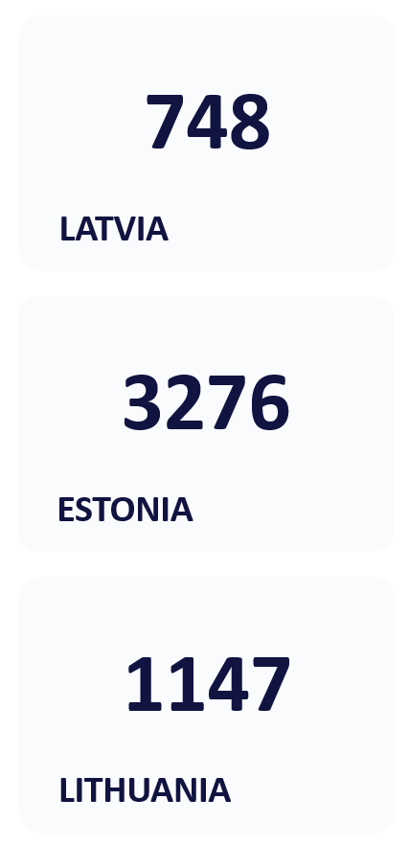
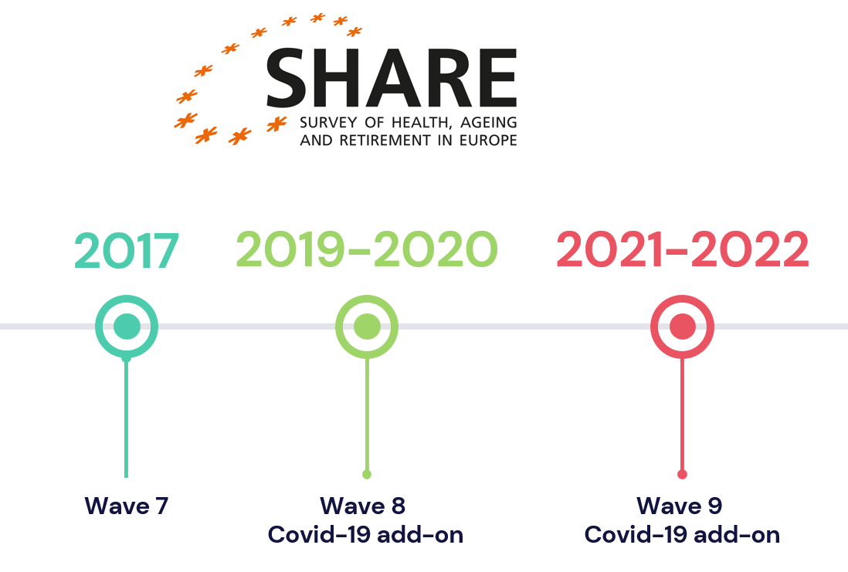

Slide 3
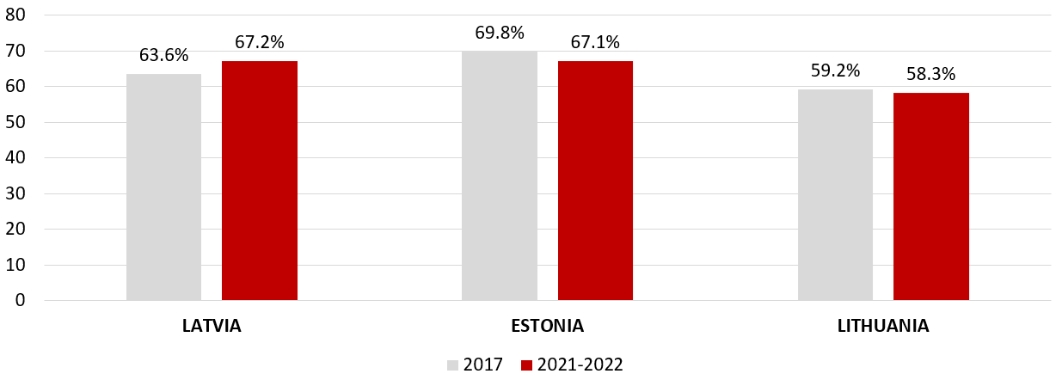
HEALTH CHANGES – POOR OR FAIR SELF-RATED HEALTH

Slide 4
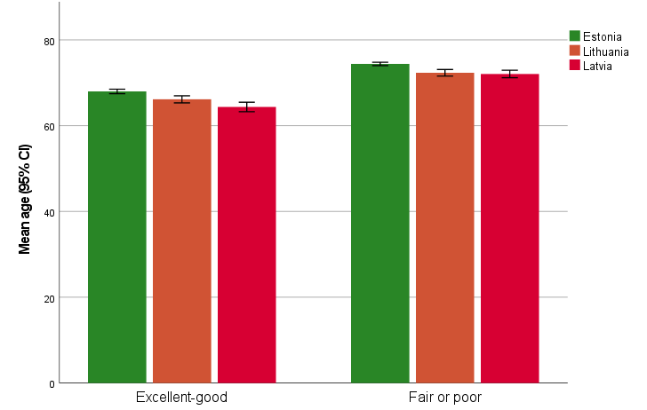
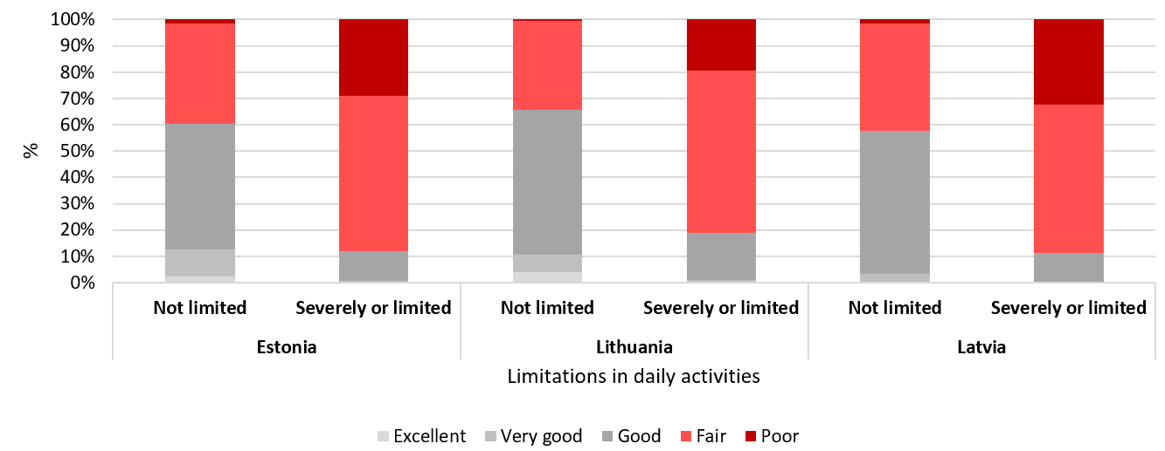
HEALTH CHANGES – POOR OR FAIR SELF-RATED HEALTH

Slide 5
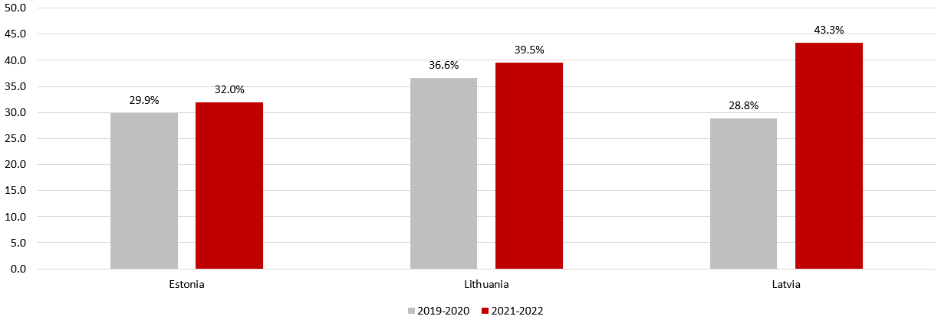
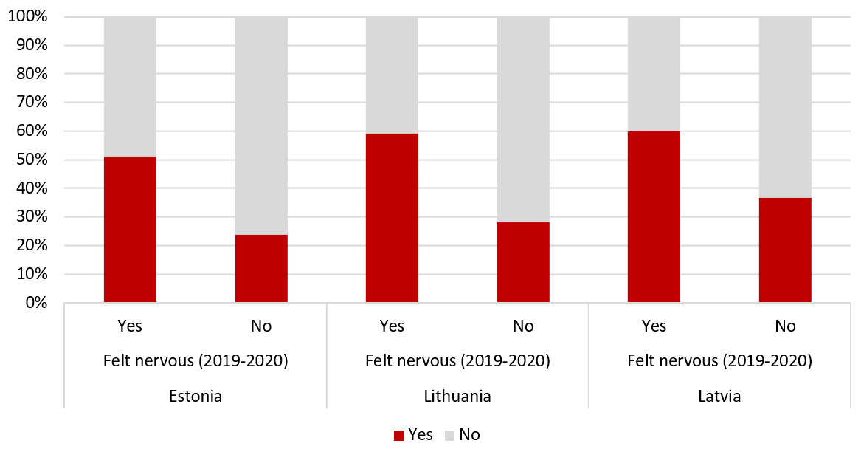
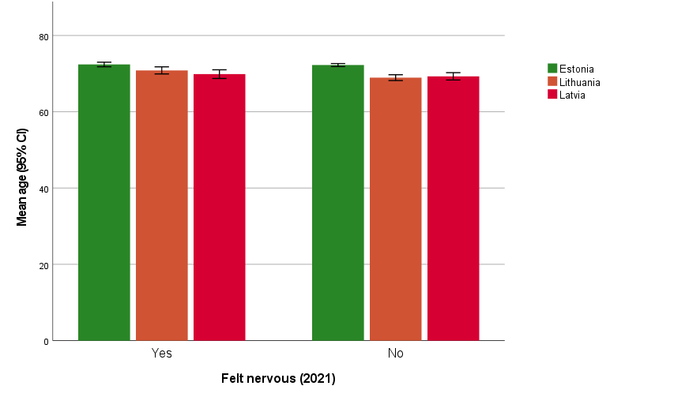
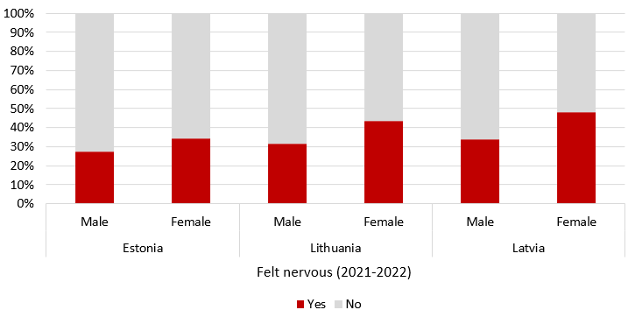
MENTAL HEALTH CHANGES – NERVOUSNESS

Slide 6
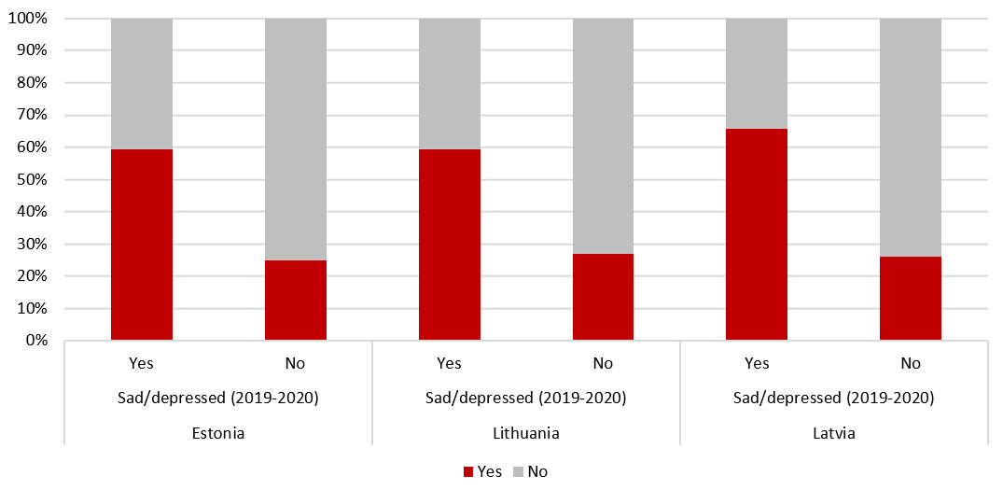
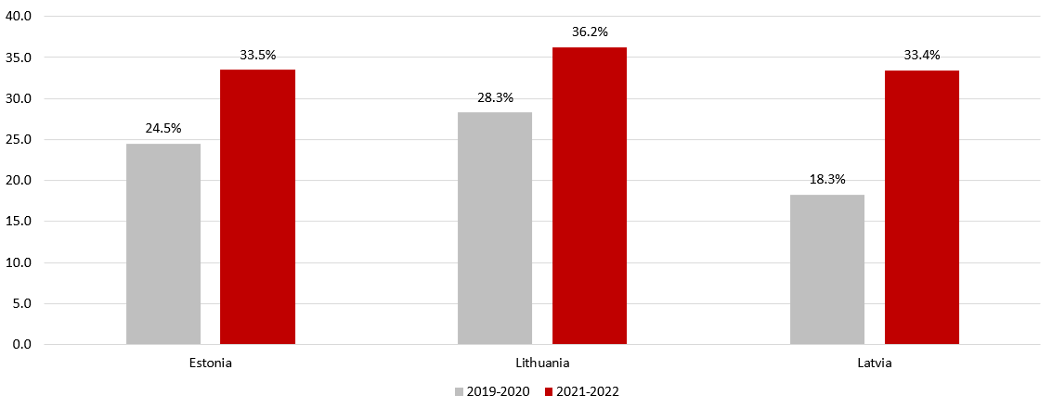
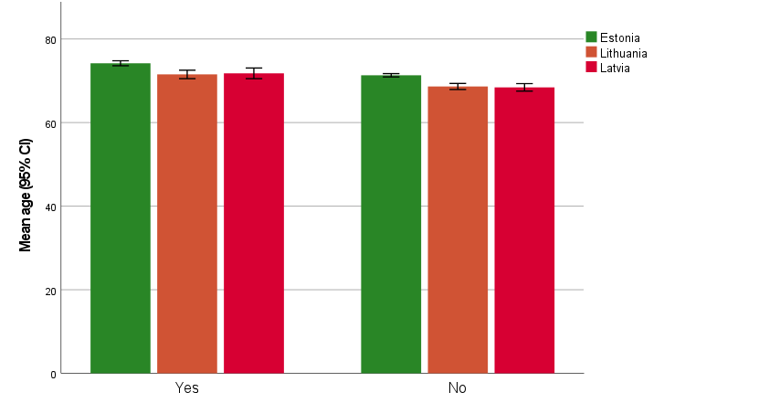
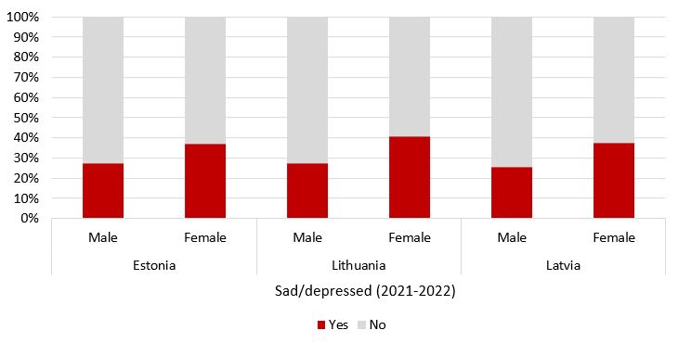
MENTAL HEALTH CHANGES – SAD/DEPRESSED

Slide 7
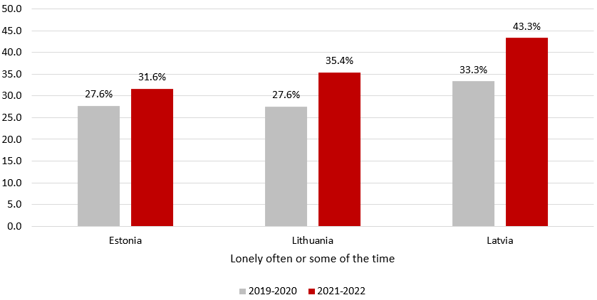
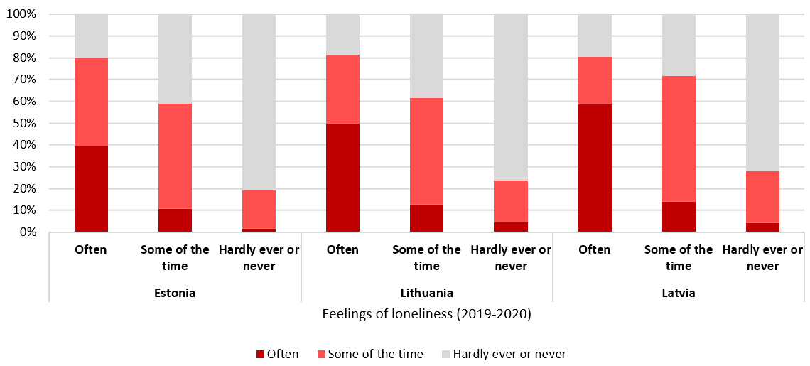
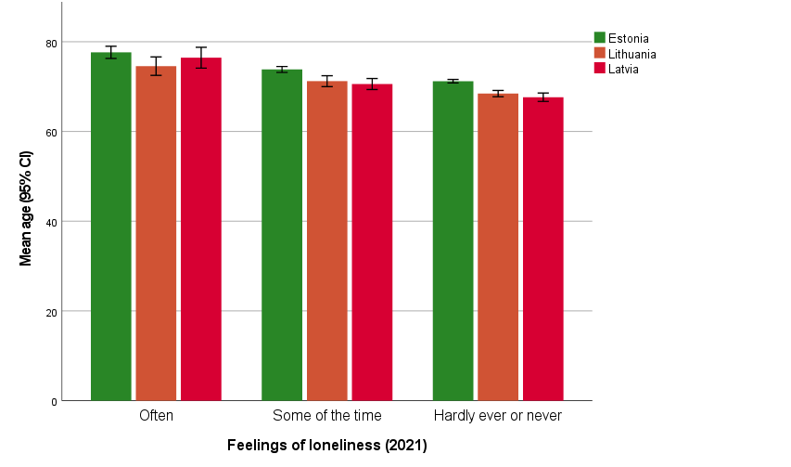
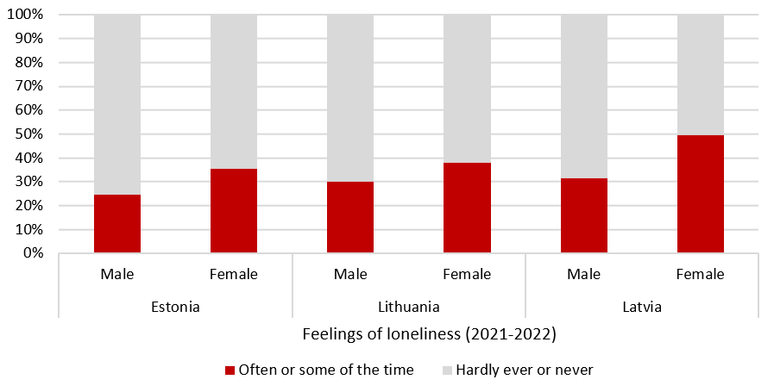
MENTAL HEALTH CHANGES – LONELINESS

Slide 8
The main predictors for fair or poor self-rated health: unadjusted OR (95%CI)
Predictors | Latvia | Lithuania | Estonia
Limitations in daily tasks | 10.58 (7.28-15.38) | 8.12 (6.20-10.64) | 11,39 (9.55-13.60)
Feelings of loneliness | 9.46 (4.02-22.21) | 7.38 (3.98-13.70) | 6.19 (3.79-10.13)
Sad/depressed | 3.67 (2.50-5.38) | 4.46 (3.38-5.91) | 3.60 (3.00-4.32)
Felt nervous | 2.05 (1.49-2.82) | 3.23 (2.50-4.19) | 2.61 (2.19-3.10)
Age | 1.09 (1.07-1.11) | 1.07 (1.05-1.08) | 1.08 (1.077-1.09)
As the proportion of respondents with poor or fair health status has increased, it could be associated with ageing process rather than Covid-19 pandemic.
The results indicate that health deterioration due to mental health factors could be intensified by the Covid-19 pandemic, but more detailed analysis is needed.

Slide 9
_{THANK YOU FOR YOUR ATTENTION!}

