Slide 1
Researchers' breakfast
Opportunities of the SHARE survey for research activities
Signe Tomsone (LV), Andrejs Ivanovs (LV), Tiina Tambaum (EE), Antanas Kairys (LT)
2 October, 2019

Slide 2

The 2019 theme aims to:
- Draw attention to the existence of old age inequalities and how this often results from a cumulation of disadvantages throughout life, and highlight intergenerational risk of increased old age inequalities.
- Bring awareness to the urgency of coping with existing — and preventing future — old age inequalities.
- Explore societal and structural changes in view of life course policies: life-long learning, proactive and adaptive labour policies, social protection and universal health coverage.
- Reflect on best practices, lessons and progress on the journey to ending older age inequalities and changing negative narratives and stereotypes involving "old age."

Slide 3
Background of SHARE
Population ageing is a big challenge to societies:
- people have fewer children than previous generations;
- children born today have a higher life expectancy than children born in the past;
- there will be 1 working person per 1 retired person in 2060 (ratio in 2010 was 2 working person per 1 retired person).
The effects of population ageing:
- great challenges to pension systems;
- many open questions for politicians and society;
- SHARE aims to generate research findings to these open questions
Notes:
Demographic change is one key challenge of European societies with a growing older population.
Therefore, it is of interest to better understand how healthy ageing is possible, how health develops over time and why health outcomes are so different across countries.

Slide 4

Survey of Health, Ageing and Retirement in Europe (SHARE)
Multidisciplinary and cross-national panel database of micro data of more than 140,000 individuals aged 50 or older
on health,
socio-economic status,
social and family networks.
Notes:
Population ageing is a big challenge to societies.
people have fewer children than previous generations;
children born today have a higher life expectancy than children born in the past;
there will be 1 working person per 1 retired person in 2060.
it was 2 working per 1 retired people in 2010.
The effects of population ageing:
great challenges to pension systems;
many open questions for politicians and society;
SHARE aims to generate research findings to these open questions
Multidisciplinarity;
Longitudinal design;
Comparability.

Slide 5

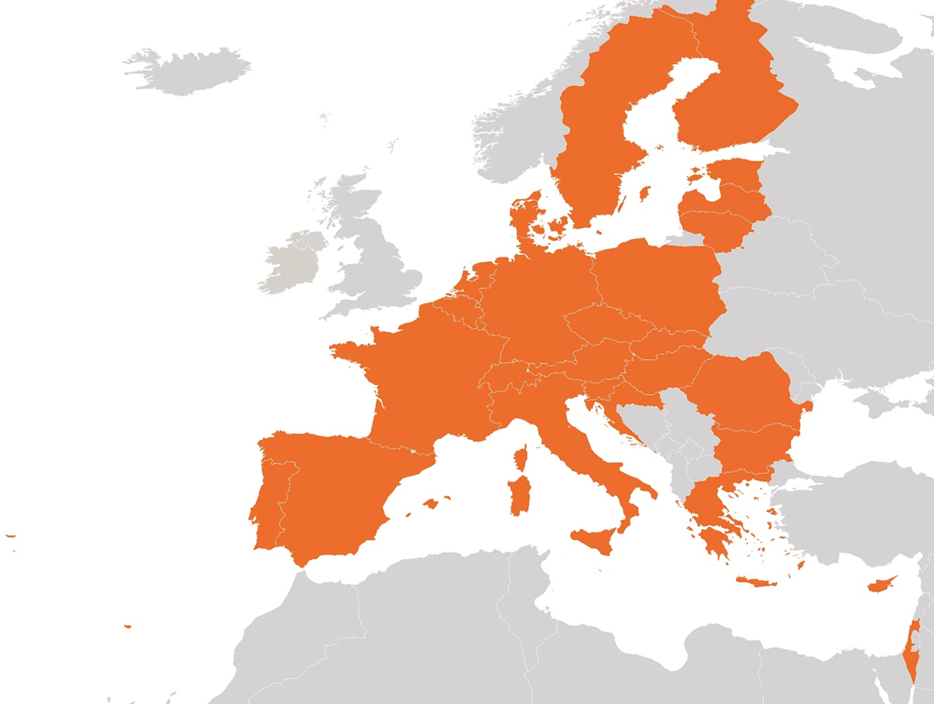
SHARE
SHARE has started in 2004. Currently SHARE covers 27 European countries and Israel.
The first data collection wave in Latvia in 2017.
Notes:
The access to SHARE data is provided free of charge to the entire research community.
Datasets of wave 1 to 6 are already available.
Wave 7 will be released in 2019 (spring).
Datasets are available in Stata and SPSS formats.
Researchers can provide better understanding of how individuals and families are affected by ageing.
The results of the research can be used in science and politics in finding solutions to the challenges of social security and health care systems.

Slide 6
SHARE data
The access to SHARE data is provided free of charge to the entire research community.
More than 9,000 researchers from all over the world are registered as SHARE users.
Datasets of wave 1 to 6 are already available.
Wave 7 released in spring 2019.
Datasets are available in Stata and SPSS formats.

Slide 7

SHARE has provided help for evidence-based policy making:
On the member state level:
Czech Republic (pension system);
France;
Israel;
The Netherlands;
Slovenia.
On the European level:
The Directorate-General (DG) for Economic and Financial Affairs (ECFIN);
DG Health and Food Safety (SANTE);
DG Employment, Social Affairs and Inclusion (EMPL).
On the international level:
OECD;
WHO;
World Bank.

Slide 8
SHARE
Organisation: SHARE became the first European Research Infrastructure Consortium (ERIC) in 2011
Management Board:
Prof. Axel Börsch-Supan, Ph.D.
Scientific Coordinator, SHARE-ERIC Managing Director
Prof. Guglielmo Weber, Ph.D.
Vice Coordinator and Area Coordinator Economics
Location: SHARE Central is located in Munich, Germany at the Munich Center for the Economics of Aging (MEA), one department of the Max Planck Institute for Social Law and Social Policy
Staff: About 30 people are working in the SHARE central office in Munich. Around 150 people are working in SHARE country teams as well as in other SHARE teams, e.g. teams responsible for questionnaire design, imputations, weigths or other special data sets.

Slide 9
SHARE Funding
European Commission:
5th framework programme (project QLK6-CT-2001-00360 in the thematic programme Quality of Life).
6th framework programme (projects SHARE-I3, RII-CT-2006-062193, as an Integrated Infrastructure Initiative, COMPARE, CIT5-CT-2005-028857, as a project in Priority 7, Citizens and Governance in a Knowledge Based Society, and SHARE-LIFE (CIT4-CT-2006-028812)).
7th framework programme (SHARE-PREP (No 211909), SHARE-LEAP (No 227822) and M4 (No 261982) and through Horizon 2020 (SHAREDEV3 (No 676536), SERISS (No 654221), SSHOC (No 823782), RItrain (No 654156) and ERIC Forum (No 823798)).
Co-funding:
US National Institute on Aging (U01 AG09740-13S2, P01 AG005842, P01 AG08291, P30 AG12815, R21 AG025169, Y1-AG-4553-01, IAG BSR06-11, OGHA 04-064, BSR12-04 and R01AG052527-02), further funding was granted for the development of a Harmonized Cognitive Assessment Protocol (HCAP) (R01 AG056329-02).
German Federal Ministry for Education and Research (Bundesministerium für Bildung und Forschung, BMBF) and the Max Planck Society for the Advancement of Science for the central coordination of SHARE.
SHARE has been part of the ESFRI (European Strategy Forum on Research Infrastructures) roadmap and became the first ERIC (European Research Infrastructure Consortium) with the first wave. National funding is now dominant, with substantial support by the European Commission’s DG Employment, Social Affairs and Equal Opportunities to new SHARE countries.

Slide 10
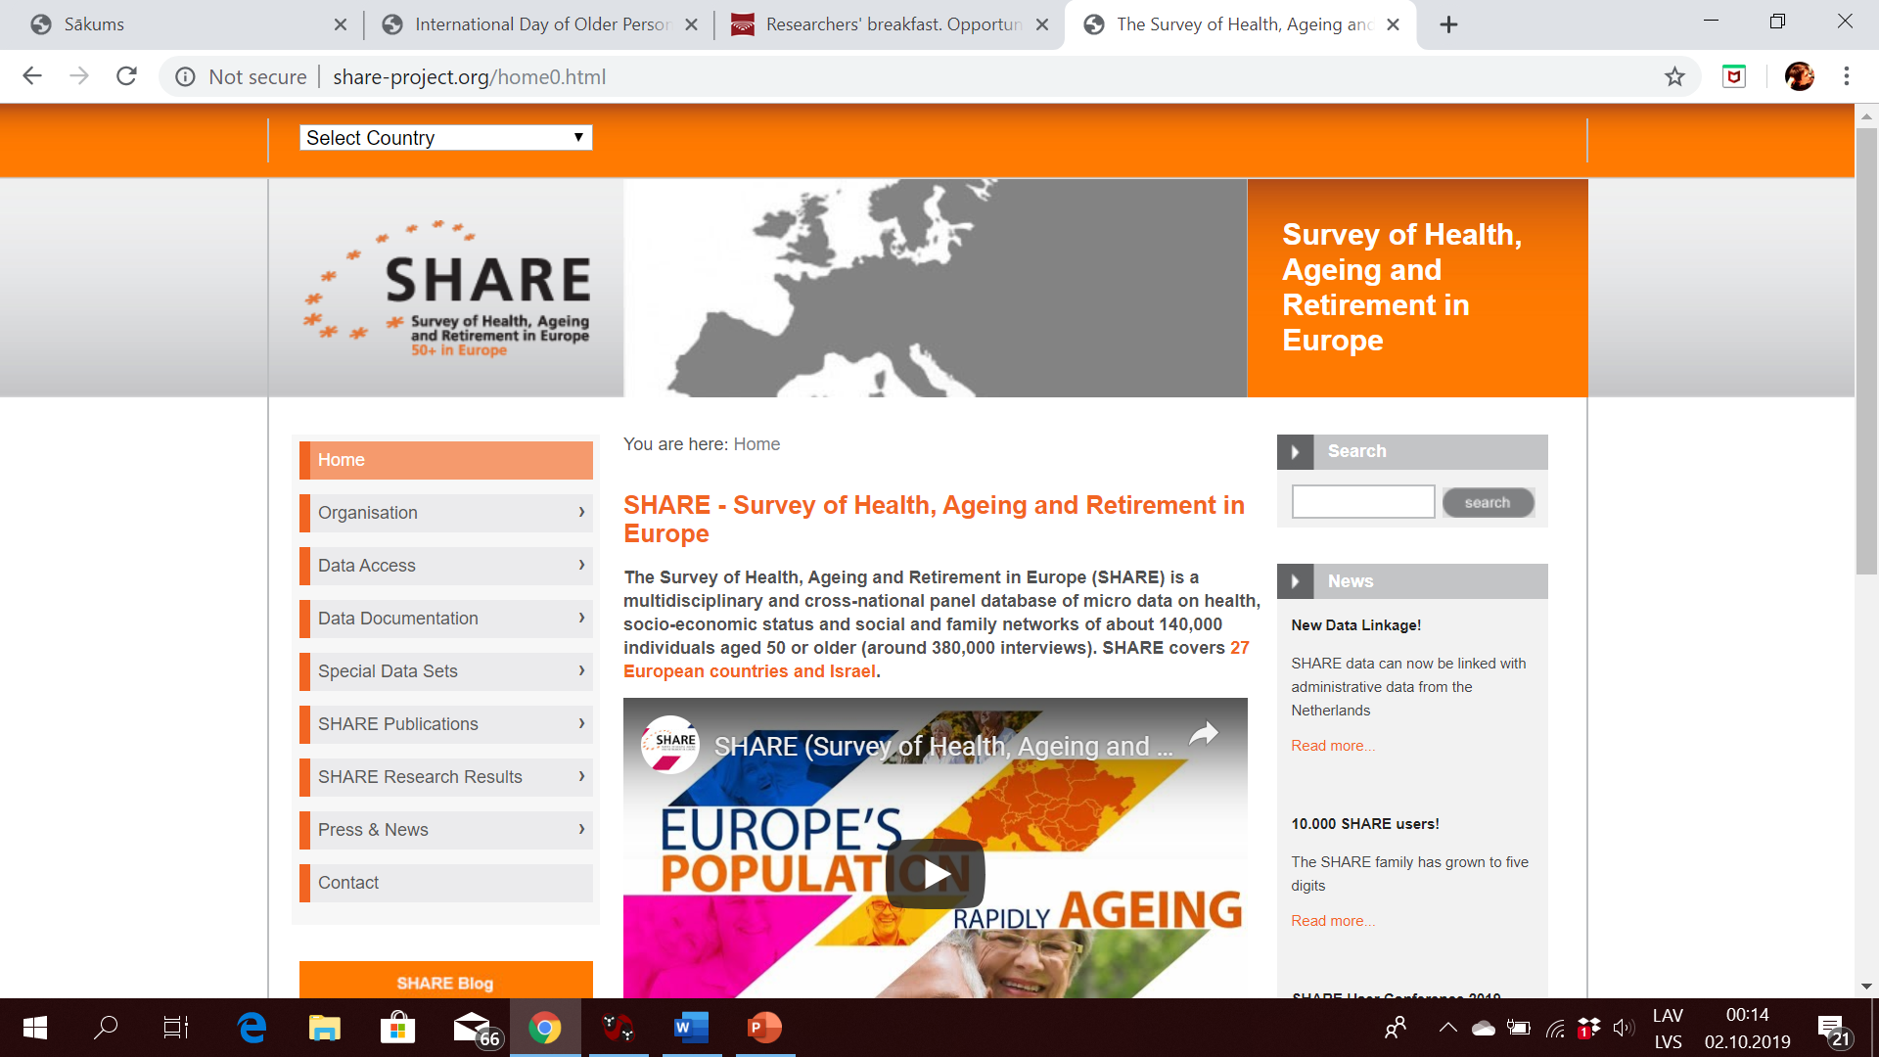
http://www.share-project.org

Slide 11
SHARE Country Team of Latvia (since 2016)
Andrejs Ivanovs, Country Team Leader (CTL);
Diāna Baltmane, Country Team Operator (CTO);
Signe Tomsone, researcher.
Fieldwork agency – «Institute of Sociological Research»

Slide 12
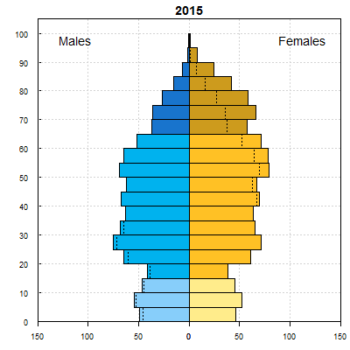
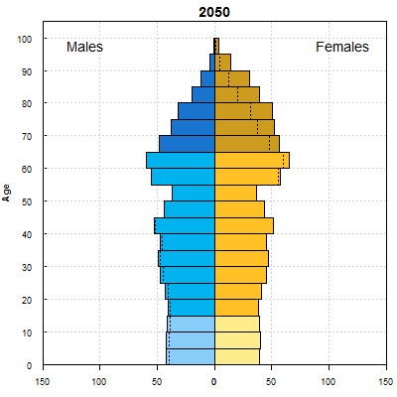
AAgeing in Latvia- estimate and projection and projection

Slide 13
Regular studies in Latvia involving older participants
Study | Participants | Topics | Data
Health Behaviour among Latvian Adult Population (FINBALT) | Latvian adult population aged 15 – 74 (from wave 2016), before 15- 64 | Socialdemographic characteristics Health-related behaviour Behavioural change in smoking, alcohol consumption, nutrition and physical activity Issues related to health services and health policy | Primary data
Elderly population of Latvia* (CSB) | Latvian adult population aged 65 and over | Demographic characteristics Economic activity, earnings and consumption Housing conditions State of health Social security | Secondary data

Slide 14
SHARE data colection in Latvia
Face-to-face interviews during home visits in period between May and September in 2017 all over in Latvia.
The cluster sample based on an address register was used for survey purposes.
1710 participants took part in this data collection wave and were included in the preliminary analysis.

