Slide 1
H2020 Project "Baltic Biomaterials Centre of Excellence" Kick-off meeting January 29th – 30th, 2020
The project BBCE «"Baltic Biomaterials Centre of Excellence" has received funding from the European Union’s Horizon 2020 research and innovation programme under grant agreement No 857287 and Latvian Government

Slide 2
H2020 Project "Baltic Biomaterials Centre of Excellence" OPENING CEREMONY January 29th, 2020
Venue: Riga Technical University Faculty of Materials Science and Applied Chemistry, 1st floor entrance hall, Paula Valdena iela 3, Kurzemes rajons, Rīga, LV-1048
Moderated by moderator.
9:00 | REGISTRATION FOR INVITED ATTENDEES AND MEDIA
9:30 | WELCOME ADDRESS The President of Latvia, H.E. Mr. Egils Levits
9:40 | WELCOME SPEECHES Riga Technical University Rector, Academician Dr. habil. sc. ing. Leonīds Ribickis TBC from European Commission representative
10:10 | INTRODUCTION by Prof. Dr. sc. ing. Jānis Ločs "BBCE project today and in the future"
10:40 | DISCUSSION PANEL “SCIENTIFIC EXCELLENCE IN LATVIA” Riga Technical University Vice-Rector of Research, Academician Dr. sc. ing. Tālis Juhna Rīga Stradiņš University Vice-Rector for Science, Agrita Kiopa Chairperson of Riga Stradiņš University Institute of Stomatology, Prof. Ilga Urtāne Director of Latvian Institute of Organic Synthesis, Dr. chem. Osvalds Pugovičs The Minister of Education and Science, Dr. philol. Ilga Šuplinska Deputy State Secretary at the Ministry of Economics, Raimonds Aleksejenko TBC European Commission representative
12:00 - 13:00 | PRESS ROOM (INTERVIEWS), COFFEE AND NETWORKING
The project BBCE «"Baltic Biomaterials Centre of Excellence" has received funding from the European Union’s Horizon 2020 research and innovation programme under grant agreement No 857287 and Latvian Government

Slide 3
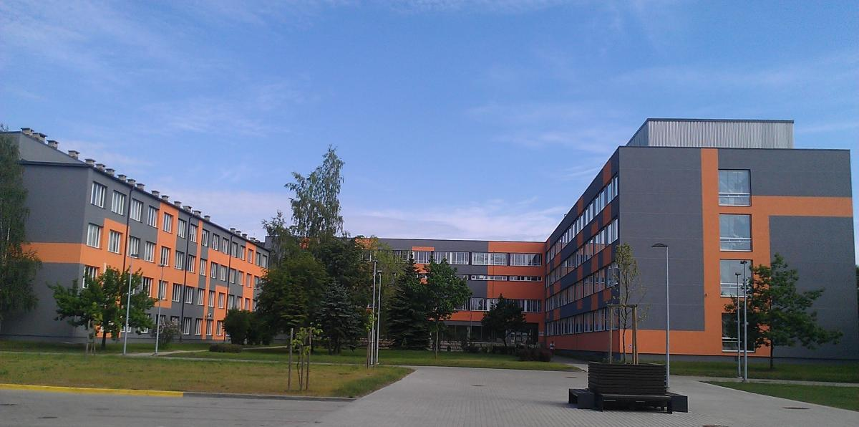
Where?
Venue of BBCE Opening ceremony
at Riga Technical University Faculty of Materials Science and Applied Chemistry, 1st floor entrance hall, Paula Valdena iela 3, Rīga
The project BBCE «"Baltic Biomaterials Centre of Excellence" has received funding from the European Union’s Horizon 2020 research and innovation programme under grant agreement No 857287 and Latvian Government

