Slide 1

Experience of SHARE data usage in Estonia Riga, October 2, 2019 Opportunities of the SHARE survey for research activities
Tiina Tambaum
SHARE Estonia
Estonian Institute for Population Studies at Tallinn University

Slide 2

2004 start (12 countries) 2010 Estonia joined the survey (16 countries, incl CZ, PL, HU, SL) 2011 wave 4 (1) – social network 2012 conference “How Estonians age?” 2013 wave 5 (2) 2013, 2014, 2015 – briefings for master students 2014 database training for analysts from ministries 2015 wave 6 (3) – bio-markers 2016 book „A view on the grey area“ (w 1, 2) 2017 wave 7 (4) – life histories (24 countries) 2019 wave 8 starts (5) – cognition 2019 conference “A view on the grey area. Ageing from the life course perspective”
History of Share Estonia

Slide 3
Sample 7500 (respondent represents 70 persons with similar socio-ecomonic background)
Great opportunity for research of migrants
Panel retention 89% (w7)

Slide 4
Luule Sakkeus, Liili Abuladze, Tiina Tambaum
Representatives of
Ministry of Social Affairs
Ministry of Economic Affairs and Communication
Ministry of Research and Education
Ministry of Finance
Bank of Estonia
+ universities
Tartu University
Tallinn Technical University
National Institute for Health Development
TLU: social work, sociology, health, psychology
The Estonian Genome Project
Executive management
Steering committee
Scientific committee

Slide 5

1. SHARE survey and ageing in Europe 2. Subjective health and health behaviour 3. Subjective and objective health ratings (w5) 4. Mental and cognitive health 5. The change of the population with activity limitations between 2011.–2013. 6. Older people labor market behaviour and respective factors 7. Differences between various beneficiaries of pensions 8. Assets and obligations 9. Stay on or leave from the labor market – wishes and plans. 10. Internet usage and social activity 11. Social services and informal care 12. Perspectives and challenges of the pension system
“A view on the grey area“
in Estonian, in web, w 1 and 2

Slide 6
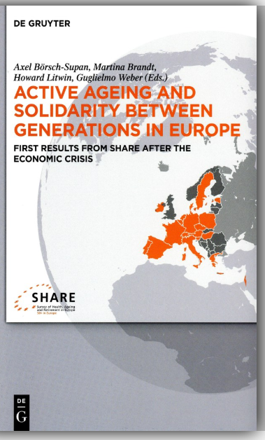
10 000 users of SHARE data base (Sept 2019)
Social networks and everyday activity limitations
by Liili Abuladze & Luule Sakkeus

Slide 7

No contributions
from Estonian authors
In Estonia 35% of individuals in the age group 50+ are in the highest quartile of the socially deprived, which is among the worst four outcomes in Europe (Myck, Najsztub, & Oczkowska, 2015).

Slide 8

The role of social networks and disability in survival
by Liili Abuladze & Luule Sakkeus

Slide 9
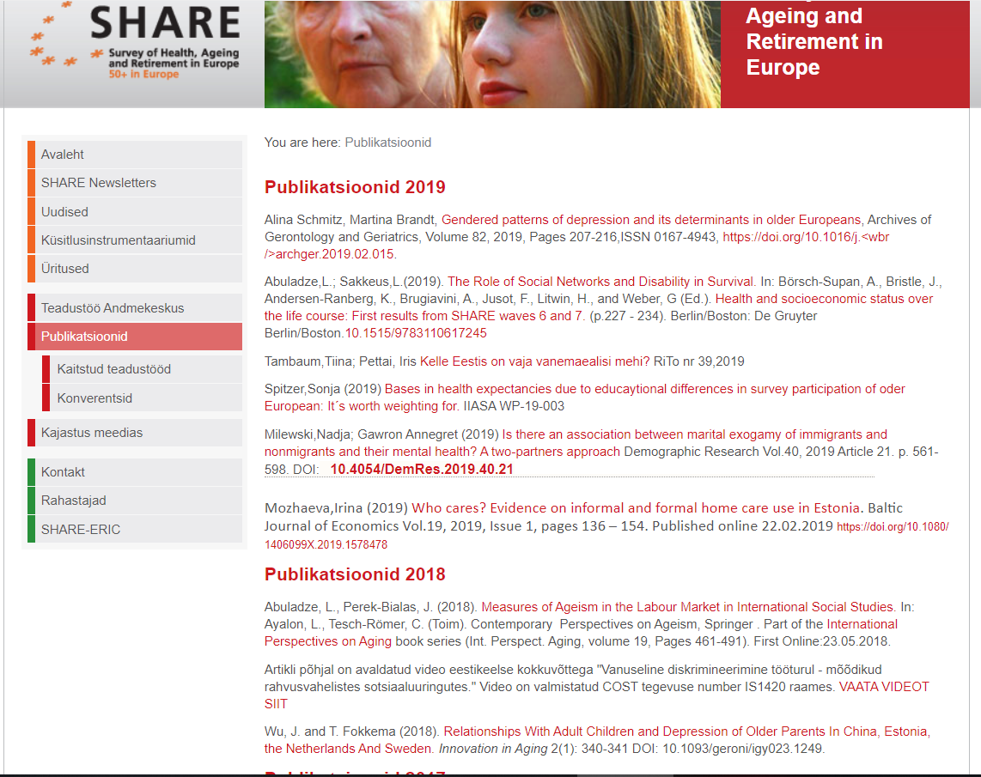
Papers that present interesting results about Estonia are listed in web
E.g. The highest share of men at risk of depressioon can be observed in two of the Eastern European countries (Poland: 32.5%, Estonia: 28.1%). In nine countries (incl Estonia), the contribution of socio-economic factors was at least five percentage points higher than that of psychosocial factors.
Alina Schmitz, Martina Brandt, Gendered patterns of depression and its determinants in older Europeans, Archives of Gerontology and Geriatrics, Volume 82, 2019, Pages 207-216
Wu, J. and T. Fokkema (2018). Relationships With Adult Children and Depression of Older Parents In China, Estonia, the Netherlands And Sweden. Innovation in Aging 2(1): 340-341 DOI: 10.1093/geroni/igy023.1249.

Slide 10
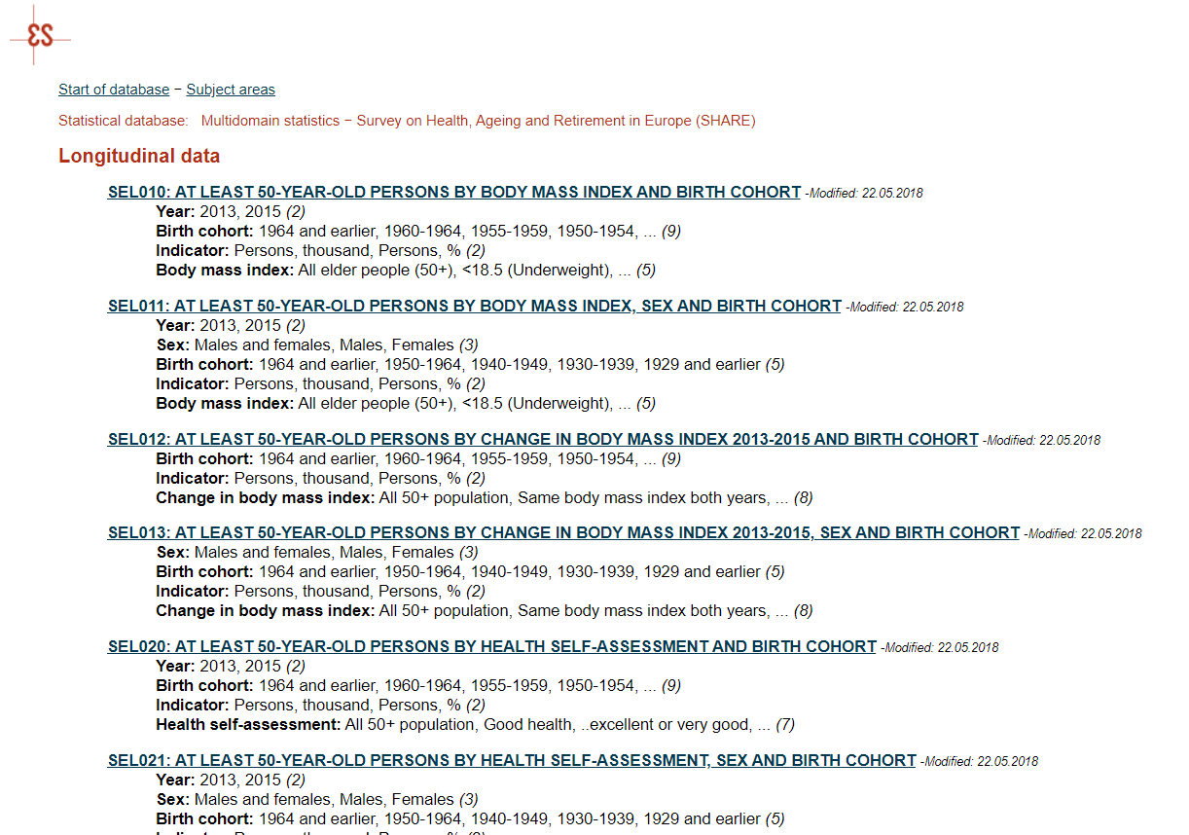
Descriptive statistics are in public use:
presented in the web of Statistics Estonia and National Institute for Health Development
SA veeb http://pub.stat.ee/px-web.2001/Database/Eri_valdkondade_statistika/Share_ee/Longituudandmed/Longituudandmed.asp
TAI veeb: http://pxweb.tai.ee/esf/pxweb2008/Database/Uuringud/08SHARE/15Longituud/15Longituud.asp

Slide 11
No original research will be presented but an overview of results in which Estonian data are included.
working life, household patterns, home and nursing care, mental health and cognitive abilities, economic coping, general skills and social inclusion,
The target group of direct marketing
Members of Parliament
Officers from Ministries (social, economic, interior (regional) affairs, education, finance)
Associations of local municipalities
National Institute for Health Development
Health Insurance Fond
Statistics Estonia
Universities (researchers, master students)
Media (daily newspapers, radio, TV, thematic magazines)
Presentations from MEA, Poland (1), Estonia (4) +
Ministers’ panel discussion „Problem- or process-based policy-making in an aging society“
Conference
“A view on the grey area. Ageing from the life course perspective” on October 29, 2019

Slide 12
Master theses
PhD research
PhD students: 2 (not graduated)
17 master theses (most of them at Tartu University, co-supervisor from Tallinn University)
2 bachelor pieces of research

Slide 13
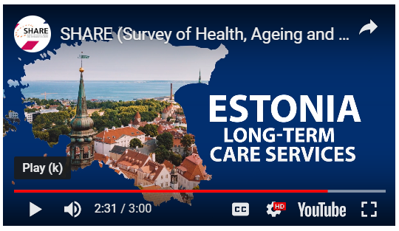
Based on SHARE data an assessment of the current situation of long-term-care in Estonia was introduced by the World Bank and a set of policy options was provided.
World Bank (2017). Reducing the Burden of Care in Estonia.
Chancellor of Justice, based on the published results of SHARE Estonia sent the formal recommendation to the Statistics Estonia by asking to add people aged 75 and older to the sample of the regular survey about Internet Users (2017)
As a joint intiative of commities of Parliment the Chapter of „Ageing society“ in the Document „Basic principles of population policy 2035“ was composed mainly based on SHARE data.
Policy impact

Slide 14
Disadvantages
Expensive – limited resourses – less time for research
The delay of data release 2 years
The complicated structure of database
Few opportunities to consider specifics of the country

Slide 15
- Reliability. A representative sample (we are able to group by all socio-demographic indicators)
- Harmonization between 26 countries in Europe. Sister surveys in US (HRS), UK (ELSA), South-Korea, Brazil, Japan
- Retrospectiveness and longitudiness provide an opportunity to find causation
- Data about the last year of life is collected (periods of fragility)
- Both subjective and objective indicators are collected (health, depression, grip strength, Chair Stand)
- Interdiciplinarity
- EasySHARE – simple but real tool for beginners
Advantages:
Comparability: local data in context

Slide 16
Research questions in the waiting list
Previously we have had a high labor force participation rates – what helps to maintain it?
Low levels of healthy life years – are disability benefits new route to poverty?
Active life in older ages – does our education system support it?
What are the main policy tools to enhance well-being at older ages. Is it a free choice of activities and less burden on health care?

Slide 17
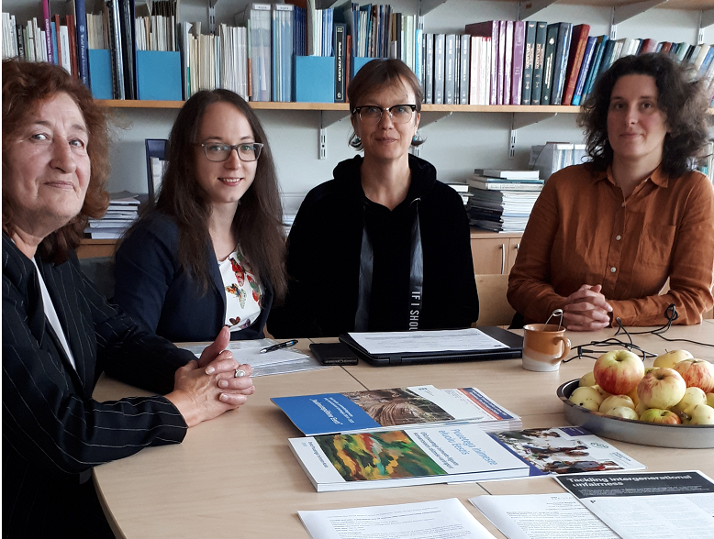
Unique chance for comparative analyses in Estonia, Latvia, Lithuania
September 16, 2019 in Tallinn

