Slide 1


SHARE in Lithuania: the hard route to great future
SHARE LT team: Antanas Kairys and Olga Zamalijeva
Vilnius university

Slide 2
You probably already had heard about it recently (I guess several minutes ago)
So, I’ll talk only about Lithuanian experience

Slide 3
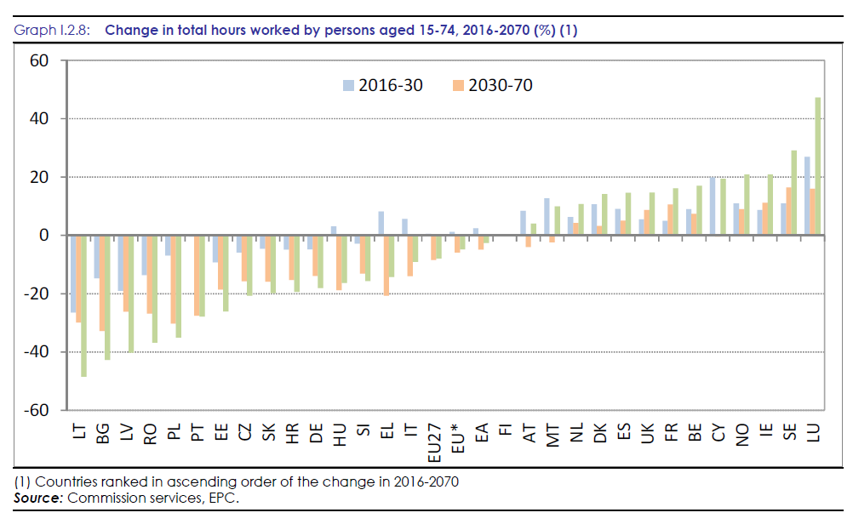
Lithuania should be really interested in SHARE data
The 2018 Ageing Report

Slide 4

Two topics
Lithuania in SHARE
SHARE and psychology

Slide 5

The route
The end of 2014: ageing is process which has a huge impact on society. Let’s do SHARE
2015 spring: Gratz meeting – oops, SHARE is much more complicated than we thought.
W7: 2016: pretest and field rehearsal
W7: 2017: main survey
W7: 2019 04 data are published
W8: 2019 pretest and field rehearsal is done, main field is under way

Slide 6
Number of users

Slide 7
Currently we have in Lithuania
12 SHARE data users
2 doctoral students who use SHARE data in PhD research
4 grant applications based on SHARE data
Interest from some institutions, like Bank of Lithuania
Note: we have Lithuanian data only form April 2019

Slide 8
Life satisfaction

Slide 9
Limitations of daily living and social services

Slide 10
We see the potential of SHARE data:
To analyze:
System of health care and social security
Work participation and projections
To track changes, when we have W8 and W9 data
The main challenge – we need more resources both to collect and analyze data

Slide 11

SHARE and psychology

Slide 12

I‘m psychologist from the field of personality psychology
Huge tests (MMPI-2: 567 questions)
Small samples (100 students – oooo, that's more than enough). Non-random samples
SHARE: small tests (most of the time – one question), huge sample. Random samples

Slide 13
Personal interests
Since SHARE is a multidisciplinary study, only several psychological variables are included:
well-being, cognitive functioning, mental health, Big Five and correlates of these variables (activities, life histories, socioeconomic situation, etc.).
But we have life histories and we can test various theories, for example form evolutionary psychology...
Expanded cognitive functioning module in SHARE wave 8.
Almost everyone can find something interesting for themselves in SHARE data

Slide 14
Thank you
Contacts: antanas.kairys@fsf.vu.lt

