Slide 1
Genetic characterization of high-risk human papillomaviruses in Ukraine and Latvia to inform national policy of cervical cancer prevention – aims, tasks and first achievements of the project
Partners:
Maria Issagouliantis – PhD, Assoc Prof, Institute of Microbiology and Virology, Riga Stradins University, Riga, Latvia;
Elena Kashuba – Dr Hab, Assoc Prof, R.E. Kavetsky Institute of experimental pathology, oncology and radiobiology (IEPOR) of National Academy of Sciences (NAS) of Ukraine
Notes:
Genetic characterization of high-risk human papillomaviruses in Ukraine and Latvia to inform national policy of cervical cancer prevention – aims, tasks and first achievements of the project

Slide 2
Cervical cancer (CC) is the second most common cancer affecting women in EU, associated with high-risk human papillomaviruses (hrHPV) infection.
CC is preventable by HPV screening and HPV vaccination, both insufficiently efficient in widening EU countries as Latvia, and not supported in EU-associated countries as Ukraine, requesting policy change.
To promote this, we will genotype and sequence regionally prevalent CC-causing hrHPVs, such data is currently missing.

Slide 3
Specific objectives of the project (I)
1. Retrospective recruitment of cases of cervical cancer in Kyiv, Ukraine, and retro- and prospective recruitment of CC cases and high-grade CL cases in Riga, Latvia, and assembly of the study cohort.
2. Genotyping of HR HPVs to create comparative epidemiologic “portrait” of HPV associated CLs and CC in Latvia and Ukraine.
3. Whole genomic sequencing (WGS) of HR HPVs prevalent in Latvia and Ukraine to characterize them on molecular level and associate their conservation/variability with cervical pathology, identification of sequence signatures associated with parameters of CLs and CCs with the aim to exploit them as molecular markers for personalized prognosis of cervical disease course and outcome, and strategy of follow up and treatment.

Slide 4
Specific objectives of the project (II)
4. Dissemination of project results and reaching project impact by informing international research community, health authorities and stake holders on HPV status of women with cervical lesions and cancer, demonstrating acute need to implement HPV vaccination in Ukraine and advance and promote HPV vaccination among teenagers and adolescents as well as catch-up vaccination among adults in Latvia.
5. Harmonization of research activities of the leading Latvian and Ukrainian medical research institutions, training and career promotion for young researchers, and support research cooperation.
6. Efficient coordination and management to ensure attaining of project results by both teams.

Slide 5
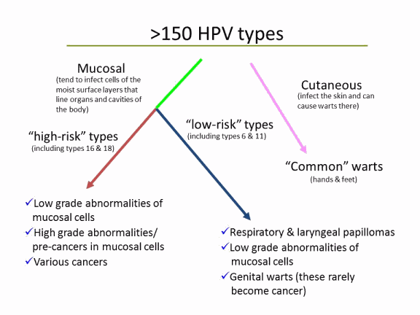
OVER 200 HUMAN PAPILLOMA VIRUS GENOTYPES!!!!
Adapted from https://www.cancer.org/cancer/risk-prevention/hpv/types-of-hpv.html

Slide 6
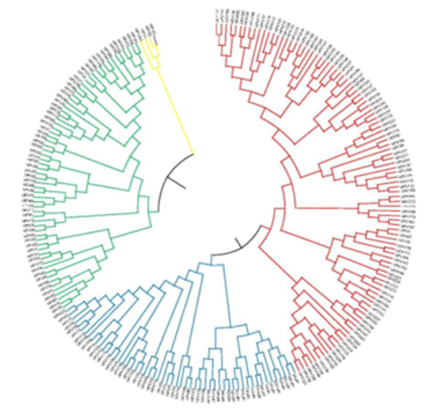
Phylogenetic tree comprising all official HPV types established until 2024-10-02
Papillomaviruses:
Alpha - green
Beta -blue,
Gamma - red
Mu - yellow
Nu – purple
The phylogenetic tree is based on the L1 part of the genome. The evolutionary history was inferred by using the Maximum Likelihood method based on the Tamura-Nei model10 and analyses were conducted in MEGA7.
Exported from https://www.hpvcenter.se/human_reference_clones/

Slide 7
Alphapapillomavirus form species groups:
alpha-3 (HPV61),
alpha-5 (HPV26, 51, 69 and 82),
alpha-6 (HPV30, 53, 56, 66),
alpha-7 (HPV18, 39, 45, 59, 68, 70, 85 and 97),
alpha-9 (HPV16, 31, 33, 35, 52, 58 and 67),
alpha-10 (HPV6 and 11),
alpha-11 (HPV34 and 73)
alpha-13 (HPV54).
Robert D. Burk, Ariana Harari, Zigui Chen,
Human papillomavirus genome variants, Virology, 2013 https://www.sciencedirect.com/science/article/pii/S0042682213004388
Notes:
Review gives reference strains to all above HPVs.

Slide 8
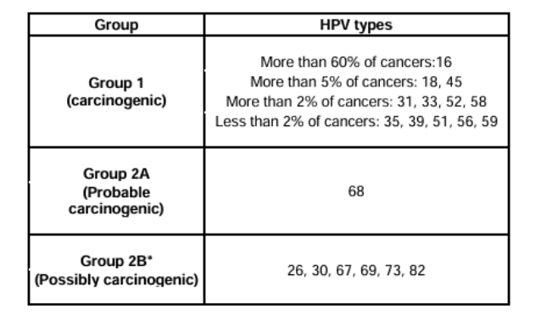
Classification of HPV types based on oncogenic risk
HPV 34, 53, 66, 70, 85, 97 do not cause any measurable fraction of cervical cancers and therefore are not listed in Group 2B.

Slide 9
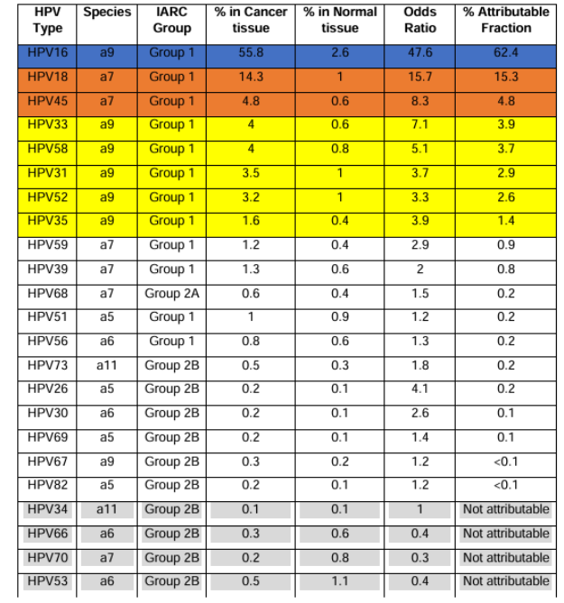
Importance of different HPV types in cervical cancer
https://www.hpvcenter.se/wp-content/uploads/Chapter-2-Human-Papillomavirus-Types.pdf
Adapted from Clifford G, et al. “IARC Handbooks Volume 18: Cervical Cancer Screening” (2022)

Slide 10
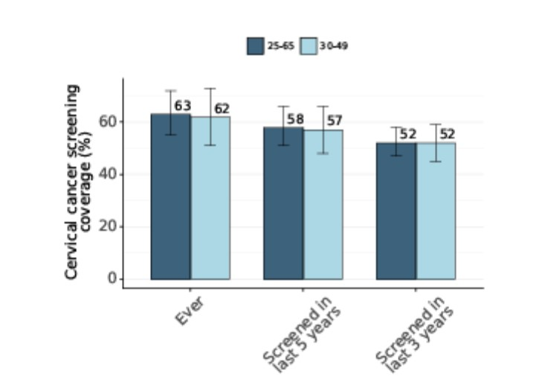
Coverage with HPV screenings
Latvia Ukraine
Exported from https://hpvcentre.net/statistics/reports/UKR_FS.pdf

Slide 11
HPV Vaccines
- 2vHPV (Cervarix) prevents HPV types 16, 18
- 4vHPV (Gardasil 4) prevents HPV types 6, 11, 16, 18 – in Latvia, in girls aged 12-17 since 2010.
Production discontinued in 2022.
- 9vHPV (Gardasil 9) prevents HPV types 6, 11, 16, 18, 31, 33, 45, 52, 58 – in Latvia, in girls aged 12-17 since 2020,
- 9vHPV (Gardasil 9) - in Latvia, in both girls and boyes aged 12-17 since 2023.

Slide 12
Of HR HPV types in cervical cancer only first 7 are included into Gardasil9.
Ones not included cause (or rather earlier caused)
<2% cancers
https://www.hpvcenter.se/wp-content/uploads/Chapter-2-Human-Papillomavirus-Types.pdf
Adapted from Clifford G, et al. “IARC Handbooks Volume 18: Cervical Cancer Screening” (2022)

Slide 13
HR-HPV genotype prevalence in cervical disease, cervical carcinmoas (CSCC) and cervical dysplasia (CD)
A – as a whole; B – by diagnosis
Sokolovska L et al, Frontiers in Oncology 2025
Notes:
. A – whole study population; B – by diagnosis; C – HR-HPV genotype combinations overall and by diagnosis (>2 positive samples)

Slide 14
HR-HPV prevalence changes as a percentage of HR-HPV positive samples across the three periods 2016-2018, 2019-2021, 2022-2024
Sokolovska L et al, Frontiers in Oncology 2025

Slide 15
HR-HPV genotype prevalence in cervical disease
Despite vaccination, HPV16 is still the leading HR-HPV genotype in CSCC and CD with overall prevalence of 91.4% (127/139 of all positive samples).
Prevalence of HPV16 in CD increased with higher stages of the disease (CIN I: 67%; CIN II: 85%; CIN III: 86%).
The second most prevalent HR-HPV genotype is HPV33 (23.0%), followed by HPV39 (9.4%) and HPV18 (7.9%).
Prevalence of HPV 66, 45, 39, 31, and 33 increased with time. Of note, three HR HPVs in bold are not included in HPV vaccine.
Sokolovska L et al, Frontiers in Oncology 2025

Slide 16
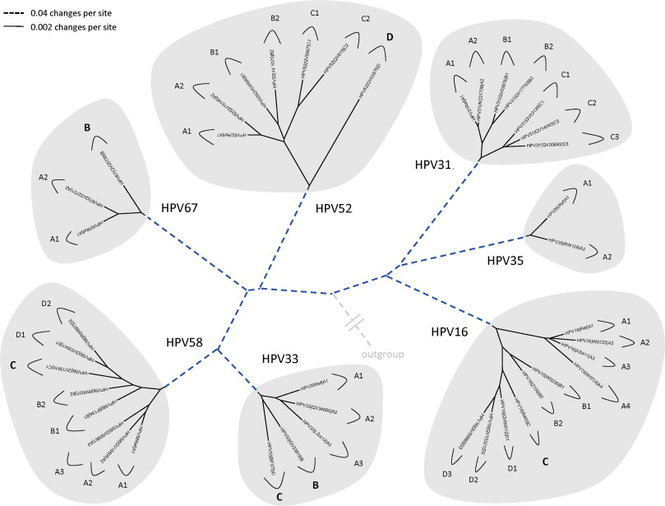
The main efforts were put into WGS of the dominant HR HPV – HPV16
Phylogenetic trees showing representative types and variant lineages/ sublineages of alpha-9.
Adapted from Robert D. Burk, Ariana Harari, Zigui Chen,
Human papillomavirus genome variants, Virology, 2013 https://www.sciencedirect.com/science/article/pii/S0042682213004388

Slide 17
The first Latvian study group Patients with squamous cell carcinomas (SCC) grades 1 to 3, cervical intraepithelial lesions (CIN) stages I to III, CINIII/carcinoma in situ (n=16).
Genotypes of hrHPV were detected by commercial PCR using quantitive assay AllPlex (both Seegene), providing virus load as Ct, and semiquantitative AnyPlex II kit providing data on virus load as high (+++), medium (++) and low (+).
Zrelov N et al, in manuscript

Slide 18
Whole genome sequencing (WGS)
The whole genome sequencing for the samples (PV809647-PV809650, PV809661, PV809662) was performed in kind by Eligens company (Riga, Latvia) on the lllumina HiSeq2500 platform (read length: 2 x 100 bp, output: 10 Gb per sample).
The whole genome sequencing for the samples (PV809651 - PV809660) was performed by CeGaT company (Tübingen, Germany) on the Illumina NovaSeq 6000 platform (read length: 2 x 100 bp, output: 52 Gb per sample).

Slide 19
Latvian HPV16 isolates belong to sublineage A1 (n=13) and A2 (n=3)
Within the current framework of the HPV16 (sub)lineage designation, all 16 of the Latvian cervical cancer sequences we were able to reconstruct clustered together with the so-called “A” lineage of HPV16.
More specifically, 13 of the isolates are most closely related to the “European” sublineage A1, whereas 3 of the isolates seem to cluster together with the “European” sublineage A2 reference

Slide 20
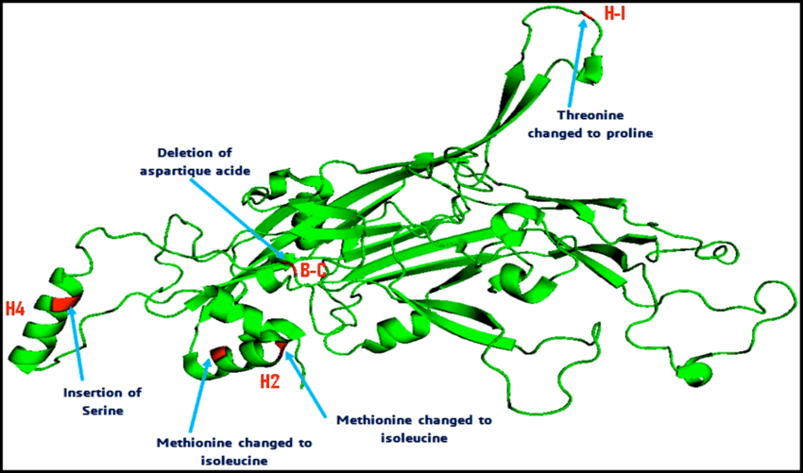
HPV vaccine is targeted against L1 protein – one can expect appearance of immune escape variants
L1 in an HPV vaccine is the major capsid protein HPVs. It is the key component of vaccines like Gardasil and Cervarix because it can be used to create virus-like particles (VLPs), which mimic the outer shell of the virus.
In the L1 ORF of the Latvian isolates, we observed SNPs at 12 sites (3 nonsynonymous and 9 synonymous). The main was L1 polymorphism led to aa substitutions A266T and was detected in 10/16 (62,5%).
Prevalence of L1:A266T remained stable in the viral population, with no difference between samples collected before and after 2019. Distribution of A266T was not related to the disease severity (did not differ between CINIII/G1 and G2/G cases; all P values >0.1).
Notes:
Check if nn of SNPs in L1 (perr bp or codon) is > than nn of SNPs in óther ORFs – ie of there is a selective pressure on this specific protein.

Slide 21
Results of the 1st year:
We have characterized WGS of 16 isolates of the most prevalent HR HPV circulating in Latvia, HPV16 in samples collected between 2012 and 2023.
We have evaluated the rate of amino acid substitutions in L1 – target for vaccine response. It was not higher than in other ORFs.
However, we detected one substitution in L1 - A266T - a potential immune escape mutation, as it is located in an immunodominant FG loop which potentially impact vaccine effectiveness.
Local sequences of other prevalent HR HPV genotypes, such as HPV31, 33, 45 remain so far unknown.

Slide 22
The 2nd Latvian study group, continued retroprospective study
21 patients with CD followed up since 2023.
Of these,
- 3 are healthy
18 have cervical lesions, mostly CINI-CINII
All volunteered to continue follow up to detect and genotype infecting HR HPVs.
Seven samples with HPV31, 35, 45, 66 had been selected for WGS
Arta Spridzane, RAKUS & RSU

Slide 23
# | # | Age | TNM | Morphology/ histological type | stage
1 | 1.01 | 40 | T_{1b}N_{x}M₀ | Squamous cell carcinoma | IB
2 | 1.02 | 38 | T_{1b}N₁M₀ | Squamous cell carcinoma | IIIB
3 | 1.03 | 46 | T_{1b}N₀M₀ | - | 0
4 | 1.04 | 40 | T_{1b}N_{x}M₀ | Adenocarcinoma | IB
5 | 1.05 | 52 | T_{1b}N₀M₀ | Squamous cell carcinoma | IB
6 | 1.06 | 38 | T_{1b}N₁M₀ | Squamous cell carcinoma | IIIB
7 | 1.07 | 47 | T_{b2}N₁M₀ | Squamous cell carcinoma | III
8 | 1.08 | 54 | T₂N₁M₀ | Squamous cell carcinoma | III
9 | 1.09 | 63 | T_{3a}N_{x}M₀ | Adenocarcinoma | IVB
10 | 1.10 | 46 | T_{1b2}N₀M₀ | Squamous cell carcinoma | IB2
11 | 1.11 | 41 | T_{1b}N₀M₀ | Squamous cell carcinoma | IB
12 | 1.12 | 37 | T_{1b2}N₀M₀ | Squamous cell carcinoma | IB2
13 | 1.13 | 30 | T_{1b}N₁M₀ | Squamous cell carcinoma | III
14 | 1.14 | 51 | T_{1b2}N₀M₀ | Squamous cell carcinoma | IB2
15 | 1.15 | 57 | T₂N₁M₀ | Squamous cell carcinoma | III
16 | 1.16 | 29 | T_{1b}N₀M₀ | Squamous cell carcinoma | IB
17 | 1.17 | 40 | T_{1b2}N₀M₀ | Squamous cell carcinoma | IB2
18 | 1.18 | 65 | T_{1b1}N₀M₀ | Squamous cell carcinoma | IB₁
19 | 1.19 | 55 | T₂N₀M₀ | Squamous cell carcinoma | II
20 | 1.20 | 66 | T_{1b}N₀M₀ | Adenocarcinoma | IB
21 | 1.21 | 53 | T_{1b}N₀M₀ | Squamous cell carcinoma | IB
22 | 1.22 | 40 | T_{1b}N₀M₀ | Squamous cell carcinoma | IB
23 | 1.23 | 30 | T_{1b2}N₀M₀ | Squamous cell carcinoma | III
24 | 1.24 | - | T_{1b}N₀M₀ | - | I
25 | 1.25 | 52 | T_{b2}N₀M₀ | Squamous cell carcinoma | IIB
26 | 1.26 | 33 | T_{1b}N₀M₀ | Squamous cell carcinoma | IB
27 | 1.27 | 50 | T_{1b2}N₀M₀ | Squamous cell carcinoma | IIB
28 | 1.28 | 74 | T_{1b}N₀M₀ | Squamous cell carcinoma | IB
29 | 1.29 | 61 | T₂N₀M₀ | Squamous cell carcinoma | II
30 | 1.30 | 48 | T₂N₀M₀ | Adenocarcinoma | II
Patients recruited to study HR HPV genomes - in Ukraine
Elena Kashuba, IEPOR, Kyiv

Slide 24
Expected project results:
Dissect the long-term effect(s) of HPV vaccination in Latvia as compared to non-vaccinated Ukrainian population with respect to prevalence of HR HPVs included or not into HPV vaccine;
Identify sequence ”foot-prints” of immune escape (in L1) in population of countries performing or not performing HPV vaccination;
Define common molecular signatures of disease severity of diagnostic/prognostic value.
Expected results for stake holders:
Project will draw attention of the health care authorities of both countries to the necessity to support and promote HPV screening and vaccination
RSU and IEPOR will take stand in anti-HPV/anti-cancer compaign;
Project will strengthen research cooperation in widening Europe.

Slide 25
Thank you for your attention!
Acknowledgements:
Karina Biserova, Svetlana Gebrila, Juris Jansons, Ilvija Krasovska, Marija Nazarenko, Jurijs Nazarovs, Dita Pole, Arta Spridzane, Nikita Zrelovs.
Project of the Latvian Science Fund
LZP_LV-UA2025-3

Slide 26
Thank you for your attention!
Acknowledgements:
Juris Jansons, Arta Spridzane, Ilvija Krasovska, Jurijs Nazarovs, Karina Biserova, Svetlana Gebrila,
Project of the Latvian Science Fund LZP_Uk LV-UA2025-3

