Slide 1


Natural history of human papillomavirus infection and molecular mechanisms of malignant transformation of epithelial cells
Elena Kashuba
10 November 2025
RE Kavetsky Institute of Experimental Pathology, Oncology and Radiobiology of National Academy of Sciences of Ukraine, Kyiv, Ukraine

Slide 2
Among agents that play an important and often causative role in tumor development there are DNA tumor viruses.
Thus, small DNA tumor viruses, exemplified by Simian virus 40 (SV40), adenoviruses, and Human papilloma viruses (HPV) are involved in cancerogenesis, though mechanisms of cell transformation are different.

Slide 3
Transformation
Changes of the cellular phenotype that makes a ”normal” cell acquire features of a ”tumor-like” cell
in vitro and/or in vivo

Slide 4
Types of virus - host cell interaction
Lytic replication - productive phase (production of 1000s of viral particles from one infecting progeny)
Latent infection
Transformation/Immortalization

Slide 5

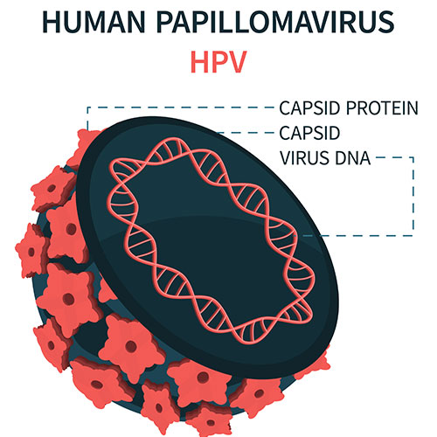
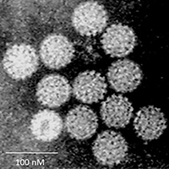
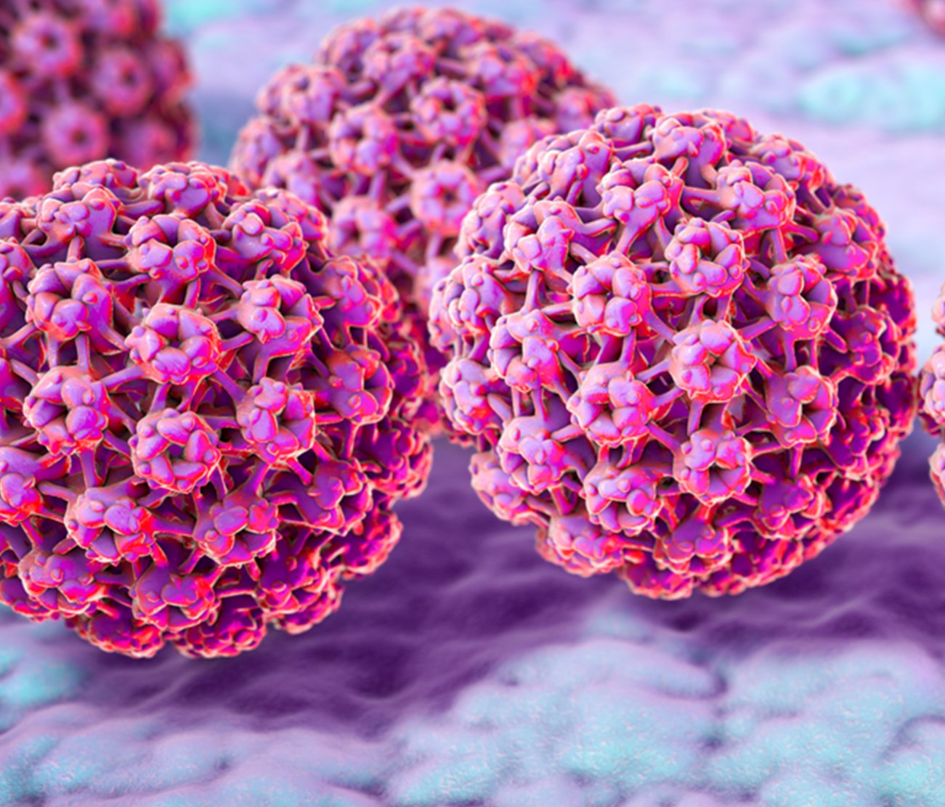

Slide 6
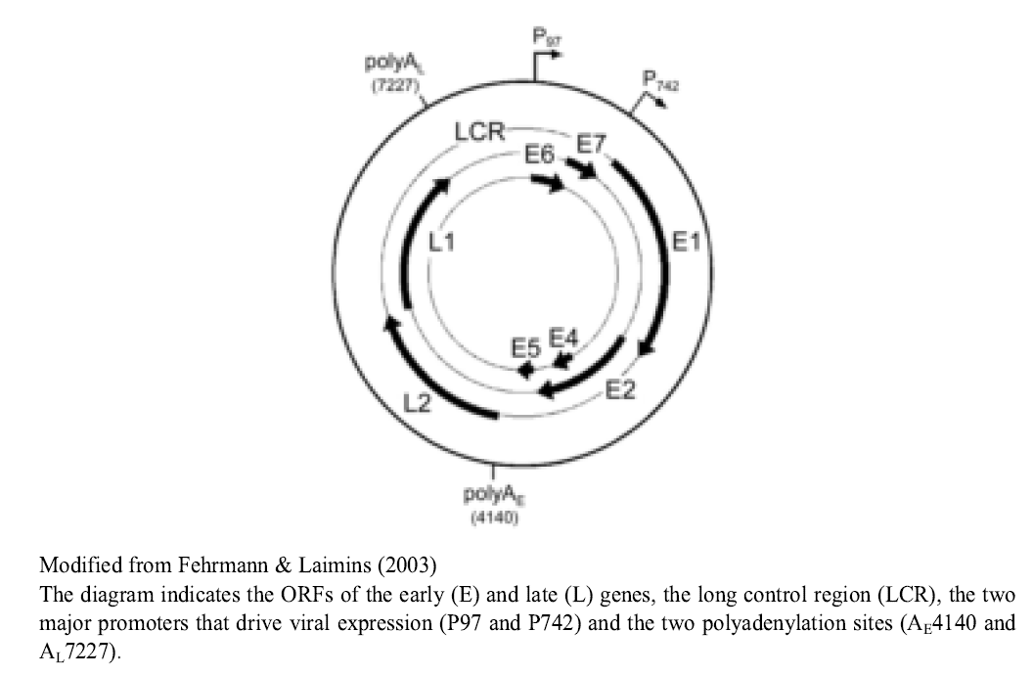

Slide 7
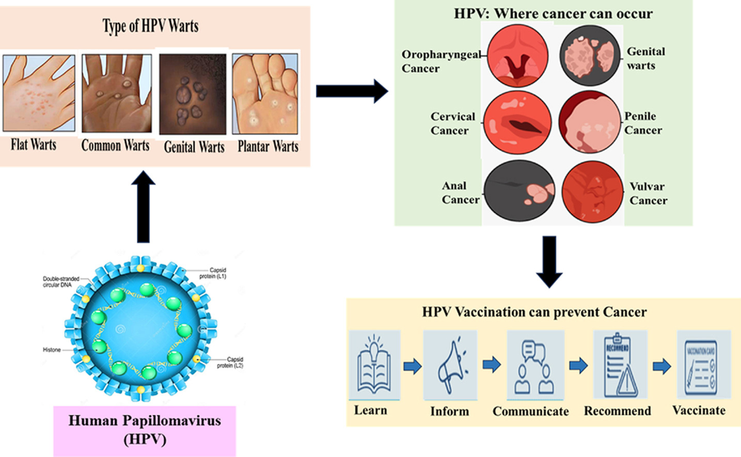

Slide 8
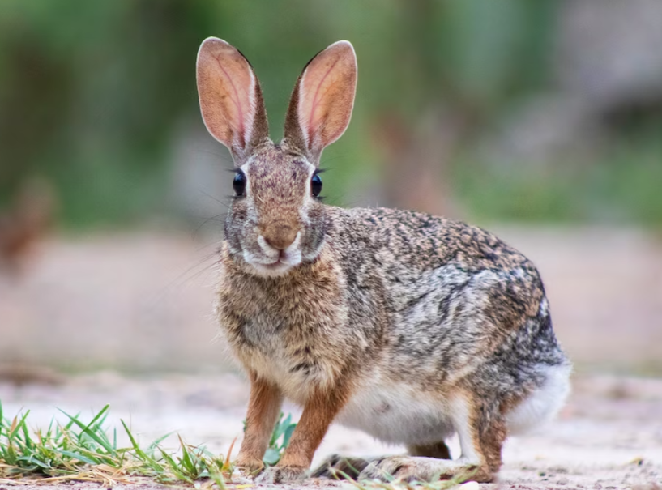
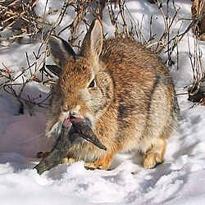
1933: Richard Shope identifies the first papillomavirus in cottontail rabbits, marking the initial detection of this type of virus.
1949: Using electron microscopy, the first description of human papillomavirus is provided by Strauss et al. in extracts from wart tissues.
1963: Crawford and Crawford describe the physical properties of HPV DNA.

Slide 9
1974: Harald zur Hausen et al. propose a strong association between HPV infection and cervical cancer.
1984: Harald zur Hausen successfully discovers, clones, and attributes cervical cancer to specific HPV types, namely strains 16 and 18. This work was foundational for the development of modern HPV vaccines.
2008: Harald zur Hausen is awarded the Nobel Prize in Physiology and Medicine for his discovery of HPV's role in causing cervical can

Slide 10
Integration of viruses into the host cell genome
HPV
It was shown that viral DNA integrated into the host cell genome in all cases of cervical carcinoma, their metastasis and derivative cell lines.
Usually DNA is linearized between genes L1 and L2 and integration occurs at the different chromosomes. Regulatory region of HVP genome and E6 and E7 oncogenes remain intact. Other viral genes, such as L1, L2, and E1 are lost or damaged. The transcriptional regulator E2 is inactivated, as a rule. Full length E2 protein prevents entry in S-phase and allows by that the viral replication.
In result of integration, normal transcripts of E6 and E7 are produced at the elevated level.
The host cell chromosomal rearrangements play a role in the cancerogenesis. For example, activation of c-myc (8q24) and JUN-B (19p13.2) and deletions on chromosome 3 (3p14, 3q25) contribute to development of tumor.

Slide 11
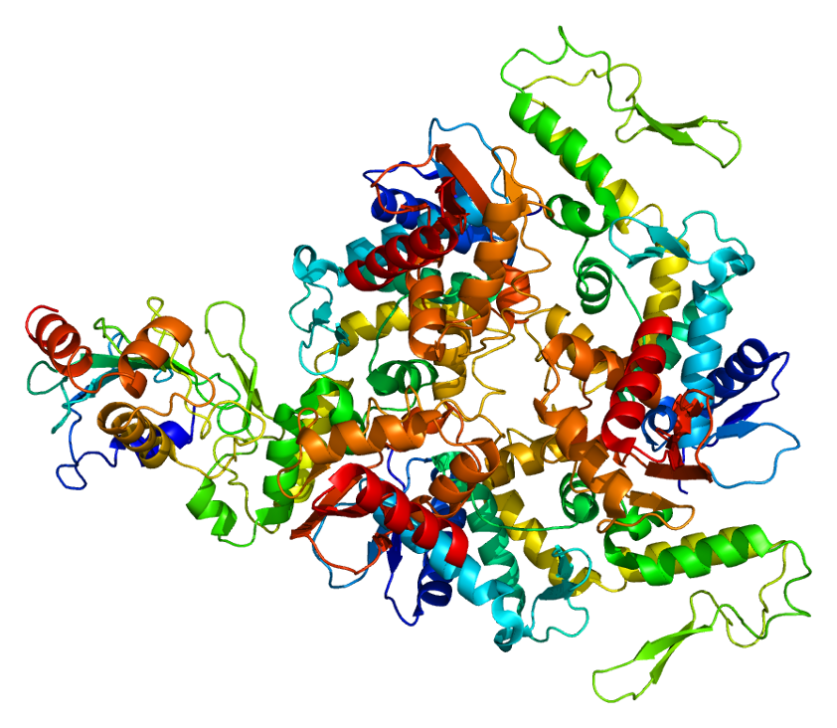
* 601623
UBIQUITIN-PROTEIN LIGASE E3A; UBE3A
Alternative titles; symbols
HUMAN PAPILLOMAVIRUS E6-ASSOCIATED PROTEIN; E6AP
HGNC Approved Gene Symbol: UBE3A
Cytogenetic location: 15q11.2 Genomic coordinates (GRCh38) : 15:25,333,728-25,439,056 (from NCBI)

Slide 12
Small DNA tumor viruses
Virus
Usual
p53 pathway
pRb pathway
i
nteraction
p53
p14ARF
MDM2
pRb
SV40
Episomal
,
Large T binds to DNA
-
Occasional loss
Large T can
Large T binds to pRb
(p130,
rarely
binding domain of p53 and
of
INK4A locus
.
bind MDM2
.
p107)
and disrupts pRb
-
E2F
integrated in
abolishes
complexes
.
transformed
Its function
.
nonpermissive
cells
.
Adeno
Integrated in
E1B
(55 kDa and 19 kDa)
No data
No data
E1A binds to pRb (p130,
transformed
binds to
p53
. E4orf6
p107) and increases free E2F
nonpermissive
protein binds to p53 and
protein level.
cells.
E1B
,
and targets p53 to
E1A binds to CtBP
.
degra
dation.
HPV
Episomal.
E6 binds to p53 and
Overexpressed
Overexpressed
E7 binds to pRb and targets it
Integrated
targets it to degradation
.
in HPV 16
/18+
in 30% of
to degradation
.
in transformed
tumors.
HPV 16/18+
cells
of the
positive tumors.
host
.

Slide 13
Acknowledgements:
This work was supported by joint Ukrainian-Latvian grant M-05/2025 from the Ministry of Education and Health of Ukraine
We thanks the Armed Forces of Ukraine for the possibility
to perform our research

